Slide 1
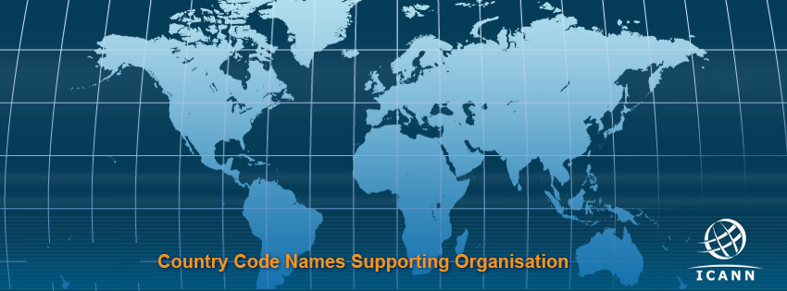

IANA Function Review
How to select IFRT members?

Slide 2
Key Things to Remember about IFR
Shall be convened no later than 1 October 2018
The ccNSO Council must select 3 members
We do not have a procedure (yet)
We do not have much time...

Slide 3
Proposal:
We develop a test procedure for the first IFR to be tested and updated afterwards

Slide 4
Composition of IFR Teams
2 ccTLD registry operator representatives – appointed by the ccNSO;
1 non-ccNSO ccTLD representative – appointed by the ccNSO;
2 representatives – appointed by Registry SG;
1 representative – appointed by Registrars SG;
1 representative – appointed by Commercial SG;
1 representative – appointed by Non-Commercial SG;
1 representative – appointed by GAC;
1 representative – appointed by SSAC;
1 representative – appointed by RSSAC;
1 representative – appointed by ALAC;
1 liaison – appointed by the CSC;
1 liaison – may be appointed by ASO;
1 liaison – may be appointed by the IAB.
Shall include members from each ICANN Geographic Region

Slide 5
We Must Concentrate on:
2 ccTLD registry operator representatives;
1 non-ccNSO ccTLD representative;
The Bylaws «strongly recommend» to consult with ROs wrt non-ccNSO member
The Bylaws CLEARLY say that:
«...the ccNSO and Registries Stakeholder Group shall not appoint multiple members who are citizens of countries from the same ICANN Geographic Region»
The IFRT shall be led by two co-chairs: one appointed by the GNSO and one appointed by the ccNSO.

Slide 6


We Need Three People:
A non-ccNSO member
Region A
A ccNSO member
Region C
A ccNSO member
Region B

Slide 7
Call for EoI
2 weeks
Any non-member?
No
What to do?
Yes
Council selects a non-member from region A
Anyone from other regions (except A)?
No
What to do?
Yes
Council selects a member from region B
Anyone from other regions (except A&B)?
No
What to do?
Yes
Council selects a member from region C

Slide 8
Call for EoI
Any non-member?
No
Should we incorporate the willingness to serve as a co-chair?
Yes
No
Risks?
Council selects a non-member from region A
Anyone from other regions (except A)?
No
Yes
HOW?
Yes
Council selects a member from region B
Anyone from other regions (except A&B)?
No
What to do?
Yes
Council selects a member from region C

Slide 9
Thank you!

