Slide 1
RDS-WHOIS2-RT
Brussels Face-to-Face Meeting
DAY 2 – 27 July 2018

Slide 2
Welcome
Agenda Item #1
Time: 09:00-09:45
Presenters: Review Team Leadership

Slide 3
Day 1 Takeaways
Day 1 Welcome
ACTION ITEM - Alan, Chris, and Stephanie to update their SOIs to reflect appointment to ePDP
ACTION ITEM - Volker to update his SOI to reflect acquisition of Key Systems
Draft Report
DECISION REACHED - Produce a PDF executive summary and table of recommendations
ACTION ITEM - Change numbers to 1.a/1.b
ACTION ITEM - Include rationales for not reviewing some of the objectives laid out in Bylaws and proposed by the GNSO
DECISION REACHED - incorporate GNSO and GAC input into set of appendices
DECISION REACHED - Retain individual GDPR sections for subgroups
ACTION ITEM - Add a section on compliance (objective 6) to note substantial body was done through WHOSI1 rec 4 subgroup. Consider moving subgroup’s findings on that objective to the new section - make decision after Compliance subsection have been discussed

Slide 4
Day 1 Takeaways
Rec 1 Strategic Priority
ACTION ITEM - ICANN Org to provide a summary of the Board WG’s (BWG-RDS) current composition and remit
ACTION ITEM - Chris to double check whether there are meeting notes of BWG sessions.
DECISION REACHED - Add recommendation to put a mechanisms in place to take a forward-looking approach regarding legislation that may impact WHOIS
DECISION REACHED - Add recommendation that BWG-RDS is of sufficient importance that it should publish minutes, etc, to enable review of its activities in the future
DECISION REACHED - Add recommendation to assign dedicated staff but not a single person responsible for overseeing all WHOIS initiatives
DECISION REACHED - Compensation will not be included as a new recommendation.
ACTION ITEM (COMPLETED) - Cathrin to draft updated/new recommendations for RT review and determination of consensus

Slide 5
Day 1 Takeaways
Rec 1 Strategic Priority
NEW PROPOSED RECOMMENDATION
The ICANN Board should put into place a forward-looking mechanism to monitor possible impacts on the RDS from legislative and policy developments around the world.
To support this mechanism, the ICANN Board should instruct the ICANN Organisation to assign responsibility for monitoring legislative and policy development and to provide regular updates to the Board.
The ICANN Board should update the Charter of its Board Working Group on RDS to ensure the necessary transparency of the group’s work, such as by providing for records of meetings and meeting minutes, to enable future review of its activities.

Slide 6
Day 1 Takeaways
Law Enforcement Needs
ACTION ITEM - Subgroup to consider the following items:
Discussed geographic distribution of responses to date. Note that Compliance subgroup also found under-representation of global south in WHOIS inaccuracy reports - possible systemic issue?
Discussed formulating a recommendation on continuous data gathering to inform future assessment of the effectiveness of WHOIS, as well as future policy development (e.g., ePDP)
Discussed possibility of opening the survey to cybersecurity professionals - if not at this point, then in the future. Potentially related to accreditation and criteria that may be applied there. Bylaws mandate is explicitly law enforcement, so results would need to be analyzed separately and not conflated.
Discussed possibility of repeating survey between public comment close and final report to allow additional participation and comparison of results; public comment could include a way for interested parties to express interest in participating in next survey (indicating their email address, duty station, geographic region)

Slide 7
Day 1 Takeaways
Law Enforcement Needs
DECISION REACHED - Reopen survey to collect additional responses; defer discussion of results (and issues/recommendations) until final survey close to avoid influencing respondents
ACTION ITEM - Cathrin to draft methodology and findings for RT review before 6 August plenary call, keeping findings confidential until the survey closes
ACTION ITEM (COMPLETED) - ICANN Org to investigate geographic distribution of responses to date and provide any available information to the subgroup, enabling additional targeted outreach by subgroup members to under-represented areas
DECISION REACHED (REFLECTED IN SURVEY)- New deadline for survey - August 6 - 23:59 UTC.

Slide 8
Day 1 Takeaways
Plan & Annual Reports
ACTION ITEM: ICANN Org to recognize problems with system that was used and to provide summary of Improvements already underway, including under new Bylaws, such as annual progress plan that would include implementation of specific review recommendations, and confirmation from RT member(s) that implementation plan reflects the intent of the recommendation.
DECISION REACHED - Subgroup on Rec 15/16 should result in a recommendation.
Discussed need for metrics to be identified for each recommendation, to allow for assessment of effectiveness.
ACTION ITEM: Alan and Lili to revise recommendation to address concerns expressed about project management, communication of progress, and tracking of metrics to enable progress and effectiveness assessment.

Slide 9
Day 1 Takeaways
Compliance
DECISION REACHED - No further recommendation is needed regarding the Compliance reporting structure.
ACTION ITEM - ICANN Org to ask GDD: What is the process and criteria used to determine the domain names to review with ARS
DECISION REACHED: The latest % be cited in the report (30%) and note downward trend.
DECISION REACHED - Add a recommendation that policy requirements and processes should be put in place to provide consistency in when domain names are unsuspended, and possibly a policy or best practice for indicating why a domain name is suspended.
ACTION ITEM - ICANN Org to ask Compliance: For domains rechecked after suspension, what % are found to be unsuspended in total and the % that are still non-compliant?

Slide 10
Day 1 Takeaways
Compliance
Rec R4.1 (metrics) - ICANN should recommend the GNSO adopt a risk-based approach to incorporating requirements for measuring, auditing, tracking, and enforcement in all new RDS policies
ACTION ITEM - Susan to refine recommendation R4.1 text for RT review and consensus to reflect concerns raised about risk-based approach, RDS policy scope, and GNSO responsibility for implementation.

Slide 11
Day 1 Takeaways
Compliance
Proposed New Language
R4.1 ICANN should recommend the GNSO adopt a risk-based approach to incorporating requirements for measurement, auditing, tracking, reporting and enforcement in all new RDS policies.
Replaces:
Require all new policies implemented to be measured, audited, tracked and enforced as required by the compliance team. Policy should integrate metrics, measurements, and reporting to ensure that the policy is effective in addressing the issue, and when metrics are defined, compliance would audit, track, report, and enforce as applicable for the policy.

Slide 12
Day 1 Takeaways
Compliance
Rec R4.2 (grandfathering) - Need to decouple elements of recommendation.
DECISIONS REACHED (with 2 objections) - Grandfathered domain names should be assessed to determine if information is missing from the registrant field. If statistically significant number of domain name registrations lack registrant data, then the Board should initiate action intended to ensure that all gTLD domain names adhere to the same registration data collection requirements.

Slide 13
Day 1 Takeaways
Compliance
Proposed New Language
R4.2 ICANN should assess grandfathered domain names to determine if information is missing from the WHOIS Registrant field. If a statistically significant number of domain names are found to lack data in the Registrant field, then the ICANN Board should initiate action intended to ensure that all gTLD domain names adhere to the same registration data collection requirements.
Replaces:
Require all domain name registrations to adhere to the WHOIS requirements in the 2013 Registrar Accreditation Agreement or the latest implemented policy for WHOIS. Once a policy is implemented all gTLD registrations must adhere to the new rules within a 12 month period. Assess the grandfathered domain names to determine if information is missing from the registrant field. If statistically significant number of domain name registrations lack registrant data then a new policy should be created to ensure all gTLDs adhere to the requirements of registrant data collection in the 2013 RAA.

Slide 14
Day 1 Takeaways
Compliance
Rec R4.3 (inaccurate data in unsuspended domains) - Discussed that this recommendation applies only in cases where the contact data is known to the registrar to be incorrect. Suggest rephrasing along these lines: “Domain names that are suspended due to inaccurate information, and remain in that state until due for deletion, should be updated as follows:”
ACTION ITEM - Susan to refine recommendation R4.3 text for RT review and consensus to reflect concerns raised about (1) application only in cases where the contact data is known to the registrar to be incorrect, (2) remain in that state until deleted not due for renewal, (3) not replace data but update the record.
DECISION REACHED - R4.5 (bulk outreach)
DECISION REACHED - R4.6 (low submission rate), rephrased as follows: Review the WHOIS ARS domain names sampled for each region to determine if the low WHOIS inaccuracy report submission rates in some regions are due to lack of knowledge of WHOIS inaccuracy reporting tools or other critical factors.

Slide 15
Day 1 Takeaways
Compliance
Proposed New Language
R4.3 ICANN contracts or GNSO policy should require that gTLD domain names suspended due to WHOIS contact data which the registrar knows to be incorrect, and that remain in that state until the registration is due for deletion, should be treated as follows. (1) The WHOIS record should include a notation that the domain name is suspended due to incorrect data; and (2) Domain names with this notation should not be unsuspended.
Replaces:
Domain names suspended due to inaccurate information and remain in that state until it is due for renewal the WHOIS record should be updated to a new status and the inaccurate data removed, as further described below. (1) Policy or contracts should require that WHOIS indicate whether a domain is on hold due to inaccurate data. (2) Domains on serverHold due to inaccurate data in WHOIS should not be unsuspended without inaccurate data being remedied

Slide 16
Day 1 Takeaways
Compliance
DECISION REACHED - R4.5 (bulk outreach)
DECISION REACHED - R4.6 (low submission rate), rephrased as follows: Review the WHOIS ARS domain names sampled for each region to determine if the low WHOIS inaccuracy report submission rates in some regions are due to lack of knowledge of WHOIS inaccuracy reporting tools or other critical factors.

Slide 17
Day 1 Takeaways
Compliance
Proposed New Language
R4.5 ICANN should publicize and encourage use of the Bulk WHOIS inaccuracy reporting tool.
Replaces:
Publicize and encourage use of the Bulk WHOIS inaccuracy reporting tool.
R4.6 ICANN should review the WHOIS records of gTLD domain names sampled by ARS for each region to determine whether lack of knowledge of WHOIS inaccuracy reporting tools or other critical factors are responsible for low WHOIS inaccuracy report submission rates in some regions.
Replaces:
Review the WHOIS ARS domain names sampled for each region to determine whether or not low submission rates to the WHOIS inaccuracy reporting tool are due to the lack of knowledge of the tool or other critical factors.

Slide 18
Day 1 Takeaways
Compliance
Rec 4.7 (audit) - Discussed Volker’s concerns. Should apply only where there is a pattern of failure to validate.
DECISION REACHED - R4.7 ICANN Compliance should detect patterns of failure to validate WHOIS data as required by the RAA. When such a pattern is detected, an audit of the registrar should be initiated to check if the registrar follows WHOIS contractual obligations and consensus policies. Sanctions should be applied if significant deficiencies in WHOIS data validation or verification are identified.

Slide 19
Day 1 Takeaways
Compliance
Proposed New Language
R4.7 ICANN should direct Compliance to detect patterns of failure to validate WHOIS data as required by the RAA. When such a pattern is detected, an audit should be initiated to check if the Registrar follows WHOIS contractual obligations and consensus policies. Sanctions should be applied if significant deficiencies in WHOIS data validation or verification are identified.
Replaces:
Following a valid WHOIS ARS ticket, or WHOIS inaccuracy complaint and where there is a pattern of failure to validate as required by the RAA, a full audit targeting the relating registrar should be initiated, to check if the registrar follows the contractual obligations, the consensus policies, etc. Sanctions should be applied if deficiencies identified.

Slide 20
Day 1 Takeaways
Compliance
Rec 4.8 (proactive monitoring) - Discussed and agreed upon edits:
DECISION REACHED - R4.8, rephrased as follows: Direct contractual compliance to proactively monitor and enforce as required to address systemic issues. A risk based approach should be executed to assess and understand inaccuracy issues and then take the appropriate actions to mitigate them.
Discussed R4.x on P/P, which is intended to cover the case where PPSAI implementation stalls or providers do not seek accreditation. Unclear whether a recommendation is needed. If it is, it belongs in the P/P section.
ACTION ITEM - Volker to add to the P/P section and rephrase along the lines of: “The board should monitor PPSAI implementation. In that event, the board should direct ICANN Org to negotiate an amendment to the RAA to…”

Slide 21
Day 1 Takeaways
Compliance
Proposed New Language
R4.8 ICANN should direct Contractual Compliance to proactively monitor and enforce WHOIS data accuracy requirements to detect and address systemic issues. A risk based approach should be executed to assess and understand inaccuracy issues and then take the appropriate actions to mitigate them.
Replaces:
Direct contractual compliance to proactively monitor and enforce as required to address systemic issues. A risk based approach should be executed to assess, and understand inaccuracy issues and then take the appropriate compliance actions to mitigate risk in systemic complaints.

Slide 22
Day 1 Takeaways
Anything New
AGREEMENT REACHED - Include Stephanie’s text in the Strategic Priority section, as rationale leading to the additional recommendation agreed earlier today (i.e., forward-looking approach to legislation)
ACTION ITEM - Stephanie to send text to Cathrin tonight for inclusion in the Rec 1 Strategic Priority section
Safeguarding Registrant Data
AGREEMENT REACHED - Update findings but retain recommendation for review by data security experts. Do not include a recommendation regarding registrant notification.
ACTION ITEM - Alan to update Rec SG.1 to reflect agreements reached

Slide 23
Day 2 Objectives
Day 2 Objectives
Complete the approval of subgroup findings and recommendations
Critical assessment of current status, the report structure and the need for any strategic changes
Consider the review team’s work plan in light of progress made and identify next steps to complete and consolidate the draft report
Determine adjustments needed to work plan

Slide 24
Opening Remarks & Day 2 Objectives
Points to consider throughout Day 2
  Do you have any concerns with the findings and recommendations produced by subgroups?
      Do you agree with the subgroup’s recommendations?
      Are those recommendations S.M.A.R.T?
      What (if any) open issues require further discussion?
      Is the subgroup’s output clear enough? Concise enough?
  Did subgroups fully-address their assigned review objectives?
  Should any further specific measurable steps be recommended?
  Is our current work plan feasible?

Slide 25
WHOIS1 Rec #10: Privacy/Proxy Services
Presenter: Volker Greimann
Subgroup Members: Volker, Susan, Cathrin, Stephanie
Subgroup Wiki: https://community.icann.org/x/7ZlEB

Slide 26
WHOIS1 Rec #10: Privacy/Proxy Services
Findings
The 2013 RAA introduced a specification on privacy and proxy registrations requiring registrars to comply with certain requirements regarding such registrations through affiliated Privacy/Proxy Service Providers as a first step towards implementing this recommendation
The Privacy/Proxy Services Accreditation Issues (PPSAI) Implementation Review Team (IRT) is currently working on an implementation of this recommendation that will also include unaffiliated providers of such services
WHOIS1 Rec #10 advises that consideration be given to several specific objectives. The subgroup finds that these objectives are reflected in the Privacy/Proxy Services Accreditation Final Report.
Based on its analysis, members of this subgroup agree that this WHOIS1 recommendation has been fully-implemented
Between the RAA 2013 Spec and this policy, the original recommendation seems to have been addressed. Anything not addressed was clearly not deemed to be important for inclusion by the community, the GNSO and the board who all approved the PPSAI PDP Final Report.

Slide 27
WHOIS1 Rec #10: Privacy/Proxy Services
Issues
The subgroup is unable to assess the exact impact of GDPR data redaction requirements on privacy services at this time. However, we note:
Creating a cost barrier next to the new policy requirements at a time that the use of such services is expected to decline due to GDPR is likely to cause low provider adoption.
We currently see no urgency or need to delay the implementation of the accreditation program due to the GDPR.
WHOIS1 Rec #10 suggests a mix of incentives and sanctions to encourage and enforce this policy once implemented. The IRT should be encouraged to also discuss incentives, as the current focus seems to solely rely on sanctions.
The subgroup addressed potential abuse of privacy and proxy services by registered name holders, but was unable to determine whether domain names using such services had a higher propensity for abusive registrations.
A future review of the impact of privacy/proxy on abuse may be beneficial.
Such a review should take into account PPSA program impact on abusive registrations.
Such a review would depend on the proper collection of data to track over time any trends of abusive use of domain names using privacy/proxy services.

Slide 28
WHOIS1 Rec #10: Privacy/Proxy Services
Recommendations - None
The subgroup proposes no new recommendations at this time specific to the prior RT's Recommendation #10.
However, the subgroup intends to track PPSAI Implementation Review Team (IRT) progress and consider recommendation(s) if necessary.

Slide 29
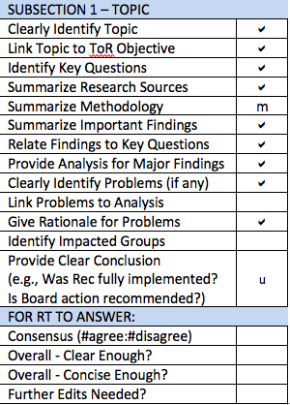
WHOIS1 Rec #10: Privacy/Proxy Services
Gap Assessment
Draft report to be updated to address ICANN62 and possibly Subgroup feedback
Subsection 3: Move key questions and methodology to Subsections 1 & 2.
Subsection 4: Would benefit from a structure such as:
  Bolded problem statement.
  Why it is a problem.
  Who it affects.
It is unclear how Findings/Analysis led to the Issues listed in Subsection 4.
Subsection 5 needs further explanation – for example, how can the WHOIS1 Recommendation be fully implemented if the PPSAI-defined policy has not yet been implemented?

Slide 30
WHOIS1 Rec #2: Single WHOIS Policy
Presenter: Carlton Samuels
Subgroup Members: Carlton, Cathrin, Thomas
Subgroup Wiki: https://community.icann.org/x/4ZlEB

Slide 31
WHOIS1 Rec #2: Single WHOIS Policy
Findings
That the web page is a good and sufficient substitute for the single authoritative WHOIS policy document but with navigational improvements and further organization of content could be better
The GNSO ePDP chartered to address the next generation Registration Data Directory Services is in progress and guided by the Board-developed Temporary Specification for Registration Data, will likely report a single fit-for-purpose gTLD registration data service (WHOIS) policy for the first time, at last.
When a single fit-for-purpose consensus gTLD registration data policy has emerged, The WHOIS website will be superseded by another digital artefact documenting this policy.

Slide 32
WHOIS1 Rec #2: Single WHOIS Policy
Issues
The organization of the website content could be further optimized for navigation and readability.
However, in the event that the Temporary Specification takes hold and is affirmed by the ePDP, then the existing website and its contents become archival artefacts.
We would expect the affirmed Temporary Specification will exist as a digital artefact and will be the new base for a single documented source of all things pertaining gTLD Registration Data.

Slide 33
WHOIS1 Rec #2: Single WHOIS Policy
Conclusions
There are no further recommendations. However, the team:
Accepts that WHOIS1 RT Recommendation 2 is fully implemented.
That the adoption of the EWG’s Final Report and development of the framework for the Board-initiated GNSO RDS PDP[s] is intended to deliver a holistic next generation WHOIS policy framework that would address current set of fragmented and decentralized WHOIS policies.
Notwithstanding its temporary nature – to be sunsetted in one (1) year - that the Temporary Specification for WHOIS promoted by the Board in May 2018 constitutes for the first time the framework for a single WHOIS policy.
That the expedited policy development process (ePDP) raised by the GNSO to address the adoption or adaption of the temporary specification will, likely affirm a single WHOIS policy at the end of its work.

Slide 34
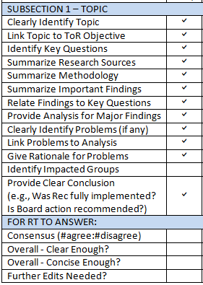
WHOIS1 Rec #2: Single WHOIS Policy
Gap Assessment
Subsection 4: Add impacted groups.

Slide 35
WHOIS1 Rec #11: Common Interface
Presenter: Volker Greimann
Subgroup Members: Volker, Susan, Alan
Subgroup Wiki: https://community.icann.org/x/8JlEB

Slide 36
WHOIS1 Rec #11: Common Interface
Findings
The common interface recommendation was intended to ensure that anyone looking up a WHOIS record could do that easily and from one source. The InterNIC was not overhauled, but a common interface was provided.
Over 4 million queries were made through the common interface - whois.icann.org - over a 6 month period in 2017.
There has been a 99.9% up time for the common interface but other statistics on usage or failure rate are not tracked.
Users are encouraged to file a contractual complaint ticket if they identify any issues with the WHOIS record. A link to file a ticket is provided on the page where results are displayed.
Based on its analysis, members of this subgroup agree that this WHOIS1 recommendation has been fully-implemented

Slide 37
WHOIS1 Rec #11: Common Interface
Issues
The common interface has no metrics that can be used to determine its effectiveness.
Metrics and SLAs could be used to address this and also to proactively spot non-compliance.
Service level agreements could be put in place to ensure the interface works reliably.
New issues raised by Compliance subgroup for discussion:
(1) As a result of GDPR implementation, RR and Ry interpretations may result in different registration data returned by WHOIS for the same domain name (e.g., the Ry may redact data that the RR displays)
(2) WHOIS access through the common interface has become less reliable (e.g., timeouts more frequent)
References that may be helpful:
SAC101: WHOIS Rate Limit Testing Results
SAC101 Advisory

Slide 38
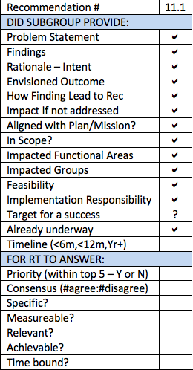
WHOIS1 Rec #11: Common Interface
Recommendation R11.1
Define metrics or SLAs to be tracked and evaluated to determine consistency of results of queries and use of any common interface (existing or future) used to provide one-stop access to registration data across all gTLDs and registrars/resellers.
Specific metrics that should be tracked for any such common interface include:
How often are fields returned blank?
How often is data displayed inconsistently overall and per gTLD?
How often does the tool not return results overall and for specific gTLDs?

Slide 39
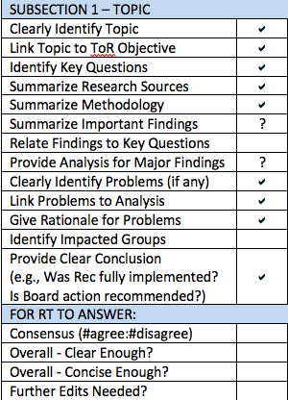
WHOIS1 Rec #11: Common Interface
Gap Assessment
Subsection 3: Focuses on details about the common interface without first giving an overview of how the recommendation was implemented. Add a brief description of the microsite and how that addresses Rec 11.
Subsection 3’s analysis needs to be more explicitly linked to the key questions listed in Subsection 1.

Slide 40
WHOIS1 Recs #5-9: Data Accuracy
Presenter: Lili Sun
Subgroup Members: Lili, Cathrin, Dmitry, Erika
Subgroup Wiki: https://community.icann.org/x/6plEB

Slide 41
WHOIS1 Recs #5-9: Data Accuracy
Findings
A WHOIS Informational Website has been established as a policy document, to educate registrants on WHOIS, their rights and responsibilities, and to allow Internet users to submit complaints on WHOIS inaccuracy.
The 2013 RAA introduced contractual obligations for registrars to validate and verify WHOIS data upon registration.
ICANN is in the midst of developing an accuracy reporting system (the WHOIS ARS), proactively identify potentially inaccurate gTLD registration data; explore using automated tools, and forward potentially inaccurate records to gTLD registrars for action.

Slide 42
WHOIS1 Recs #5-9: Data Accuracy
Findings
WHOIS1 | Has Been | Rationale
Rec # 5 | Fully-implemented | However, effectiveness still needs to be assessed
Rec # 6 | Partially-implemented | Because Accuracy Reporting System implementation is on-going
Rec # 7 | Partially-implemented | Because Substantial Failure and Full Failure rates are missing from reports
Rec # 8 | Fully-implemented
Rec # 9 | Not implemented | Because there has been no measurable assessment of WHOIS data quality improvement either through WDRP or other alternative policies

Slide 43
WHOIS1 Recs #5-9: Data Accuracy
Issues
The objective of reliable WHOIS data has not been achieved
WHOIS inaccuracy is believed to be largely under-reported
Contractual obligations for registrant to provide accurate WHOIS data and for registrars to validate and verify WHOIS data are not properly enforced
The WHOIS accuracy of domain names that utilize Privacy and Proxy Services is unknown
The Action Plan indicated that ICANN Board offered an alternative approach rather than WDRP to achieve the intended result of Rec #9, which referred back to the implementation of Rec #5-7. However, the analysis of implementation of Rec #5-7 showed no assessment of improving data quality in a measurable way.
The measures taken so far are not sufficient to reduce WHOIS inaccuracy.

Slide 44
WHOIS1 Recs #5-9: Data Accuracy
Recommendations – Provided by other Subgroups
To address these issues, the subgroup drafted recommendations which can be found in Compliance and Privacy/Proxy subgroup reports.

Slide 45
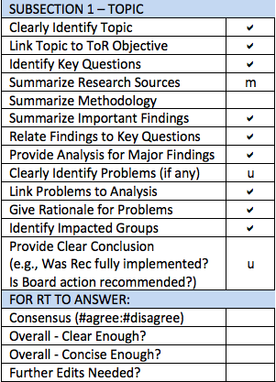
WHOIS1 Recs #5-9: Data Accuracy
Gap Assessment
Draft report to be updated to address ICANN62 feedback (aligned with Rec4 Compliance report)
Subsection 1: A very brief summary of WHOIS1 Recs 5-9 would be helpful
Subsection 2: Add methodology and specific list of research materials
Subsections 3 and 4: Could be made more concise and clear.
  For example, cite data sources instead of copying in data tables, simplify lengthy sentences, delete template instructions.
Subsection 5: Add conclusion specifically linking each identified Problem to any new recommendation(s)

Slide 46
Addressing Stephanie’s Concern
Stephanie’s concern raised in response to the Brussels face-to-face meeting #2 conclusions
The drive to accuracy may have unintended consequences, namely ID theft to get solid data. We need to examine that risk, or instruct ICANN compliance to measure it.

Slide 47
Parking Lot for Items that Require Further Discussion
Presenters: Review Team Leadership

Slide 48
Subgroup 4 – Consumer Trust
Presenter: Erika Mann
Subgroup Members: Erika, Carlton, Dmitry, Stephanie, Susan
Subgroup Wiki: https://community.icann.org/x/AZpEB

Slide 49
Subgroup 4 – Consumer Trust
Findings
Using the 2012 report as a foundation, the subgroup plans to examine the findings and analysis of other subgroups assessing WHOIS1 Rec implementation:
This examination will produce a gap analysis which identifies areas of WHOIS which may need to be further enhanced to promote consumer trust.
The gap analysis will need to be repeated after WHOIS evolves to comply with GDPR – at least for access to data that impacts WHOIS data from European users.
The definition of “consumer” to be addressed in this review must be broad and include Internet users. Users are potential domain name owners and insofar, it’s important to approach and address all users, whenever appropriate.

Slide 50
Subgroup 4 – Consumer Trust
Issues
The basic idea is that WHOIS contributes to consumer trust, mostly indirectly. The subgroup notes that here are different opinions about whether the visibility of WHOIS data contributes to trust.
The subgroup reviewed websites from well-known and less well-known resellers. Based on this research, it is clear that many of the well-known resellers have little information for 'consumers' and, if they do, the information is often very hard to find.
The subgroup notes a lack of Reseller transparency in WHOIS as a potential gap, to be addressed through policy and/or contractual changes. Gaps include lack of easy identifiable information about data privacy/data protection practices and redress contact point.

Slide 51
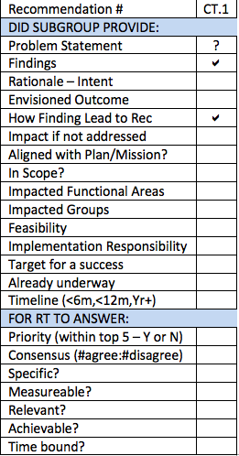
Subgroup 4 – Consumer Trust
Recommendation CT.1
ICANN should request from resellers more clear information, including the recommendation to include relevant information on their websites.
A good location for ICANN to make such a recommendation would be RAA (e.g., Sections 3.7.10, 3.12.2, 3.12.15).
ICANN must ensure that RAA provides updated information concerning relevant topics relate to consumers and WHOIS Obligations.
ICANN should recommend general policy and website/communication guidelines for resellers.

Slide 52
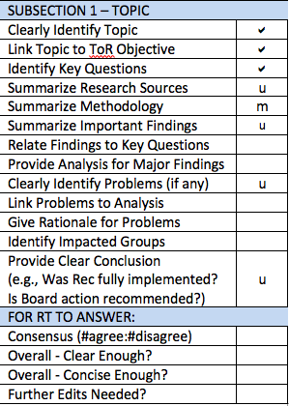
Subgroup 4 – Consumer Trust
Gap Assessment
Draft report to be updated to address ICANN62 feedback (new materials, associated findings)
Subsection 4: Contains excerpts from documents (Findings) but little Analysis.
Needs Analysis text to tie Findings back to key questions currently listed in Subsection 1.
Subsection 5 (Problem/Issue): Needs more concise Problem statement for Reseller Transparency, tied back to Analysis.
Currently, Findings and Analysis do not tie at all to the identified Problem/Issue.
Recommendation in Subsection 6 needs to be fleshed out and made specific & measurable.

Slide 53
WHOIS1 Rec #3: Outreach
Presenter: Alan Greenberg
Subgroup Members: Alan, Carlton, Erika
Subgroup Wiki: https://community.icann.org/x/5JlEB

Slide 54
WHOIS1 Rec #3: Outreach
Findings
ICANN has implemented a wide variety of documents and resources designed to educate various communities on issues related to WHOIS.
The WHOIS Portal is well organized and the level of information is reasonable, but it is less than clear how it should be used.
The other material available on the ICANN website generally pre-dates the Portal, and no attempt was made to update this material, or integrate it.
The review of contractual compliance issues noted that there was a particular problem related to filing WHOIS inaccuracy reports and this will be addressed as well.
Registrant education videos are on a completely separate part of the ICANN site dedicated to Registrars (not Registrants).
Significant outreach to communities within ICANN has been carried out, but there is little evidence of substantive outreach to non-ICANN groups.
  Based on its analysis, members of this subgroup agree that
  this WHOIS1 recommendation has been partially-implemented

Slide 55
WHOIS1 Rec #3: Outreach
Issues
A typical user or registrant will not be able to readily identify where they need to look for information.
The problem is exacerbated by the introduction of the terms RDS (and at times RDDS) to replace WHOIS.
There is little strong evidence that any outreach targeted at non-ICANN audiences was contemplated or carried out.

Slide 56
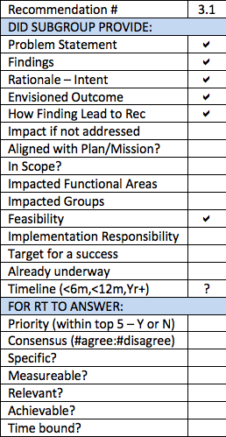
WHOIS1 Rec #3: Outreach
Recommendation R3.1
All of the information related to WHOIS and by implication to other information related to the registration of 2nd level gTLD Domains needs to be revised with the intent of making the information readily accessible and understandable, and should provide details of when and how to interact with ICANN or contracted parties. Although not the sole focus interactions with Contractual Compliance, such as when filing WHOIS inaccuracy reports, should be a particular focus. This should be done post-GDPR implementation and consideration should be given to deferring this until we have a stable permanent GDPR implementation. The revision of this web documentation and instructional material should not be undertaken as a purely internal operation but should include users and potentially focus groups to ensure that the final result fully meets the requirements.

Slide 57
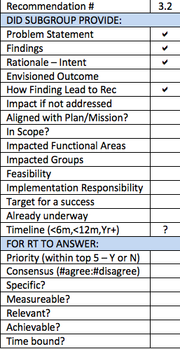
WHOIS1 Rec #3: Outreach
Recommendation R3.2
With community input, ICANN should decide to what extent there is a need to carry out outreach to groups outside of the normal ICANN participant, and should such outreach be deemed necessary, a plan should be developed to carry this out and document it. WHOIS inaccuracy reported was previously an issue requiring additional education and outreach and may require a particular focus. The need for and details of the outreach may vary depending on the ultimate GDPR implementation and cannot be detailed at this point.

Slide 58
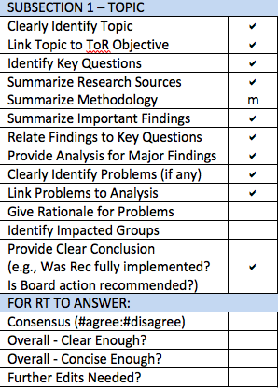
WHOIS1 Rec #3: Outreach
Gap Assessment
  Subsection 1: Move methodology to Subsection 2.
  Subsection 4: Would benefit from a structure such as:
    Bolded problem statement.
    Why it is a problem.
    Who does it affect.
  For example, Why is lack of outreach to non-ICANN audiences a problem? Who might benefit from outreach?

Slide 59
WHOIS1 Recs #12-14: Internationalized Domain Names
Presenter: Alan Greenberg
Subgroup Members: Alan, Dmitry, Lili
Subgroup Wiki: https://community.icann.org/x/85lEB

Slide 60
WHOIS1 Recs #12-14: Internationalized Domain Names
Findings
A set of related efforts implemented WHOIS1 Rec #12:
An expert working group to determine the requirements for the submission and display of internationalized registration data.
A commissioned study to evaluate available solutions for internationalized registration data.
A Policy Development Process (PDP) to determine whether translation or transliteration of contact information is needed. If so, specify who should bear the burden of the transformation.
As requirements for the translation and transliteration of registration data were not finalized in time for the 2013 RAA, placeholders can be found both in Registry Agreement (RA) and Registrar Accreditation Agreement (RAA). However, implementation of WHOIS1 Rec #13 depends on RDAP progress.
WHOIS1 Rec #14 is currently being performed as part of the Accuracy Reporting System (ARS). The metrics and measures developed by ARS are suitable when internationalized registration data become available for studying.

Slide 61
WHOIS1 Recs #12-14: Internationalized Domain Names
Findings continued
Based on its analysis, members of this subgroup agree that
these WHOIS1 recommendations have been fully-implemented
Work was done to the extent it can be done without an RDAP-based WHOIS system.
Issues
  The commercial feasibility loophole in the current contracts allows registrars and registries to not implement RDAP.

Slide 62
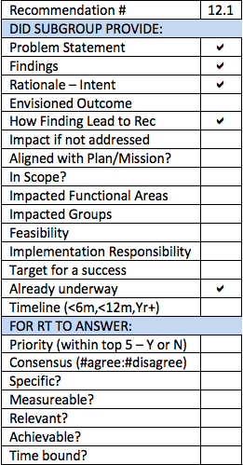
WHOIS1 Recs #12-14: Internationalized Domain Names
Recommendation R12.1
The implementation of Rec #12-14 should be reviewed again after RDAP is implemented, and the translation and transliteration of the registration data launches.

Slide 63
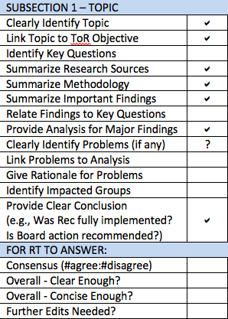
WHOIS1 Recs #12-14: Internationalized Domain Names
Gap Assessment
Subsection 2 (Topic) does not appear to define key questions that the Subgroup tried to answer
As such Subsection 4 (Findings/Analysis) cannot tie back to key questions
Subsection 5 (Problem/Issue) states a finding but does not really explain the problem caused by that finding.
Expand to briefly state the problem, explain why it is a problem, and identify who is affected.
Recommendation in Subsection 6 needs to be fleshed out and made specific & measurable

Slide 64
Brainstorming on Content of Executive Summary
Presenters: Review Team Leadership & ICANN org

Slide 65
Adjust (as Needed) Structure of Report (e.g. Merge Sections etc.)
Presenters: Review Team Leadership
Draft Report on Wiki Page: https://community.icann.org/x/cyQFBQ

Slide 66
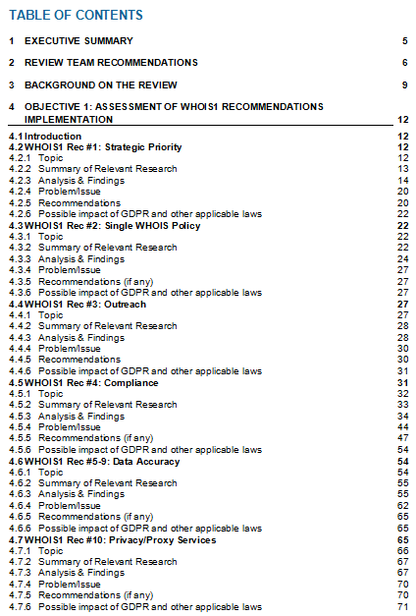
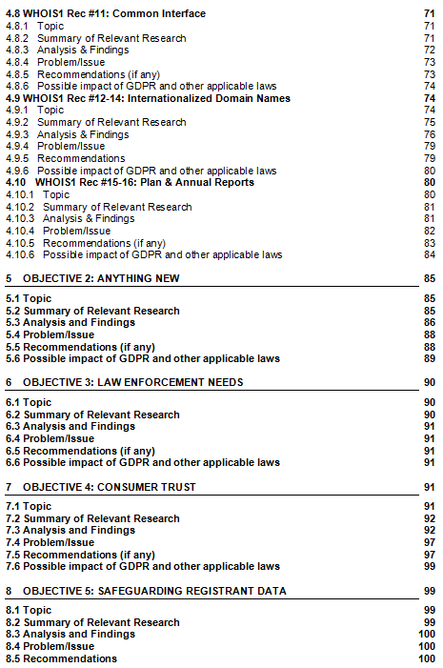
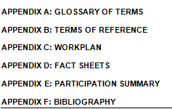
Adjust (as Needed) Structure of Report
Refer to:
Draft Report Table of Contents

Slide 67
Review Work Plan
Presenters: Review Team Leadership

Slide 68
Current Work Plan & Deliverables
DATE * | DELIVERABLE*
By 31 July | Approve draft report for public comment
7 August – 5 October | Public comment on Draft Report
By 26 October | Adopt public comment summary for publication
By 30 November | Update recommendations and report based on public comment
By 21 December | Approve final findings and recommendations for submission to ICANN Board
*Per work plan submitted to ICANN Board on 9 February 2018 and reconfirmed at Brussels face-to-face meeting #2
Any adjustments needed?

Slide 69
Parking Lot for Items that Require Further Discussion
Presenters: Review Team Leadership

Slide 70
Face-to-Face Meeting #3 Wrap-Up
Presenters: Review Team Leadership & ICANN org

Slide 71
Face-to-Face Meeting #3 Wrap-Up
Roadmap to publication of Draft Report for Public Comment:
  Set deadlines for completing outstanding actions and gaps
  Identify penholders, etc.
Confirm consensus level and remaining gaps for
  Each Subgroup’s findings overall
  Each Recommendation
Confirm action items
Any other Business
Closing remarks

Slide 72
Roadmap to publication of Draft Report for Public Comment
Xxx – Support team to circulate an updated draft report containing agreed recommendations from this meeting, as the base document for rapporteurs to use
Xxx –
Deadline for completing/circulating action items
Deadline for Rapporteurs to address items listed in recommendations/reports gap assessment tools
Xxx – Deadline for RT to send objections, comments, edits on output produced by rapporteurs and action items penholders
Xxx – Plenary call to address edits/comments and for consensus call on new materials
Xxx – Support team to finalize draft report and circulate to review team
Xxx – Deadline to submit objections, comments and edits on Draft Report
Xxx – Plenary call to address comments and for consensus call. Formally adopt report
Xxx – Release public comment on Draft Report

Slide 73
Confirm Consensus Level
Refer to:
Gap Assessment Tools and Appendix A (S.M.A.R.T. Criteria)
Confirm for each Subgroup Report | R1 Strat Priority | R2 Single Policy | R3 Out reach | R4 Comp | R5 Accur | R10 P/P | R11 Comm I/F | R12 IDN | R15 Plans & Reports | 2 Any New | 3 LE Need | 4 Cons Trust | 5 Safe Data
Consensus (#agree:#disagree)
Overall - Clear Enough?
Overall - Concise Enough?
Further Edits Needed?
Confirm for each Recommendation | R1 Strat | R2 Policy | R3 Outreach |  | R4 Compliance |  |  |  |  |  |  |  | R11 I/F | R12 IDN | R15 Plan | Cons Trust | Safe Data
Recommendation # | 1.1 | 2.1 | 3.1 | 3.2 | 4.1 | 4.2 | 4.3 |  | 4.5 | 4.6 | 4.7 | 4.8 | 11.1 | 12.1 | 15.1 | CT.1 | SG.1
Priority (within top 5?)
Consensus (#agree:#disagree)
Specific?
Measureable?
Relevant?
Achievable?
Time bound?

Slide 74
Confirm Day 2 Decisions Reached/Action Items
Strategic Priority
AGREEMENT REACHED - New Proposed Recommendations on Strategic Priority:
The ICANN Board should put into place a forward-looking mechanism to monitor possible impacts on the RDS from legislative and policy developments around the world.
To support this mechanism, the ICANN Board should instruct the ICANN Organisation to assign responsibility for monitoring legislative and policy development and to provide regular updates to the Board.
The ICANN Board should update the Charter of its Board Working Group on RDS to ensure the necessary transparency of the group’s work, such as by providing for records of meetings and meeting minutes, to enable future review of its activities.
Law Enforcement Needs
ACTION ITEM - Law Enforcement subgroup to consider discussion points from Day 1 when drafting its subgroup report, proposing any associated recommendations it may develop for RT review.

Slide 75
Confirm Day 2 Decisions Reached/Action Items
Compliance
AGREEMENT REACHED (replaces Day 1 agreement)-
R4.1 ICANN should recommend the GNSO adopt a risk-based approach to incorporating requirements for measurement, auditing, tracking, reporting and enforcement in all new RDS policies.
ACTION ITEM - Susan and Stephanie the action to draft supporting text for the recommendation, explaining what “a risk-based approach” is intended to mean
R4.2 ICANN should assess grandfathered domain names to determine if information is missing from the WHOIS Registrant field. If [X%] of domain names are found to lack data in the Registrant field, then the ICANN Board should initiate action intended to ensure that all gTLD domain names adhere to the same registration data collection requirements [within Y months].
ACTION ITEM - Susan to propose updated text to address items in [ ] for RT review and determination of consensus.
.

Slide 76
Confirm Day 2 Decisions Reached/Action Items
Compliance
AGREEMENT REACHED - (replaces Day 1 agreement)
R4.3 ICANN contracts or GNSO policy should require that gTLD domain names suspended due to WHOIS contact data which the registrar knows to be incorrect, and that remain in that state until the registration is due for deletion, should be treated as follows. (1) The WHOIS record should include a notation that the domain name is suspended due to incorrect data; and (2) Domain names with this notation should not be unsuspended without correcting the data.
AGREEMENT REACHED - (replaces Day 1 agreement)
R4.5 ICANN should publicize and encourage use of the Bulk WHOIS inaccuracy reporting tool.
AGREEMENT REACHED - (replaces Day 1 agreement)
R4.6 ICANN should review the WHOIS records of gTLD domain names sampled by ARS for each region to determine whether lack of knowledge of WHOIS inaccuracy reporting tools or other critical factors are responsible for low WHOIS inaccuracy report submission rates in some regions.
.

Slide 77
Confirm Day 2 Decisions Reached/Action Items
Compliance
AGREEMENT REACHED - (replaces Day 1 agreement)
R4.7 ICANN should direct Compliance to look for patterns of failure to validate and verify WHOIS data as required by the RAA. When such a pattern is detected, an audit should be initiated to check if the Registrar follows WHOIS contractual obligations and consensus policies. Sanctions should be applied if significant deficiencies in WHOIS data validation or verification are identified.
AGREEMENT REACHED - (replaces Day 1 agreement)
R4.8 ICANN should direct Contractual Compliance to proactively monitor and enforce WHOIS data accuracy requirements to look for and address systemic issues. A risk based approach should be executed to assess and understand inaccuracy issues and then take the appropriate actions to mitigate them.
.

Slide 78
Confirm Day 2 Decisions Reached/Action Items
Privacy/Proxy Services
DECISION REACHED - No change to subgroup’s conclusion that the recommendation to initiate policy development is “fully implemented” but the conclusion should clearly state that policy implementation remains underway.
PROPOSED RECOMMENDATION - (still to be test for consensus)
R10.1 In the event that the PPSAI policy does not become operational by [timeframe], the ICANN Board should propose an amendment to the RAA that underlying customer information provided to affiliated Privacy/Proxy providers be verified and validated in the same way as other registration data.
DECISION REACHED - The entire P/P Issues/Problems section should be prefaced with a qualifier that the issues are based on the status of PPSAI policy implementation as of July 2018, and are subject to update as implementation continues.
.

Slide 79
Confirm Day 2 Decisions Reached/Action Items
Privacy/Proxy Services
DECISION REACHED - Issue #3 is subject to confirmation after ICANN legal review is completed: The RT is currently not aware of any need to delay the implementation of accreditation program due to GDPR.
DECISION REACHED - Issue #5 to be expanded to discuss P/P abuse risk, potential for change in P/P use due to GDPR, a reference to the WHOIS P/P Abuse Study, and also to the CCT RT study on P/P and DDARP recommendation (when available).
ACTION ITEM - Volker to update subgroup report to reflect decisions reached and proposed recommendation.
.

Slide 80
Confirm Day 2 Decisions Reached/Action Items
Single WHOIS Policy
DECISION REACHED - No objection to conclusions reached by this subgroup, with no recommendation made.

Slide 81
Confirm Day 2 Decisions Reached/Action Items
Rec 11 - Common Interface
For R11.1, expand findings to define what “displayed inconsistently” means. Means differences for the same domain name.
AGREEMENT REACHED -
R11.1 Define metrics or SLAs to be tracked and evaluated to determine consistency of results of queries and use of any common interface (existing or future) used to provide one-stop access to registration data across all gTLDs and registrars/resellers.
Specific metrics that should be tracked for any such common interface include:
•How often are fields returned blank?
•How often is data displayed (for the same domain name) inconsistently, overall and per gTLD?
•How often does the tool not return results, overall and for specific gTLDs?

Slide 82
Confirm Day 2 Decisions Reached/Action Items
Rec 11 - Common Interface
AGREEMENT REACHED -
To address the issue raised:
As a result of GDPR implementation, RR and Ry interpretations may result in different registration data returned by WHOIS for the same domain name (e.g., the Ry may redact data that the RR displays)
The following recommendation will be made:
R11.2 ICANN should maintain the common interface to display all publicly-available WHOIS output for each gTLD domain name (i.e., both the registry and registrar WHOIS output.)
ACTION ITEM - Volker to finalize text for new recommendation R11.2 to make clear what publicly-available output is expected - for example, whether it is just port 43 output or web output in cases where port 43 is redacted.
.

Slide 83
Confirm Day 2 Decisions Reached/Action Items
Rec 5-9 – Data Accuracy
ACTION ITEM - ICANN to ask GDD and Compliance whether there is a routine feedback process in place for Compliance to advise the ARS project of ARS-detected inaccuracies that were not ultimately found by Compliance to be inaccuracies (e.g., tickets generated because the state was missing in a country where states are not applicable)
ACTION ITEM - Lili to generate a recommendation that the ARS team look for potentially-anomalous results (e.g., 40% of ARS-generated tickets closed with no action because the WHOIS record changed) to determine the underlying cause.
ACTION ITEM - ICANN to ask SMEs to answer the question: Does ARS have access to non-public data under the Temporary Specification? Is the WHOIS data that is sampled by ARS obtained from the Registrar or Registry (for thick TLDs, since under GDPR much contact data is redacted?)
.

Slide 84
Confirm Day 2 Decisions Reached/Action Items
Rec 5-9 – Data Accuracy
ACTION ITEM - Lili and Alan to provide the linkage between the issues identified in the DA section and the recommendations in the Compliance section. For example, do all of the recommendations contribute to improving data accuracy?
DECISION REACHED - The RT will not formulate an issue or recommendation regarding assessing risk of identity theft. There were no objections.
.

Slide 85
Confirm Day 2 Decisions Reached/Action Items
Consumer Trust
AGREEMENT REACHED - Beyond individual consumer use of WHOIS, there is a connection between consumer protection and WHOIS in the third party use of WHOIS to investigate abuse, deter phishing, etc. Consumers may not be aware that WHOIS plays a role in protection.
ACTION ITEM - Erika to draft text to identify the intersection between consumer trust and WHOIS. If there is an intersection, then GDPR redaction of WHOIS data will have an impact on consumer trust - this could be documented as a Problem/Issue.
ACTION ITEM - Erika to revise proposed recommendation CT.1 to explicitly identify how it is related to WHOIS and what information should be provided.
.

Slide 86
Confirm Day 2 Decisions Reached/Action Items
Outreach
AGREEMENT REACHED - R3.1, with the amendment that the recommendation ideally be implemented post-GDPR implementation, but no later than [TBD months] after the recommendation is adopted.
AGREEMENT REACHED - R3.2, revised as follows (text to be finalized by Alan)
With community input, ICANN should decide which groups outside of those that routinely engage with ICANN should be targeted effectively through outreach. An outreach plan should then be developed, executed, and documented. WHOIS inaccuracy reporting was identified as an issue requiring additional education and outreach and may require a particular focus. The need for and details of the outreach may vary depending on the ultimate GDPR implementation and cannot be detailed at this point.
ACTION ITEM - Alan to update and finalize the text of recommendations R3.1 and R3.2, based on agreements reached.
.

Slide 87
Confirm Day 2 Decisions Reached/Action Items
IDNs
AGREEMENT REACHED - Replace title of section and refer consistently throughout to “Internationalized Registration Data” - footnoting that the WHOIS1 report referred to this set of recommendations as IDNs.
AGREEMENT REACHED - R12.1 as revised:
R12.1 Reviewing the effectiveness of the implementation of #Rec 12-14 should be deferred and carried out by the next RDS review team after RDAP is implemented, and the translation and transliteration of the registrant data launches.
AGREEMENT REACHED - R10.x to be added to P/P section:
R10.x Reviewing the effectiveness of the implementation of #Rec 10 should be deferred and carried out by the next RDS review team after PPSAI Policy is implemented.
ACTION ITEM - Alan to finalize and incorporate the updated agreement R12.1, for inclusion in the the Internationalized Registration Data section. Volker uto do the same for R10.x and the P/P section.
.

Slide 88
Confirm Day 2 Decisions Reached/Action Items
Brainstorming on Executive Summary
ACTION ITEM - Alan to develop the first draft of the Exec Summary by 3 August, for Susan to review and revise as needed, and then distribute for RT review.
Adjust Structure of Report
Review Work Plan
.

Slide 89
Any Other Business
ICANN63 Engagement session

Slide 90
Appendix A
S.M.A.R.T. Recommendations

Slide 91
Criteria for S.M.A.R.T. Recommendations
S
M
A
R
T
PECIFIC
EASURABLE
CHIEVABLE
ELEVANT
IME-BOUND
Evaluate results:
what is expected, how to get it done and what the target is?

Slide 92
Criteria for S.M.A.R.T. Recommendations
11 questions to encourage discussion and consideration to result in clear, useful and implementable recommendations:
    What observed fact-based issue is the recommendation intending to solve? What is the “problem statement”?
    What are the findings that support the recommendation?
    How significant would the impact be if not addressed:
      Very significant
      Moderately significant
      Impacted areas (for example, security, transparency, legitimacy, efficiency, diversity, etc.)
    What is the intent of the recommendation?
    What outcome is the Review Team seeking? How will the effectiveness of implemented improvements be measured? What is the target for a successful implementation?
Notes:
[1] Findings are based on comprehensive and objective gathering of facts through appropriate means of research and data collection. Review Team should summarize supporting evidence.
[2] The Review Team should consult with relevant subject matter experts on ICANN staff to help with high-level scoping of resources required for the implementation.

Slide 93
Criteria for S.M.A.R.T. Recommendations
Does the Review Team envision[2] the implementation to be:
  Short-term: implemented within 6 months
  Mid-term: implemented within 12 months
  Longer-term: implemented in more than 12 months
Is the recommendation aligned with ICANN’s strategic plan and ICANN mission? If yes, how?
Does this recommendation require new policies to be adopted? If yes, what stakeholders need to be engaged in the policy development process to support successful implementation of this recommendation?
Is related work already underway? If so, what is it and who is carrying it out?

Slide 94
S.M.A.R.T. Recommendations
Who are the (responsible) parties that need to be involved in the implementation work for this recommendation?
  Community
  ICANN org
  Board
  Combination of the above
If only 5 recommendations can be implemented due to community bandwidth and other resource constraints, would this recommendation be one of the top 5? Why or why not?

Slide 95
Suggested Recommendations Format
Recommendation:
Findings:
Rationale:
Impact of Recommendation:
Feasibility of Recommendation:
Implementation:
Priority:
Level of Consensus:
Included in your subgroup report template

