Slide 1


CCNSO | June 2021
Newcomers' Webinar

Slide 2
What are ccTLDs?

Slide 3
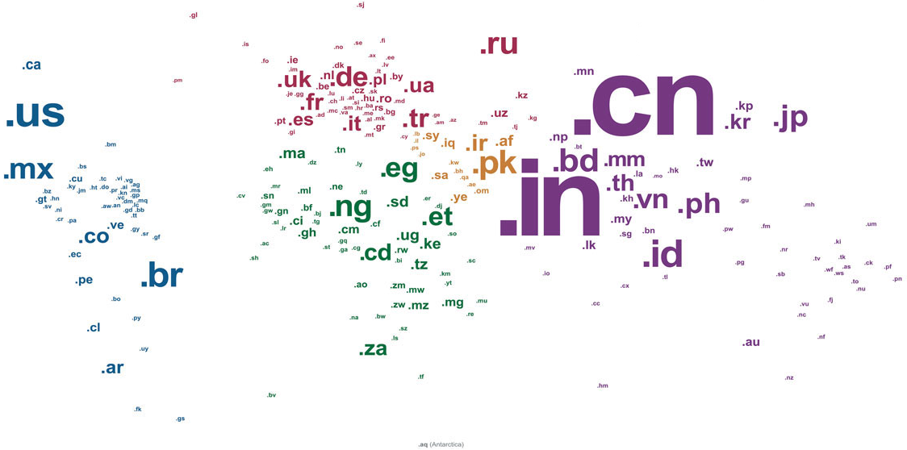
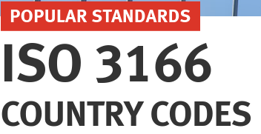
ccTLD - country code Top Level Domain
https://www.iso.org/iso-3166-country-codes.html
Notes:
There are three (3) types of domain names: Sponsored, Generic, and country codes (ccTLDs).
CCtlds use the two letter code assigned by the ISO-3166 to identify a country or territory.
Seven (7) of the ten (10) largest TLDS are ccTLDs: .com, .tk, .cn, .de, .net, .uk, .org,.nl, .ru, .icu .

Slide 4

Why are ccTLDs important?
43 %
57%
156.5 million ccTLDs
207 million gTLDs
7 of the top 10 largest TLDs are ccTLDs:
.com, .tk, .cn, .de, .net, .uk, .org, .nl, .ru and .br.
Volume 18 – issue 2 | June 2021 (source: Verisign DNIB)
https://www.verisign.com/assets/domain-name-report-Q12021.pdf

Slide 5
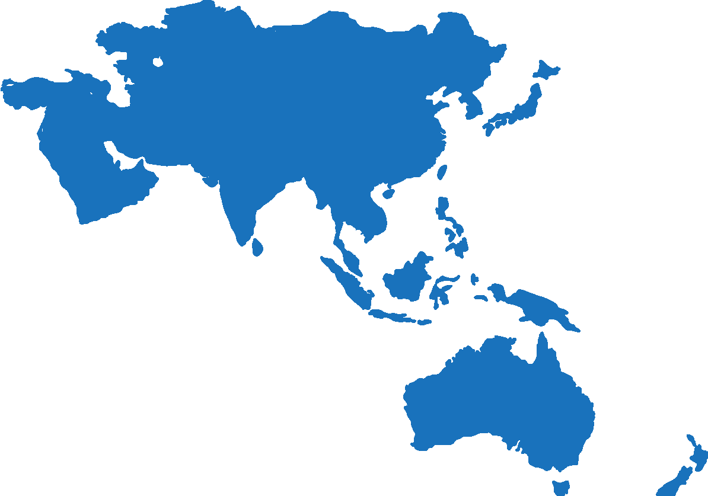
4
Europe
North America
Asia/Australia/
Pacific
Latin America/
Caribbean islands
2
Africa

Slide 6
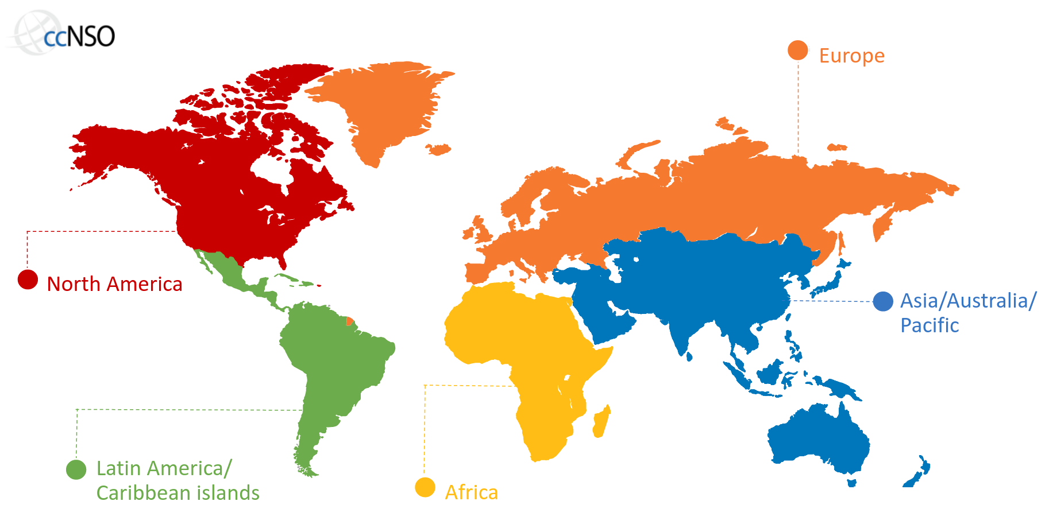




Notes:
ccTLDs organize themselves in regional organizations (ROs):
AfTLD - African ccTLDs
ApTLD - Asian ccTLDs
Centr - European ccTLDs
LACTLD - Latin American & Caribbean ccTLDs

Slide 7

4
Europe
North America
Asia/Australia/
Pacific
Latin America/
Caribbean islands
2
Africa
Notes:
The ccNSO is the body within the ICANN structure created by TLD operators for TLD operators.
Is a supporting organization (SO) with policy development power related to ccTLDs.
It nurtures consensus among TLD operators, provides a networking space, and facilitates coordination with other ICANN constituencies.

Slide 8
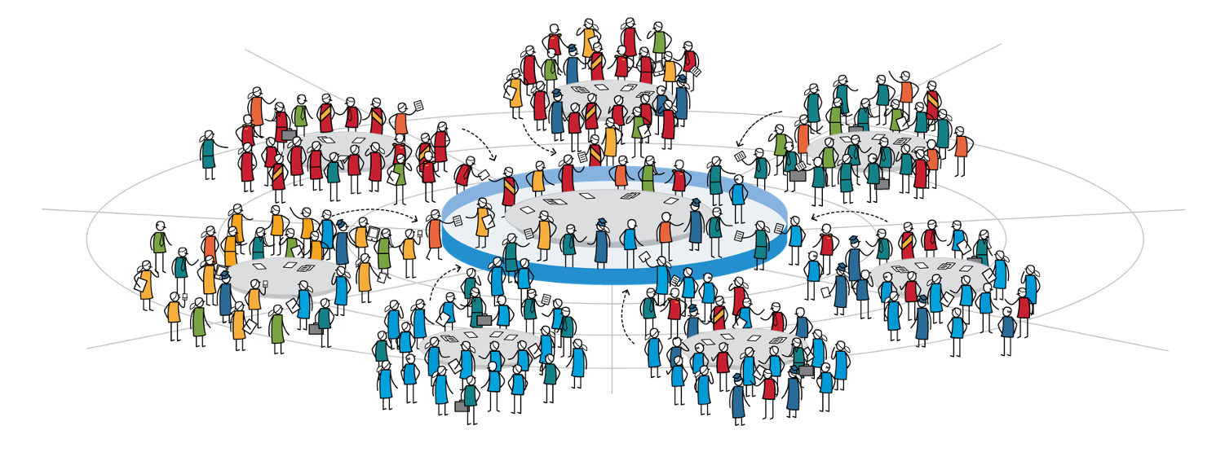







Country Code Names
Supporting Organization
ICANN Community
Governmental
Advisory Committee
Generic Names
Supporting Organization
At-Large
Advisory Committee
Root Server System
Advisory Committee
Address
Supporting Organization
Security & Stability
Advisory Committee
Business
Government
Civil Society
Domain Name
Business
Internet user
Academic
Technical

Slide 9

Governmental
Advisory Committee
President & CEO
16
Ombudsman
At-Large
Advisory Committee
15
Internet Engineering
Task Force
ICANN Board
of Directors
Generic Names
Supporting Organization
Technical
Liaison Group
14
13
country code Names
Supporting Organization
Root Server System
Advisory Committee
12
11
Address
Supporting Organization
Security & Stability
Advisory Committee
10
9
8
7
6
5
4
3
2
1
Nominating Committee
Non-Voting Members

Slide 10
Governmental
Advisory Committee
President & CEO
16
Ombudsman
At-Large
Advisory Committee
15
Internet Engineering
Task Force
ICANN Board
of Directors
Generic Names
Supporting Organization
Technical
Liaison Group
14
13
country code Names
Supporting Organization
Root Server System
Advisory Committee
12
11
Address
Supporting Organization
Security & Stability
Advisory Committee
10
9
8
7
6
5
4
3
2
1
Nominating Committee
Non-Voting Members

Slide 11
ccNSO | The global platform for ccTLDs

Slide 12

What is the ccNSO?
country code Names Supporting Organization
ICANN Bylaws, Article 10
ICANN Policy Development body:
Global policies relating to ccTLDs
Nurturing consensus
Coordinating with other ICANN constituencies
  The ccNSO may also engage in other activities authorized by its members.
https://www.flaticon.com/free-icon/parchment_2332918
https://www.icann.org/resources/pages/governance/bylaws-en/#article10
Notes:
ARTICLE 10 COUNTRY-CODE NAMES SUPPORTING ORGANIZATION
Section 10.1. DESCRIPTION
There shall be a policy-development body known as the Country-Code Names Supporting Organization ("ccNSO"), which shall be responsible for:
(a) developing and recommending to the Board global policies relating to country-code top-level domains;
(b) Nurturing consensus across the ccNSO's community, including the name-related activities of ccTLDs;
(c) Coordinating with other ICANN Supporting Organizations, committees, and constituencies under ICANN;
(d) Nominating individuals to fill Seats 11 and 12 on the Board; and
(e) Other responsibilities of the ccNSO as set forth in these Bylaws.
Policies that apply to ccNSO members by virtue of their membership are only those policies developed according to Section 10.4(j) and Section 10.4(k). However, the ccNSO may also engage in other activities authorized by its members. Adherence to the results of these activities will be voluntary and such activities may include: seeking to develop voluntary best practices for ccTLD managers, assisting in skills building within the global community of ccTLD managers, and enhancing operational and technical cooperation among ccTLD managers.

Slide 13
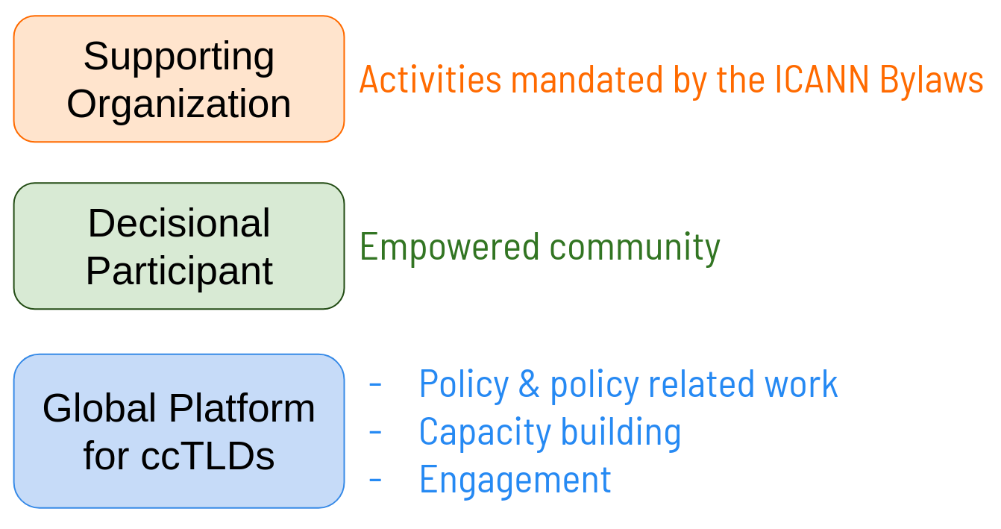
Purpose & Value of the ccNSO

Slide 14



Evolved Functions and Other Activities
Policy & related
- ccPDP4: (de)selection IDN ccTLD strings
- ccPDP3:
* retirement of ccTLDs
* review mechanism on delegation, transfer, revocation and retirement of ccTLDs
Platform function
- ccTLD News Sessions
- ccNSO Members Meetings
- TLD OPS Workshops & Report
- Tech Day
- Topical webinars
- ccNSO Monthly Newsletter
Represents
ccTLD community
- ICANN Board & SO/ACs
- Strategic and Operational Planning Committee (SOPC)
- ccTLD voluntary contributions to ICANN
Notes:
We'll talk more on policy later.
Platform function: Develop voluntary best practices for ccTLD managers, assisting in skills building within the global community of ccTLD managers, and enhancing operational and technical cooperation among ccTLD managers.
ccNSO represents ccTLD community within ICANN.

Slide 15
ccNSO Members per region _{(June 2021)}
Total of members: 172
4
Europe: 47
North America: 6
Asia/Australia/
Pacific: 53
Latin America/
Caribbean islands: 28
2
Africa: 38
https://forms.icann.org/en/ccnso-membership
Notes:
Membership of the ccNSO is open to all ccTLD Managers. As defined in the ICANN bylaws (Section 10.4 (a)) a ccTLD Manager is the organization or entity responsible for managing an ISO 3166 country-code top-level domain, or under any later variant, for that country-code top-level domain.
Membership is free of charge. The only requirement for application is to fill the online application form and the council approval.

Slide 16




ccNSO Council Members
LATIN AMERICA & THE CARIBBEAN
NOMCOM
AFRICA
ASIA PACIFIC
NORTH AMERICA
EUROPE
15 Councillors elected by ccTLDs
3 NomCom Councillors
Council Elections are held every year:
gNSO
liaison
ALAC
liaison
Regional Organizations Observers
Notes:
The role of the ccNSO Council is to administer and coordinate the affairs of the ccNSO and to manage the development of policy recommendations. The ccNSO Council shall also undertake such other roles as the members of the ccNSO shall decide from time to time.

Slide 17
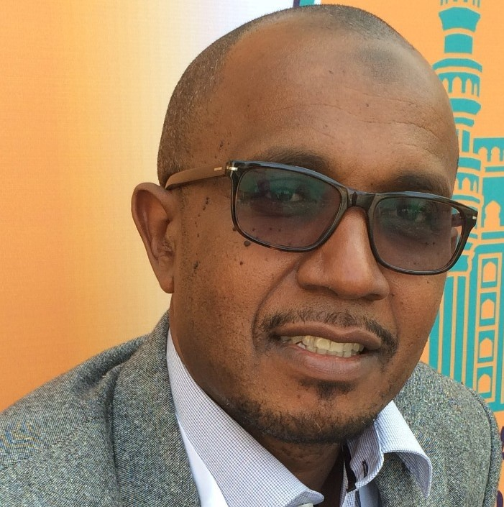
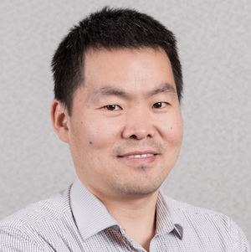
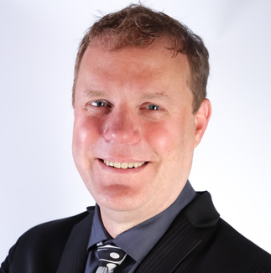
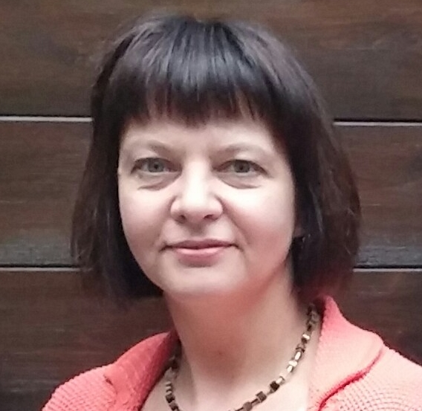
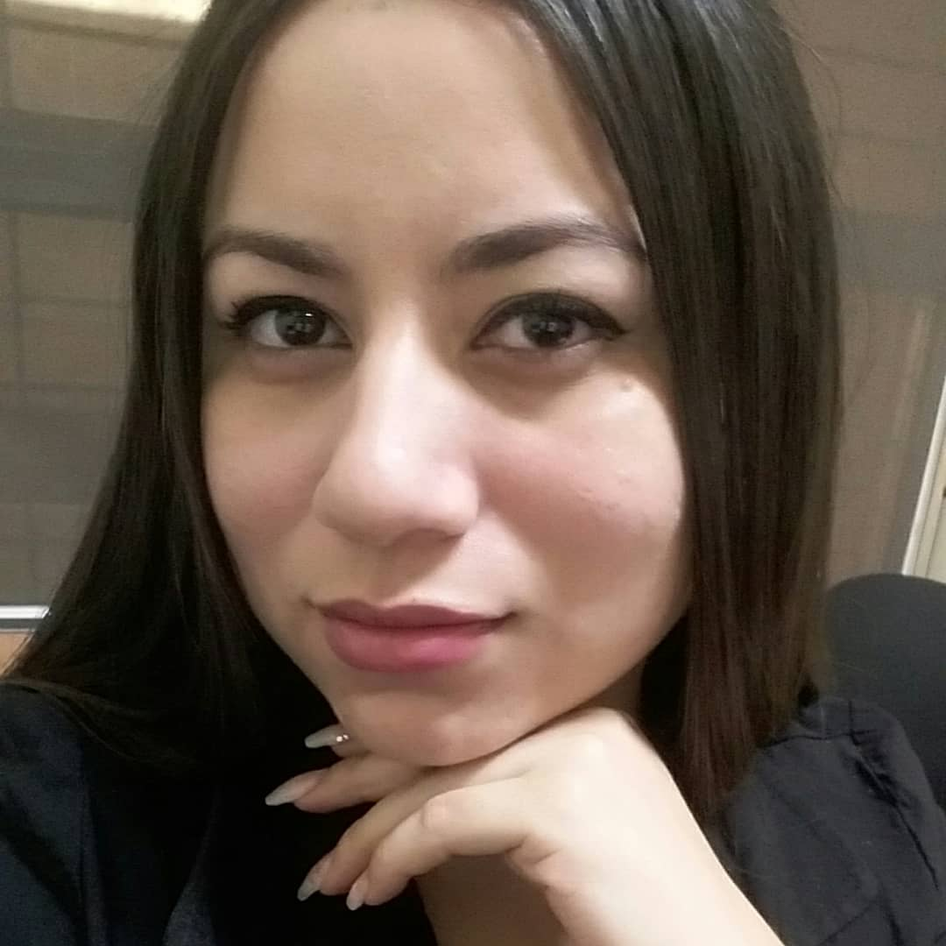
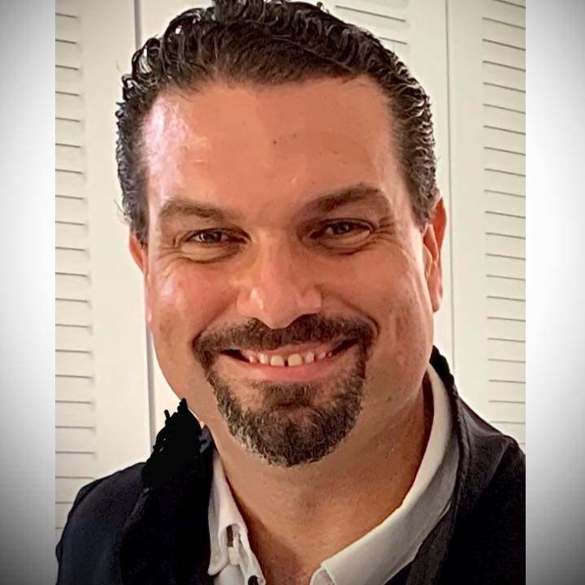
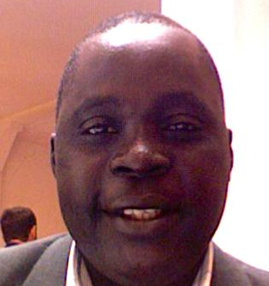
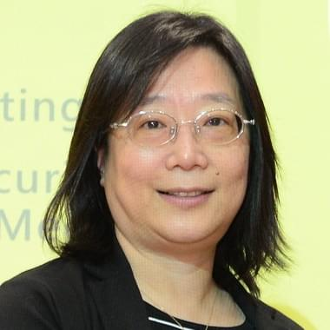
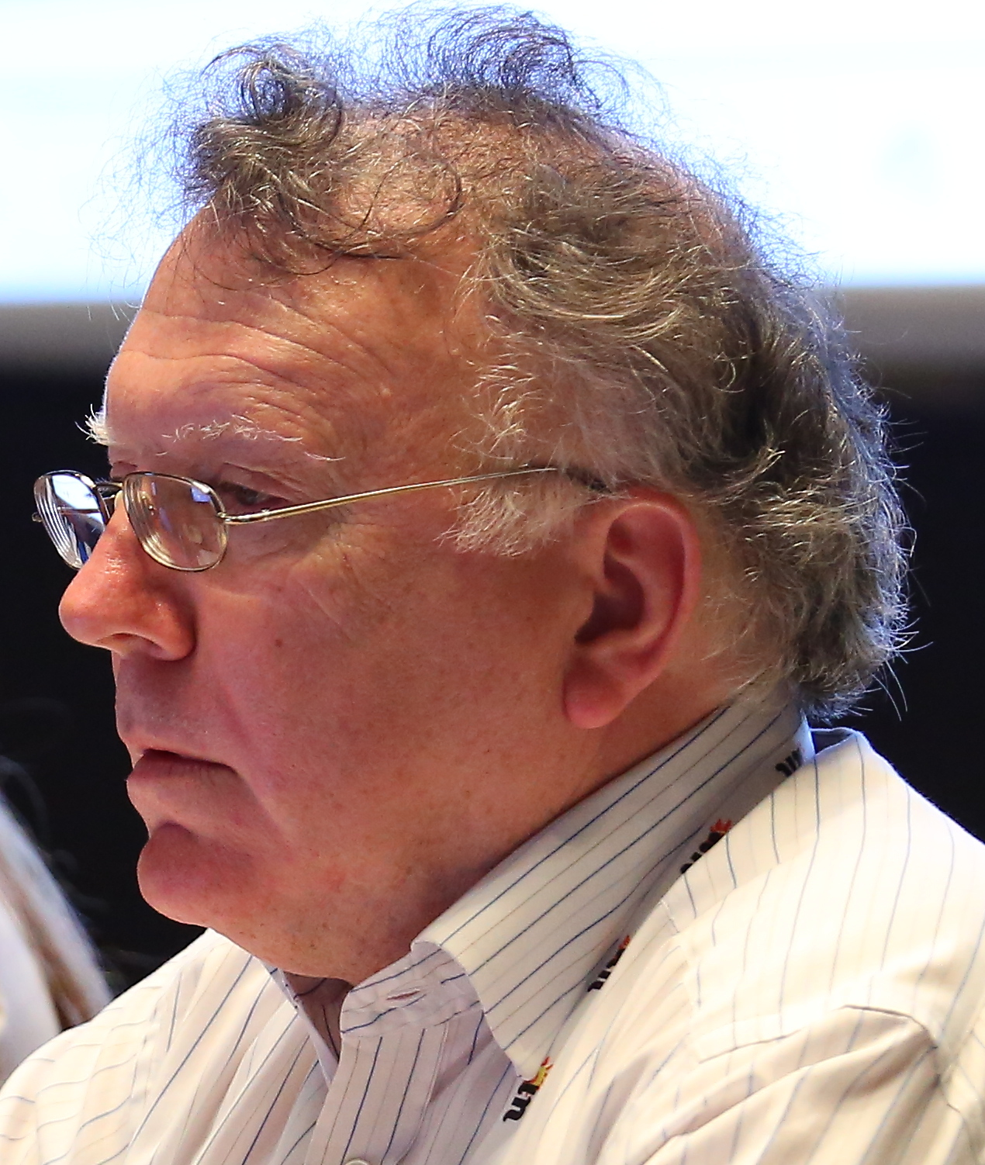
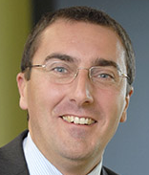
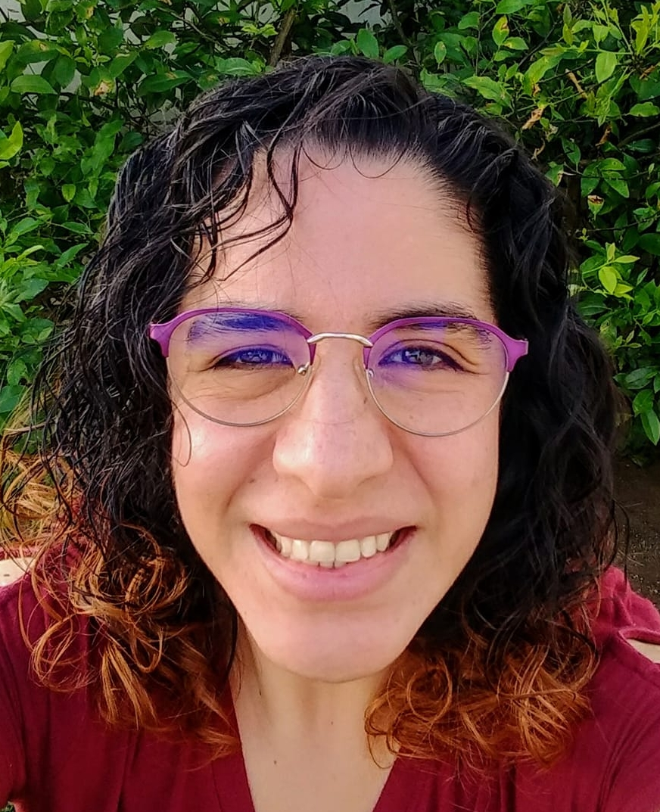
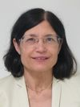
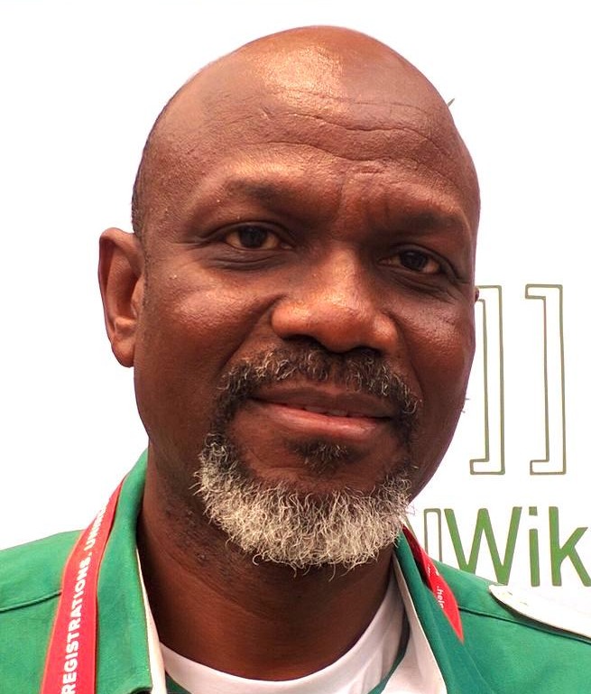
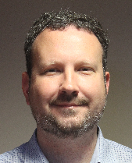
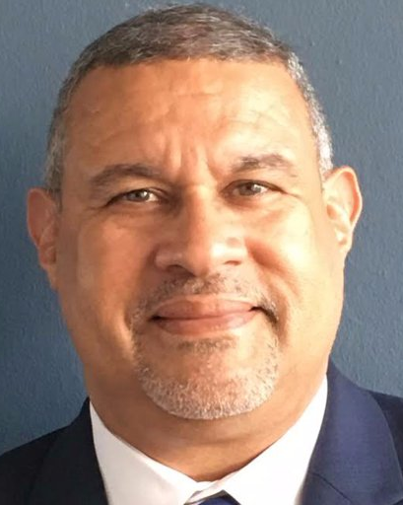
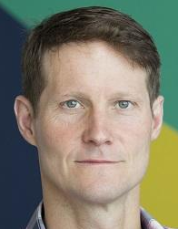
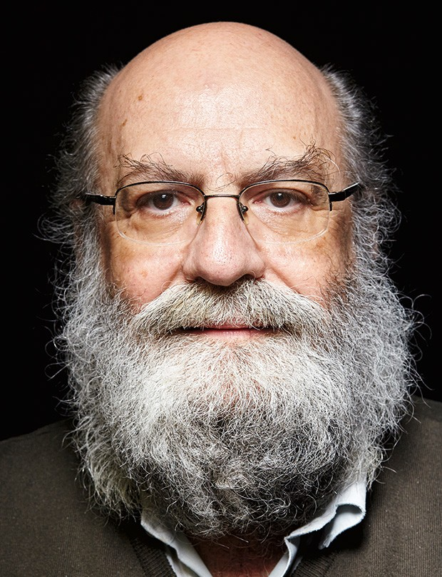
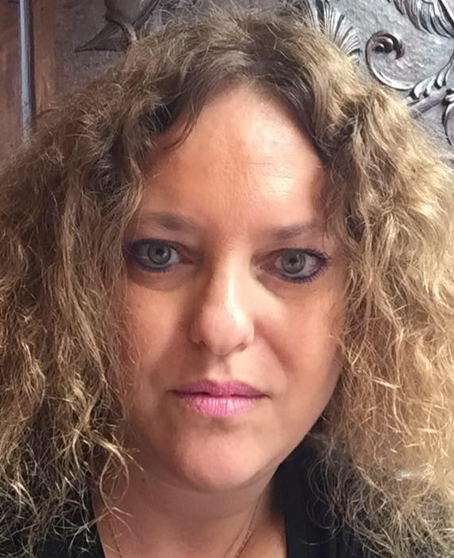
March
2024
Hadji Mmadi Ali .km
Jiankang Yao .cn
Sean Copeland .vi
Irina Danelia .ru
Jenifer López .pa
Javier Rúa-Jovet
AM'23
March
2023
Souleymane Oumtanaga .ci
Ai-Chjn Lu .tw
Stephen Deerhake .as
Giovanni Seppia .eu
Chair
Marie-Noémi Marques
AM'22
Alejandra Reynoso .gt
March
2022
Vice Chair
Vice Chair
Nick Wenban-Smith .uk
Demi Getschko .br
Laura Margolis
AM'21
Biyi Oladipo .ng
Jordan Carter .nz
Pablo Rodríguez .pr
AFRICA
ASIA PACIFIC
NORTH AMERICA
EUROPE
LATIN AMERICA &
THE CARIBBEAN
NOMCOM
Notes:
Current councillors

Slide 18
How to get involved?

Slide 19
Participants at the ccNSO
ccNSO Member?
ccTLDs
  Any entity responsible for managing a 2-letter ISO 3166 country-code top-level domain, who has agreed in writing to be a ccNSO member
  Future: Also IDN ccTLDs (pending Bylaw change)
ccNSO Members
Volunteers
Council
Staff

Slide 20
Participants at the ccNSO
ccNSO Member?
ccTLDs
  Any entity responsible for managing a 2-letter ISO 3166 country-code top-level domain, who has agreed in writing to be a ccNSO member
  Future: Also IDN ccTLDs (pending Bylaw change)
ccNSO Volunteer?
ccNSO Members
Volunteers
  Any employee of a ccTLD
Council
Staff

Slide 21
Participants at the ccNSO
ccNSO Member?
ccTLDs
  Any entity responsible for managing a 2-letter ISO 3166 country-code top-level domain, who has agreed in writing to be a ccNSO member
  Future: Also IDN ccTLDs (pending Bylaw change)
ccNSO Volunteer?
ccNSO Members
Volunteers
  Any employee of a ccTLD
Council
ccNSO Councillor?
  Anyone who has been:
    nominated by a ccNSO member
    seconded by a ccNSO member (same region)
    elected by ccNSO members (from that region)
Staff

Slide 22








How to participate?
Mailing list &
newsletter
Attend
ccNSO Meetings
Participate in
ccNSO Meetings
Ask
Questions
Present, Moderate, Chair
Join WGs or
ccNSO Council
Public
Comments
Spread the news on ccNSO work
https://www.flaticon.com/free-icon/presentation_3534082
https://www.flaticon.com/free-icon/join_2733455
https://www.flaticon.com/free-icon/viral_2540301
https://www.flaticon.com/free-icon/comments_2190552
https://www.flaticon.com/free-icon/subscribe_3997718
https://www.flaticon.com/free-icon/calendar_812836
https://www.flaticon.com/free-icon/support_2755357
https://www.flaticon.com/free-icon/quiz_3400213

Slide 23
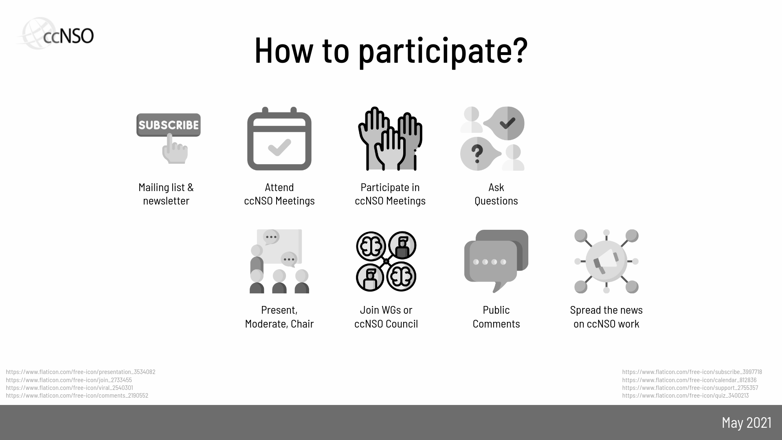

How to participate?
Your role and level of involvement may change over time. Choose the one that works for you.
https://www.flaticon.com/free-icon/destination_854894

Slide 24
Global impact of the ccNSO

Slide 25

Working Groups & Committees
  Outreach and Involvement Standing Committee (OISC)
  Strategic and Operational Planning Committee (SOPC)
  Meetings Programme Committee (MPC)
  ccNSO Internet Governance Liaison Committee (IGLC)
  TLD-OPS Standing Committee (TLD-OPS)
  Technical Working Group (Tech Day)
  Guidelines Review Committee (GRC)
  ccPDP3: Retirement WG
  ccPDP3: Review Mechanisms WG
  ccPDP4: IDN policy WG
https://www.flaticon.com/free-icon/videoconference_3214781
http://ccnso.icann.org/workinggroups

Slide 26
Meeting Program Committee
In every meeting we have more than:
150
participants
80
ccTLDs
20
presentations

Slide 27
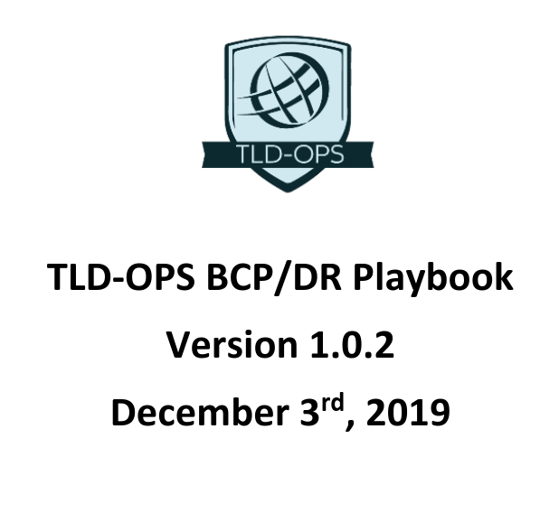
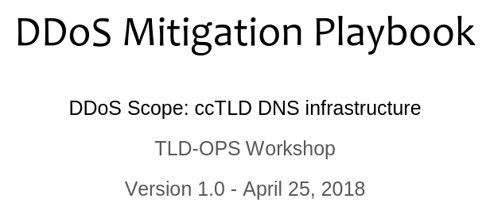
TLD-OPS
Detect and mitigate incidents that may affect the security and stability of ccTLD services.

Slide 28
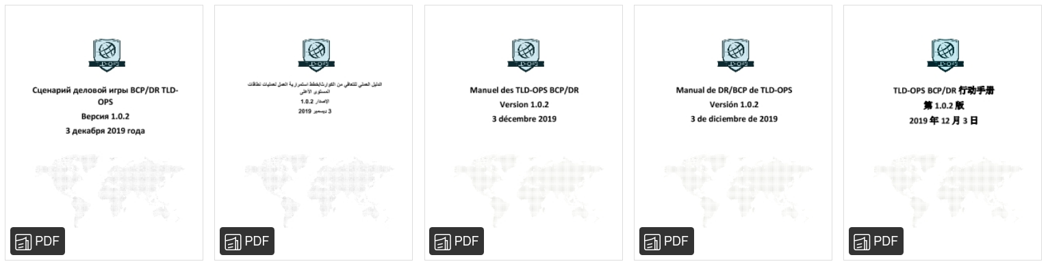

TLD-OPS
Playbooks are translated to the rest of UN languages.
https://assets.rappler.co/images/un-8-facts-5-six-languages-20131023.jpg

Slide 29
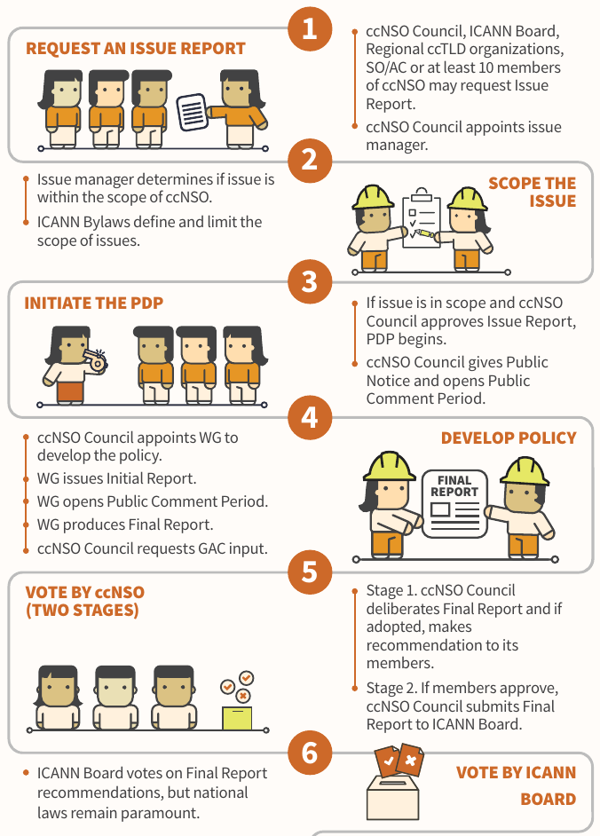
ccNSO Policy
Development Process
https://www.icann.org/en/system/files/files/multistakeholder-policy-development-31jan17-en.pdf
https://www.icann.org/en/system/files/files/ccnso-pdp-flowchart-31aug17-en.pdf

Slide 30
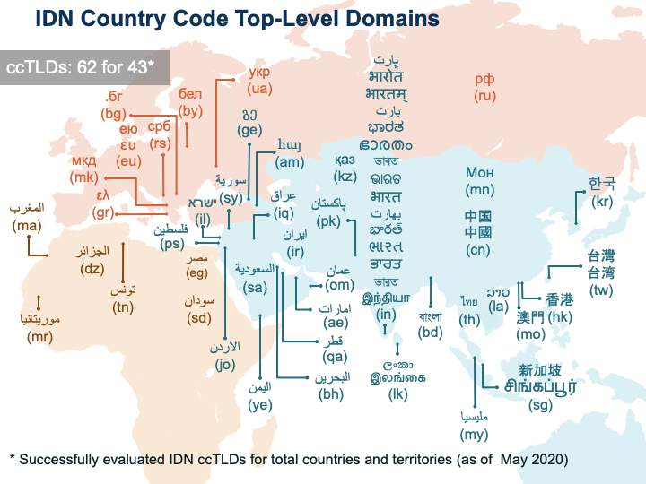
Fast Track Process -
enabled IDN ccTLDs representing respective country or territory names in scripts other than Latin.
3.5 billion
Internet users can choose a ccTLD in their own language
Notes:
IDN ccTLD Fast Track Process:
The approval of the IDN country code Top-Level Domain (ccTLD) Fast Track Process by the ICANN Board at its annual meeting in Seoul, South Korea in October 2009, enabled countries and territories to submit requests to ICANN for IDN ccTLDs representing their respective country or territory names in scripts other than Latin. A country or territory represented on the ISO3166-1 list is eligible to participate in the IDN ccTLD Fast Track Process and to request an IDN ccTLD string that fulfils the additional requirements defined in the Final Implementation Plan for IDN ccTLD Fast Track Process (FIP).
https://www.icann.org/resources/pages/fast-track-2012-02-25-en
Soon IDN ccTLDs will be able to join the ccNSO. The process to change the bylaws and make this happen is still ongoing.

Slide 31

Ongoing
ccNSO Policy Development Processes
ccPDP4: (de)selection of Internationalized Domain Name (IDN) ccTLD strings
* Eventually replaces the IDN ccTLD Fast Track Process.
* WG seeks feedback from the broader community at ICANN71
ccPDP3: Retirement of ccTLDs
* Will now go into the decision-making phase
* If supported by ccNSO Council: voting by ccNSO members in July!
ccPDP3: Review Mechanisms for decisions regarding the delegation, transfer, revocation, and retirement of ccTLDs
* Identified which decisions should be subject to a review
* Explored requirements for the review mechanism
https://www.flaticon.com/free-icon/policy_1576469

Slide 32
ccNSO at ICANN71

Slide 33
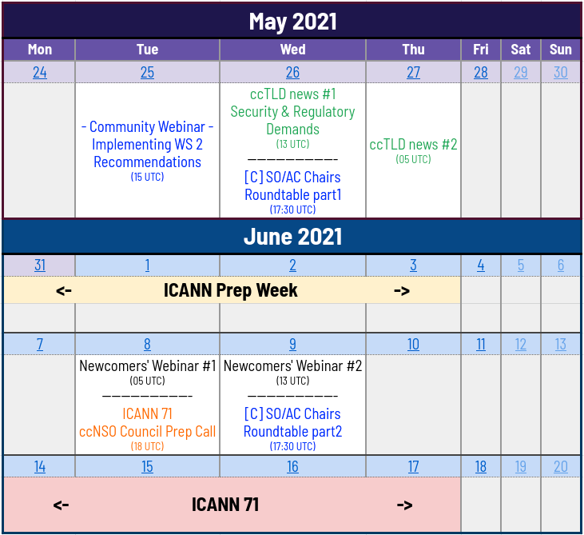

ccnso.agenda@gmail.com

Slide 34
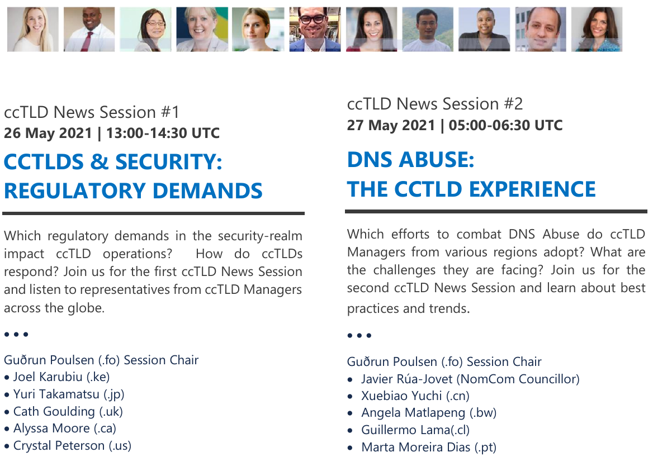

Slide 35
ICANN71 ccNSO Block Schedule
UTC | Mo, 14 June | Tue, 15 June | Wed, 16 June | Thu, 17 June
Block 1 (60’) 07:00-08:00 | DNSSEC Workshop | Governance Session |  | SOPC
Block 2 (90’) 08:30-10:00 | DNSSEC Workshop |  |  | Plenary Understanding Reputation Block List Providers
Block 3 (90’) 10:30-12:00 | Plenary Governmental Regulatory Developments, WHOIS, Data Protection, and Cybersecurity | Q&A with ccTLD-related ICANN Board | Policy Session
Block 4 (90’) 12:30-14:00 | Tech Day | Plenary ICANN and the Internet Governance Ecosystem |  | ccNSO Council
Block 5 (60’) 14:30-15:30 | Tech Day |  | CSC/PTI update to the community

Slide 36

ICANN71 | Links to bookmark now
ccNSO Schedule Hub
https://community.icann.org/x/WIG1CQ
ccNSO Members Meeting,
including sessions held prior to ICANN71
https://community.icann.org/x/UYG1CQ
Tech Day
https://community.icann.org/x/a4G1CQ

Slide 37






Let’s keep in touch
twitter.com/ccNSO
ccnso.agenda@gmail.com
facebook.com/ccnso
ccnsosecretariat@icann.org
ccnso.icann.org
community.icann.org/category/ccnso
community.icann.org/display/ccnsowkspc/ccNSO+Newsletter

Slide 38
Thank you!

