Slide 1
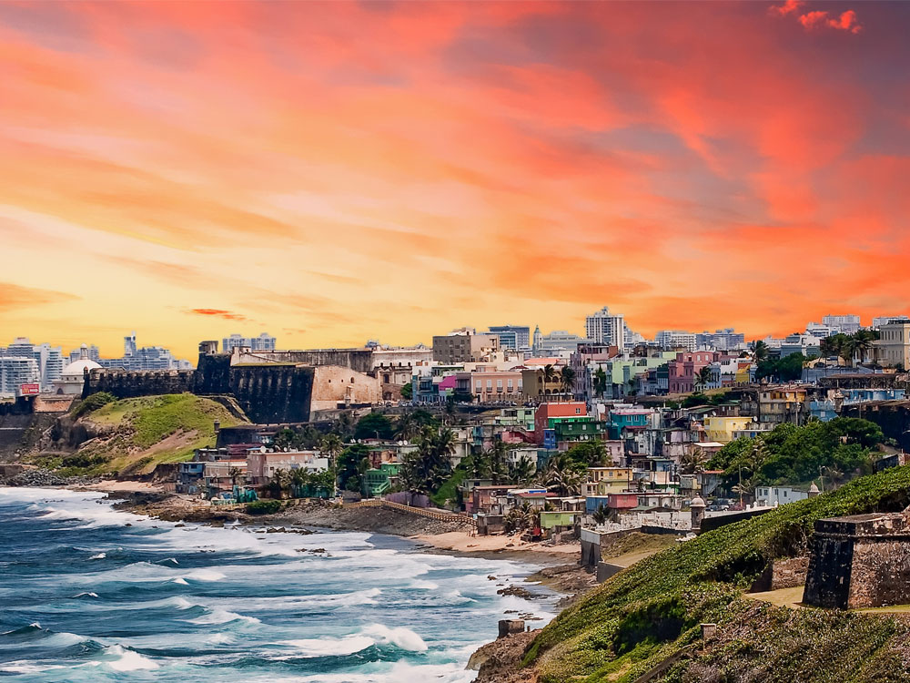


Slide 2
Strategic Planning on effective and efficient GNSO policy development
ICANN61, San Juan – Puerto Rico
10 March 2018

Slide 3
Agenda
1
2
3
9.00 - 9.30
Setting the Scene & Introduction
9.30 – 10.15
Hearing from PDP Chairs and others – What are the main challenges?
10.15 – 10.45
Break – Brainstorm on how these challenges can be overcome
4
5
10.30 – 11.45
What does good look like in a PDP?
Designing PDP 2.0
11.45 – 12.00
Next Steps
Here’s a place to introduce your sixth agenda item from your talk.
Notes:
This is a stylized agenda slide for your presentation.
To delete a box, if there are too many boxes, click the edge of the box, ensure the entire box is highlighted, then DELETE.
To update the numbers and text, click inside the circle for the numbers or in the box for the text, revise the text.

Slide 4
Setting the Scene & Introducion
Agenda Item #1

Slide 5
Why is this session being held?
Conversation started during GNSO Council Strategic Planning Session in Jan 2018 where the Council observed in its role of manager of the PDP:
Challenges for PDP WG meeting timelines – work plans are adjusted by WGs with limited Council or community input/oversight;
Significant increase in time to Initial Report;
Significant increase in membership numbers with limited corresponding change to those doing the ‘heavy lifting’;
Possible mismatch of skills & knowledge of members;
Increased demands on leadership teams in terms of commitments and skills;
Focus is moving away from finding consensus to zero sum game.

Slide 6
Macro-level challenges / concerns
Pressure on the budget / resources
Not reasonable to expect volunteers to participate actively in a PDP WG for 4 years or more
Credibility of multi-stakeholder model and reputation of GNSO is at stake
Legitimacy & robustness of PDP

Slide 7
Current Dynamics of GNSO PDP WGs
Staff Discussion Paper – Optimizing increased engagement & participation while ensuring efficient & effective policy development
Marika Konings

Slide 8
Agenda
1
2
3
The Past
The Present
Challenges
4
5
The Future
Discussion
Here’s a place to introduce your sixth agenda item from your talk.
Notes:
This is a stylized agenda slide for your presentation.
To delete a box, if there are too many boxes, click the edge of the box, ensure the entire box is highlighted, then DELETE.
To update the numbers and text, click inside the circle for the numbers or in the box for the text, revise the text.

Slide 9
The Past – GNSO Task Force Model
Each Constituency and/or Stakeholder Groups of the GNSO invited to appoint one individual
Additionally, the Council could appoint up to three outside advisors to sit on the task force.
The Council could increase the number of Representatives per Constituency or Stakeholder Group that may sit on a task force in its discretion in circumstances that it deems necessary or appropriate.
TF Model considered too limiting and not allowing for input from non-GNSO members / communities. GNSO Review recommends Open WG Model.

Slide 10
The Present – Open Working Group Model
Introduced following the GNSO Review of 2008-2012: “A working group model should become the focal point for policy development and enhance the policy development process by making it more inclusive and representative, and – ultimately – more effective and efficient”.
Anyone interest can join a GNSO Working Group – only requirement is completing a Statement of Interest (SOI)
Calls for volunteers are broadly circulated and publicized which has resulted in gradual increase in membership, e.g. 13 for IRTP Part A in 2009 to 195 for RDS PDP WG in 2017.
At the same time, overall duration of delivering an Initial Report for public comment has increased from 245 days to over 661 (and counting!)

Slide 11
The Present – Open Working Group Model

Slide 12
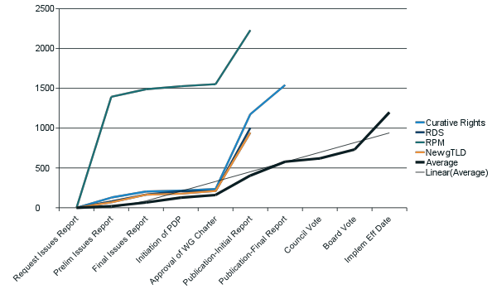
PDP Timelines
# of days
Based on current trend, delivery of Initial Report will take at least 2 - 4 x amount of time (but likely significantly more) compared to average based on previous PDPs.

Slide 13
Staff Discussion Paper – observations & research
Large working groups are difficult to moderate, even for the most experienced leaders in the ICANN community;
Social loafing, a commonly observed phenomenon in which members of larger groups exert less effort towards group goals;
With growing size, teams and groups may experience reduced cooperation, higher levels of member dissatisfaction, and increased turnover in membership;
At the same time, bulk of the work still falls on a relatively small number of community members;
Some community newcomers lack the skills, knowledge, and/or resources to contribute meaningfully from the start, which may frustrate more experienced volunteers;
WG members that join later in the process may intentionally or perhaps unknowingly re-open long-settled fundamental matters of agreement, thus also contributing to delays.

Slide 14
The Present - Challenges
1
Inclusive and effective - a contradiction in terms?
4
Consensus by exhaustion?
2
5
Negotiations instead of consensus policy development
Quantity over quality?
3
6
Legitimacy of MSM and ICANN bottom-up community driven policy development
Who is accountable to whom?
Notes:
Look for different ways to display your data or text by using alternatives to simple bullets.
To adjust the number in the arrow to text or another number, click on the text box around the number, revise.
To add an arrow, click on the arrow, ensure the arrow is highlighted, COPY and PASTE and move to the desired placement, or DELETE if there are too many arrows.

Slide 15
Engage with ICANN – Thank You and Questions

Slide 16
GNSO Policy Development Process
PDP provides flexibility to consider preferred work methods as well as model for work team – without needing to modify Bylaws or Operating Procedures.
Just because things have been done a certain way does not mean they need to continue if there is a better way.
Also, there does not need to be one-size-fits all – not every PDP is created equal
E.g.: “Upon approval of the PDP Charter, the GNSO Council may form a working group, task force, committee of the whole or drafting team (the “PDP Team”), to perform the PDP activities”.
“The PDP Team is responsible for engaging in the collection of information. If deemed appropriate or helpful by the PDP Team, the PDP Team may solicit the opinions of outside advisors, experts, or other members of the public”.

Slide 17
GNSO Policy Development Process
ICANN Bylaws – Annex A - https://www.icann.org/resources/pages/bylaws-2017-07-25-en#annexA
GNSO PDP Manual - https://gnso.icann.org/en/council/annex-2-pdp-manual-30jan18-en.pdf
GNSO Working Group Guidelines - https://gnso.icann.org/en/council/annex-1-gnso-wg-guidelines-30jan18-en.pdf
PDP Working Group Charter Template - https://gnso.icann.org/en/council/gnso-groupname-charter-yyyymmdd-template.dotx

Slide 18
Hearing from PDP leaders and the broader GNSO community – What are the main challenges to deliver consensus recommendations in a timely manner ?
Agenda Item #2

Slide 19
Proposed Rules
Try to be brief to allow everyone to provide their input;
If a challenge has already been identified and captured, no need to repeat it;
Save potential solutions for the next part of the session;
It is not the intention to point fingers or assign blame, but do not be afraid to be critical.

Slide 20

Presenters (max. 10 minutes each)
New gTLD Subsequent Procedures PDP
Registration Directory Services (RDS) PDP
Review of all Rights Protection Mechanisms PDP
Curative Rights for IGO/INGOs PDP
Reconvened PDP Red Cross Protections
Others?

Slide 21
Break – Brainstorm on how these challenges can be overcome
Agenda Item #3
PDP Chairs to facilitate small-group breakouts

Slide 22
What does good look like in a PDP? How to overcome these hurdles & deep dive on ideas/suggestions (Designing PDP 2.0)
Agenda Item #4

Slide 23
The Future – What does good look like?
Policy development that is efficient, effective, representative and data driven.
Accept that a certain level of knowledge, availability and representation are needed
Ensure that public at-large is able to weigh in at various states of the process and observe deliberations
Various models that could be explored, e.g. Expert WG, Rapporteur, Parliamentary Style model, Task Force + model
Other tools that may facilitate these models such as moderator/facilitator, F2F meetings

Slide 24
Ideas / Suggestions
A job description for WG Chairs;
Terms of participation for WG members/participants that would reflect a requirement to work in good faith to reach consensus;
Reiterating the role of the GNSO Council Liaisons;
Limit the # of WG members and consider other ways in which individuals can engage and provide input or consider having unlimited observers but limit WG members to those designated by different groups. Also get those WG members to commit to the # of hours / timeline that has been identified to ensure there is buy-in and understanding of what is required.
Council to provide criteria for information that needs to be provided by PDP WG leadership as part of their updates;
Resource reporting for PDP WGs to better track resources spent;
Other?

Slide 25
White Boarding Exercise
Determine which ideas / suggestions are most promising in addressing challenges in current and/or future PDP WGs;
Each PDP WG Chair will lead the discussion on one idea/suggestion with those interested to try and work out further details of how this idea/suggestion could be applied in practice;
Pick the idea/suggestion that appeals most to you, but feel free to rotate once you have shared your thoughts’
Report back to the full meeting.

Slide 26
Next Steps
Agenda Item #5

Slide 27
Next Steps
Develop PDP Continuous Improvements Paper (“PDP 3.0”) which is expected to identify
  a) low hanging fruits,
  b) possible changes to the PDP Manual and/or WG Guidelines,
  c) possible changes to existing charters / PDPs.
Idea is to consider incremental changes within the boundaries of the existing PDP model.
Such incremental changes could apply to existing PDPs and/or future PDPs – community/PDP leadership & WGs will need to consider what may be implemented immediately and what is only applicable to future PDPs.
Expected to be published for community input by ICANN62.

Slide 28
Engage with ICANN – Thank You and Questions

