Slide 1
ICANN SSAC Review by the Independent Examiner
Discussion with the RWP
April 12, 2018

Slide 2
Agenda
Project Timeline
Summary of Interviews to Date
Discussion of the Draft Survey Instrument
Next Steps
Q&A

Slide 3
Project Timeline
Milestone | Estimated Date
Review relevant background documents | February
Develop interview questions and solicit RWP interview question feedback | Finalize by March 5
Interviews at ICANN61 (and remotely as needed) | March - Late April
Process interview notes, design survey, and solicit RWP survey feedback | March - Mid April
Survey period | Mid April - Mid May
Send Draft Assessment Report to RWP for discussion | Late May
Assessment Report published | June 20
Present Assessment Report at ICANN62 | June 25 - 28
Deliver Recommendations to RWP | August
Draft Final Report published for public comment | September
Public Session at ICANN63 | October 20 - 26
Final Report published | November

Slide 4
Agenda
Project Timeline
Summary of Interviews to Date
Discussion of the Draft Survey Instrument
Next Steps
Q&A

Slide 5
Interview Process
  Interviews were/are semi-structured, last approximately 45 minutes, and touch on a range of topics that reflect the criteria previously mentioned, including:
    Purpose and the extent to which the SSAC fulfills its purpose.
    Membership size, structure, and diversity.
    Methods of setting committee focus and developing work product.
    Internal and external communication
    Transparency, accountability, and fairness.
    Implementation of and developments related to last SSAC review.
  Interviewees were/are encouraged to share both strengths and weaknesses of the SSAC, and suggestions for improving the SSAC.

Slide 6
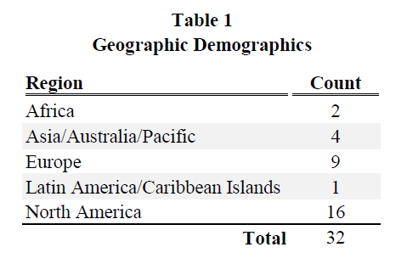
Interview Process
  Conducted 32 interviews at ICANN61. Remote interviews are being scheduled and will take place over the month of April.
  ICANN61 interviewees included individuals from the following:

Slide 7
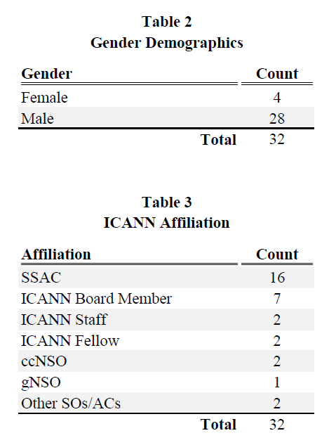
Interview Process

Slide 8
Interview Process - Discussion
  Preliminary interview summary.
    Draft summary was provided to the SSAC RWP on April 1st.
    It will be updated as remote interviews continue.
    A refined version will be provided as an Appendix to the Assessment Report.
  Discussion of the preliminary interview summary.
    Do any views you were expecting stand out as missing?
    Do you have any additional feedback?

Slide 9
Agenda
Project Timeline
Summary of Interviews to Date
Discussion of the Draft Survey Instrument
Next Steps
Q&A

Slide 10
Survey Process
  Is designed to elicit feedback on the SSAC’s strengths and weaknesses from the community.
    The survey is an information gathering tool and will not be analyzed in a statistical manner. But, we will provide a quantitative analysis of the survey results.
    Supplements interviews and casts a wider net in the ICANN community.
  Informed by interview experience.
    The survey also provides an opportunity for free-form responses.
  Will run from April 18th through May 18th.
Notes:
Survey will reflect the most insightful questions based on our interview experience, touching on the criteria outlined previously
Survey also provides an opportunity for free-form responses to avoid limiting survey responses to those we have already received
Promotion of the survey has included
ICANN announcements and through ICANN social media
Outreach to community members conducted by the RWP
Remains open until mid-May
Everyone is encouraged to take the survey.

Slide 11
Survey Process
  Survey design based on survey best practices. For example:
    Randomized answer order to avoid potential bias (where appropriate).
    Minimized open-ended questions to reduce survey fatigue.
    The option of “Don’t know / unsure” is included to ensure respondents do not feel forced to answer a question where they have limited knowledge.
    Ordered questions to reduce respondent drop-out.
  Promotion of the survey includes:
    ICANN announcements and through ICANN social media.
    Outreach to community members conducted by the RWP.
    Follow-up with interviewees.
Notes:
Survey will reflect the most insightful questions based on our interview experience, touching on the criteria outlined previously
Survey also provides an opportunity for free-form responses to avoid limiting survey responses to those we have already received
Promotion of the survey has included
ICANN announcements and through ICANN social media
Outreach to community members conducted by the RWP
Remains open until mid-May
Everyone is encouraged to take the survey.

Slide 12
Survey Process
  Draft survey instrument.
    Draft survey instrument was provided to the SSAC RWP on April 4th.
    It was designed to be over-inclusive and will be refined to reduce the length of taking the survey (to increase the response rate).
    The survey will go “live” on April 18th via an online link. The survey will be coded in Sawtooth.
  Discussion of draft survey questions.
    Are any questions missing that you feel are important?
    Are there certain questions you feel are not useful to ask?
    Are there any sensitivities around question wording (and options provided to questions), that we should be aware of?

Slide 13
Agenda
Project Timeline
Summary of Interviews to Date
Discussion of the Draft Survey Instrument
Next Steps
Q&A

Slide 14
Project Timeline
Milestone | Estimated Date
Review relevant background documents | February
Develop interview questions and solicit RWP interview question feedback | Finalize by March 5
Interviews at ICANN61 (and remotely as needed) | March - Late April
Process interview notes, design survey, and solicit RWP survey feedback | March - Mid April
Survey period | Mid April - Mid May
Send Draft Assessment Report to RWP for discussion | Late May
Assessment Report published | June 20
Present Assessment Report at ICANN62 | June 25 - 28
Deliver Recommendations to RWP | August
Draft Final Report published for public comment | September
Public Session at ICANN63 | October 20 - 26
Final Report published | November

Slide 15
Agenda
Project Timeline
Summary of Interviews to Date
Discussion of the Draft Survey Instrument
Next Steps
Q&A

Slide 16
Thank you for your time!
Questions?

