Slide 1

2011 – 2014 ICANN
Strategic Plan Development
Stakeholder Review
4 November 2010

Slide 2
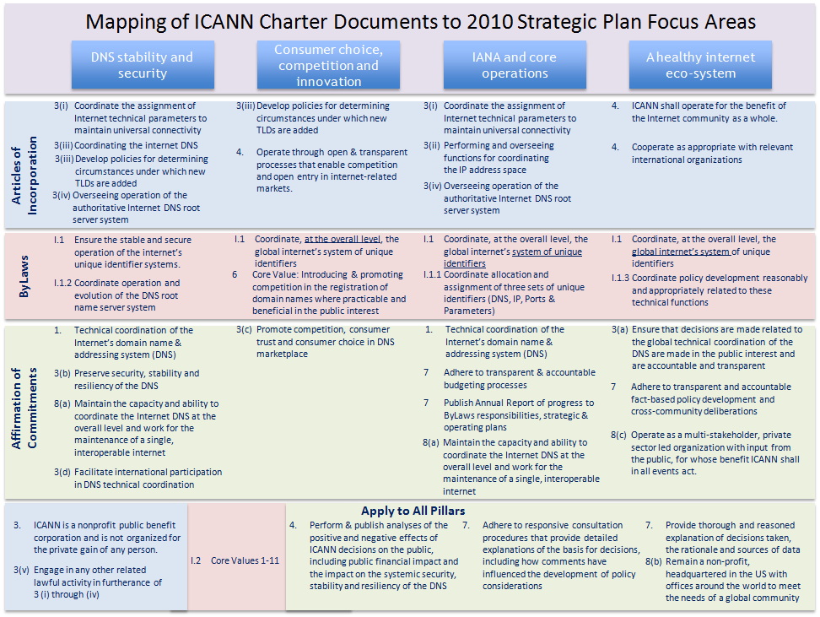
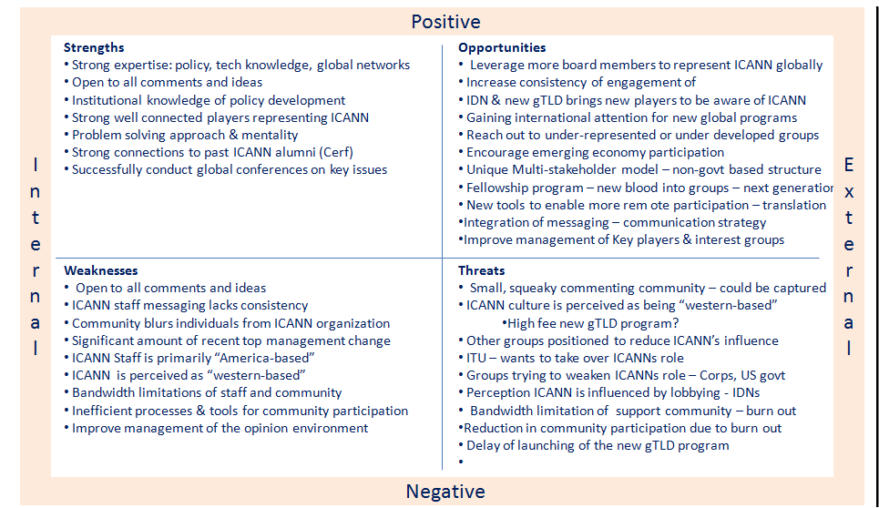
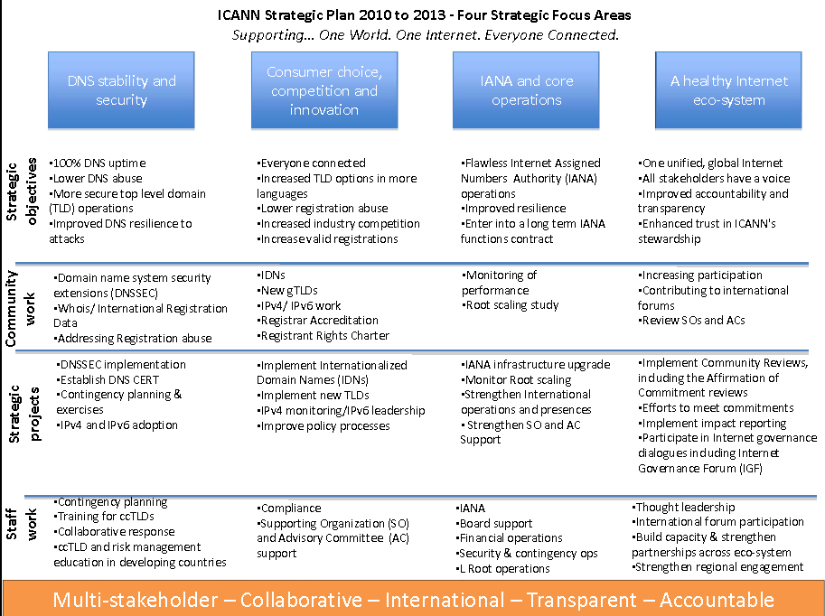
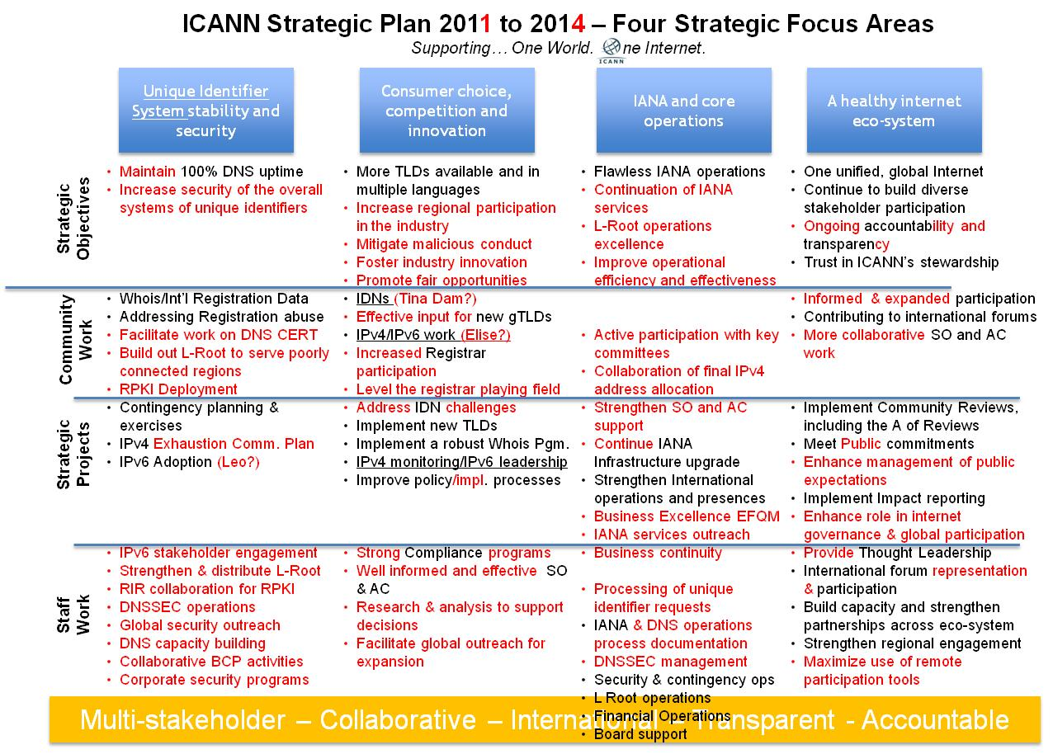
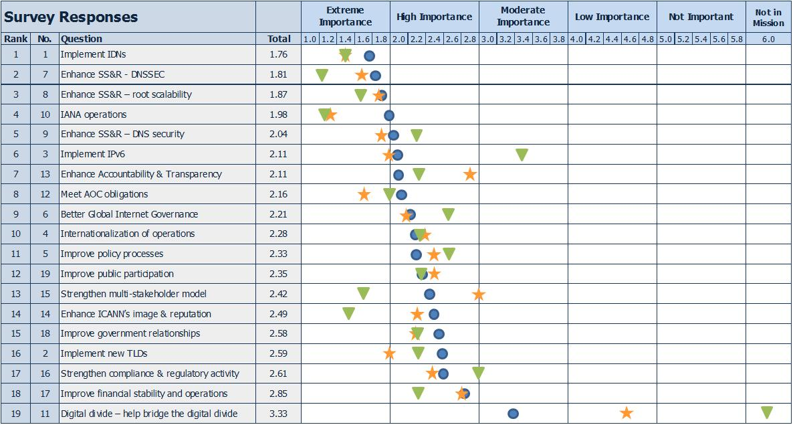
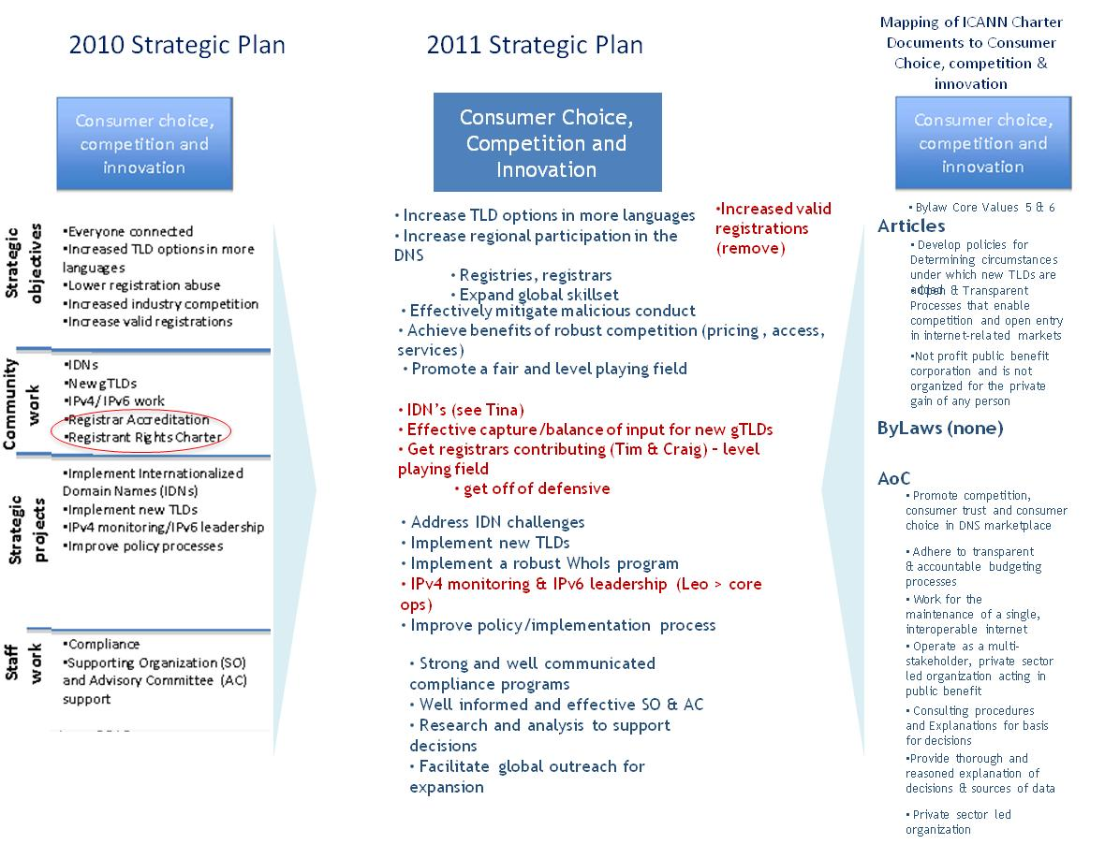

2011 Streamlined Strategic Planning Process
2010
Staff
Development
SWOT
Analyses
Stakeholder
Interviews
Stakeholder
Reviews
Strategic
Issues Survey
45 Day Public
Comment
Analyze
& Update
Environmental Scan
2011
ICANN
Strategic Plan
What has changed?
Staff
Development
Stakeholder
Reviews
30 Day Public
Comment
Analyze
& Update
Prior Year
Strategic Plan
September – December
Current Year
Strategic Plan

Slide 3
Mapping of ICANN Charter Documents to 2011 Strategic Plan Focus Areas
Unique identifier stability and security
Consumer choice, competition and innovation
IANA and core operations
A healthy internet
eco-system
3(i) Coordinate the assignment of Internet technical parameters to maintain universal connectivity
3(iii) Develop policies for determining circumstances under which new TLDs are added
3(i) Coordinate the assignment of Internet technical parameters to maintain universal connectivity
4. ICANN shall operate for the benefit of the Internet community as a whole.
3(iii) Coordinating the internet DNS
Operate through open & transparent processes that enable competition and open entry in internet-related markets.
3(ii) Performing and overseeing functions for coordinating the IP address space
4. Cooperate as appropriate with relevant international organizations
Articles of Incorporation
3(iii) Develop policies for determining circumstances under which new TLDs are added
3(iv) Overseeing operation of the authoritative Internet DNS root server system
3(iv) Overseeing operation of the authoritative Internet DNS root server system
I.1 Ensure the stable and secure operation of the internet’s unique identifier systems.
I.1 Coordinate, at the overall level, the global internet’s system of unique identifiers
I.1 Coordinate, at the overall level, the global internet’s system of unique identifiers
I.1 Coordinate, at the overall level, the global internet’s system of unique identifiers
ByLaws
I.1.2 Coordinate operation and evolution of the DNS root name server system
6 Core Value: Introducing & promoting competition in the registration of domain names where practicable and beneficial in the public interest
I.1.1 Coordinate allocation and assignment of three sets of unique identifiers (DNS, IP, Ports & Parameters)
I.1.3 Coordinate policy development reasonably and appropriately related to these technical functions
1. Technical coordination of the Internet’s domain name & addressing system (DNS)
3(c) Promote competition, consumer trust and consumer choice in DNS marketplace
1. Technical coordination of the Internet’s domain name & addressing system (DNS)
3(a) Ensure that decisions are made related to the global technical coordination of the DNS are made in the public interest and are accountable and transparent
3(b) Preserve security, stability and resiliency of the DNS
Adhere to transparent & accountable budgeting processes
Affirmation of Commitments
7 Adhere to transparent and accountable fact-based policy development and cross-community deliberations
8(a) Maintain the capacity and ability to coordinate the Internet DNS at the overall level and work for the maintenance of a single, interoperable internet
Publish Annual Report of progress to ByLaws responsibilities, strategic & operating plans
8(a) Maintain the capacity and ability to coordinate the Internet DNS at the overall level and work for the maintenance of a single, interoperable internet
8(c) Operate as a multi-stakeholder, private sector led organization with input from the public, for whose benefit ICANN shall in all events act.
3(d) Facilitate international participation in DNS technical coordination
Apply to All Focus Areas
3. ICANN is a nonprofit public benefit corporation and is not organized for the private gain of any person.
4. Perform & publish analyses of the positive and negative effects of ICANN decisions on the public, including public financial impact and the impact on the systemic security, stability and resiliency of the DNS
7. Adhere to responsive consultation procedures that provide detailed explanations of the basis for decisions, including how comments have influenced the development of policy considerations
7. Provide thorough and reasoned explanation of decisions taken, the rationale and sources of data
3(v) Engage in any other related lawful activity in furtherance of 3 (i) through (iv)
I.2 Core Values 1-11
8(b) Remain a non-profit, headquartered in the US with offices around the world to meet the needs of a global community

Slide 4
ICANN Strategic Plan 2010 to 2013 – Four Strategic Focus Areas
Supporting… One World. One Internet. Everyone Connected.
DNS stability and security
Consumer choice, competition and innovation
IANA and core operations
A healthy internet
eco-system
100% DNS uptime
Lower DNS abuse
More secure top level domain (TLD) operations
Improved DNS resilience to attacks
Domain name system security extensions (DNSSEC)
Whois/International Registration Data
Addressing Registration abuse
DNSSEC Implementation
Establish DNS CERT
Contingency planning & exercises
IPv4 and IPv6 adoption
Contingency Planning
Training for ccTLDs
Collaborative response
ccTLD and risk management education in developing countries
Everyone connected
Increased TLD options in more languages
Lower registration abuse
Increased industry competition
Increase valid registrations
IDNs
New gTLDs
IPv4/IPv6 work
Registrar Accreditation
Registrant Rights Charter
Implement Internationalized Domain Names (IDNs)
Implement new TLDs
IPv4 monitoring/IPv6 leadership
Improve policy processes
Compliance
Supporting Organizations (SO) and Advisory Committee (AC) support
Flawless Internet Assigned Numbers Authority (IANA) ops
Improved resilience
Enter into a long term IANA functions contract
Monitoring of performance
Root scaling study
IANA Infrastructure upgrade
Monitoring root scaling
Strengthen International operations and presences
Strengthen SO and AC support
IANA
Board support
Financial Operations
Security & contingency ops
L Root operations
One unified , global Internet
All stakeholders have a voice
Improved accountability and transparency
Enhanced trust in ICANN’s stewardship
Increasing participation
Contributing to international forums
Review SOs and Acs
Implement Community Reviews, including the Affirmation of Commitment reviews
Efforts to meet commitments
Implement Impact reporting
Participate in Internet governance dialogues including Internet Governance Forum (IGF)
Thought Leadership
International forum participation
One unified, global Internet
Build capacity and strengthen partnerships across eco-system
Strengthen regional engagement
Strategic
Objectives
Community
Work
Strategic
Projects
Staff
Work
Multi-stakeholder – Collaborative – International – Transparent - Accountable

Slide 5
ICANN Strategic - One of the Four Strategic Focus Areas
DNS stability and security .
What we have
2010-2013
Topics for discussion
2011-2014
100% DNS uptime
Lower DNS abuse
More secure top level domain (TLD) operations
Improved DNS resilience to attacks
Domain name system security extensions (DNSSEC)
Whois/International Registration Data
Addressing Registration abuse
DNSSEC Implementation
Establish DNS CERT
Contingency planning & exercises
IPv4 and IPv6 adoption
Contingency Planning
Training for ccTLDs
Collaborative response
ccTLD and risk management education in developing countries
100% DNS uptime
Enhance DNS risk management
Broad DNSSEC adoption
Enhanced international DNS cooperation
Improved DNS resiliency
Full DNSSEC adoption
Internationalized Whois
Registration Data
Implementable DNS CERT solution
IPv6 rollout
DNSSEC propagation
Support DNS CERT work
Full business continuity planning
IPv4 exhaustion risk management
IPv6 adoption
RPKI deployment
Collaborative business continuity planning (BCP)
Collaboration with RIRs & technical groups
DNSSEC operations & propagation
IPv4 & IPv6 engagement
ccTLD training in developing countries
Strategic
Objectives
Community
Work
What we collectively achieved in 2010
Community Consultation
Strategic
Projects
Staff
Work
Multi-stakeholder – Collaborative – International – Transparent - Accountable

Slide 6
ICANN Strategic - One of the Four Strategic Focus Areas
Consumer choice, competition and innovation.
What we have
2010-2013
Topics for discussion for
2011-2014
Everyone connected
Increased TLD options in more languages
Lower registration abuse
Increased industry competition
Increase valid registrations
IDNs
New gTLDs
IPv4/IPv6 work
Registrar Accreditation
Registrant Rights Charter
Implement Internationalized Domain Names (IDNs)
Implement new TLDs
IPv4 monitoring/IPv6 leadership
Improve policy processes
Compliance
Supporting Organizations (SO) and Advisory Committee (AC) support
Everyone connected (unified root)
New gTLDs including IDNs
Lower registration abuse
Increased industry competition
More Regional TLD’s
IDN protocols
New TLD rollout
Registrar Accreditation Agreement amendments
Registrant Rights Charter
Internationalized Domain Name (IDNs) expansion
Implement new gTLDs
Whois program improvements
Improve policy processes
Registrant protection
Compliance improvements
Support Supporting Organizations (SOs) & Advisory Committee (ACs) work
Global outreach
IDN ccTLD Fast Track
New gTLD implementation
Regional expansion
Strategic
Objectives
Community
Work
What we collectively achieved in 2010
Community Consultation
Strategic
Projects
Staff
Work
Multi-stakeholder – Collaborative – International – Transparent - Accountable

Slide 7
ICANN Strategic - One of the Four Strategic Focus Areas
IANA and core operations
What we have
2010-2013
Topics for discussion
2011-2014
Flawless Internet Assigned Numbers Authority (IANA) ops
Improved resilience
Enter into a long term IANA functions contract
Monitoring of performance
Root scaling study
IANA Infrastructure upgrade
Monitoring root scaling
Strengthen International operations and presences
Strengthen SO and AC support
IANA
Board support
Financial Operations
Security & contingency ops
L Root operations
Flawless IANA operations
Resilient L-Root operations
Continually improving (TQM)
Internationalization
Long-term IANA functions responsibility
Monitoring of performance
Key committee participation
Final IPv4 address allocation
Root Zone Management (RZM)
IANA infrastructure upgrade
IANA services outreach
Monitoring root zone performance
IANA Excellence efforts
Organization Effectiveness Initiative (OEI)
Staff International plan
IANA request processing
Board support
Security and contingency operations
L-Root operations
Implement new Financial System
Implement new Strategic Plan process
Strategic
Objectives
Community
Work
What we collectively achieved in 2010
Community Consultation
Strategic
Projects
Staff
Work
Multi-stakeholder – Collaborative – International – Transparent - Accountable

Slide 8
ICANN Strategic - One of the Four Strategic Focus Areas
A healthy Internet ecosystem
What we have
2010-2013
Topics for discussion
2011-2014
One unified, global Internet
All stakeholders have a voice
Improved accountability and transparency
Enhanced trust in ICANN’s stewardship
Increasing participation
Contributing to international forums
Review SOs and ACs
Implement Community Reviews, including the Affirmation of Commitment reviews
Efforts to meet commitments
Implement Impact reporting
Participate in Internet governance dialogues including Internet Governance Forum (IGF)
Thought Leadership
International forum participation
One unified, global Internet
Build capacity and strengthen partnerships across eco-system
Strengthen regional engagement
One Internet through excellent internet governance
Stakeholder diversity
World-class accountability and transparency
Enhanced trust in ICANN’s stewardship
Focus on global public interest
Increased multi-stakeholder participation
Contributing to international fora
Review SOs and ACs
Affirmation of Commitments & organizational reviews
Attract new & diverse community members
Build global support for a unified root
More constructive and mutually respectful Internet Governance
Thought leadership
Wider International engagement
Strength Corporate & Government & other stakeholder partnership
Decision impact analysis & reporting
Improve web site
Strategic
Objectives
Community
Work
What we collectively achieved in 2010
Community Consultation
Strategic
Projects
Staff
Work
Multi-stakeholder – Collaborative – International – Transparent - Accountable

Slide 9
Next Steps
Activities
Meet with stakeholders to review 2010-2013 plan and collect feedback
Analyze comments and update the draft 2011-2014 Strategic Plan
Publish for public comment
Synthesize comment, amend plan
Submit to Board for approval

Slide 10
Thank you

