Slide 1


Guidelines Review Committee
Update
31 October - 1 November 2017, Abu Dhabi

Slide 2
Johannesburg > Abu Dhabi
Document Type | Document Title
Guideline: | ccNSO Actions Respecting the IANA IPR Community Coordination Group
Guideline: | ccNSO Council Roles and Responsibilities
Guideline: | ccNSO Council Election Procedure
Guideline: | ccNSO Travel Funding
Guideline: | Procedure for Exercise of Empowered Community’s Rights to Reject Specified Actions
Guideline: | ccNSO Procedure for Participating in IRP Administrative and Process Matters
New
Updated
Updated
Updated
In progress
In progress

Slide 3
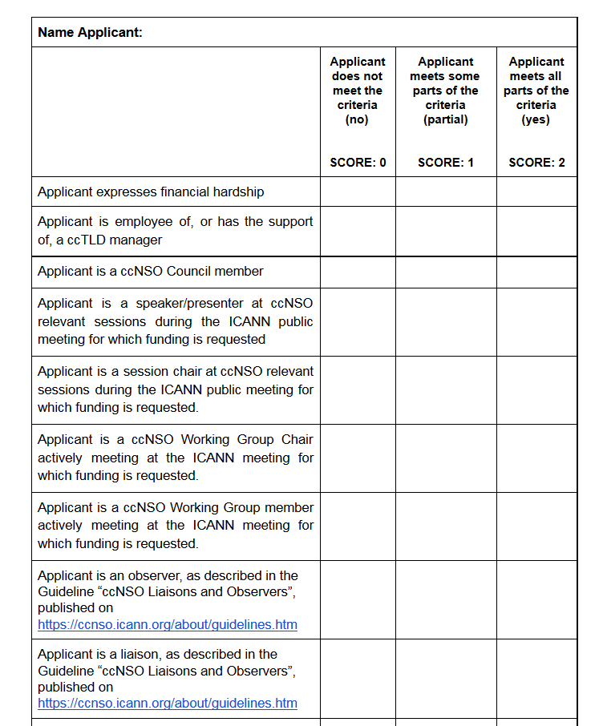
Travel Funding Criteria
Let’s test!

Slide 4
Abu Dhabi > San Juan
Document Type | Document Title
Guideline: | ccNSO Council Roles and Responsibilities
Guideline: | ccNSO Nominations Process ICANN Board seats 11 and 12
Guideline: | Customer Standing Committee Charter Review Procedure
Guideline: | Procedure for Exercise of Empowered Community’s Rights to Reject Specified Actions
Guideline: | ccNSO Procedure for Participating in IRP Administrative and Process Matters
Guideline: | ccNSO Nominations to Specific Review Teams
Update
Update
New
Update

Slide 5
Operating Standards
Draft version published in October 2017
GRC reviews and discusses the draft
Changes to Guideline: ccNSO Nominations to Specific Review Teams
Cross-community session on Monday, October 30

Slide 6

Preparations for ccNSO Review

Slide 7
Thank you!

