Slide 1


Rejection Actions
What are they and
what are we supposed to do?
27 – 28 June 2017, Johannesburg
Notes:
Who, what, why, when and how?

Slide 2

ICANN Bylaws...

Slide 3


Slide 4
Empowered Community
GNSO
GAC
GNSO
ccNSO
ASO
ALAC
Decisional Participants

Slide 5
Right to Reject Specified Actions
Actions
PTI Governance Actions
IFR Recommendation Decisions
Special IFR Recommendation Decisions
SCWG Creation Decisions
SCWG Recommendation Decisions
ICANN Budgets
IANA Budgets
Operating Plans
Strategic Plans
Standard Bylaw Amendments

Slide 6
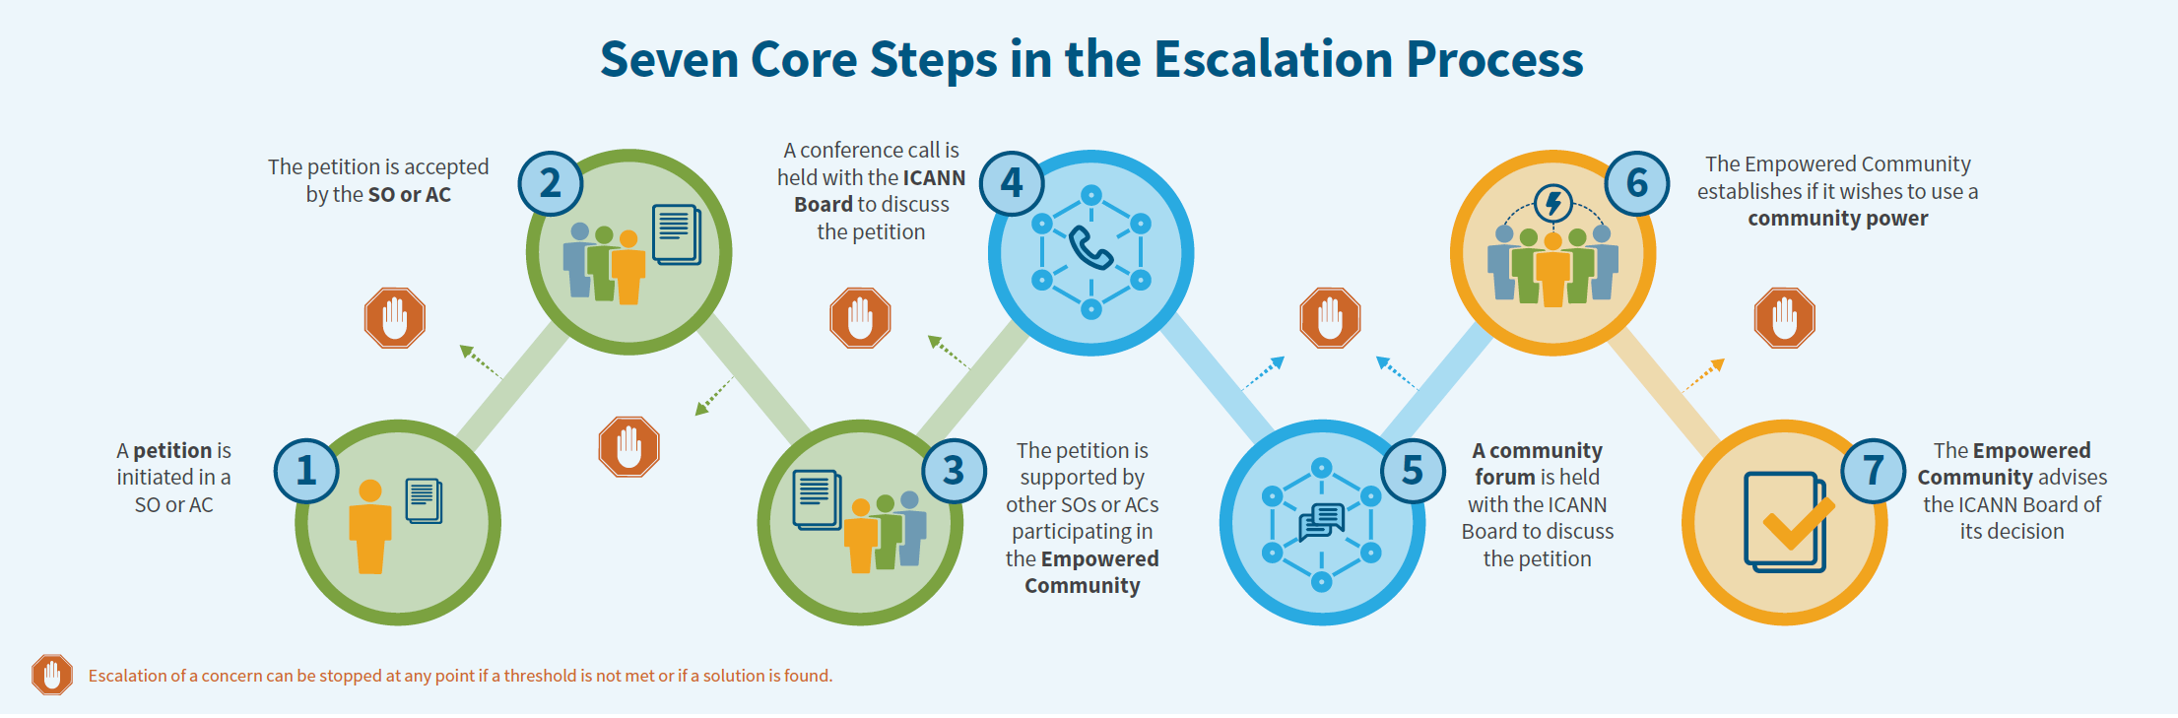
Start
40 day public comment period
Report
BoD decision
ECA notified
ccNSO gets involved ...
https://www.icann.org/empowered_community_powers_file_download?file_name=download_english
Notes:
Needs to include action for rejection (by Board)

Slide 7
ccNSO has the opportunity to submit a petition – 21 days
Other DP submits a petition – 7 days
ccNSO receives a petition(s) from a ccTLD(s)
NO support from Council
Council supports
the petition
Council rejects
petition
Council accepts
petition
10 % of ccNSO members call for ratification
No time for ratification call
ccNSO members vote too late: no decision
Notes:
Ccnso may need to have rules and procedures in place to reject or accept a petition. Question: what would be impact if someone petitions the ccNSO with respect to the upcoming budget? Requirements for budget etc. Petition needs to refer to issues rasied before during public comment,
Who may submit rejection petition? WG? ccTLD amanger, individual from ccTLD manager, others (members and non-members?) Rules section 6.1 (g)

Slide 8
ccNSO involvement in
Community Forum
ccNSO Council
ccTLD community
Inform ccTLD community
Solicit views from ccTLDs
Submit views from ccTLDs
Participate in discussions
Share their views
Submit comments to ccNSO Council
Contribute to Community Forum

Slide 9
Potential ccNSO Decision during
Rejection Action Community Forum
ccNSO Decision during
Community Forum period
ccNSO Council decision on retraction
Members role
ccNSO Council rejects
the action
ccNSO Council no decision
10 % Members ask ratify within relevant period
No decision? Consultation?
Notes:
Ccnso may need to have rules and procedures in place to reject or accept a petition during or realted to Community Forum. Specific situation 2.3. (h) Could be very meaningful as aligns with Community Forum

Slide 10
Final ccNSO Rejection Decision
ccNSO Decision on
Rejection Action
ccNSO Council decision
21 Days
ccNSO Council rejects/abstains
the action
to support the Action
ccNSO members
17 members ask to ratify, 1 week after publication
Consultation? ccNSO abstains
(post deadline)
Notes:
In case of Budget, Ops plan or Strategic Plan Bylaws do not allow for defer Community Forum ( see section 2.3 )

