Slide 1


Guidelines Review Committee
Update
27-28 June 2017, Johannesburg

Slide 2
Copenhagen > Johannesburg
Document Type | Document Title
Guideline: | Procedure for Exercise of Empowered Community’s Rights to Approve Specified Actions
Guideline: | ccNSO Council Elections
Guideline: | ccNSO Travel Funding
Guideline: | Procedure for Exercise of Empowered Community’s Rights to Reject Specified Actions
Guideline: | Roles and Responsibilities
New
Updated
In progress
In progress
In progress

Slide 3
Approval Actions
Fundamental Bylaw Amendments
Articles Amendments
Asset Sales

Slide 4
Approval Actions Guideline
Defines the role of the Approval Action Manager
Describes procedures relating to Approval Action
  Communication
  Consultation mechanism
  Council decision taking mechanism

Slide 5
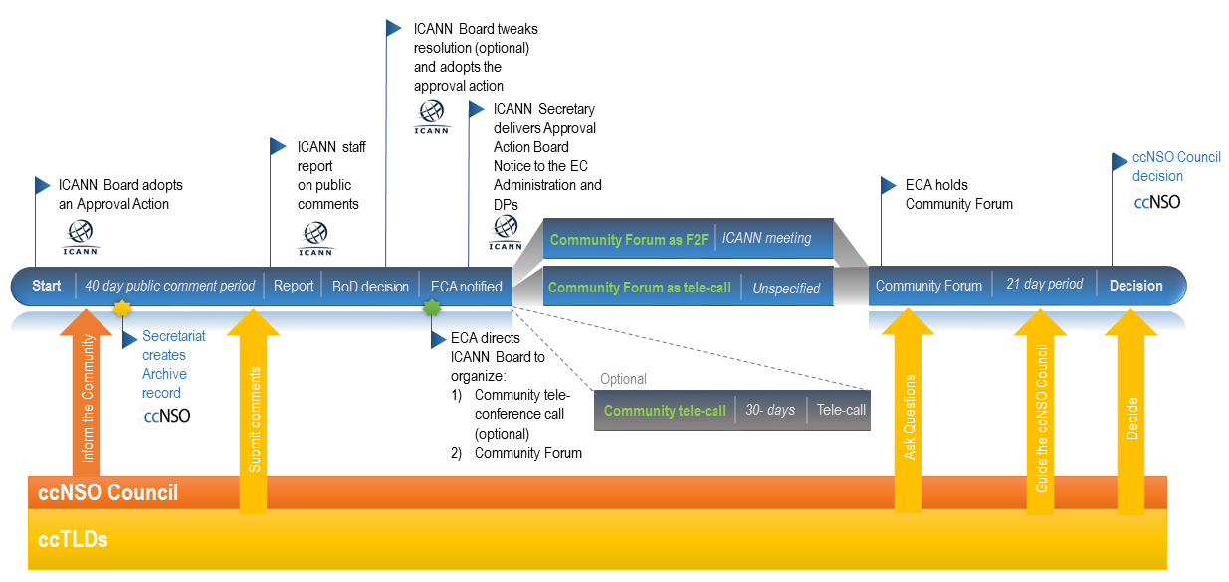
Approval Actions

Slide 6


Slide 7
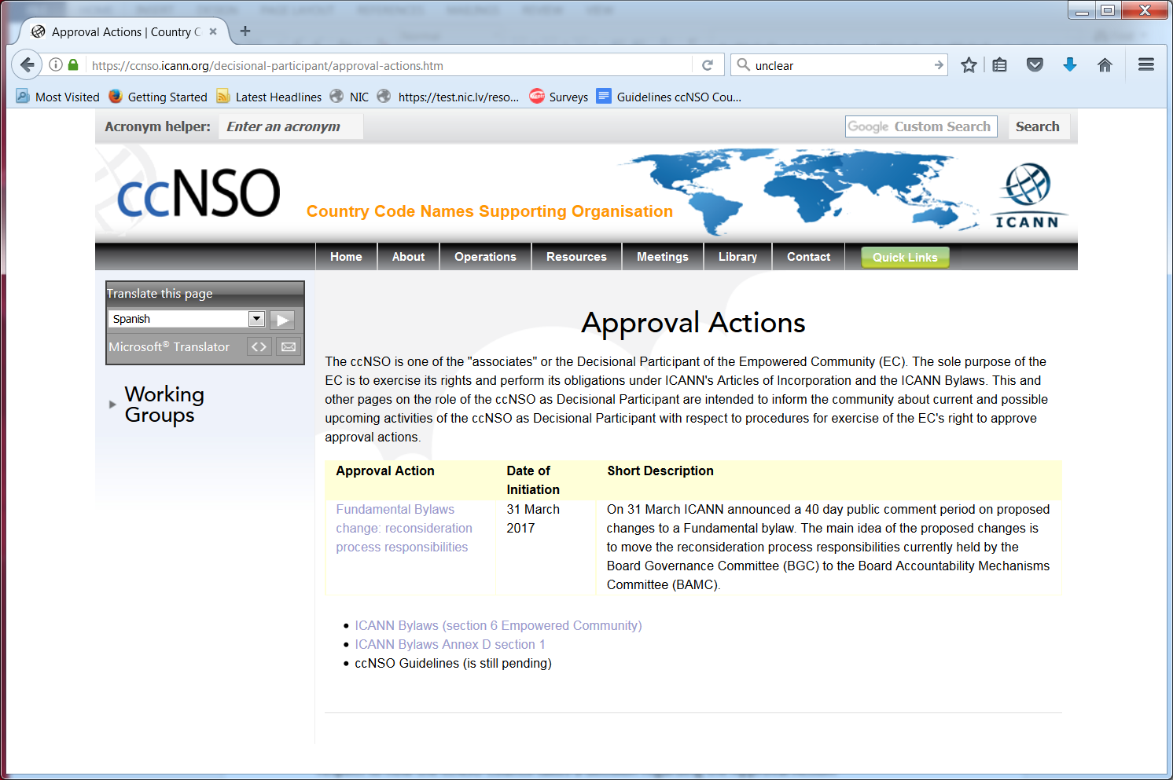

Slide 8
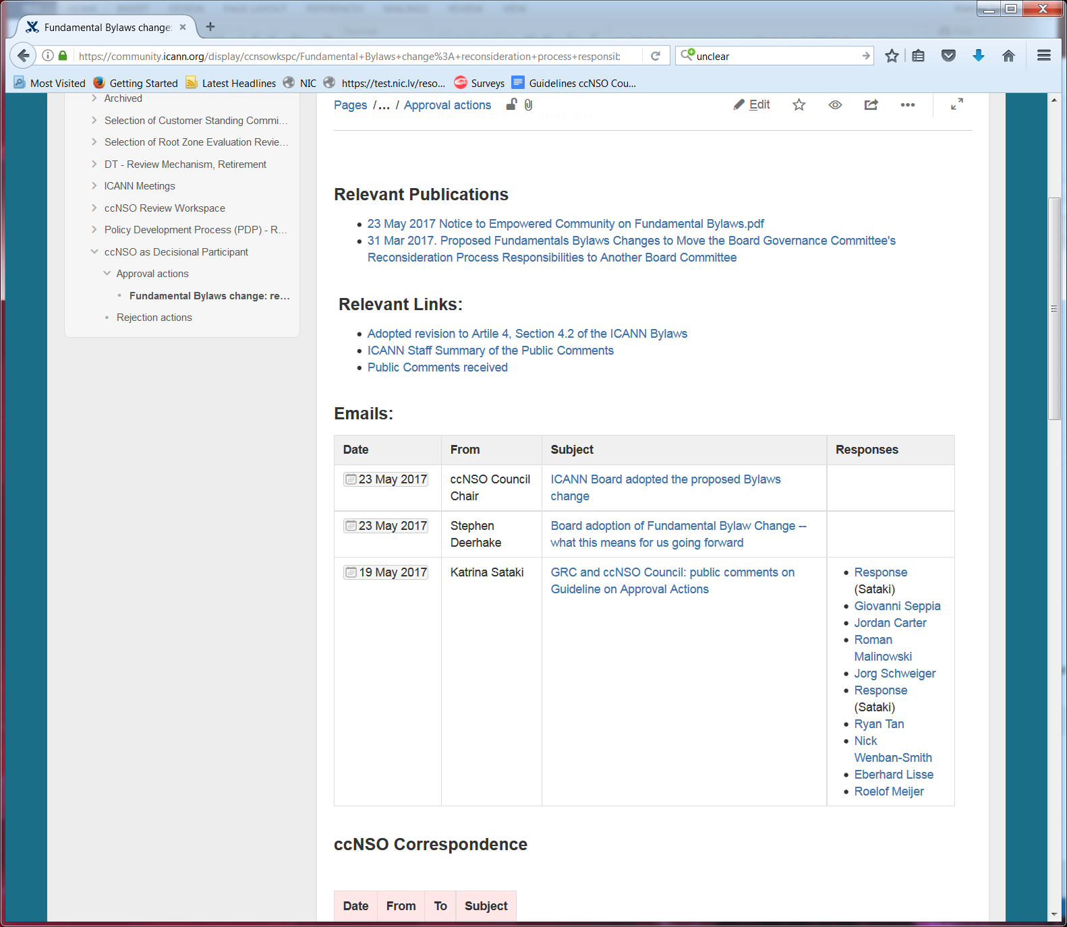

Slide 9
Approval Actions

Slide 10
Approval Actions: Final Stage
Issue (Approval Action)
21 days
Decision

Slide 11
Full ccNSO Process
ccNSO discusses the issue
ccNSO Council is asked to vote
ccNSO members can start objecting
ccNSO members vote
If less than 50% vote, a second vote will commence
Issue
Discussions
Resolution
7 + 5 days
Decision published
7 days
Proposal
5 + 14 days
Decision/ Second vote
14 + 14 days
Decision
Worst scenario: 66 days*
* Does not include time for discussions/consultations

Slide 12
66 ≠ 21
ccNSO discusses the issue
ccNSO Council is asked to vote
ccNSO members can start objecting
ccNSO members vote
If less than 50% vote, a second vote will commence
Issue
Discussions
Resolution
7 + 5 days
Decision published
7 days
Proposal
5 + 14 days
Decision/ Second vote
14 + 14 days
Decision
?
Issue (Approval Action)
21 days
Decision

Slide 13
Stages of the ccNSO Process
Issue
Discussions
Resolution
7 + 5 days
Decision published
7 days
Proposal
5 + 14 days
Decision/ Second vote
14 + 14 days
Decision
Consultations
Council decision
Community
objection
Members vote
First round, quorum requirement
Second round (if needed)

Slide 14
Alternative 1
Issue
Discussions
Resolution
7 + 5 days
Decision published
7 days
Proposal
5 + 14 days
Decision/ Second vote
14 + 14 days
Decision
Consultations
Council decision
Community
objection
Members vote
First round, quorum requirement
Second round (if needed)
Issue
Community discussions – 12 days + 7 days
ccNSO Council Decision

Slide 15
Alternative 2
Issue
Discussions
Resolution
7 + 5 days
Decision published
7 days
Proposal
5 + 14 days
Decision/ Second vote
14 + 14 days
Decision
Consultations
Council decision
Community
objection
Members vote
First round, quorum requirement
Second round (if needed)
Issue
Discussions 5 days + 7 days
ccNSO Council decision
7 days
Decision

Slide 16
Which Alternative do you prefer?

Slide 17
Thank you!

