Slide 1
AT-Large Captioning Pilot Project II
WS2 Diversity Meeting #9 | 13 January 2017

Slide 2

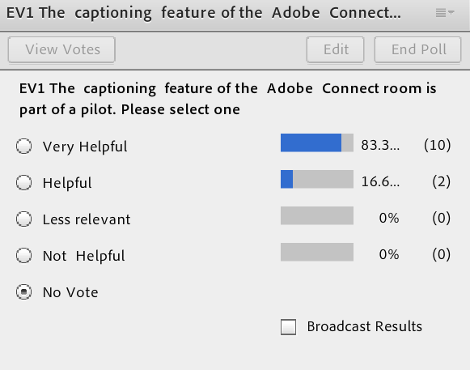
Question 1
Notes:
Use this slide for diagrams or other graphic elements.

Slide 3
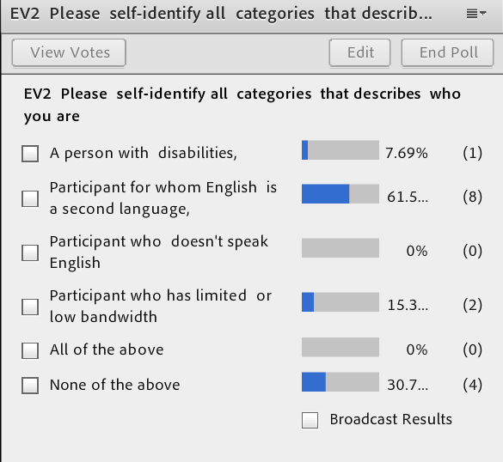
Question 2
Notes:
Use this slide for diagrams or other graphic elements.

Slide 4
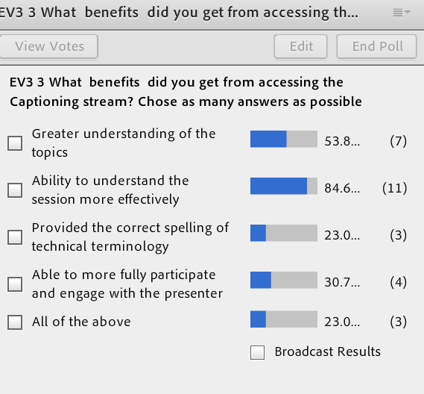
Question 3
Notes:
Use this slide for diagrams or other graphic elements.

Slide 5
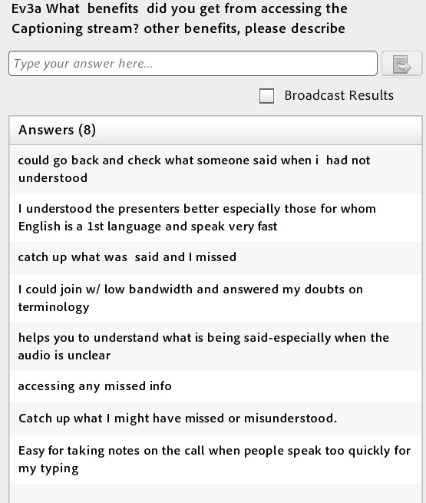
Question 3a
Notes:
Use this slide for diagrams or other graphic elements.

Slide 6
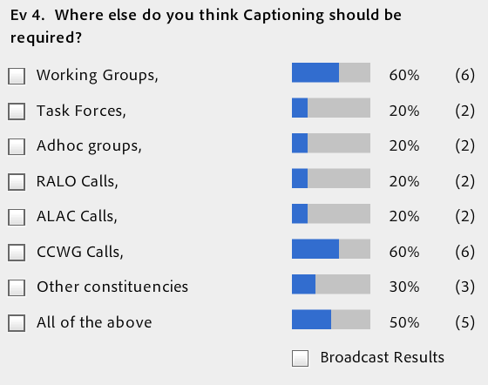
Question 4
Notes:
Use this slide for diagrams or other graphic elements.

Slide 7
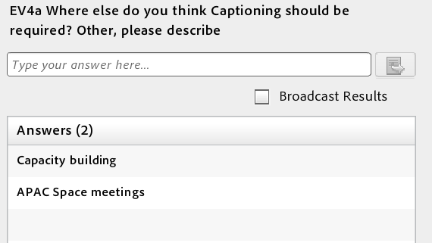
Question 4a
Notes:
Use this slide for diagrams or other graphic elements.

Slide 8
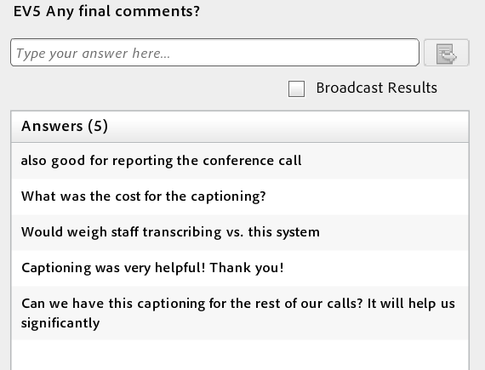
Question 5
Notes:
Use this slide for diagrams or other graphic elements.

