Slide 1
8th Capacity Building Webinar - 2017
Update on WHOIS-related Initiatives :
Next Generation Registration Services and its impact on end –users
Holly Raiche | 04 October 2017 | 21:00 UTC

Slide 2
At-Large:
Representing the Interest of Internet Users

Slide 3
ICANN Bylaws
12.2(d)(i) The role of the ALAC shall be to consider and provide advice on the activities of ICANN, insofar as they relate to the interests of individual Internet users. This includes policies created through ICANN's Supporting Organizations, as well as the many other issues for which community input and advice is appropriate.

Slide 4
Today’s Agenda
1
2
3
What is the Policy Development Process?
How does the ALAC write Policy Statements?
What topics are particularly interesting to End Users?
4
5
6
Current Policy Processes of importance to End Users
Calling on
YOU
Questions
Notes:
This is a stylized agenda slide for your presentation.
To delete a box, if there are too many boxes, click the edge of the box, ensure the entire box is highlighted, then DELETE.
To update the numbers and text, click inside the circle for the numbers or in the box for the text, revise the text.

Slide 5
#1: What is the Policy Development Process?
Notes:
Breakup your presentation, divide it into sections. This is especially useful if most of your presentation is text.

Slide 6
What is the Policy Development Process?
Development of Policy relating to ICANN’s mission
Takes place in an ICANN Supporting Organisation (SO):
  Address Supporting Organisation (ASO)
    Mostly done within the Regional Internet Registries (AFRINIC, APNIC, ARIN, LACNIC, RIPE)
  Country Code Names Supporting Organisation (ccNSO)
    Mostly done at Country Code / Country Registry level
  Generic Name Supporting Organisation (GNSO)
    Done in GNSO working groups
      Policy Development Process (PDP) working groups
Notes:
Use this slide for diagrams or other graphic elements.

Slide 7
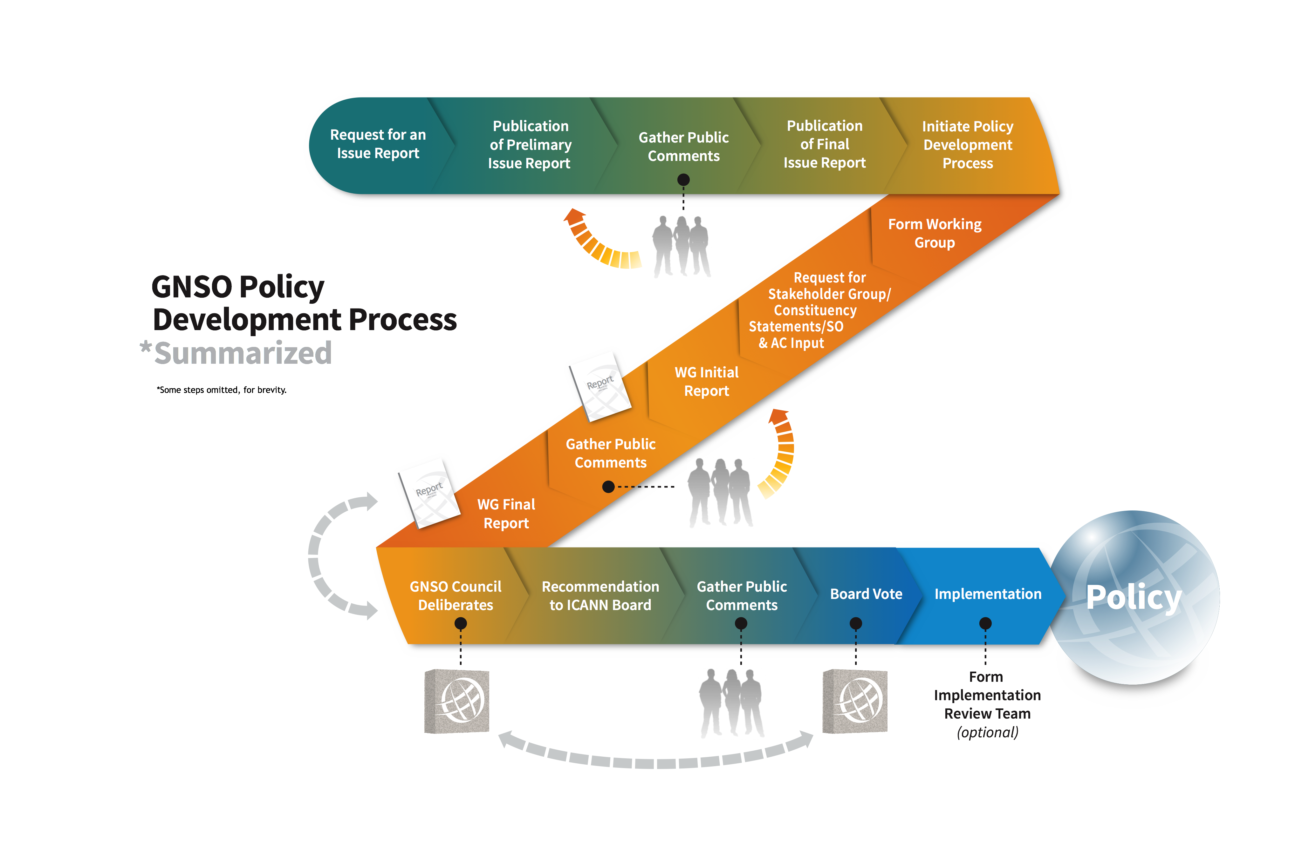
GNSO Council – the Manager of the PDP

Slide 8
PDP Requirements
Process prescribed by Bylaws, PDP Manual and Working Group (WG) Guidelines:
Must formally seek opinions from other ICANN Advisory Committees and Supporting Organizations, and statements from GNSO Stakeholder Groups and Constituencies, at early stage of the PDP
Specific roles for WG chair(s) and members in WG Guidelines – consensus-building emphasized
Publication of Initial Report for public comment
WG must review comments in preparing Final Report
Final Report – including consensus levels for each recommendation - delivered to GNSO Council

Slide 9

WGs use a Standard Methodology for Decision-Making
There are specific designations for WGs to indicate support for policy recommendations
Chair is responsible for determining level of support – an iterative process
Current designations:
  Full consensus
  Consensus
  Strong support but significant opposition
  Divergence
  Minority view

Slide 10
#2: How does the ALAC write Policy Statements?
Notes:
Breakup your presentation, divide it into sections. This is especially useful if most of your presentation is text.

Slide 11
How does the ALAC write Policy Statements?
ICANN Public Comment Page:
http://www.icann.org/public-comments
At-Large Policy Advice Development Page:
https://community.icann.org/x/bwFO
• A web-based platform for collaborative work
• Duplicate the content from ICANN Public Comment pages
• Present the internal timeline for developing ALAC responses, their
drafters
• Publish initial draft, final draft, and submitted ALAC responses
• Collect comments from the At-Large Community on the draft ALAC
responses
Notes:
Use this slide for diagrams or other graphic elements.

Slide 12
How does the ALAC respond?
Notes:
Use this slide for diagrams or other graphic elements.

Slide 13
#3: What topics are particularly interesting to end users?
(Extracted from The Document on: https://atlarge.icann.org/advice_statements/9895 )
Notes:
Breakup your presentation, divide it into sections. This is especially useful if most of your presentation is text.

Slide 14
Policy Topic: New Generic Top Level Domains (gTLDs)
o A TLD is the rightmost label starting from the last dot in a web address (e.g. .com, .net, .biz).
The domain namespace originally had eight TLDs. In 2000, seven new TLDs were introduced,
and in 2004, eight more were made available. In 2012, ICANN launched the New gTLD
Program which resulted in the massive expansion of the domain namespace. As of today,
more than 1,000 new gTLDs have been delegated to the root zone.
Why should end users care?
o New gTLDs offer greater flexibility for individual registrants to create memorable, innovative names for their websites. They also ease the overcrowding in the legacy gTLD domain market.
o As New gTLDs open up opportunities for new Registries and Registrars to enter the domain name industry, individual registrants have more choices when purchasing services.
o New gTLDs also could cause widespread confusion, as users may have to learn the new
addresses of websites that they are using.
o In addition, users may be exposed to fraud, counterfeiting, and identity theft when criminals take advantage of this confusion to create hostile sites with new gTLDs.
Notes:
Use this slide for diagrams or other graphic elements.

Slide 15
Policy Topic: WHOIS / Registration Directory Services (RDS)
o Every year, millions of individuals, businesses, organizations and governments register
domain names. Each one must provide identifying and contact information which may
include: name, address, email, phone number, and administrative and technical contacts.
This information is often referred to as “WHOIS data.”
o WHOIS service is not a single, centrally-operated database. Instead, the data is managed by
independent entities known as registrars and registries. Any entity that wants to become a
registrar must earn ICANN accreditation.
o WHOIS data is key for fixing system problems, maintaining Internet stability, and enhancing
the accountability of registrants.
Why should end users care?
o The “one-size-fits-all” disclosure of identifying information may also expose registrants,
especially individual registrants, to potential spam, phishing, and identity theft.
o Due to its implication in privacy, data protection, policing, security, and malicious use and
abuse, WHOIS matters to end users, especially individual registrants.
Notes:
Use this slide for diagrams or other graphic elements.

Slide 16
Policy Topic: Contracted Party Agreements
(i.e. Registry Agreement, Registrar Accreditation Agreement)
o A registry operator of a top-level domain (TLD) must enter a contract (i.e. Registry
Agreement - RA) with ICANN in order to operate and maintain a generic TLD (gTLD).
o Registrars that offer domain name registration services with a direct access to TLD registries
are also required to obtain accreditation from ICANN (i.e. Registrar Accreditation
Agreement - RAA).
o ICANN’s Contractual Compliance Department ensures registries and registrars are in
compliance with those agreements.
o The RA and RAA are also subject to changes by consensus policy developed through the
Generic Names Supporting Organization (GNSO)’s bottom-up, consensus-based Policy
Development Process (PDP).
Why should end users care?
o Policy changes to the RA and RAA directly affect individual registrants’ rights, obligations,
and overall experiences using the domain name registration services.
o As contracted party agreements are critical to the security and stability of the domain name
system and have implications to the public interest, they also affect end users who do not
have domain registrations.
o Individual registrants and end users can contribute to shaping contracted party agreements,
specifically the RAA, through GNSO processes.
Notes:
Use this slide for diagrams or other graphic elements.

Slide 17
Policy Topic: Internationalized Domain Names (IDNs)
o IDNs give users around the world the ability to access the web in their native tongue,
making it easier for them to discover/remember websites and promote local content via
service providers likely in their own countries.
o It is expected that IDNs will increase the Internet penetration in emerging economies of
Asia Pacific, Africa, and Latin America where English is not the primary language.
o Due to the lack of universal acceptance, using IDNs can be challenging across browsers,
emails, and mobile apps.
Why should end users care?
o ICANN’s work on the universal acceptance, Label Generation Rules, and other key IDN
issues will ultimately improve user experience, increasing the IDN uptake and making the
Internet truly multilingual.
http://افغانستا.example http://österreich.example
http://বাংলাদেশ.example http://беларусь.example
http://中国.example http://ελλάδα.example
http://இலங்கை.example
Notes:
Use this slide for diagrams or other graphic elements.

Slide 18
Policy Topic: The Public Interest
o Discussions on the topic of “public interest within ICANN’s remit” have been going on for
years within the ICANN Community. Some community members are advocating to devise
mechanisms that will more effectively address the public interest.
o The Public Interest is a key topic of the At-Large Community. It has established a Public
Interest Working Group. In particular, the European Regional At-Large Organization
(EURALO) has advocated for related principles such as Open Access, Free Software, and
Creative Commons since its inception.
o One sub-topic that At-Large cares deeply about is the Public Interest Commitments (PICs),
especially pertaining to the Category 1 TLDs related to sensitive strings as defined by the
GAC, such as .doctor and .bank.
Why should end users care?
o The Internet has become a critical part of the global public sphere. As the influence of
commercial interests and state powers has been increasing, stakeholders need to work
together and form a comprehensive vision on the Internet that addresses the protection of
civil liberties, such as free speech and privacy.
Notes:
Use this slide for diagrams or other graphic elements.

Slide 19
#4: Calling on YOU
Notes:
Breakup your presentation, divide it into sections. This is especially useful if most of your presentation is text.

Slide 20
What we do
Statements & Advice
Participation

Slide 21
Ways to participate
Join a GNSO, ccNSO, Cross-Community WG
Join an At-Large WG that shadows non-At-Large groups
  ICANN Evolution, gTLD, Registration Issues
Draft Statements for ALAC Consideration
  Join a drafting group
Comment on draft statements

Slide 22
How to get up to speed!
Attend targeted webinars
Attend pre-ICANN meeting briefings
ICANN meetings often have sessions reviewing WG activities and all have remote participation
Join a group and just listen
Read regular monthly briefings that ICANN distributes
And coming soon….

Slide 23
New Policy Briefings documents
Aimed specifically at At-Large members
Intent is to be understandable
  Presumes minimal prior knowledge
  Multiple languages

Slide 24
It is only with wide contributions that we can be sure we are representing the needs of Internet Users

Slide 25
Current Policy Processes of importance to End Users
Notes:
Breakup your presentation, divide it into sections. This is especially useful if most of your presentation is text.

Slide 26
Current Policy Advice Development
Policy Advice Currently being drafted:
Policy Advice Development Page: https://community.icann.org/x/bwFO
Already Submitted Policy Advice:
At-Large Website: https://atlarge.icann.org/policy-summary
Notes:
Use this slide for diagrams or other graphic elements.

Slide 27
Summary of what we have covered today
Policy Development Process at ICANN
GNSO Open to All.
End Users - YOU are encouraged
1
1
ALAC Writes Policy Statements
YOU can write and comment
2
2
Many Topics affect End Users directly
YOU can influence Global Policy directly
3
3
Notes:
Summarize the three main points of your presentation here.

Slide 28
Questions? Comments?
Notes:
Breakup your presentation, divide it into sections. This is especially useful if most of your presentation is text.

Slide 29




Thank You and Questions
Reach us at:
Email: staff@atlarge.icann.org
Website: atlarge.icann.org
twitter.com/icannatlarge
facebook.com/icannatlarge
youtube.com/user/icannatlarge
flickr.com/photos/icannatlarge
Notes:
You can adjust the email/web address to whichever email or web address is best suited to your presentation. This should be your final slide.

