Slide 1



Slide 2
RDS PDP: Project Timeline & Major Milestones
Next Steps:
Second Initial Report (Phase 1)
Final Report (Phase 1)
If a next-gen RDS is needed:
Phase 2 (Policy Development)
Phase 3 (Implementation and Coexistence Guidance)
Apr 2015
Board Resolution
Nov 2015
Charter Approval
Jan 2016
Phase 1 WG Formed
Jun 2016
Possible
Req’ts List
Nov 2016
Deliberation
Begins
TBD 2017
First Initial
Report (P1)
WHAT THIS PROJECT IS ABOUT
In April 2015, the ICANN Board reaffirmed ‘its request for a Board-initiated GNSO policy development process to define the purpose of collecting, maintaining and providing access to generic top-level domain (gTLD) registration data, and consider safeguards for protecting data, using the recommendations in the Expert Working Group (EWG) Final Report as an input to, and, if appropriate, as the foundation for a new gTLD policy’.
Following publication of the PDP Final Issue Report, the GNSO Council adopted the charter for the PDP WG, which commenced its deliberations at the end of January 2016. During the first phase its work, the WG has been tasked with providing the GNSO Council with recommendations on the following two questions:
1) What are the fundamental requirements for gTLD registration data?
2) Is a new policy framework and next-generation registration directory services (RDS) needed to address these requirements?

Slide 3
What are the current challenges & issues under discussion?
Issues now under discussion: Phase 1 deliberation on Fundamental Requirements for 3 charter questions:
  Users/Purposes: Who should have access to gTLD registration data and why?
  Data Elements: What data should be collected, stored, and disclosed?
  Privacy: What steps are needed to protect data and privacy?
Initial points of rough consensus reached since ICANN57 are reflected in our working document
Current challenges include burnout, complexity, duration, and conflicting views
  When agreeing upon individual requirements proved difficult, we refocused on “Key Concepts”
  To find common ground, we narrowed the focus of initial deliberation to “thin data” and collection

Slide 4
How can the GNSO Council & ICANN community assist?
At ICANN58, sessions with data commissioners may help us better understand key data protection and privacy concepts, so that our WG can apply them to registration data & directory services.
As Key Concepts are identified by our WG, we are using polls to confirm rough consensus & identify next steps. GNSO SGs/Cs and ACs/SOs can assist by encouraging their members who participate in this PDP to participate in meetings and polls, keep an open mind, listen to each other, and be willing to consider compromises.
When this WG posts its First Initial Report for public comment, GNSO SGs/Cs and ACs/SOs can assist by providing robust feedback on WG-identified possible requirements pertaining to RDS Purpose, Data Elements, and Privacy.

Slide 5
Sessions at ICANN58 and Further Information
Open Working Group meeting/community sessions:
Saturday 11 March 13:45 CET: http://sched.co/9npN and
Wednesday 15 March 13:45 CET: http://sched.co/9npc
Background information:
Background Docs: https://community.icann.org/x/QIxlAw
Phase 1 Docs: https://community.icann.org/x/p4xlAw
ICANN58 Background Briefing Paper:
http://gnso.icann.org/en/issues/policy-briefing-next-gen-rds-27feb17-en.pdf
Working Group Charter:
https://community.icann.org/x/E4xlAw
Working Group online wiki space (with meeting transcripts, call recordings, draft documents and background materials):
https://community.icann.org/x/rjJ-Ag

Slide 6
Additional Slides

Slide 7
Initial points of rough consensus (iterative deliberation on-going)
Should gTLD registration thin data elements be accessible for any purpose or only for specific purposes?
    The WG should continue deliberation on the purpose(s) of "thin data."
    Every "thin data" element should have at least one legitimate purpose.
    Every existing "thin data" element does have at least one legitimate purpose for collection.
For what specific (legitimate) purposes should gTLD registration thin data elements be collected?
    EWG-identified purposes apply to at least one "thin data" element.
    Domain name control is a legitimate purpose for “thin data” collection.
    Technical Issue Resolution is a legitimate purpose for “thin data” collection.
    Domain Name Certification is a legitimate purpose for "thin data" collection.
    Business Domain Name Purchase or Sale is a legitimate purpose for "thin data" collection.
    Academic / Public Interest DNS Research is a legitimate purpose for "thin data" collection.
    Regulatory and Contractual Enforcement is a legitimate purpose for "thin data" collection.
    Criminal Investigation & DNS Abuse Mitigation is a legitimate purpose for "thin data" collection.
    Legal Actions is a legitimate purpose for "thin data" collection.
    Individual Internet Use is a legitimate purpose for "thin data" collection.

Slide 8
Initial points of rough consensus (iterative deliberation on-going)
For thin data only -- Do existing gTLD registration directory services policies sufficiently address
compliance with applicable data protection, privacy, and free speech laws within each jurisdiction?
    Existing gTLD RDS policies do NOT sufficiently address compliance with applicable data protection, privacy, and free speech laws about purpose.
    As a WG, we need to agree upon a purpose statement for the RDS.
What should the over-arching purpose be of collecting, maintaining, and providing access to gTLD registration (thin) data?
    A purpose of gTLD registration data is to provide info about the lifecycle of a domain name.
    A purpose of RDS is to identify domain contacts and facilitate communication with domain contacts associated with gTLDs, [based on approved policy]
    A purpose of gTLD registration data is to provide a record of domain name registrations
    A purpose of RDS policy is to facilitate the accuracy of gTLD registration data

Slide 9
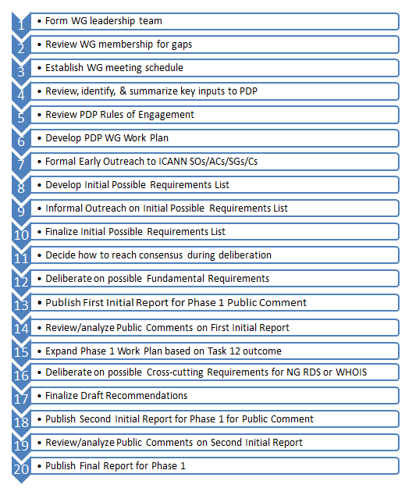
Phase 1 Workplan
Currently, we are working on Task 12) Deliberating on Fundamental Requirements for:
  Users/Purposes
  Data Elements
  Privacy
  Gated Access
  Data Accuracy
Our First Initial Report will be published in Task 13), attempting to
answer the Foundational Question:
  "Is a new next-gen RDS needed or can the existing WHOIS system be modified to satisfy fundamental requirements?”

Slide 10
Phase 1 approach to reach consensus
UP
FQ Foundational Question
OQ Other Questions
UP Users/Purposes
GA Gated Access
DA Data Accuracy
DE Data Elements
PR Privacy
CX Coexistence
CM Compliance
SM System Model
CS Cost
BE Benefits
RI Risks
DE
PR
12e
13
First Initial Report
14
FQ
Public Comment
12a&b
GA
DA
15-16
CX
OQ
CM
12c&d
SM
18
Second
Initial Report
19
CS
Public Comment
BE
20
Consensus
Final Report
Phase 1
RI
Rough Informal Consensus
Formal Consensus per Charter IV
Task #s are taken from Work Plan @ https://community.icann.org/x/oIxlAw

