Slide 1
IANA Stewardship Transition &
Enhancing ICANN Accountability
Jia-Rong Low, Sr Director, GSE Asia | APRALO-APAC Hub Webinar
24 November 2015

Slide 2
The U.S. Government’s Announcement
14 March 2014: U.S. Government announces intent to transition its stewardship of the IANA functions to the global multistakeholder community
  Asked ICANN to convene global stakeholders to develop a proposal
  The multistakeholder community has set policies implemented by ICANN for more than 15 years
The U.S. Government’s announcement:
Marks the final phase of the privatization of the DNS
Further supports and enhances the multistakeholder model of Internet policy making and governance
ICANN was asked to serve as a facilitator, based on its role as the IANA functions administrator and global coordinator for the Internet’s Domain Name System (DNS)
Why
now?

Slide 3
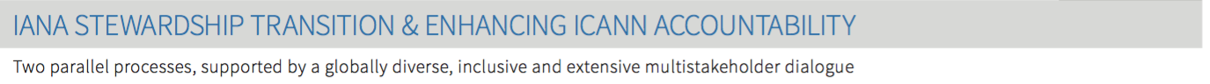
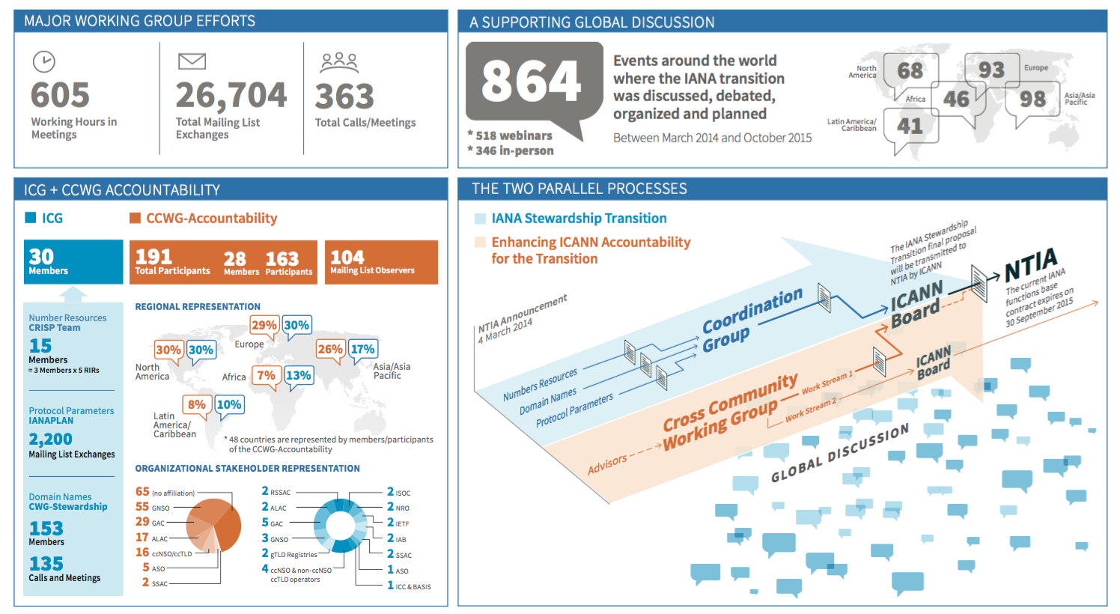
19 months since…

Slide 4

The Two Parallel Processes – Dublin centre stage
IANA Stewardship Transition
Focused on delivering a proposal to transition the stewardship of the IANA functions to the multistakeholder community
IANA Stewardship Transition Coordination Group (ICG)
Enhancing ICANN Accountability
Focused on ensuring that ICANN remains accountable in the absence of its historical contractual relationship with the U.S. Government
Cross-Community Working Group on Enhancing ICANN Accountability (CCWG-Accountability)

Slide 5
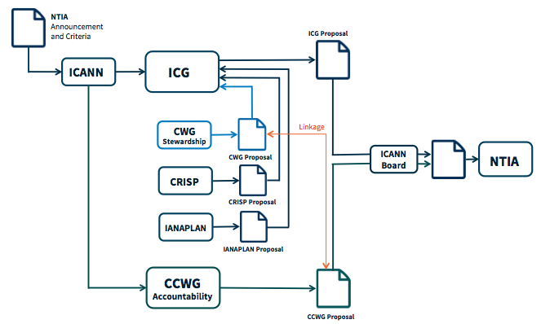
ICG…
Public Comment period – 31 July to 8 Sep
The ICG finalized its work at ICANN54 in Dublin
The group awaits confirmation from CWG-Stewardship that its requirements have been met by the CCWG-Accountability
Full announcement and final report on: https://www.icann.org/news/announcement-2015-10-29-en
Currently discussing need for implementation related work, if any

Slide 6
Combined Proposal Overview

Slide 7
CCWG-Accountability
Public Comment period – 3 August to 12 September
15 November – 36 page formal update released: https://www.icann.org/news/blog/ccwg-accountability-issues-formal-update-on-progress-made-in-and-after-icann54-in-dublin
3rd Draft Proposal on Work Stream 1 to be shared for public comment: 30 Nov to 21 Dec
21
Europe
29
North America
13
Asia Pacific &
Oceania
Work Stream 1
Focused on mechanisms enhancing ICANN accountability that must be in place or committed to within the time frame of the IANA Stewardship Transition
2
Africa
5
Latin America &
Caribbean
Work Stream 2
Focused on addressing accountability topics for which a timeline for developing solutions and full implementation may extend beyond the IANA Stewardship Transition
13
International
Includes ICANN SO/AC, Constituencies, etc.

Slide 8
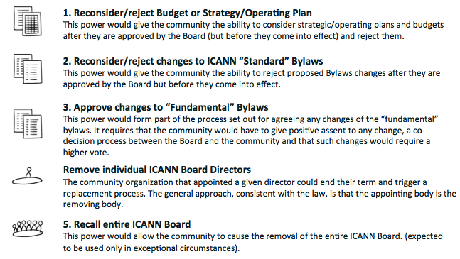
36-page Formal Update - Highlights
12 Findings and Recommendations
Summary of key elements:
Revised Mission Statement
Enhanced Independent Review Process
New specific powers, including:
Exercised through
processes of engagement
and escalation
+ Give community a say in decisions about the IANA Function Reviews and any separation of the IANA Names Functions
Notes:
A summary of key decisions and agreed-upon next steps are outlined below:
Sole Designator as Reference for Enforcement
The group reached broad agreement to move forward with the Sole Designator as the new reference enforcement model for the next draft proposal. The group will next attempt to finalize "patching" the model to alleviate any outstanding concerns on their next draft proposal.
Decision-Making Model
The group begun defining a consensus based decision-making model, which includes a community consultation period. Discussions on the topic were informed by concerns raised in the Public Comment on the 2nd Draft Report about unintended concentrations of power.
Independent Review Process
The group confirmed support for the proposed IRP enhancements, and is now moving into the implementation phase. To spearhead this phase, a drafting sub-group with expert support will be constructed to develop and draft bylaws and detailed operating procedures.
Community Power: Review/Reject Budget and Operating Plan
The group has identified a balanced process and approach for the One-Year Operating Plan and Budget, which was an outstanding item coming into Dublin.
Community Power: Recall Individual Board Directors
The group confirmed a decision method for removal of a director appointed by the Nominating Committee, and a separate decision method for removal of a director appointed by an Advisory Committee or Supporting Organization.
Mission and Core Values
The group confirmed its support for a clarification of the Mission Statement and articulation of the Commitments and Core Values. An example of a clarification includes ICANN's ability to enforce agreements with contracted parties, subject to reasonable checks and balances.
Human Rights
The group reached consensus to include a general human rights commitment into the Bylaws. However, further work is needed on language and has been tasked to the Human Rights Working Party.
Incorporation of the Affirmation of Commitments into the Bylaws
The group finalized outstanding details of the incorporation of the Affirmation of Commitments Review into the bylaws. There is high confidence that these bylaws are nearly ready for consideration in terms of implementation.
Work Stream 2
The group adopted a focused list of Work Stream 2 items, with an emphasis on transparency requirements. There was also broad agreement to bring some of these transparency requirements into Work Stream 1 in consideration of the discussions around the Sole Designator enforcement model.

Slide 9
36-page Formal Update – Highlights (II)
Summary of key elements:
Revised Mission Statement
Enhanced Independent Review Process
New specific powers, exercised through processes of engagement and escalation
Above elements are supported through:
Empowered Community - Sole Designator as reference for enforcement
Fundamental Bylaws – include core elements of ICANN’s governing documents (Articles and Bylaws)
Notes:
A summary of key decisions and agreed-upon next steps are outlined below:
Sole Designator as Reference for Enforcement
The group reached broad agreement to move forward with the Sole Designator as the new reference enforcement model for the next draft proposal. The group will next attempt to finalize "patching" the model to alleviate any outstanding concerns on their next draft proposal.
Decision-Making Model
The group begun defining a consensus based decision-making model, which includes a community consultation period. Discussions on the topic were informed by concerns raised in the Public Comment on the 2nd Draft Report about unintended concentrations of power.
Independent Review Process
The group confirmed support for the proposed IRP enhancements, and is now moving into the implementation phase. To spearhead this phase, a drafting sub-group with expert support will be constructed to develop and draft bylaws and detailed operating procedures.
Community Power: Review/Reject Budget and Operating Plan
The group has identified a balanced process and approach for the One-Year Operating Plan and Budget, which was an outstanding item coming into Dublin.
Community Power: Recall Individual Board Directors
The group confirmed a decision method for removal of a director appointed by the Nominating Committee, and a separate decision method for removal of a director appointed by an Advisory Committee or Supporting Organization.
Mission and Core Values
The group confirmed its support for a clarification of the Mission Statement and articulation of the Commitments and Core Values. An example of a clarification includes ICANN's ability to enforce agreements with contracted parties, subject to reasonable checks and balances.
Human Rights
The group reached consensus to include a general human rights commitment into the Bylaws. However, further work is needed on language and has been tasked to the Human Rights Working Party.
Incorporation of the Affirmation of Commitments into the Bylaws
The group finalized outstanding details of the incorporation of the Affirmation of Commitments Review into the bylaws. There is high confidence that these bylaws are nearly ready for consideration in terms of implementation.
Work Stream 2
The group adopted a focused list of Work Stream 2 items, with an emphasis on transparency requirements. There was also broad agreement to bring some of these transparency requirements into Work Stream 1 in consideration of the discussions around the Sole Designator enforcement model.

Slide 10
36-page Formal Update – Highlights (III)
Other proposed changes:
A recognition of ICANN’s respect for Human Rights
Incorporation of ICANN’s commitments under the 2009 Affirmation of Commitments with the US Department of Commerce into the Bylaws, where appropriate
Improved accountability and diversity for ICANN’s Supporting Organizations and Advisory Committees
A commitment to discuss additional accountability improvements and broader accountability enhancements in 2016, following implementation of this core set of accountability improvements
Notes:
A summary of key decisions and agreed-upon next steps are outlined below:
Sole Designator as Reference for Enforcement
The group reached broad agreement to move forward with the Sole Designator as the new reference enforcement model for the next draft proposal. The group will next attempt to finalize "patching" the model to alleviate any outstanding concerns on their next draft proposal.
Decision-Making Model
The group begun defining a consensus based decision-making model, which includes a community consultation period. Discussions on the topic were informed by concerns raised in the Public Comment on the 2nd Draft Report about unintended concentrations of power.
Independent Review Process
The group confirmed support for the proposed IRP enhancements, and is now moving into the implementation phase. To spearhead this phase, a drafting sub-group with expert support will be constructed to develop and draft bylaws and detailed operating procedures.
Community Power: Review/Reject Budget and Operating Plan
The group has identified a balanced process and approach for the One-Year Operating Plan and Budget, which was an outstanding item coming into Dublin.
Community Power: Recall Individual Board Directors
The group confirmed a decision method for removal of a director appointed by the Nominating Committee, and a separate decision method for removal of a director appointed by an Advisory Committee or Supporting Organization.
Mission and Core Values
The group confirmed its support for a clarification of the Mission Statement and articulation of the Commitments and Core Values. An example of a clarification includes ICANN's ability to enforce agreements with contracted parties, subject to reasonable checks and balances.
Human Rights
The group reached consensus to include a general human rights commitment into the Bylaws. However, further work is needed on language and has been tasked to the Human Rights Working Party.
Incorporation of the Affirmation of Commitments into the Bylaws
The group finalized outstanding details of the incorporation of the Affirmation of Commitments Review into the bylaws. There is high confidence that these bylaws are nearly ready for consideration in terms of implementation.
Work Stream 2
The group adopted a focused list of Work Stream 2 items, with an emphasis on transparency requirements. There was also broad agreement to bring some of these transparency requirements into Work Stream 1 in consideration of the discussions around the Sole Designator enforcement model.

Slide 11
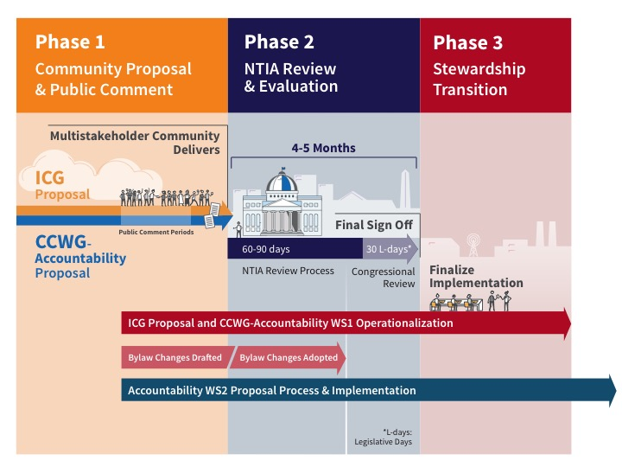
Next Steps and Timeline
30 November-21 December 2015 Public Comment.
30 Nov – 21 Dec : Public Comment period
Mid-January : Submit to ICANN Board
Notes:
Timeline and Next Steps
The CCWG-Accountability has had intensive discussions on the group's work plan, anticipated progress and next steps towards finalization. As such, the group has adjusted its timeline in a manner that attempts to balance the various timeline constraints, both inside and outside of the community. While details are still being solidified, the timeline is rigorous, and will likely keep the CCWG-Accountability busy through January. However, the co-Chairs, members and participants of the CCWG-Accountability understand the importance of and will execute an inclusive, open and bottom-up process.
The current timeline proposes posting a high-level overview of recommendations and a summary of changes from the 2nd Draft Proposal for a 35-day public comment on 15 November 2015. Alongside the 35-day public comment, the CCWG-Accountability will submit these resources to the Chartering Organizations for initial feedback. The CCWG-Accountability plans to issue a full detailed report, including annexes and in-depth documentation, mid-way into the public comment period for roughly 20 days of consultation. After synthesis of the comments received, and assuming no major changes, the group currently projects submission of Work Stream 1 Recommendations to the ICANN Board in late January 2016.

Slide 12


Questions?
Thank You and Questions
twitter.com/icann
Website: https://www.icann.org/
stewardship-accountability
facebook.com/icannorg
IANA Stewardship Transition
https://www.icann.org/stewardship
Latest news and information on the IANA Stewardship Transition and ICG
Community participation information
Resources and archives from ICG meetings
Enhancing ICANN Accountability
https://community.icann.org/category/accountability
Latest news and information on the Enhancing ICANN Accountability process and CCWG
Announcements and upcoming events

