Slide 1
Amending ICANN’s Bylaws
As a result of the IANA Stewardship Transition Proposals
Theresa Swinehart | 9 May 2016
Notes:
Background
Purpose
How to get involved
What’s the process
Next steps

Slide 2
The U.S. Government’s Announcement
14 March 2014: U.S. Government announces intent to transition its stewardship of the IANA functions to the global multistakeholder community
  Asked ICANN to convene global stakeholders to develop a proposal
  The multistakeholder community has set policies implemented by ICANN for more than 15 years
The U.S. Government’s announcement:
Marks the final phase of the privatization of the DNS
Further supports and enhances the multistakeholder model of Internet policy making and governance
ICANN was asked to serve as a facilitator, based on its role as the IANA functions administrator and global coordinator for the Internet’s Domain Name System (DNS)
Why
now?

Slide 3




Transition Requirements set by NTIA
NTIA has stated that the transition proposal must have broad community support and address the following four principles:
Support and enhance the multistakeholder model
Maintain the security, stability and resiliency of the Internet DNS
Meet the needs and expectations of the global customers and partners of the IANA services
Maintain the openness of the Internet
NTIA also specified that it will not accept a proposal that replaces the NTIA role with a government-led or intergovernmental organization solution.

Slide 4
Two Parallel Processes
The community developed and is following two parallel processes:
IANA Stewardship Transition
Focused on delivering a proposal to transition the stewardship of the IANA functions to the multistakeholder community
Enhancing ICANN Accountability
Focused on ensuring that ICANN remains accountable in the absence of its historical contractual relationship with the U.S. Government
To drive the processes, the community created multilayered, transparent and diverse working groups to foster discussion and within those groups, has developed working methods and systems for determining consensus

Slide 5
Developing Proposals
NTIA
Announcement
and Criteria
ICG Proposal
ICANN
ICG
CWG
Stewardship
Linkage
CWG Proposal
ICANN
Board
NTIA
Z
CRISP
IANA Stewardship
Transition Package
CRISP Proposal
IANAPLAN
IANAPLAN Proposal
CCWG
Accountability
CCWG Proposal
Notes:
This is a simpler agenda slide, the outline for your presentation.

Slide 6
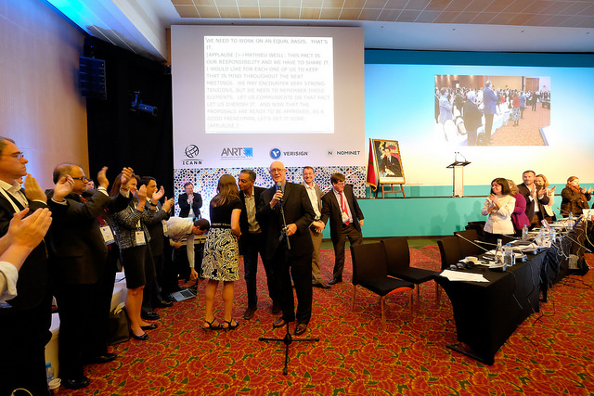

Delivery of IANA Stewardship Transition Package
At ICANN55 in Marrakech, the IANA Stewardship Transition and Enhancing ICANN Accountability proposals were submitted to the ICANN Board
After launching a short review period, the ICANN Board issued resolutions to transmit both proposals to NTIA at their Board Meeting at the end of the conference
The package of proposals was transmitted to NTIA on 10 March 2016, almost exactly 2 years after the transition was announced

Slide 7
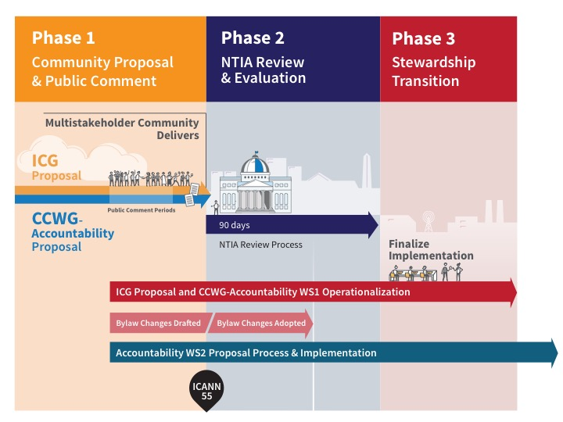
3 Phases of the Transition

Slide 8
Amending ICANN’s Bylaws
ICANN’s Bylaws are being amended to reflect the recommendations in the ICG and CCWG-Accountability proposals.
ICANN
Bylaws
The new Bylaws were drafted by:
Independent law firms hired to
assist the CWG-Stewardship
and CCWG-Accountability
ICANN’s legal team
+
With clarifications and input from
Bylaws Coordination Group
Comprised of both community and ICANN Board members, as well as with the CWG-Stewardship and the CCWG-Accountability.

Slide 9
Timeline for ICANN Bylaws Adoption
NTIA has stated that prior to their approval of the IANA Stewardship Transition proposals, any new Bylaws must be adopted by the ICANN Board.
MAR 16 |  | APR 16 |  | MAY 16 |  | JUN 16
Transmission of proposals to NTIA
NTIA issues report that conditions are met
TODAY
10
tbd
Anticipated 90-day Inter-Agency Review Process
30-day Public Comment Period
21
21
tbd
ICANN posts Bylaws for public comment
Board adopts Bylaws
Board sends adopted Bylaws language to NTIA

Slide 10
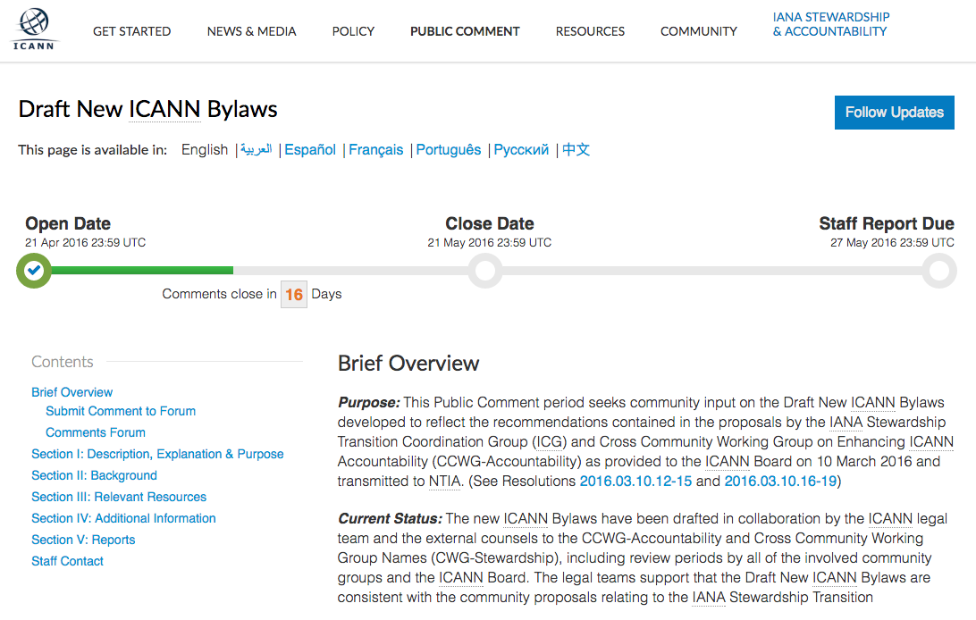
Where Can I Find the New Draft Bylaws?
Recommended documents to review:
New Draft Bylaws
Redline of Bylaws
A redline edit of current ICANN Bylaws to show differences between old and new draft Bylaws
Current ICANN Bylaws

Slide 11
What Kind of Feedback is Being Requested?
This comment period is designed to solicit inputs from the broader community on:
How elements of the proposals were brought into the Bylaws
If there are any areas seen as “inconsistent” with the IANA
Stewardship Proposal package
This public comment period is not intended to be:
A forum for the reconsideration of the transition-related
proposals
Clean-up edits that were not called for within the proposals

Slide 12
How to Submit a Comment

Slide 13
Questions?

