Slide 1
gTLD Marketplace Health Index: Advisory Panel Meeting
26 April 2017

Slide 2
Agenda
1
2
3
Timeline
‘Marketplace Stability’ Category Definition
‘Trust’ Category Definition
4
5
6
‘Robust Competition’ Category Definition
Existing ‘Beta’ Metrics in light of Category Definition Revisions
Next Steps
Notes:
Mukesh—15mins here

Slide 3
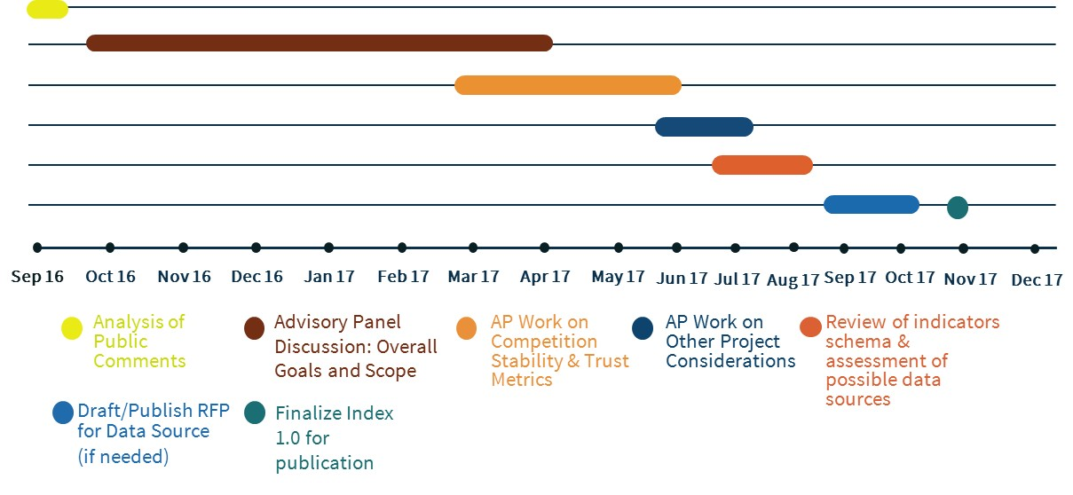
gTLD Marketplace Health Index 1.0: Proposed Timeline
Upcoming meeting planned for 4th week of May
Doodle poll on ideal dates/times forthcoming
Beta report providing coverage of 2H 2016 data planned for release mid-2017
Current phase

Slide 4



Revisiting Overall Scope (Today’s Discussion Areas)
Goal: track progress on ICANN objective 2.3, “Support the evolution of domain name marketplace to be robust, stable and trusted.”
  Coverage: Look to include ccTLD data, where available and relevant
  Initiative Name: Rename project to Domain Name Marketplace Indicators
  Revisit metrics category definitions for ‘robust competition’, ‘marketplace stability’ and ‘trust’
  Revisit continued relevance of beta metrics. Explore other relevant, recurring, reliable and rigorous datasets.
  Others: Revisit considerations on publication frequency, report design and language, academic review, evaluate extent to which indicators can be delivered via ICANN’s Open Data Initiative. etc.

Slide 5
Definition for ‘Marketplace Stability’
Original Category Definition used in Beta Report | Revised Definition (As of 2017-4-26)
#1: More gTLD registrars and gTLD registry operators are entering the gTLD marketplace than are leaving. | -deleted-
#2: Service providers are reliable, setting consistent expectations and meeting levels of service for: gTLD registrants, Internet users and the global community (including gTLD registry operators, gTLD registrars, law enforcement and intellectual property holders).* | #1: Registries and registrars consistently deliver against their contractual obligations, and do not introduce market instability through their business practices that would result in harm to registrants.
Refer to Tracking Doc, Section 9
*The gTLD Marketplace Health Index (Beta) did not include metrics for these.

Slide 6
Definition for ‘Trust’
Original Category Definition used in Beta Report | Revised Definition (As of 2017-4-26)
#1: Service providers, gTLD registry operators, gTLD registrars and gTLD registrants are: a) Compliant with their contractual obligations | #1: Demonstrated by operational success of domain name industry safeguards for registrants, Internet users and the global community (including law enforcement and intellectual property holders)
b) Perceived to be trustworthy* | -deleted-
Other suggestion: | #2: Users can register and use a domain name in any TLD within widely-distributed web browsers and mobile apps, and when setting up online accounts, can use any email address for service and use any name server regardless of the written script, length, and newness of the TLD.
Refer to Tracking Doc, Section 10
*The gTLD Marketplace Health Index (Beta) did not include metrics for these.

Slide 7
Definition for ‘Robust Competition’
Original Category Definition used in Beta Report | Revised Definition (As of 2017-4-26)
#1: Diversity exists in the choice of a service provider, including: a) Geography b) Scripts offered c) Languages offered* d) Service model* | #1: Registrants should have a choice for which domains they can purchase and where they can purchase them, characterized by: Geographical spread of registrants Domain names are available across languages and character scripts Suppliers’ terms & conditions are available across languages and character scripts Variety of payment methods
#2: The commercial marketplace is thriving –demonstrated by growth in new gTLDs and across all gTLDs. | #2: Demonstrated by registrant adoption of new TLDs and across all TLDs
#3: The marketplace is open to new players. | #3: The TLD marketplace is open to new providers, including back-end technology service providers, registries, registrars, and resellers
#4: Marketplace competition is perceived to be fair.* | -deleted-
#5: The marketplace is not dependent on one or a small number of players.* | #4: The TLD marketplace as a whole is not excessively controlled by a small number of providers, including back-end technology service providers, registries, registrars, and resellers
Refer to Tracking Doc, Section 8
*The gTLD Marketplace Health Index (Beta) did not include metrics for these.

Slide 8
Continued Relevance of Existing ‘Beta’ Metrics
ICANN staff circulated an online survey on Feb 28th to members of the Advisory Panel (AP) to obtain input on the continued relevance of published ‘beta’ metrics in light of changes made to the category definitions.
AP volunteers had the option to indicate whether they recommended maintaining, removing, or remained unsure of the relevance of 'beta' metrics. Opportunity to indicate any further questions was also made available.
Fifteen AP volunteers provided their feedback.
Survey results being presented as a basis for further discussion.

Slide 9
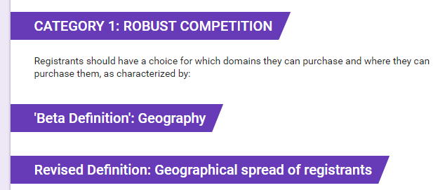
Continued Relevance of Existing Robust Competition ‘Beta’ Metrics

Slide 10
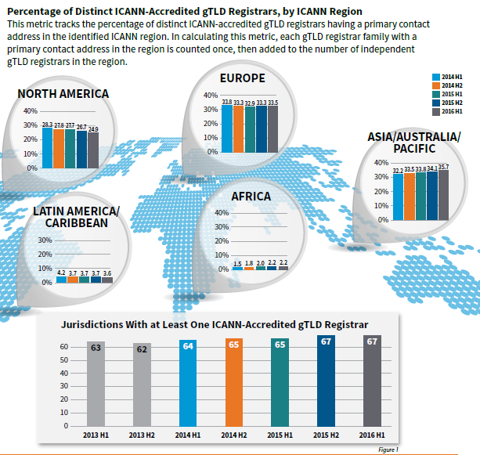
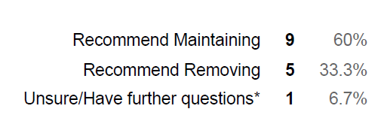
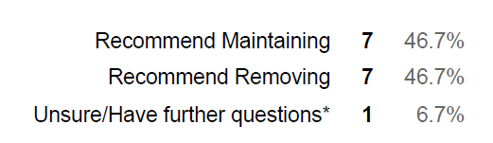
Continued Relevance of Existing Robust Competition ‘Beta’ Metrics

Slide 11
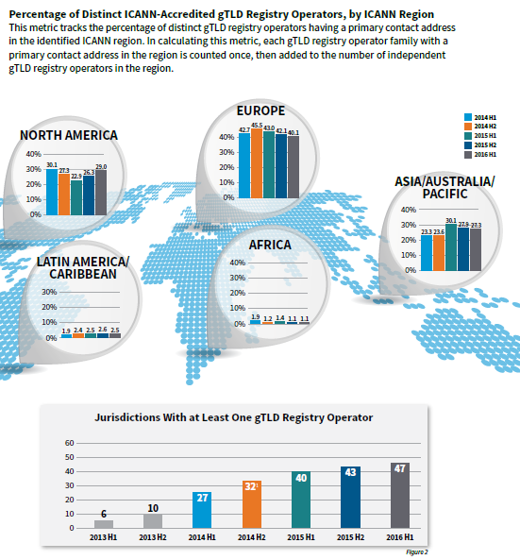



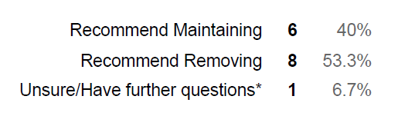
Continued Relevance of Existing Robust Competition ‘Beta’ Metrics

Slide 12

Continued Relevance of Existing Robust Competition ‘Beta’ Metrics
ICANN regions don't mean anything to those outside ICANN and registries/registrars hence the emphasis on geographical spread by jurisdiction rather than ICANN region. Best keep things simple so that the metrics can be understood by the widest possible audience.
Points 1 and 3 (which corresponds to Percentage of Distinct Registrars/Registry Operators by Region) are sufficient to describe geography. The absence of a registry or registrar operation may be a scope of technological (and business) development and outside the scope of this panel.
Heading says spread of "registrants" but the questions are about Registrars!
We discussed making this more about registrant distribution, not geographic distribution of registrars. String availability should be the key.

Slide 13
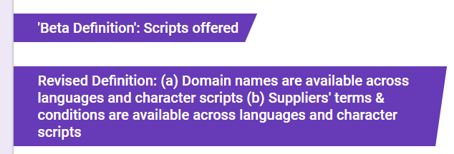
Continued Relevance of Existing Robust Competition ‘Beta’ Metrics

Slide 14
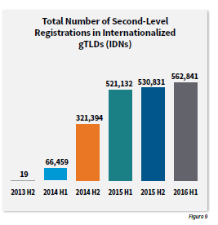
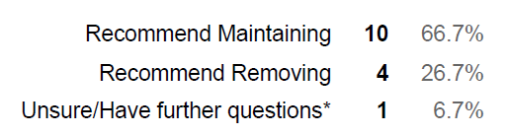
Continued Relevance of Existing Robust Competition ‘Beta’ Metrics
Total number of registrations is an insufficient measure. Especially if the category is dominated by a few registrants.

Slide 15
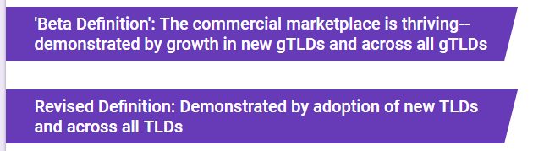
Continued Relevance of Existing Robust Competition ‘Beta’ Metrics

Slide 16
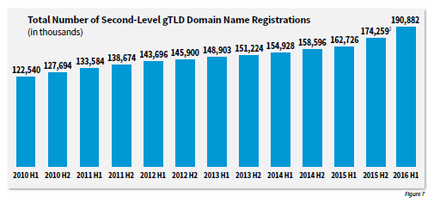
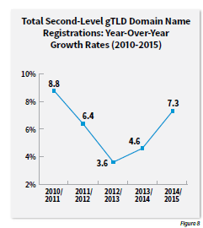

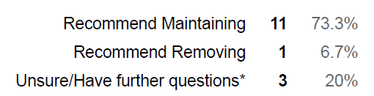
Continued Relevance of Existing Robust Competition ‘Beta’ Metrics

Slide 17
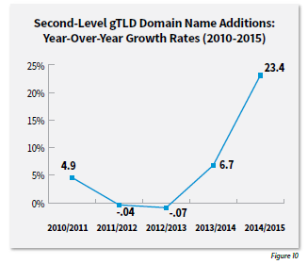
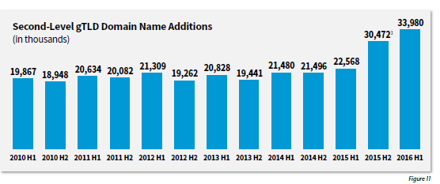
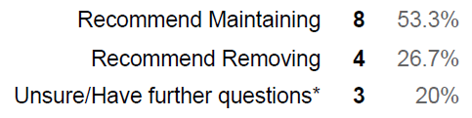
Continued Relevance of Existing Robust Competition ‘Beta’ Metrics

Slide 18
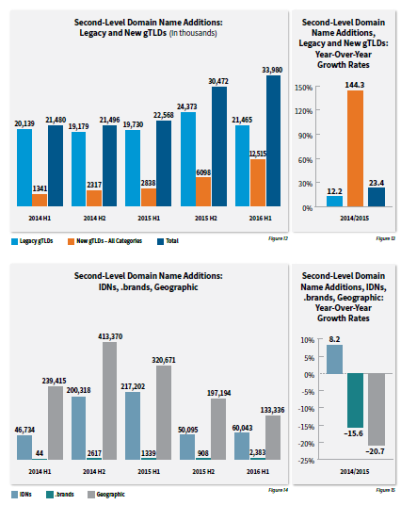
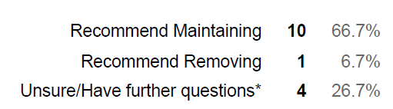
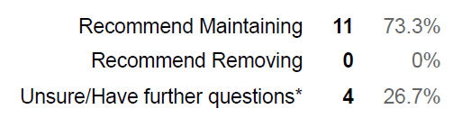
Continued Relevance of Existing Robust Competition ‘Beta’ Metrics

Slide 19
Continued Relevance of Existing Robust Competition ‘Beta’ Metrics

Slide 20
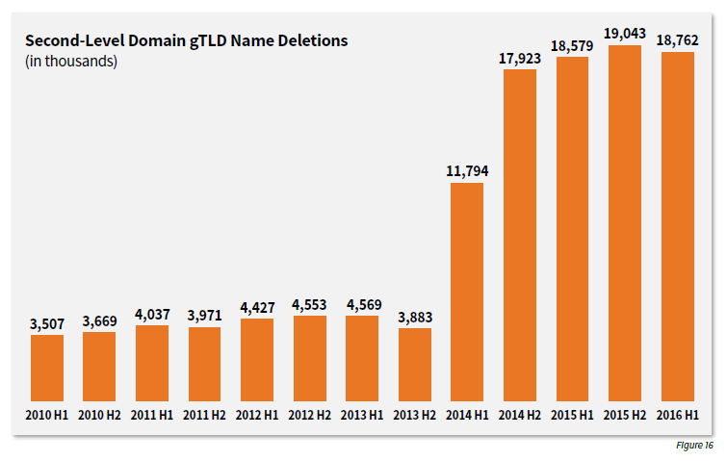
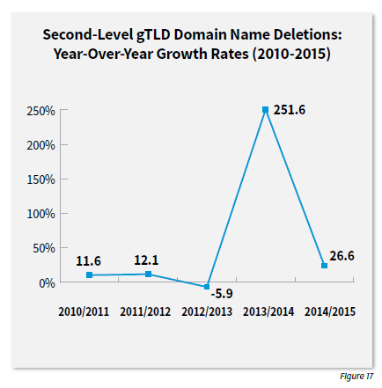
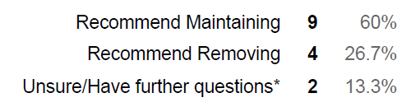
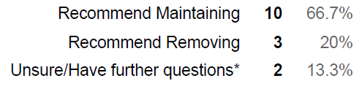
Continued Relevance of Existing Robust Competition ‘Beta’ Metrics

Slide 21
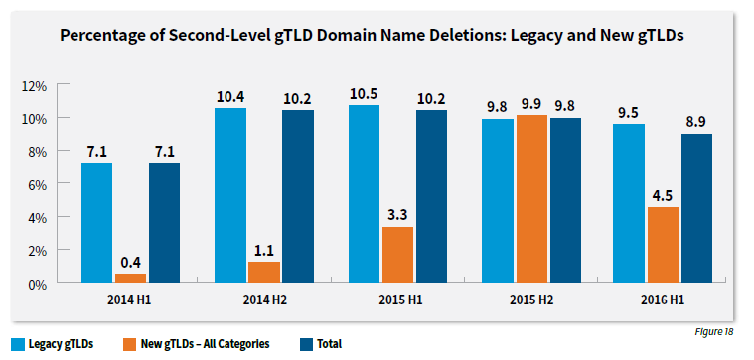
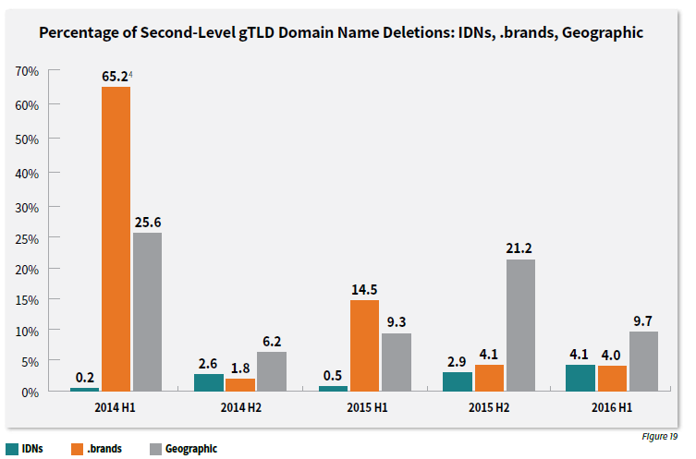
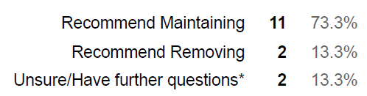
Continued Relevance of Existing Robust Competition ‘Beta’ Metrics

Slide 22
Continued Relevance of Existing Robust Competition ‘Beta’ Metrics
I would strongly recommend adding end-user adoption rates.
I'm still confused by the new definition. ‘New TLDs’ to me means something very specific - TLD launched post 2012.
Unclear what the objectives would be for each of these data points to consider them "metrics." More sophisticated "concentration" calculation probably better.
The word "adoption" in the definition is too non-specific to say that any metric actually fulfills it.

Slide 23
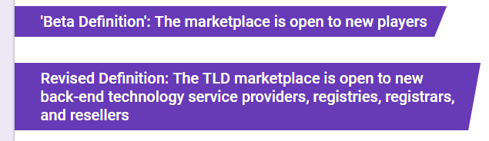
Continued Relevance of Existing Robust Competition ‘Beta’ Metrics

Slide 24
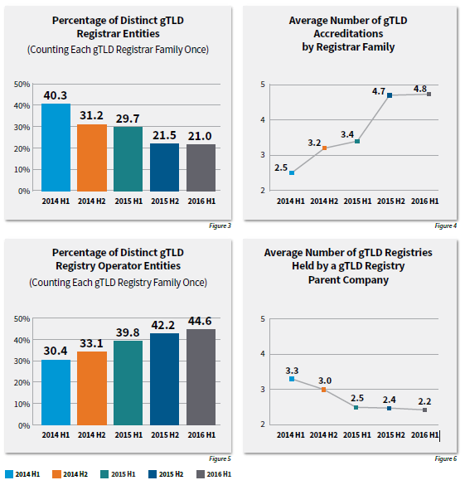
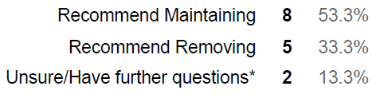
Continued Relevance of Existing Robust Competition ‘Beta’ Metrics

Slide 25
Continued Relevance of Existing Robust Competition ‘Beta’ Metrics
Figure 4 (which corresponds to Actual Number of gTLD Accreditations by Registrar Family) can be affected by actual market concentration (registrars buying registrars) or specific conditions such as drop catch registrars. Recommend removing.
"Fig 4: "by registrar family" is unclear for me
Not sure volume speaks to market friction. Need some other measure.
Sorry, what does "percentage" mean in this case?

Slide 26
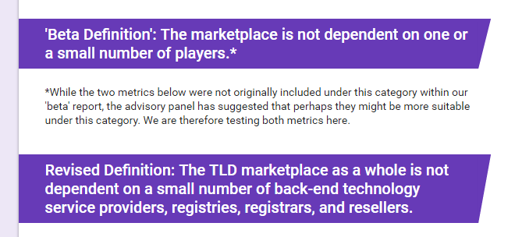
Continued Relevance of Existing Robust Competition ‘Beta’ Metrics

Slide 27
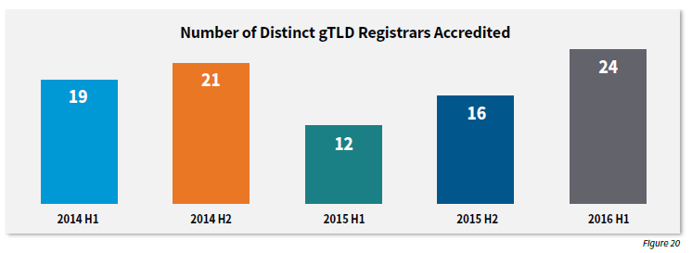
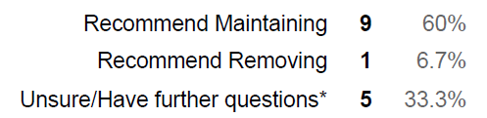
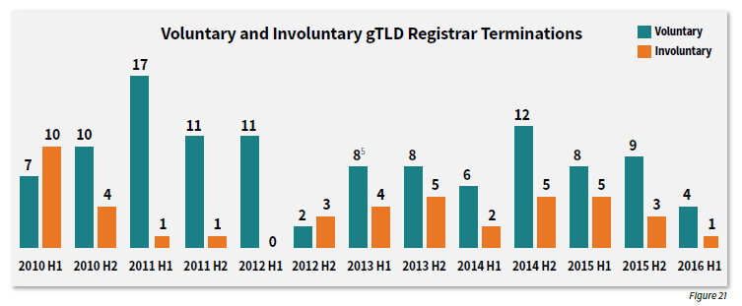
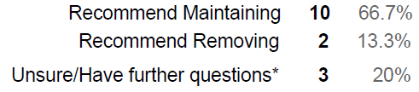
Continued Relevance of Existing Robust Competition ‘Beta’ Metrics

Slide 28
Continued Relevance of Existing Robust Competition ‘Beta’ Metrics
The figures proposed are inadequate to cover the revised definition. I only see registrars.
Would this include gTLD Registrars that are part of the same Group (as a fully or partly owned subsidiary)?
Figure 20 should be "gTLD Registrar Families - Newly Accredited" so it's not impacted by drop catch registrar accreditations. Figure 21 could be either families or individual registrars, but symmetry suggests using families as well.
Without knowing the reasons, difficult to attribute to market dynamics (as opposed to compliance violations, etc.)
It is not immediately obvious that these metrics will fulfill the stated goal.

Slide 29
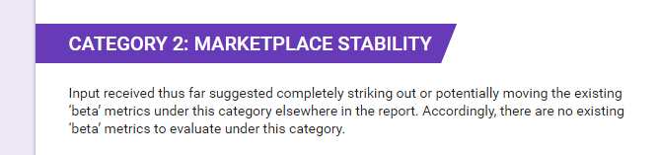
Continued Relevance of Existing Marketplace Stability ‘Beta’ Metrics

Slide 30
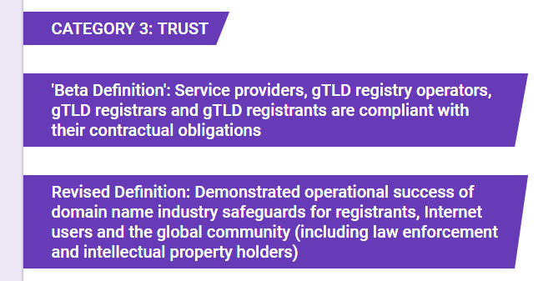
Continued Relevance of Existing Trust ‘Beta’ Metrics

Slide 31
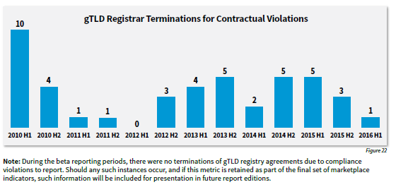
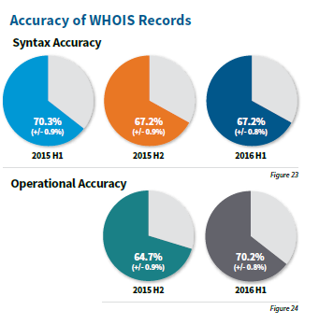
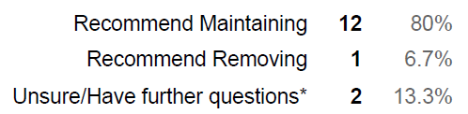
Continued Relevance of Existing Trust ‘Beta’ Metrics

Slide 32
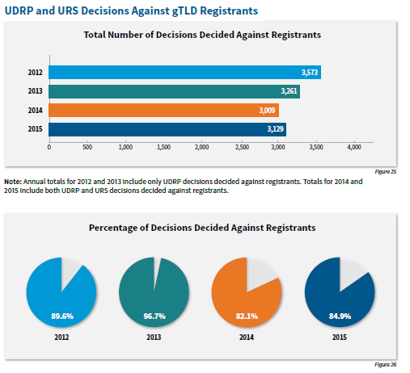
Continued Relevance of Existing Trust ‘Beta’ Metrics

Slide 33
Continued Relevance of Existing Trust ‘Beta’ Metrics
The term safeguards is one that might mean something different than what these metrics measure. There are safeguards that the GAC has been proposed (some accepted by the board and others rejected) and there could be more evolution of safeguards as a result of the compliance department hiring a director for consumer safeguards.
It is not immediately clear whether or not these metrics properly align with the stated goal.

Slide 34
Next Steps and Action Items
Next Steps
Actions
Capture inputs arising from session today.
Lock down category definitions
Continue to discuss relevance of existing and previously suggested beta metrics
ICANN: Update tracking document with inputs received and circulate to Advisory Panel
Advisory Panel: Review and provide any feedback prior to next meeting
ICANN: Create online poll for metrics previously suggested but not included in the Beta report (as noted in report Appendix)
Advisory Panel: Provide inputs
ICANN: Share final category definitions via mailing list
Advisory Panel: (Breathe a sigh of relief) Factor these definitions into input provided on suitable metrics.

Slide 35
Questions?

Slide 36








Engage with ICANN
Thank You and Questions
Email: Mukesh.Chulani@icann.org
Amy.Bivins@icann.org
Please submit feedback on metrics to gtldmarketplace@icann.org
twitter.com/icann
gplus.to/icann
facebook.com/icannorg
weibo.com/ICANNorg
linkedin.com/company/icann
flickr.com/photos/icann
youtube.com/user/icannnews
slideshare.net/icannpresentations

Slide 37
Appendix—Robust Competition Metrics in Beta
Percentage of distinct ICANN-accredited gTLD registrars, by ICANN region.
Number of jurisdictions with at least one ICANN-accredited registrar.
Percentage of distinct ICANN-accredited gTLD registry operators, by ICANN region.
Number of jurisdictions with at least one ICANN-accredited registry operator.
Percentage of gTLD registrars that are distinct entities (counting one per family).
Average number of gTLD registrar accreditations per registrar family.
Percentage of gTLD registry operators that are distinct entities (counting one per family).
Average number of gTLD registries held by each gTLD registry parent company.
Total number of second-level domain names registered in gTLDs.
Year-over-year growth rates in second-level domain names registered in gTLDs.

Slide 38
Appendix—Robust Competition Metrics in Beta (cont.)
11. Total number of second-level domain names registered in Internationalized gTLDs (IDNs).
12. Total second-level domain name additions in all gTLDs.
13. Year-over-year growth rates for second-level domain name additions.
14. Second-level domain name additions, broken down into the following categories: legacy gTLDs, new gTLDs, IDNs, .brands, and geographic gTLDs, plus year-over-year growth rates for each of these categories.
15. Second-level domain name deletions in gTLDs, plus year-over-year growth rates for second-level domain name deletions.
16. Second-level domain name deletion percentages in gTLDs (the percentage of total second-level domain names deleted) broken down into the following categories: total gTLDs, legacy gTLDs, new gTLDs, IDN gTLDs, .brands, and geographic gTLDs.
Notes:
Total number of second-level domain names registered in Internationalized gTLDs (IDNs).
Total second-level domain name additions in all gTLDs.
Year-over-year growth rates for second-level domain name additions.
Second-level domain name additions, broken down into the following categories: legacy gTLDs, new gTLDs, IDNs, .brands, and geographic gTLDs, plus year-over-year growth rates for each of these categories.
Second-level domain name deletions in gTLDs, plus year-over-year growth rates for second-level domain name deletions.
Second-level domain name deletion percentages in gTLDs (the percentage of total second-level domain names deleted) broken down into the following categories: total gTLDs, legacy gTLDs, new gTLDs, IDN gTLDs, .brands, and geographic gTLDs.

Slide 39
Appendix—Marketplace Stability Metrics in Beta
1. Number of gTLD registrars newly accredited.
2. Number of gTLD registrars disaccredited (divided out by voluntary and involuntary accreditations revoked)

Slide 40
Appendix—Trust Metrics in Beta
1. Number of involuntary gTLD registrar terminations (related to accreditations revoked involuntarily).
2. WHOIS Accuracy rates detected by ICANN WHOIS Accuracy Reporting System.
3. Number of UDRP and URS complaints decided against second-level gTLD registrants (annual total plus percentage of cases filed).
Notes:
Number of involuntary gTLD registrar terminations (related to accreditations revoked involuntarily).
WHOIS Accuracy rates detected by ICANN WHOIS Accuracy Reporting System.
Number of UDRP and URS complaints decided against second-level gTLD registrants (annual total plus percentage of cases filed).

