Slide 1




ICANN
Chairing Skills
Webinar

Slide 2
Agenda
Leadership Skills
Communication Skills
Organization Skills
Notes:
2

Slide 3
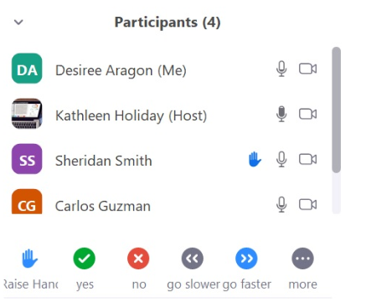


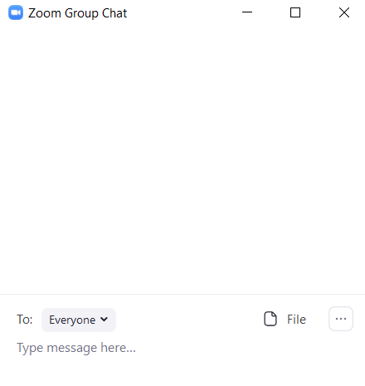
Zoom quick tips
Top of Screen
Views: Gallery View versus Speaker View
Attendees have access
to these Zoom features
Bottom of Screen
Mute / Unmute: Mute and unmute your microphone.
Start Video / Stop Video: Turns your camera on or off.
Participants: See who's in the meeting. View feedback icons. This places an icon by your name to quickly notify the host.
Reactions: Clap or Thumbs up icon.
Chat: Chat with the participants.
Notes:
For newbies to zoom if needed… slide builds

Slide 4
Leadership Skills
4

Slide 5
What are the qualities of an effective chair at ICANN?
Use the Annotate Feature to contribute…
Notes:
What they write down will all (my hunch is).. connect to CARE.. Segue to we have a model that captures most of what you just wrote.

Slide 6
Modeling all the time
Be visible…and approachable
Connect with others…always listening well
Communicate your decisions…early and often
Be encouraging of others…and yourself
Project positivity…be the bright side
Watch your language…”yes and” vs. “yes but”
Celebrate effort…not just success
Keep perspective…it’s not the grail

Slide 7

A CAREing leader
Credibility = Content expertise plus presence
Authenticity = Willingness to be vulnerable and honest
Reliability = Consistent and dependable behavior
Egoless = Not focused on self and your agenda

Slide 8
Credible: Knowledge and presence
You may know the right answer to a question, but you have to be convincing in how you respond.
Knowledge without presence may not convince others that you are right and presence without knowledge can seem like empty promises or manipulation.
Make sure you have done your research and are up to date in your field of expertise.
Presence reflects confidence and how you come across to others in a group.
Presence in face-to-face meetings includes your appearance, gestures, posture, voice tone, and ability to communicate using the language and technology.
On the phone or online you may only have voice tone and words.
Being clear, concise, and compelling.

Slide 9
Authentic: vulnerable and honest
Act in ways that demonstrates who you really are, that you are a well-intended good person.
It starts with you knowing who you really are and how you might feel about something. In our world of social media, authenticity is always in question.
The more you can express yourself in a way that honestly represents you the more authentic you will be to others.
If you don’t know something; say you don’t know.
Authenticity involves allowing yourself to be vulnerable.
Being authentic will allow people to feel safe with you.

Slide 10
Reliable: consistent and dependable
Follow through on your commitments. You do what you say you are going to do.
Reliability comes with time since it is dependent on the number of interactions you have with someone; what promises are made; and, more importantly, what promises are kept.
Reliability is also about being consistent in your behavior and actions.
People know what to expect. You represent stability with your consistency.

Slide 11
Egoless = Not focused on self
We question a person’s credibility, authenticity, and reliability when there is too much ego. We question how much they actually care.
Being egoless means not having an ego or not being driven by your sense of self-importance.
Everyone should have high self-esteem but not high self-importance. Self-esteem is how you value yourself, but self-importance is trying to prove your value to others.
We all know self-important people; they will let you know how great they are in the first conversation!
The problem is that being self-important is being ego driven so your needs are more important to you than the needs of others.
Being egoless does not mean you have no identity or self-worth; it means you are considering the context, the needs of others, and your own needs to accomplish the best outcome for all.

Slide 12
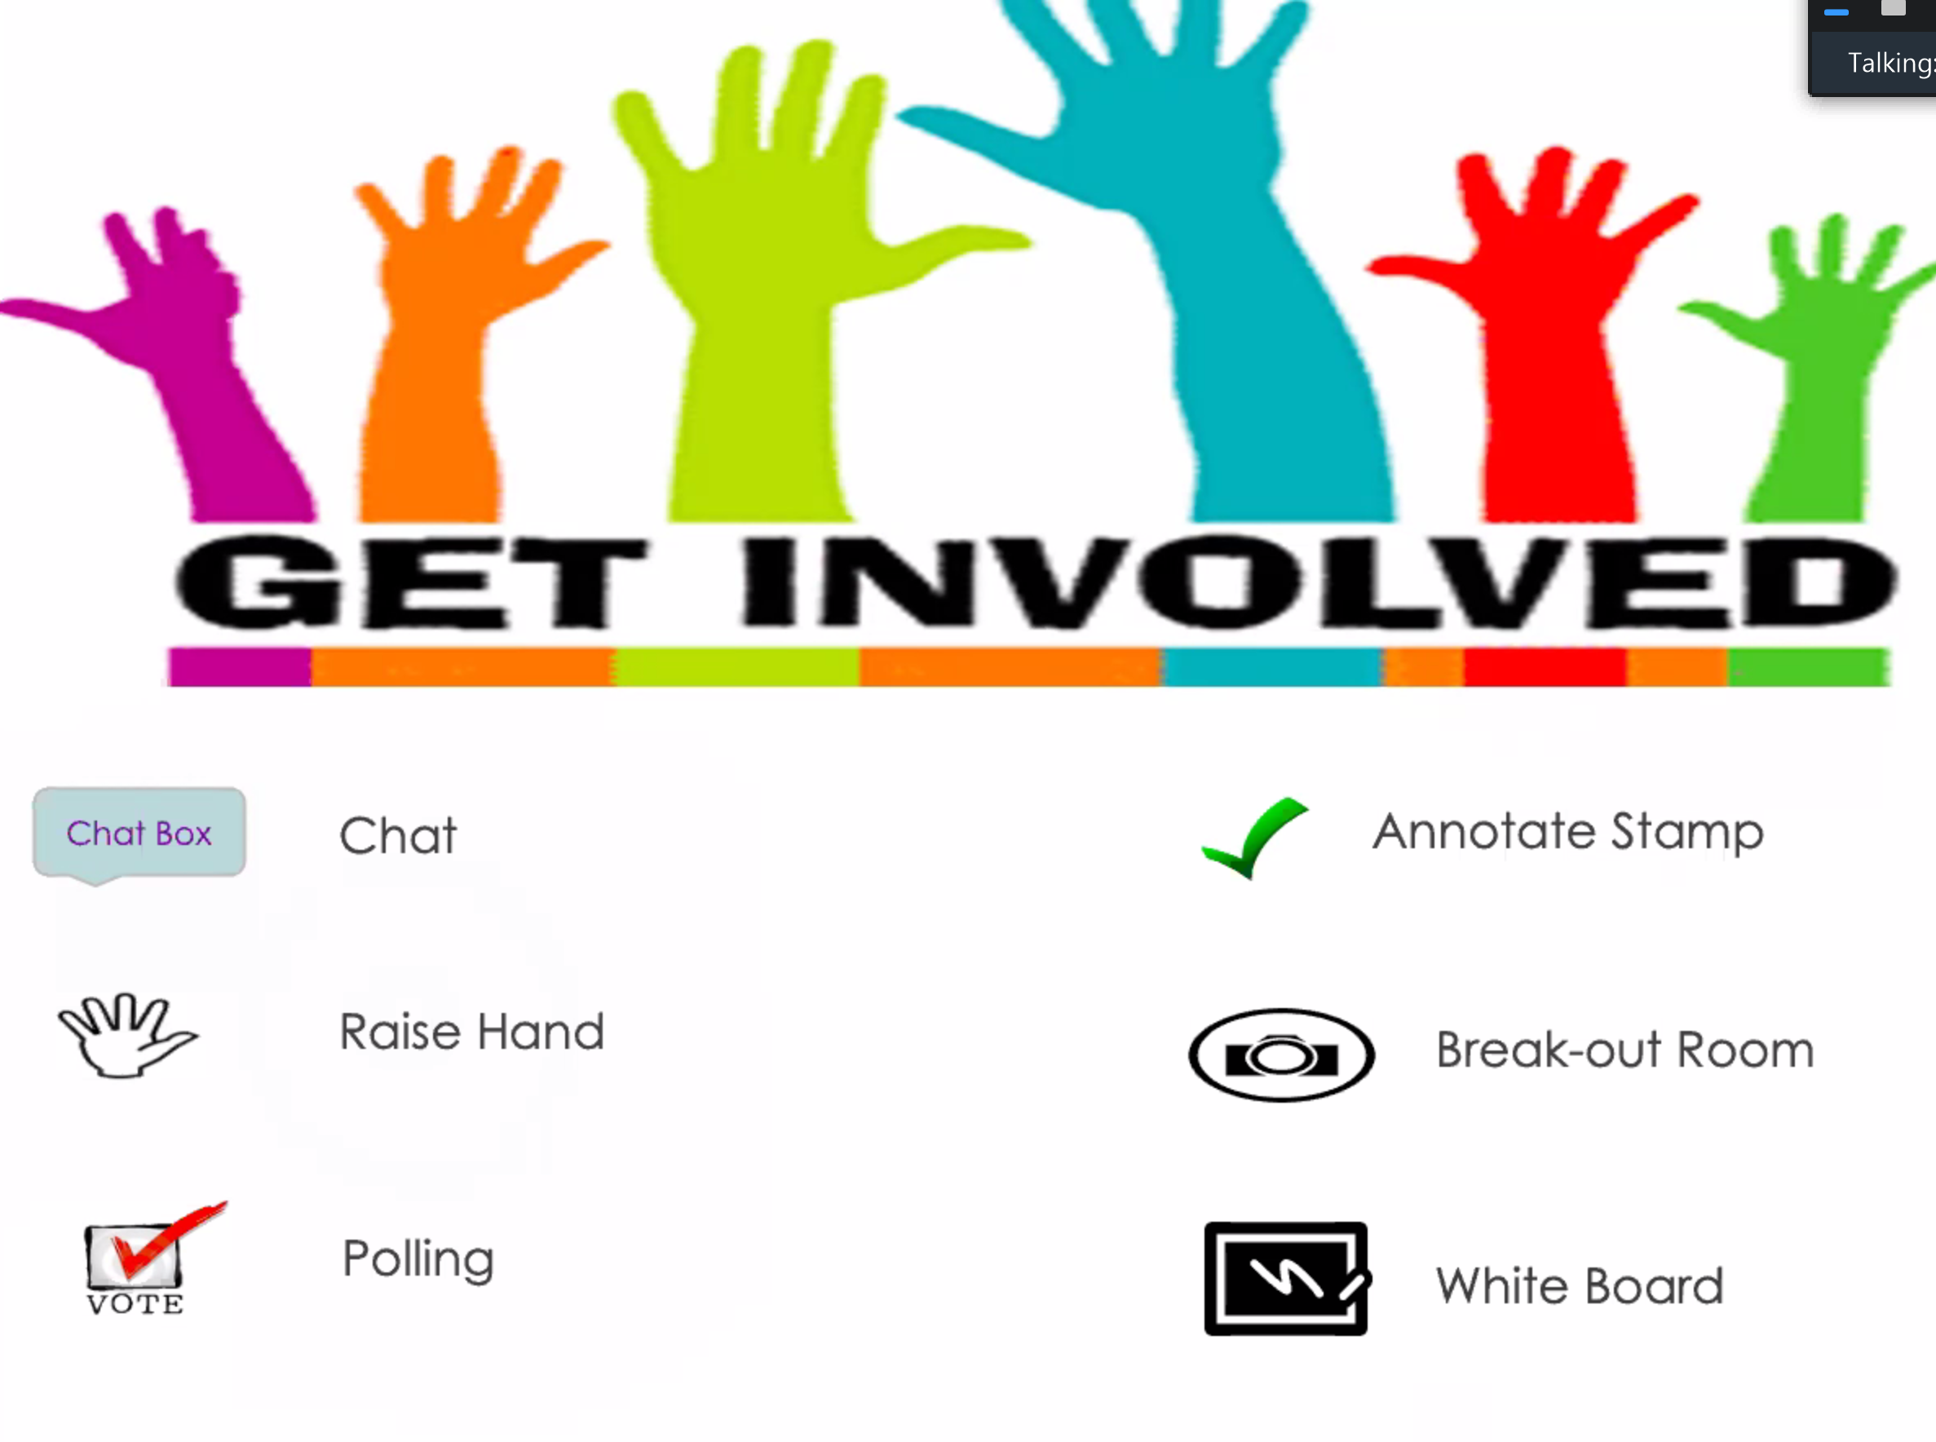
Let’s discuss in a
Breakout Room

Slide 13
Acts of leadership
10 minute breakout discussion
Choose a spokesperson to report back on discussion.
Describe outstanding examples of chairing leadership you have seen at ICANN.
Describe more understated everyday acts of chairing leadership.
Leadership can be summarized in two words…
Strength
And
Warmth
Notes:
Breakout Group of 3-4 … 12 min. Select a report out person to share highlights of the discussion after
Return and put reactions in Chat… or have report out person share.
This may be where we assign facilitators to the breakouts

Slide 14
Build trust quickly
Use the CARE model as your guiding intention
Initial meetings engender assumed trust. Reinforce this by being gracious, recognizing performance, and build your credibility by beating deadlines and being effective in your facilitation
Be predictable with times you are available, answering emails efficiently, perhaps setting up a time that you are accessible.
Be responsive
Be persistent and positive, always assuming goodwill.
Notes:
14

Slide 15
Let’s take a Poll

Slide 16
CARE model Poll
Let's take a poll: (Select only 1 answer)
Think about a situation where developing your leadership skills further will make a difference. What part of the CARE Model needs your focus most?
Credibility
Authenticity
Reliability
Egoless

Slide 17
Communication Skills
17

Slide 18
ICANN Consensus Playbook
Assess the situation
Use a skilled and credible facilitator
PDP initiated, charter created, and call to members
Have a purpose and clear agenda for each meeting
Use meeting best practices
Facilitate process and recognize needs
Help participants deliberate and communicate
Seek mutual agreements
Prevent and overcome deadlocks
Adapt and learn

Slide 19
Effective communication
Know your group
Maintain a problem-solving orientation
Ask questions and summarize
Reframe issues so all can discuss
Develop options
Strength
Assert
Warmth
Listen
LISTEN = SILENT
Notes:
19

Slide 20

What leads to positions?
Positions
Issues
Interests
Values

Slide 21
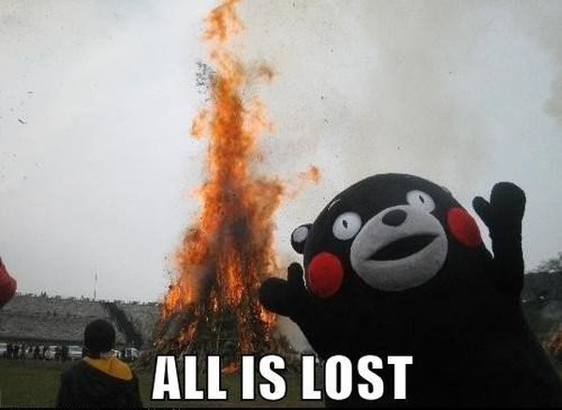
Be aware of value differences
Be careful when speaking about deep value differences; they are serious but the way we talk about them can make problems worse
Need ground rules to create safe space
Suspend preconceptions about others and listen
Learn interests that underlie issues
Acknowledge and recognize concession and effort
Craft practical options that work for all parties
Create mutual gains not poor compromise

Slide 22
What gets in the way?
Institutions: “we have always done it this way"
Deadlock: “we can’t agree on anything”
Escalation and positional bargaining: it’s personal and transactional
Communication: not connecting or listening, no trust
Complexity: overwhelmed by all of the layers
Ambiguity: unclear
What barriers do you experience at ICANN?

Slide 23
What barriers do you experience at ICANN?
Use the Annotate Feature to comment here:
Notes:
USE annotate feature for group interaction… Producer note… Use Select tool to move comments around for visibility
Screen shot warning and them clear before proceeding

Slide 24
Maintain a problem solving orientation
Suspend your position so you can understand other positions.
Act the way you want others to act no matter how they act.
Express concerns in an unconditionally constructive manner.
Engage in active listening.
Disagree without being disagreeable.
Be transparent.

Slide 25
Ask questions
What other ideas do people have on this topic?
Who has a new idea that hasn’t been discussed?
Why is that so important to you?
What is most important on this issue?
What if…?
What makes that fair? What is that based on?
What are the key attributes a solution needs to have?
Let’s hear from someone new on this.
From ICANN Consensus Playbook

Slide 26
Paraphrasing, summarizing and reframing
Paraphrasing shows you are hearing the message not just the words. It demonstrates mutual understanding.
Summarizing considers what you have heard so far to show you are understanding the whole concept not just one piece of it.
Reframing translates information into a form making it mutually discussable.
Reframe from positions to: interests, options, and/or criteria

Slide 27
Develop options
Get everyone educated
Whole group brainstorms options
Task groups develop recommendations for whole group
Proposals are prepared
Outside experts are consulted for assistance
Interest groups develop proposals for whole group

Slide 28
Let’s take a Poll

Slide 29
Enhancing Communication Poll
Let's take a poll: (select only 1 or 2 answers)
When considering the chairing that you will be doing. What area must you focus on more than you have been?
Recognizing differing values and cultural differences
Facilitating a problem-solving focus
Listening and asking more questions
Summarize, paraphrase and reframe more
Developing options and moving to action

Slide 30
Organization Skills
30

Slide 31
COPEing with work
Capture and Clarify: Make a list, get it out of your head. What is the desired outcome? What is the next action?
Organize: Action steps; do, share, or delegate. Assess resources. Prioritize and plan.
Prepare: Create an agenda, make sure participants have what is needed in advance so they are prepared.
Engage: Work based on context, time that you have, when group will meet and then prioritize to make the most of time

Slide 32
Capture tasks and make a List!
Create four columns on a piece of paper
In first column capture what’s on your mind (your to do list) write down the first 10 items that come to mind
Label the other three columns: Do, Share, Delegate
Go through your list and indicate how to best treat each item by checking one of the columns.
Take 5 minutes individually to create your COPE list
Task | Do | Share | Delegate
Invite WG members
Talk to GNSO about review process
Brother’s birthday
Register for meeting
Notes:
So, do this for 5 minutes as a solo activity
Then put them in paired breakouts for 10 Min

Slide 33
Let’s discuss in a
Breakout Room

Slide 34
Revise your list with a bit of help from a friend
You will be in a breakout room for 8 minutes with a partner to go over your lists. Question each other on whether you have placed your items in the right category. After our webinar, go back through your list and revise based on your discussion.
Notes:
So, do this for 5 minutes as a solo activity
Then put them in a breakout group in pairs for 8-10 minutes

Slide 35
Prioritize and plan
High Impact | Low hanging fruit! Go for the quick win. Involve others so the credit can be shared. These are motivating to people | Large projects and processes like PDP and Reviews that will take time. Plan to make progress.
Low Impact | When time allows attend to these task while the effort required is low. Don’t let them stack up. Great to delegate so someone can learn. | Don’t spend too much time here. These are the thankless tasks but many still need to be done. Can you delegate?
 | Low effort to implement | High effort to implement

Slide 36
COPEing with work
Capture and Clarify: Make a list, get it out of your head. What is the desired outcome? What is the next action?
Organize: Action steps; do, share, or delegate. Assess resources. Prioritize and plan.
Prepare: Create an agenda, make sure participants have what is needed in advance so they are prepared.
Engage: Work based on context, time that you have, when group will meet and then prioritize to make the most of time

Slide 37
Organize to address virtual challenges
Communication
Language
Technology
Time zones
Culture
Generational
Equity
Operating style
Notes:
You could start this as an Annotate question and then go through their answers and these (if time)

Slide 38
ICANN Virtual Collaboration Best Practices
Be realistic about the amount of time it takes
Foster positive productive relationships with support staff
Be neutral and stay that way
Lead from behind
Enjoy learning from the group
Maintain the WG as open/safe place
Be curious and creative
Treat surprises as puzzlers not problems
Apply knowledge in a creative way

Slide 39
COPEing with work
Capture and Clarify: Make a list, get it out of your head. What is the desired outcome? What is the next action?
Organize: Action steps; do, share, or delegate. Assess resources. Prioritize and plan.
Prepare: Create an agenda, make sure participants have what is needed in advance so they are prepared.
Engage: Work based on context, time that you have, when group will meet and then prioritize to make the most of time

Slide 40
Meeting Organization Best Practices
Be realistic about the amount of time it takes
Foster positive productive relationships with support staff
Be neutral and stay that way
Lead from behind
Enjoy learning from the group
Maintain the WG as open/safe place
Be curious and creative
Treat surprises as puzzlers not problems
Apply knowledge in a creative way

Slide 41
Meeting Organization Best Practices
Be comfortable in the knowledge that not everything will work
Know when to ditch an idea that isn't working
Encourage others to be innovating and sharing their ideas as well
Function well in diversity - appreciating, leveraging
Set and manage expectations more proactively
Know your IT
Spend more time building and maintaining relationships

Slide 42
Final Breakout Room
Discussion. What steps are you committed to take?
Notes:
Final Breakout group in trios… 7 minutes

Slide 43
Final thoughts
Leadership Skills
Communication Skills
Organization Skills

