Slide 1



Slide 2
Input to Competition, Consumer Trust & Consumer Choice Review Team
| 4 November 2016

Slide 3
Process Update
Notes:
Breakup your presentation, divide it into sections. This is especially useful if most of your presentation is text.

Slide 4
CCT-RT Mandate
Evaluate how New gTLD Program has promoted competition, consumer trust and consumer choice
Evaluate effectiveness of application and evaluation processes
Evaluate effectiveness of safeguards
Goal for Hyderabad: Seek community feedback on interim findings
Notes:
Margie

Slide 5

Informed by Multiple Resources
June 2016 – Global Consumer Research – Wave 2 (Nielsen)
September 2016 - Global Registrant Survey - Wave 2 (Nielsen)
October 2016 - Phase II Assessment of the Competitive Effects Associated with the New gTLD Program (Analysis Group)
October 2016 - New gTLDs and the Global South: Understanding Limited Global South Demand in the Most Recent New gTLD Round and Options Going Forward (AMGlobal)
November 2016 - Applicant Survey
March 2017 - DNS Abuse Study (Preliminary Report)
Evaluate effectiveness of application and evaluation processes
Evaluate effectiveness of safeguards
Attend Competition, Consumer Trust an Consumer Choice Research Results session on 5 November for more information
Notes:
Margie

Slide 6
Initial Observations
We are in “Early Innings” – the full effects of New gTLDs will not be felt for some time
Lack of relevant data has hampered the analysis – missing key data- such as information about legacy gTLD pricing, DNS abuse and burden and costs to trademark owners
Alternative market definitions considered - Lack of information prevents us from defining the relevant “market” for the purpose of analyzing competition, and have considered a number of market definitions
Evaluate effectiveness of application and evaluation processes
Evaluate effectiveness of safeguards
Notes:
Margie

Slide 7
Competition & Consumer Choice
High-Level Findings
Notes:
Breakup your presentation, divide it into sections. This is especially useful if most of your presentation is text.

Slide 8
Industry Structure
The existence of registrars and backend providers facilitates the entry of new gTLDs into the market.
There are hundreds of registrars offering new gTLDs, but only a handful of backend providers. However, 6 providers service at least 1M SLDs under the gTLDs that they support.
90% of new gTLDs have <10,000 registrations, excluding .BRANDs.
So far, only a single TLD has ceased operations. (A few others have been sold.)
Most gTLDs have modest numbers of registrations, raising the possibility that they have not achieved minimum viable scale. So far, we have seen only one failure, so the structure of the industry may make it possible for “stand alone” gTLDs to continue to operate even with low registration volumes.
Recommendation: Continue to measure metrics around gTLD viability.

Slide 9
New gTLD Market
New gTLDs represent about half the overall growth in gTLD registrations since the end of 2013, and about 1/3 of the increase in total registrations (including ccTLDs). Overall, new gTLDs represent approx. 9% of current registrations amongst all gTLDs.
By all standard measures of market concentration, the “new gTLD market” is significantly less concentrated than the “overall gTLD market”.
New gTLDs have decreased concentration in the gTLD market, but because the program is relatively new and the existing base of registered domains is large, the overall effect has been modest.
Although many studies in other industries find a relationship between concentration and price, we are missing important data to draw strong conclusions regarding price.
The current average wholesale price in new gTLDs is higher than the current average price cap in legacy gTLDs.
Recommendation: ICANN needs to gather more data relating to price in legacy gTLDs. (This may be particularly interesting if price caps are removed from some legacy gTLDs.)

Slide 10
Parking
A majority of new gTLD registrations (65%) are parked or unused, although there is considerable per-TLD variation (e.g., .xin is 95% parked, .science 23% and .xyz 65%).
  Of those, most “parked” domains simply do not resolve or serve errors.
Parking is common in legacy gTLDs as well, although we do not yet have comparable data between legacy and new gTLDs.
The prevalence of parking in new gTLDs, and lack of ability to compare to legacy gTLDs, is one of the factors that makes it harder to understand the impact of new gTLDs in the marketplace.

Slide 11
Registrars
Concentration among registrars within new gTLDs has declined somewhat since the introduction of new gTLDs, largely due to slightly lower concentration within the new gTLDs.
Although there is sometimes high concentration amongst registrars within a specific gTLD, even in those gTLDs there are a large number of registrars.
There is a surprising degree of variation in retail prices between registrars for the same gTLD.

Slide 12
Trademarks
As with previous expansions of the gTLD space, some trademark holders engage in defensive registrations.
In a sample studied by Analysis Group, 54% of trademarks registered in .com were registered in one or more of the new gTLDs.
Most trademarks are only registered in a small number of new gTLDs (median of 3), although 4% of trademarks were registered in over 100 new gTLDs, and one trademark was registered in 406 gTLDs.
The cost of the new gTLD program for most trademark holders related to direct registrations in defensive registrations has been relatively low; however, a small fraction of trademark holders are likely incurring significant costs. Further study on other potential costs is underway.

Slide 13
Choice
In some cases (18%), users prefer to register in new gTLDs even when the SLD is available in .COM.
  This is particularly true in IDN TLDs. In some IDN TLDs, >60% of SLDs registered are available as exact matches in .COM.
The vast majority (92%) of new gTLD registrations could have been registered in .COM instead in the form SLDTLD.COM. (e.g., users pick BIGSHOTS.PHOTOGRAPHY even though BIGSHOTSPHOTOGRAPHY.COM was available)
  For many gTLDs, this is true despite the fact that the retail price for the gTLD is typically higher than for .COM.
Registrants are attracted to new gTLDs because they perceive them as modern, more flexible, facilitate communication and are priced well.

Slide 14
Pricing
In general, we are missing important data to draw strong conclusions. In particular, we are missing transactional data from registrars, wholesale pricing from most legacy gTLDs, and data on resale prices of domain names.
Most of the data we do have is inconclusive.
  On average, new gTLDs are priced no lower than the price caps for legacy gTLDs, but it is unclear what prices the legacy gTLDs would charge in the absence of the price caps.

Slide 15
Policies
Most of top 30 registries (90%) have published Privacy policy.
Two thirds of these registries would not share those data with third parties, except in cases prescribed by law and regarding to Whois policy.
  43% of these registries have strict obligation in their policies that they will take reasonable measures to provide the security of personal data.
No restrictions on who can register, except for .nyc.
All of these registries have compliance procedure for abusive behavior or other violation of policy.
No TLDs have policies related to “parked domain names”.

Slide 16
Competition & Consumer Choice
Q&A
Notes:
Breakup your presentation, divide it into sections. This is especially useful if most of your presentation is text.

Slide 17
Safeguards & Trust
High Level Findings
Notes:
Breakup your presentation, divide it into sections. This is especially useful if most of your presentation is text.

Slide 18
Mandate
Affirmation of Commitments
ICANN will organize a review that will examine the extent to which the introduction or expansion of gTLDs has promoted competition, consumer trust and consumer choice, as well as effectiveness of (a) the application and evaluation process, and (b) safeguards put in place to mitigate issues involved in the introduction or expansion.

Slide 19
Safeguards and Trust
High Level Questions:
Has the new gTLD Program put sufficient mechanisms in place to:
improve trustworthiness and
mitigate risks to DNS?

Slide 20
Safeguards and Trust
High Level Questions:
Have these efforts had an impact on public perception of the DNS?

Slide 21
Safeguards and Trust
Improve Trustworthiness/Mitigate Risks
Sub-questions
Have the safeguards been implemented in a manner that promotes effective enforcement?
What was the impact of the new safeguards on DNS Abuse?
Did the Rights Protection Mechanisms mitigate certain risks involved with the expansion of the new gTLD program?

Slide 22
Safeguards and Trust
Improve Trustworthiness/Mitigate Risks
Mechanisms
Technical Safeguards
Safeguards Applicable to all new gTLDs
Safeguards Applicable to new gTLDs that: raise consumer protection concerns, contain sensitive strings, or strings in regulated/highly regulated markets
Voluntary Public Interest Commitments
Rights Protection Mechanisms

Slide 23
Technical Safeguards
Vet Registry Operators
Voluntary Framework for
High Security Zones
Most implemented via application process or contract provisions in standard Registry/Registrar Agreements
DNSSEC
Expedited Registry Security Request
Prohibit Wildcarding
Centralized Zone file access
Prohibit orphan glue records
Thick WHOIS
Registry + Registrar Level Abuse Contacts
Screen out bad actors
Ensure integrity/utility of registry info +Focused Efforts to combat abuse
Not Implemented

Slide 24
Safeguards Applicable to All New gTLDs
WHOIS
  verification/documentation
  Checks
- RAA (June 2013), §3.7.8; 3.7.7.1-2; WHOIS Accuracy Specification; ICANN WHOIS ARS
Mitigating abusive activity
  provision prohibiting registered name holders from engaging in abusive activities
  consequences (including suspension)
- RA (Jan. 2014, Spec. 11, 3(a)
Security checks
  technical analysis
  maintain reports
RA (Jan. 2014), Spec. 11, 3(b)
Complaints
  procedures for making/handling
  abuse POC
- RA (Jan. 2014), § 2.8; Spec. 6, § 4.1

Slide 25
Implemented in Manner that Promotes Effective Enforcement?
WHOIS
  Registrar provisions with clear obligations and timelines
  Largest category of complaints for ICANN Compliance
  Accuracy still an issue
Security checks
  Lacks obligations to: 1) notify registrar or 2) respond to threats
  Community discussions underway
Complaints
  Questions about what constitutes “reasonable steps” to respond to complaints

Slide 26
Safeguards Applicable to New gTLDs Raising Concerns
CP Concerns/sensitive strings/strings in regulated markets:
Compliance with applicable laws (registrants must comply with all applicable laws, including those that relate to:
  Privacy
  data collection
  consumer protection (re: misleading and deceptive conduct, fair lending, debt collection, organic farming, disclosure of data, and financial disclosures)
Implement reasonable/appropriate security measures for collection of sensitive financial/health information
- RA, Jan. 2014, Spec. 11, 3(a); Implementation Framework for GAC Category 1 Advice

Slide 27
Implemented in Manner that Promotes Effective Enforcement?
CP Concerns/sensitive strings/strings in regulated markets:
Compliance with applicable laws (including privacy, data collection, and consumer protection
  ICANN Compliance proactively monitored in 2014 and reported 99% compliance (Ks contained provision)
Implement reasonable/appropriate security measures for collection of sensitive financial/health information
  Difficult to assess b/c ICANN compliance does not identify complaints by safeguard category or potential law violation

Slide 28
Safeguards Applicable to New gTLDs Raising Concerns
CP Concerns/sensitive strings/strings in highly regulated markets:
Registries to establish relationship w/relevant regulatory/industry bodies
Registrants to have a single point of contact for complaint reporting and contact info for relevant regulatory bodies
- RA, Jan. 2014, Spec. 11, 3(a)-(b)
Verification/validation of credentials:
  Representation that Registrant possesses necessary authorizations, charters, licenses and/or other related credentials for participation in the sector associated with the Registry TLD string.
  Duty to consult if Complaint (If Registry Operator receives complaint re: authenticity of credentials, Registry Operators should consult with relevant national supervisory authorities re: authenticity)
  Duty to Update Credential Status (Registrant)
-Implementation Framework for GAC Category 1 Advice

Slide 29
Implemented in Manner that Promotes Effective Enforcement?
CP Concerns/sensitive strings/strings in highly regulated markets:
Relationship with relevant regulatory/industry bodies
  implementation language appears to require only publicizing a point of contact and issuing an invitation , rather than actually establishing a working relationship
Verification/validation of credentials
  proactively screening before doing business with public using the name of a regulated sector such as a bank, charity, or pharmacy vs. “representation” that Registrant has appropriate credentials and duty to consult w/authorities if complaints
  periodic post-registration checks to ensure validity of credentials vs. self-reporting of material changes
    poses the risk of consumer fraud and potential harm because risk that bad actors will make false representations about their credentials

Slide 30
Safeguards/Voluntary Public Interest Commitments
71 out of the 116 regulated gTLDs and 17 out of 29 high regulated gTLDs adopted some form of voluntary public interest commitments.
9 out of 29 highly regulated new gTLD domain name registries included a form of voluntary commitments focused on abuse, included in Specification 11 or 12.
Six operators ran the top 30 largest new gTLDs that incorporated voluntary public interest commitments (PICs) in their application or registry agreement.
An operator of six of the top 30 new gTLDs reserved the right to discontinue any of its voluntary PICs “in the case of a substantial and compelling business need.”
*** Still gathering data

Slide 31
Safeguards/Rights Protection Mechanisms
Numbers of Cases filed (Uniform Domain Name Dispute Resolution Policy and Uniform Rapid Suspension System)
UDRP: We have seen a drop in UDRP complaints since the introduction of new gTLDs taking 2012 as a baseline
    Roughly 13% drop
URS: New process as of 2012:
    In both 2014 and 2015 there were a little over 200 URS complaints
Total complaints filed (UDRP + URS): Remain lower than the total UDRPs in 2012
    7.5% decrease
Note: number of UDRPs and URSs filed may be tip of the iceberg. Bulk of enforcement costs incurred with defensive registrations /monitoring / cease and desist letters, etc.
Upcoming: Looking at data from WIPO and Forum plus results of the INTA Impact Study December 2016

Slide 32
Safeguards/RPMs and Total Costs to Trademark Owners
The wider picture:
Cost to Trademark Owners continual and the total cost rising as more TLDs go into the root with monitoring / cease and desist letters / litigation / TMCH / sunrises / premium pricing / defensive registrations / blocking registrations.
Difficult to quantify the various costs as data not available
Some data points to there being more infringement proportionally in new gTLDs than in legacy TLDs:
  Of all gTLD registrations 9% are new gTLDs.
  Of all UDRP cases (WIPO) new gTLDs account for 15% of their caseload.
On current data unclear whether the RPMs have appreciably done more or less in to mitigate certain risks involved with the Expansion of the gTLD program.
Upcoming: Looking at data from WIPO and Forum plus results of the INTA ImpactStudy December 2016

Slide 33
Safeguards and Trust
High Level Questions:
Have consumers expressed trust in new gTLDs?
Has consumer trust in the DNS improved overall since introduction of new gTLDs?

Slide 34
Safeguards & Trust Topics
What is level of consumer awareness of new gTlDs?
Consumers
46% to 52%
2015, 2016
Have these efforts had an impact on public perception of the DNS?
Registrants
64% to 66%
2015, 2016
Do consumers trust gTLDs ?
Legacy gTLDs
90-91% “very/somewhat” trustworthy
2015, 2016
New gTLDs
49z% to 45 to 52%
2015, 2016 (added gTLDs)
Has consumer trust in the DNS improved since the introduction of New gTLDs
Trust has not decreased
Behavior:
Comfort level providing sensitive PII half as much for new gTLDs vs. legacy
Reputation and Familiarity:
  Trustworthiness
Restrictions on who can purchase domain names contribute to trust
Source: Nielsen Consumer / Registrant Surveys 2015 -2016

Slide 35
Safeguards & Trust
Q&A
Notes:
Breakup your presentation, divide it into sections. This is especially useful if most of your presentation is text.

Slide 36
Application & Evaluation
High Level Findings
Notes:
Breakup your presentation, divide it into sections. This is especially useful if most of your presentation is text.

Slide 37
Safeguards/String Contentions
230 exact match contention sets, majority of which are now resolved
The outcome of the objections to plural versus singular string contention not particularly consistent
The International Chamber of Commerce (ICC) dispute resolution center addressed applications for 62 gTLDs that raised community objections.
  ICC found in favor of the community in 12 gTLDs, the objectors failed for 31 gTLDs and objections were dropped for 19 gTLDs. The number of total cases is greater because single gTLDs sometimes had multiple cases raised.
The International Chamber of Commerce (ICC) dispute resolution center addressed objections against applications for 10 gTLDs on limited public interest grounds.
  The ICC found in favor of the objector in only one gTLD, the objectors failed for 5 gTLDs and objections were dropped for 4 gTLDs. Again the number of total cases is greater because single gTLDs sometimes had multiple cases raised.
Many strings had objections for more than one issue (for example community plus limited public interest or confusability plus community).

Slide 38
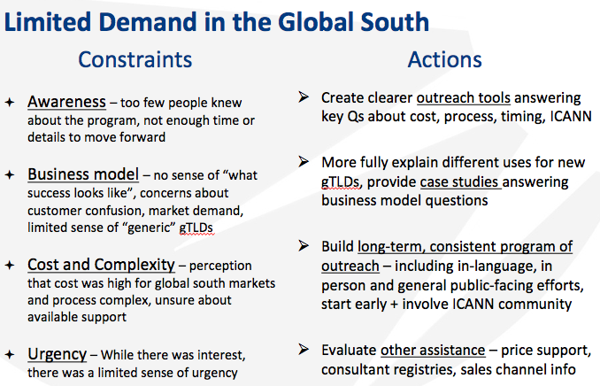
New gTLDs and the Global South (AMGlobal)

Slide 39
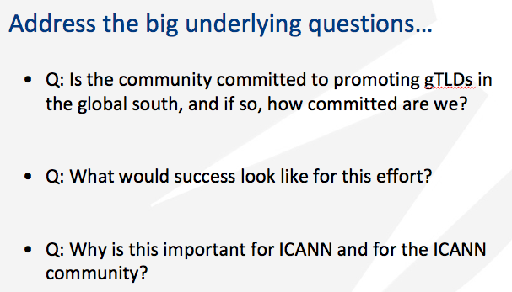
New gTLDs and the Global South (AMGlobal)

Slide 40
Applicant Survey (Nielsen)
Satisfaction
49% said received sufficient guidance from ICANN.
64% would apply again under the same process.
Discussion with respondents who agreed to be re-contacted (n=9) points out that the process itself is seen as onerous and bureaucratic. And it was marred by some technical malfunctions.
As such, applicants are seldom going to be “very satisfied” (1 in 45)
  As one participant stated “For this process, somewhat satisfied is actually a good rating.”

Slide 41
Applicant Survey (Nielsen)
Additional Insights from Follow-On
Technical problems (outage, digital archery) did not present ICANN well.
Changing process/timelines very frustrating for those who “played by the rules”. “If you work hard to meet the deadline, and someone else does not, that should be your advantage.”
Rule/process changes or shifting guidance undermine credibility e.g. plurals, linguistic reviews.
Perception held by some that ICANN does not respect the business/financial implications that their delays have on applicants.
Process was about procedure, not substance of applications—potentially a stronger concern for community applicants.
Letters of credit and bank transfers seen as onerous, non-standard, “illegal” or inappropriate for government entities.
Communication methods designed to convey impartiality, but some don’t believe impartiality was maintained.

Slide 42
Application & Evaluation
Q&A
Notes:
Breakup your presentation, divide it into sections. This is especially useful if most of your presentation is text.

Slide 43
Work Plan & Timeline
Notes:
Breakup your presentation, divide it into sections. This is especially useful if most of your presentation is text.

Slide 44


Work Plan
Community Input on Interim Findings
Final Report for Board consideration
Nov 2016
DNS Abuse Study and INTA Survey
July 2017
Draft Report for Public Comment
March 2017
Dec 2016
ICANN57
ICANN58

Slide 45
The Floor is Yours
Notes:
Breakup your presentation, divide it into sections. This is especially useful if most of your presentation is text.

Slide 46

WE WANT TO HEAR FROM YOU!
Send us an email at input-to-cctrt@icann.org
Interested in our work?
Follow our wiki at http://cct.wiki for more!
Happy to join your session at ICANN 57
Or to schedule a conference call
The floor is yours!

Slide 47
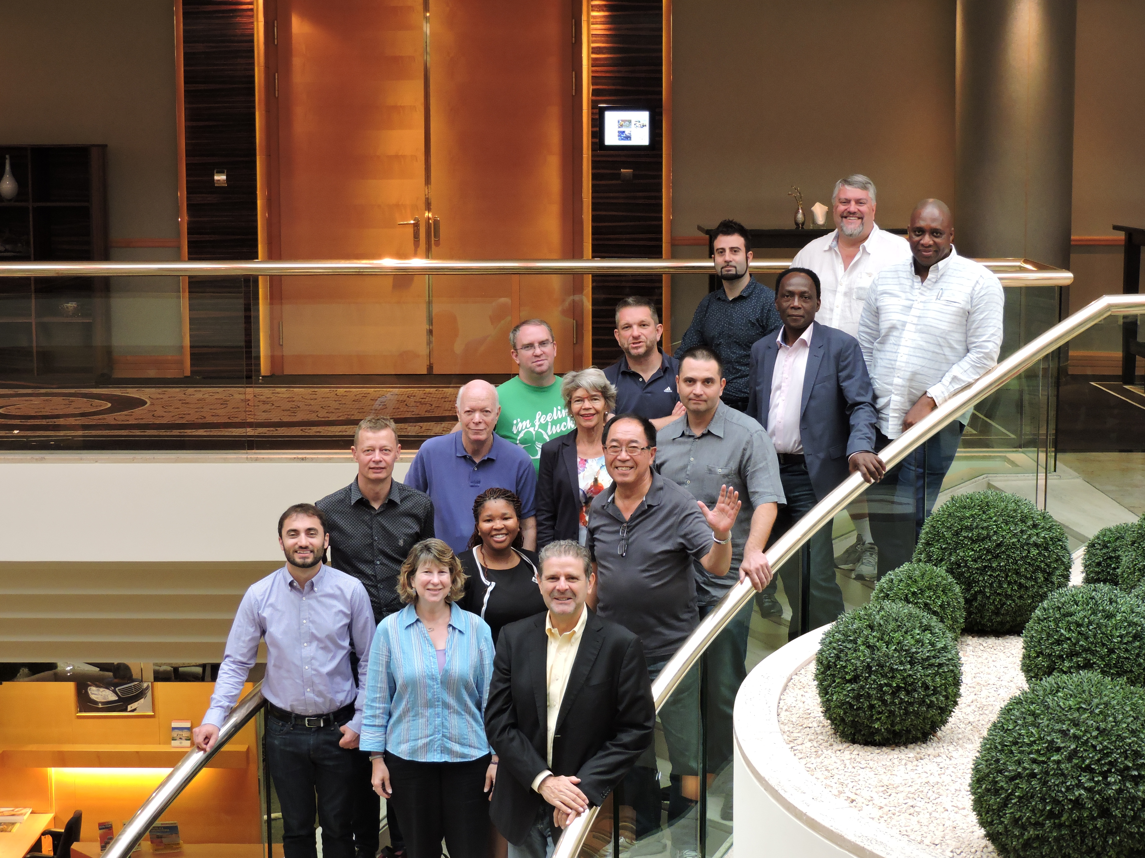
Thank you!
Notes:
Breakup your presentation, divide it into sections. This is especially useful if most of your presentation is text.

