Slide 1
Competition, Consumer Trust &
Consumer Choice Review – CCT-RT

Slide 2
Mandate
Evaluate how New gTLD Program has promoted competition, consumer trust and consumer choice
Effectiveness of application and evaluation processes
Affirmation of Commitments (AoC) review
Safeguards and protections
Safeguards and Trust

Slide 3

CCT Review Team Members
3
Europe
6
North America
2
3
Africa
Asia Pacific &
Oceania
3
Latin America &
Caribbean
17
Review Team Members include:
Independent Experts
ICANN CEO & Chair of GAC Designated Representatives
3

Slide 4
CCT Review Team Members
SO/AC Representatives |  | Independent Experts | Chair of GAC & ICANN CEO Representatives
GNSO | Calvin Browne | Drew Bagley | Laureen Kapin
 | Jordyn Buchanan | Stanley Besen | Jamie Hedlund
 | Carlos Raúl Gutiérrez | N. Ravi Shankar
 | Waudo Siganga | Fabro Steibel
 | David Taylor
 | Jonathan Zuck
ALAC | Kaili Kan
 | Carlton Samuels
GAC | Megan Richards
ccNSO | Dejan Djukic
 | Gaongalelwe G.P. Mosweu

Slide 5
Work Plan - Subteams
Competition & Consumer Choice
Safeguards & Trust
Application & Evaluation Process

Slide 6
Work Plan
March 2016: Determine issue areas
Q2-Q3 2016: Request additional data sets
May 2016: Phase 2 consumer survey results published
June 2016: Phase 2 economic study results published
Q2 2016: Interim recommendations issued
Q3 2016: Issue findings
Dec. 2016: Draft republic published for public comment
Dec. 2016-Jan. 2017: Public comment period
April 2017: Deliver final report and recommendations to ICANN Board

Slide 7
Competition and Consumer Choice Subteam
Notes:
Breakup your presentation, divide it into sections. This is especially useful if most of your presentation is text.

Slide 8
Key Questions: Competition
Has the expansion of gTLDs been effective at promoting price competition between TLD operators?
Has the expansion of gTLDs been effective at promoting non-price competition between TLD operators?
What are reasonable definitions of relevant markets that we might use to analyze competition?
How has the introduction of the new TLD’s affected competition between registrars and/or resellers?
Are consumers sufficiently aware to allow for competition?

Slide 9
Key Questions: Consumer Choice
Is further segmentation and regulation of the namespace valuable to consumers navigating the name space?
Has the benefits of the increase in choice outweighed the potential for the cost of confusion?
Do consumers have expanded choices in different…
  Regions
  Languages / Scripts
...and do they have options to purchase domains? (are there available registrars/resellers in their language/region/etc.)

Slide 10
Other Topics (lower priority)
Have different types of TLDs (community vs. brand vs. geo vs. “standard”) been able to provide effective alternatives to other TLDs?
Are domain names being allocated more efficiently to registrants who will use them well?
What is the effect of external influences of new technologies (e.g., mobile apps or QR codes) on the introduction of new gTLDs?
Is it too soon to accurately consider these issues?
What is the minimum viable scale for a TLD registry?
Is a new TLD a valid choice for a registrant if there isn’t universal acceptance of it?

Slide 11
Safeguards & Trust
Subteam
Notes:
Breakup your presentation, divide it into sections. This is especially useful if most of your presentation is text.

Slide 12
Safeguards & Consumer Trust
Can the public safely navigate to use new and gTLDs?
Impact of PICs and safeguards/
Risk of confusion and DNS abuse
Developing Countries
Trademark Issues

Slide 13
Safeguards and Consumer Trust
Safe Navigation and Use
Reach intended destination?
Destination is safe
Impact of PICS and Safeguards
Role of safeguards in new gTLDs
Are Public Interest Commitments enforced?
PICs for gTLDs in highly regulated sectors
Consumer literacy

Slide 14
Safeguards and Consumer Trust
Risk of Confusion and DNS Abuse
Consumer confusion over similarly named strings?
Developing Countries
Has the low participation of developing countries in the new gTLD process impacted the public’s trust and willingness to use new gTLDs?
Botnets, pharming, phishing, malware
Comparison of level of abuse and abuse policies in legacy and new gTLDs

Slide 15
Safeguards and Consumer Trust
Trademark Issues
Pricing models (absence of restrictions)
Rights Protection Mechanisms

Slide 16
Application & Evaluation Process Subteam
Notes:
Breakup your presentation, divide it into sections. This is especially useful if most of your presentation is text.

Slide 17
Was the application and evaluation process effective at…
Addressing the needs of underserved areas and markets?
  Serving the community
  Encouraging participation as providers from within the area
  Providing effective dispute resolutions for developing regions
  Examine barriers to entry for prospective participants for emerging economies
  IDNs
  App support

Slide 18
Was the application and evaluation process effective at…
Preventing the delegation of TLDs that would be confusing or harmful
  Standing in objection process
  String confusion
  Singular plurals
  Inconsistent decisions/appeals (not sure this is in scope)

Slide 19
Was the application and evaluation process effective at…
Allowing specific communities to be served by a relevant TLD?
  How we define community applicants and design an evaluation process fit to purpose?
  IDNs

Slide 20
Was the application and evaluation process effective at…
Providing equal opportunity for participation in the Program
  Risk of unfair advantage for those with more money (or disadvantage those with fewer resources)
  Linguistic barriers
  Sufficient outreach and awareness
  Infrastructure access

Slide 21
Was the application and evaluation process effective at…
Collecting and implementing GAC public policy advice
  Public Interest Commitments: voluntary vs. mandated
  Early enough participation by GAC
  Was GAC advice effectively formulated?

Slide 22
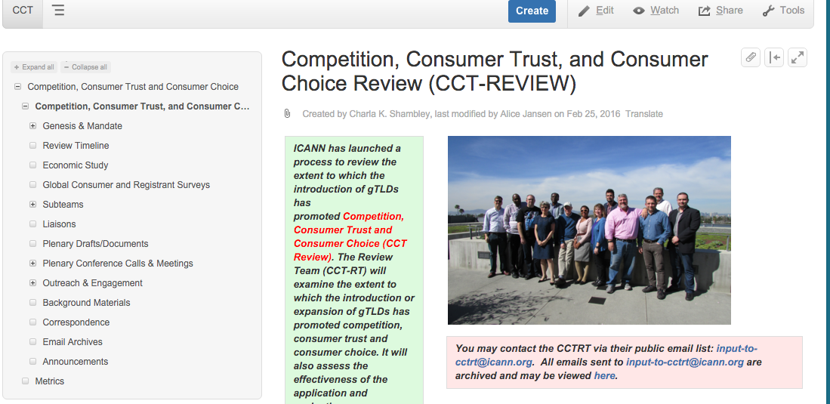
Interested in us?
Public wiki
Mailing-list archives
Open calls/meetings
etc..
See more at https://community.icann.org/pages/viewpage.action?pageId=56135383
Notes:
This is a simpler agenda slide, the outline for your presentation.

Slide 23

We want to hear from you!
Share your unique perspective with us - Your input is KEY to this process
Send us an email at input-to-cctrt@icann.org
Happy to join your session at ICANN 55
Or to schedule a conference call
The floor is yours!
Notes:
Use this slide for diagrams or other graphic elements.

Slide 24
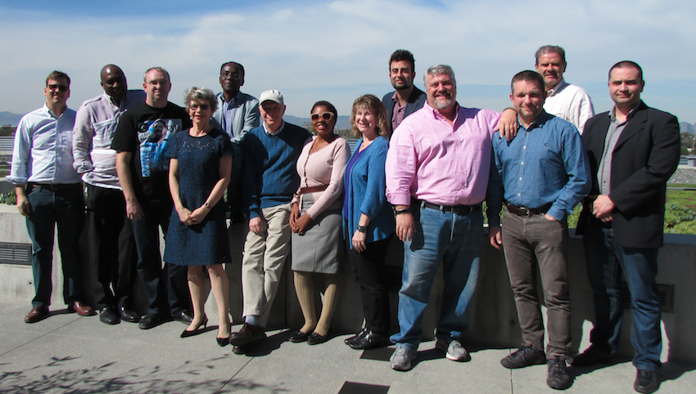
Thank you!
Full Width Photo or Video Here
350px x 650px
Notes:
Insert a 850 x 450 pixels photo.

