Slide 1
IANA Stewardship Transition &
Enhancing ICANN Accountability
Panel and Audience discussion | WSIS Forum | 5 May 2016

Slide 2
What is ICANN?
The Internet Corporation for Assigned Names and Numbers (ICANN) is a multistakeholder, private sector-led organization that manages Internet resources for the public benefit
ICANN helps coordinate the top-level of the Internet's system of unique identifiers via global, multistakeholder, bottom-up consensus policy processes, with the outcome of those processes implemented via the IANA Functions.

Slide 3
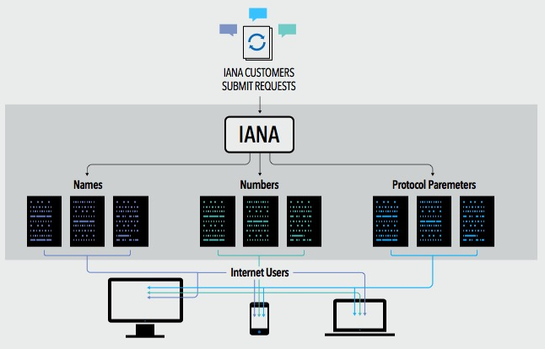
What are the IANA Functions?
The IANA Functions evolved in support of the Internet Engineering Task Force, and initially funded via research projects supported by the U. S. Department of Defense, Advance Research Projects Agency.
ICANN was created to perform the IANA Functions and has done so pursuant to a no-cost contract with the Department of Commerce for over 15 years
These functions include:
The coordination of the assignment of technical Internet protocol parameters
The administration of certain responsibilities associated with Internet DNS Root zone management
The allocation of Internet IP addresses

Slide 4






What is the multistakeholder community?
“Stakeholder” refers broadly to anyone who has an interest in the Internet
Within ICANN, stakeholders include:
The multistakeholder community functions on bottom-up consensus building which, by design, is resistant to capture due to the openness, diversity and equal division of authority among participants
ICANN’s private sector-led multi-stakeholder community supports the success of the Internet’s DNS
Large and small businesses
Technical community
Civil society
Governments
Researchers and academics
End users

Slide 5
The U.S. Government’s Announcement
14 March 2014: U.S. Government announces intent to transition its stewardship of the IANA functions to the global multistakeholder community
  Asked ICANN to convene global stakeholders to develop a proposal
  The multistakeholder community has set policies implemented by ICANN for more than 15 years
The U.S. Government’s announcement:
Marks the final phase of the privatization of the DNS
Further supports and enhances the multistakeholder model of Internet policy making and governance
ICANN was asked to serve as a facilitator, based on its role as the IANA functions administrator and global coordinator for the Internet’s Domain Name System (DNS)
Why
now?

Slide 6
Two Parallel Processes
The community developed and is following two parallel processes:
IANA Stewardship Transition
Focused on delivering a proposal to transition the stewardship of the IANA functions to the multistakeholder community
Enhancing ICANN Accountability
Focused on ensuring that ICANN remains accountable in the absence of its historical contractual relationship with the U.S. Government
To drive the processes, the community created multilayered, transparent and diverse working groups to foster discussion and within those groups, has developed working methods and systems for determining consensus

Slide 7
Developing Proposals
NTIA
Announcement
and Criteria
ICG Proposal
ICANN
ICG
CWG
Stewardship
Linkage
CWG Proposal
ICANN
Board
NTIA
Z
CRISP
CRISP Proposal
IANAPLAN
IANAPLAN Proposal
CCWG
Accountability
CCWG Proposal
Notes:
This is a simpler agenda slide, the outline for your presentation.

Slide 8
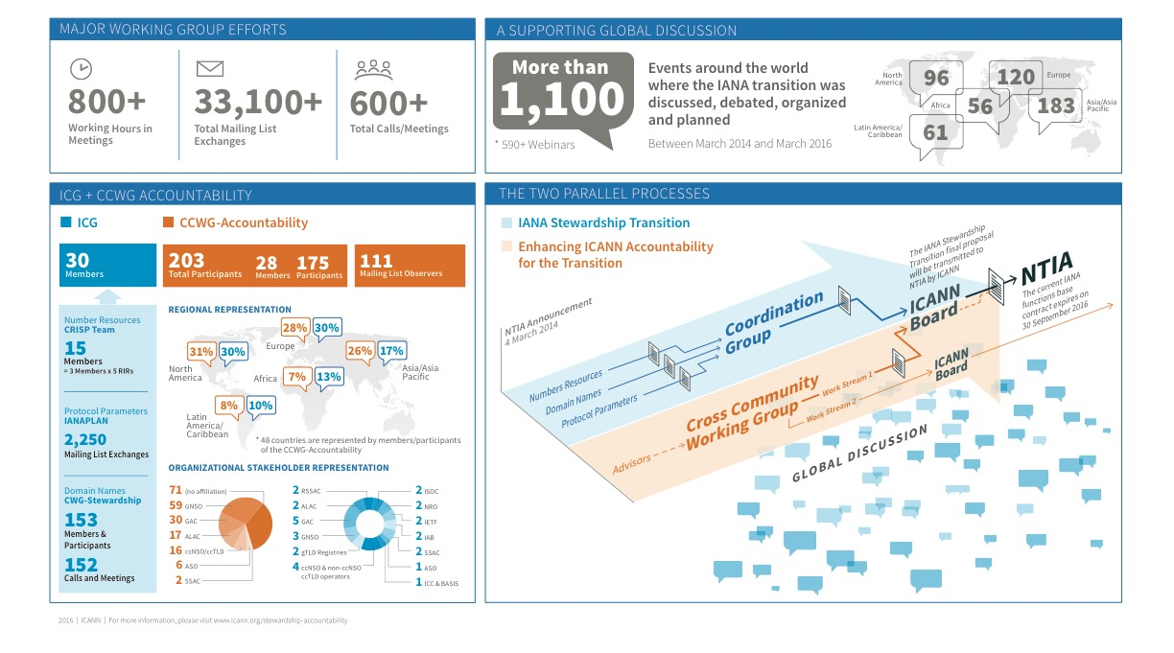
An Unprecedented Multistakeholder Effort

Slide 9
IANA STEWARDSHIP TRANSITION

Slide 10
Proposal Overview

Slide 11
Combined Proposal Overview

Slide 12
ENHANCING ICANN ACCOUNTABILITY

Slide 13
Work Streams
To address accountability concerns raised during initial discussions on IANA Stewardship Transition, a Cross Community Working Group on Enhancing ICANN Accountability (CCWG-Accountability) was convened.
The CCWG-Accountability’s work consists of two tracks:
GOAL: The CCWG-Accountability is expected to deliver proposals that would enhance ICANN’s accountability towards all its stakeholders
WORK STREAM 1: Focused on mechanisms enhancing ICANN accountability that must be in place or committed to within the time frame of the IANA Stewardship Transition.
WORK STREAM 2: Focused on addressing accountability topics for which a timeline for developing solutions and full implementation may extend beyond the IANA Stewardship Transition.

Slide 14
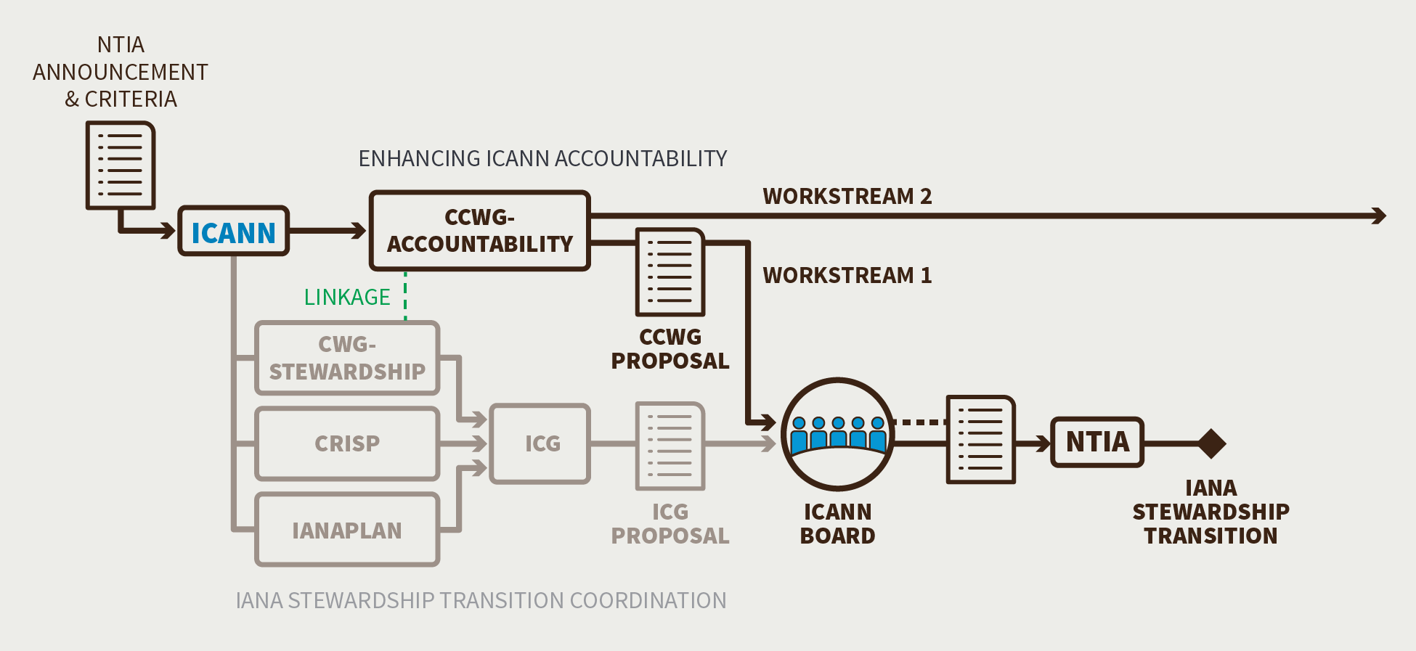
CCWG-Accountability
From December 2014 - March 2016, the CCWG-Accountability developed a set of proposed enhancements to ICANN’s accountability to the global Internet community. This document was distributed for the consideration and approval of the working group’s 6 Chartering Organizations.

Slide 15
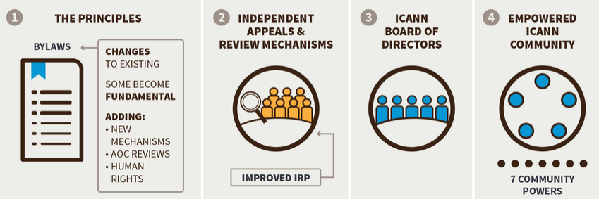
Four Building Blocks
The CCWG-Accountability identified four building blocks that would form the mechanisms required to improve ICANN’s accountability.

Slide 16
Principles / Mission
  Limited scope of what ICANN can do; no “content regulation”
  Updated definition of role for Domain Names, Numbering Resources and Protocol Parameters
  Incorporate Affirmation of Commitment (AoC) reviews
  Commitment to Human Rights

Slide 17
Independent Appeals & Review Mechanisms
  An enhanced Independent Review Process and redress process with a broader scope and the power to ensure ICANN stays within its Mission
  A community Independent Review Process as an enforcement mechanism further to a Board action or inaction

Slide 18
ICANN Board of Directors
  Clarify Board obligations with regards to consideration of Advice provided by the Governmental Advisory Committee (GAC)
  Include the review of Supporting Organization and Advisory Committee accountability mechanisms in the independent structural reviews performed on a regular basis

Slide 19
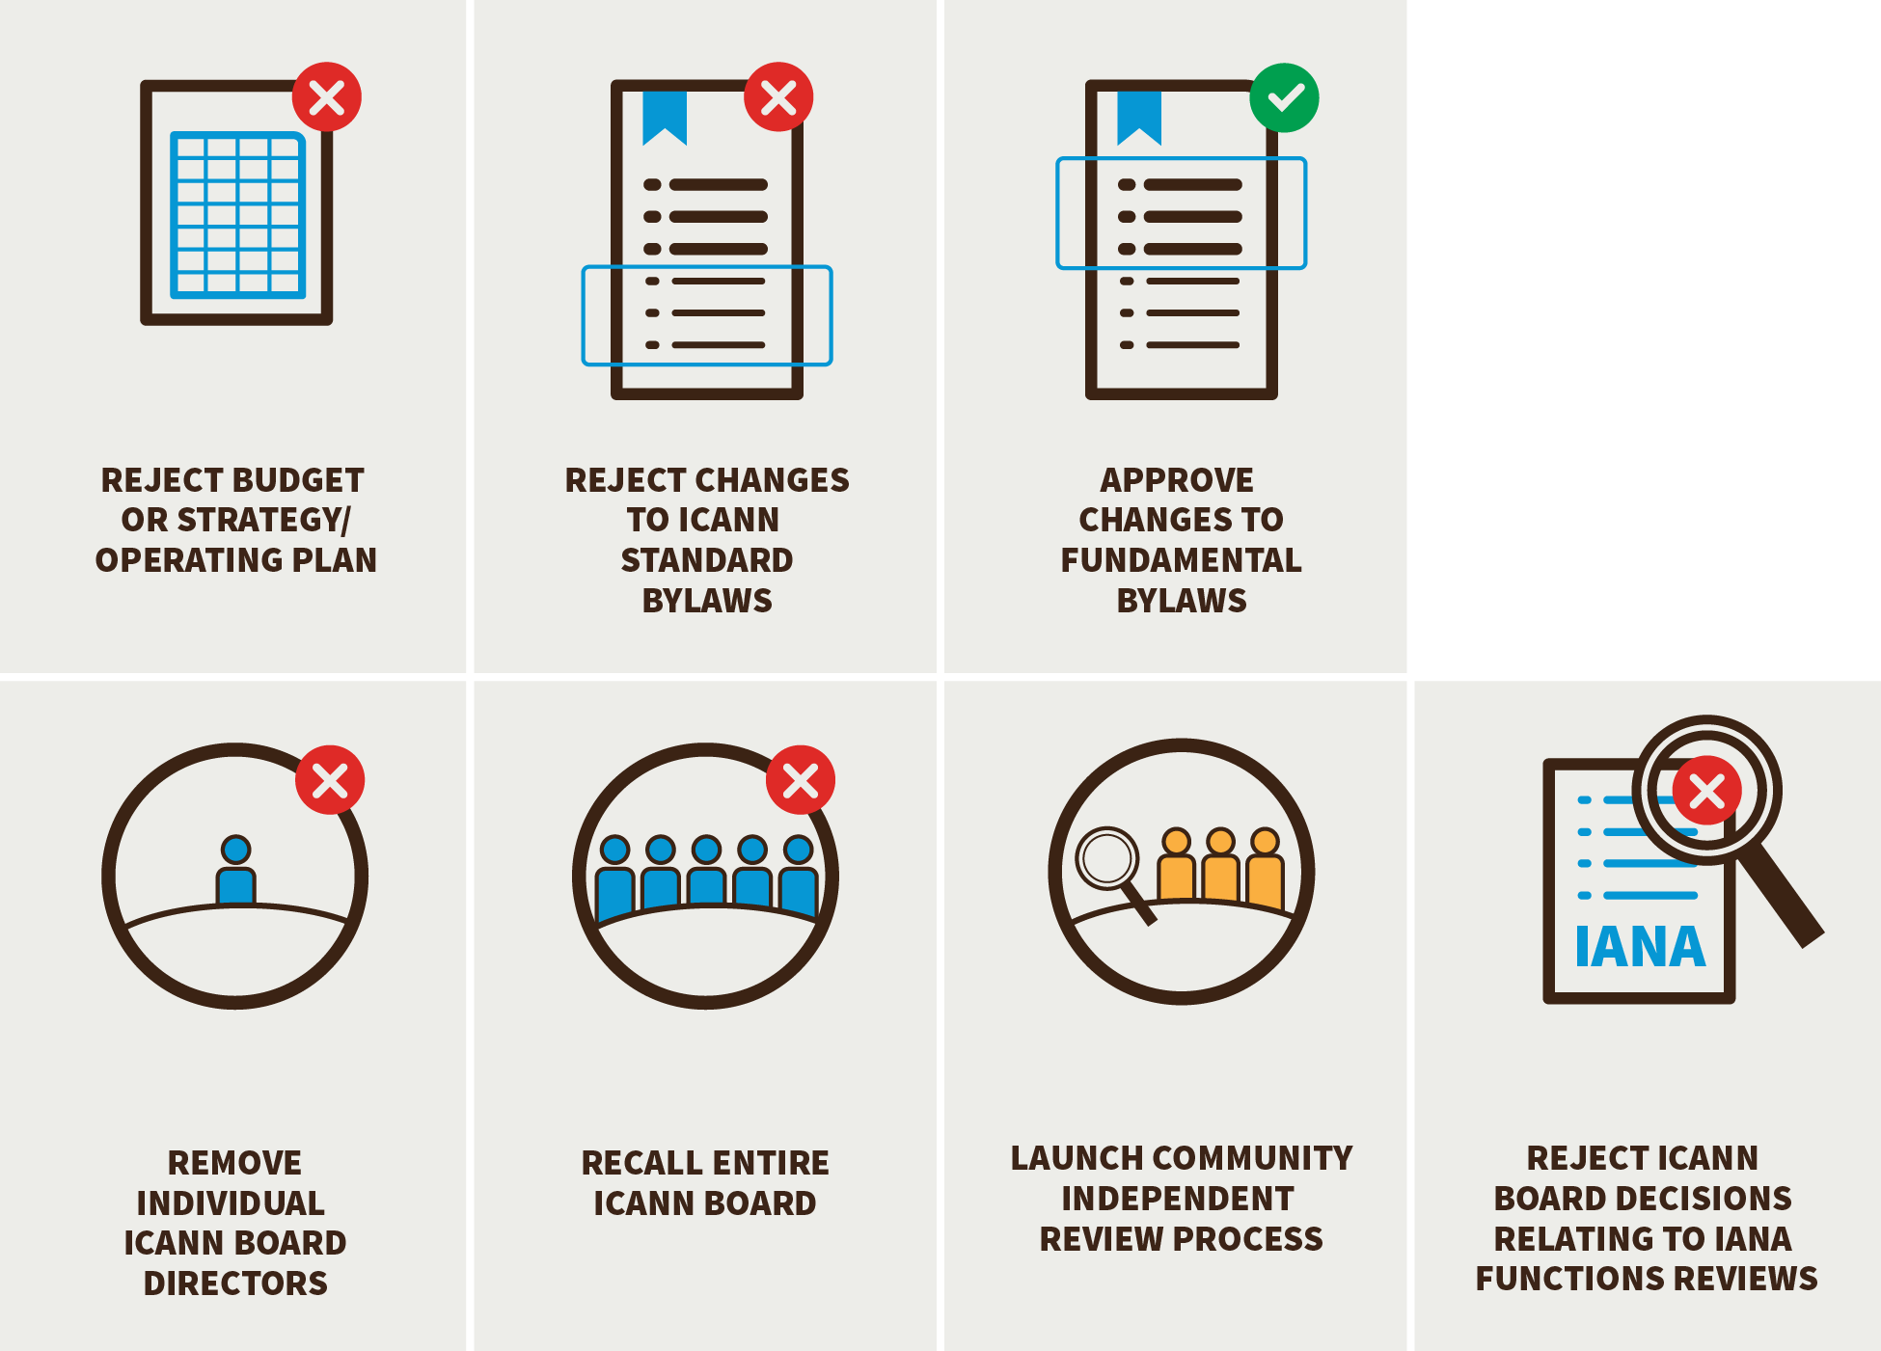
Empowered ICANN Community
Powers exercised by five groups within the ICANN community, recognized as a “Sole Designator”
Strong focus on Engagement and Escalation, before Enforcement

Slide 20
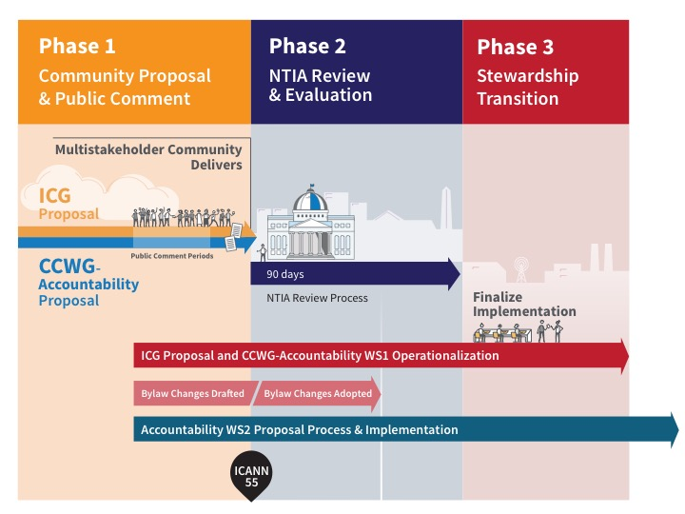
A Look Ahead: Phases 2 and 3

Slide 21
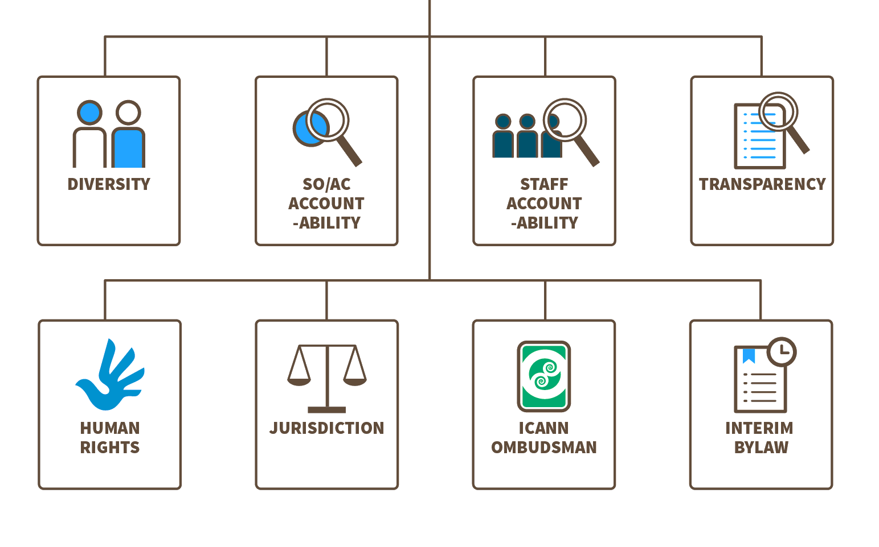
Committing to Further Accountability Work in Work Stream 2
The CCWG-Accountability’s work consists of two Work Streams:
WORK STREAM 1: Focused on mechanisms enhancing ICANN accountability that must be in place or committed to within the time frame of the IANA Stewardship Transition (COMPLETED)
WORK STREAM 2: Focused on addressing accountability topics for which a timeline for developing solutions and full implementation may extend beyond the IANA Stewardship Transition (IN PROGRESS)

Slide 22
QUESTIONS / DISCUSSION

Slide 23
What Can I Do Now To Get Involved?
Join a working group
  CCWG-Accountability, contact acct-staff@icann.org
Participate in a public comment period
Participating in public comment periods is an integral part of ICANN’s inclusive and bottom-up model of proposal development
Stay up to date on recent developments
  Visit: https://www.icann.org/stewardship-accountability
  Follow @ICANN on Twitter or like ICANN on Facebook
  Subscribe to ICANN news alerts

Slide 24


Questions?
Thank You and Questions
twitter.com/icann
Website: https://www.icann.org/
stewardship-accountability
facebook.com/icannorg
IANA Stewardship Transition
https://www.icann.org/stewardship
Latest news and information on the IANA Stewardship Transition and ICG
Community participation information
Resources and archives from ICG meetings
Enhancing ICANN Accountability
https://community.icann.org/category/accountability
Latest news and information on the Enhancing ICANN Accountability process and CCWG
Announcements and upcoming events

