Slide 1
At-Large Working Groups
Best Practices in Chairing, organization and participation
Cheryl Langdon-Orr & Olivier Crépin-Leblond
At-Large Capacity Building Webinar – 23 March 2016

Slide 2
Overview of Presentation
Overview of Working Groups
Working Group Types
Requirements for a working group
What needs to be decided as soon as possible?
What does a Chair do?
Working Plan
Monthly Reports
Conducting Meetings and calls
Questions

Slide 3
Overview of At-Large Working Groups: General (1)
Much of the work of the ALAC and At-Large takes place within some type of At-Large Working Group (WG)
The primary activity of At-Large WGs generally includes:
  Development of policy advice that feeds into ALAC statements
  Provision of advice to the ALAC on a specific project or on-going process-related activity
  Oversight on an on-going process
  Carrying out actions delegated by the ALAC related to policy, process or outreach and engagement

Slide 4
Overview of At-Large Working Groups: Types
There are several types of WGs depending on the nature of their mission:
  Sub-committee - Typically has an ongoing task that requires formal ALAC motions and voting.
  Example: The on-going requesting and monitoring of funding by
  the ALAC Subcommittee on Finance and Budget
  Standing Working Groups – Generally work on on-going or long-term issues
  Ad-Hoc Working Groups – The ALAC and RALOs may form ad hoc WGs to address specific projects or reach specific goals
  Taskforces – Usually have mandates to accomplish in a short time-frame
  Archived WGs – Deemed by the ALAC as being inactive or having completed their mandate

Slide 5
Overview of At-Large Working Groups: Requirements
When the ALAC establishes a WGs/Sub-Committee or Taskforce, it must set out the following:
  Terms of reference or charter
  Expected outcomes
  Method of selection of membership – including whether the membership is limited to ALAC members, to include balanced RALO or regional representation or is open to member of At-Large
  Identification of an interim Chair and how the permanent Chair is to be selected
  Whether the group is to be Sub-committee, a standing or ad-hoc WG or Taskforce based on mission or terms of reference

Slide 6
What needs to be decided as soon as possible?
Once an interim Chair or a permanent Chair is selected:
  Definition and tracking of objectives
  Decision on working methods:
    Conference calls
      Call timing rotation – very important
      Is interpretation really needed?
    Mailing List
      Stimulate as much work and discussion on the mailing list
    WIKI pages
    Face to Face meetings
      These might happen at ICANN meetings or other occasions, but are few and far between

Slide 7
So what does a WG Chair do?
Once an interim Chair or a permanent Chair is selected:
  Definition of a working plan
    Communication is the key to a successful working group
  The Chair is a facilitator
    Making sure all documents can be found in a single location:
      Document store
      Use both PPT/MSWord & PDF formats
    Stimulate the discussion on the mailing list
      Ask provocative questions
      Enquire whether a current topic needs addressing by the WG
    Make sure that the WG is run in harmony
      https://www.icann.org/resources/pages/expected-standards-2012-05-15-en
      If things go wrong, tell Staff ASAP

Slide 8
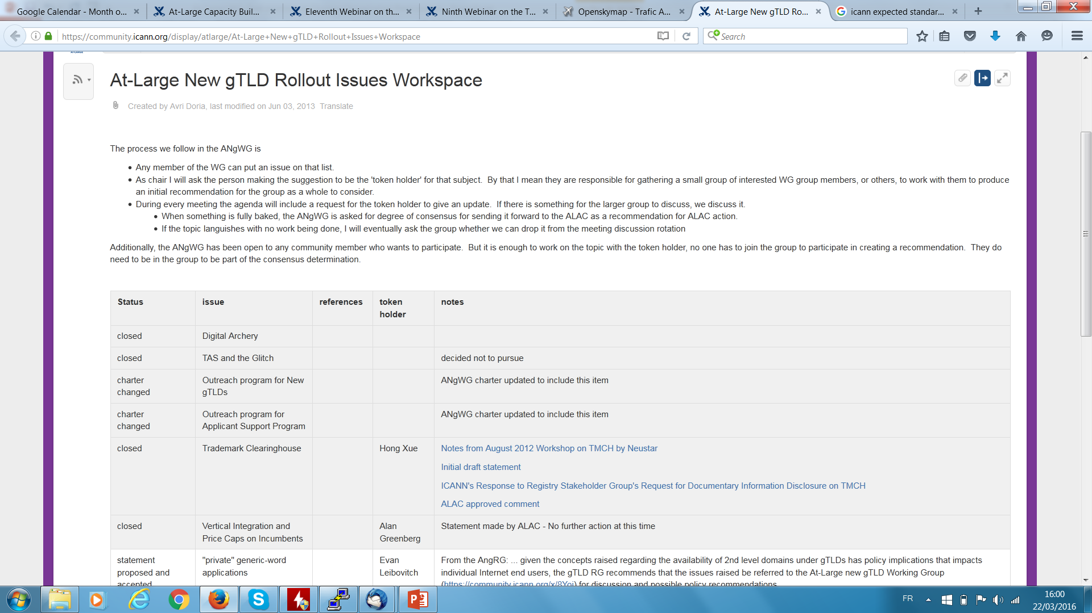
Working Plan

Slide 9

Monthly Reports

Slide 10
Responsibilities of the Chair - Meetings...
Before- Admin matters (often facilitated by / with our excellent staff support)
Clarify and agree on Purposes and Aims (noting different meeting types and activities require different styles and levels of this ranging from a Mandate or Charter, Purpose Statement,. )
Scheduling / doodle invitations to attend/’advertising’.
Platform, virtual ‘room’ or physical space
Preparatory and support material *including an AGENDA* (wiki, email, hard copy, digital or web) Everything else on an agenda, beyond the including topics, times, and presenters are the activities that, taken together, will accomplish the aims. A weekly or regular meeting may not require meeting aims beyond the agenda items.
Circulate material (or links to it) in advance.
Ensure any recording or language services requirements.

Slide 11
Responsibilities of the Chair - Meetings...
During - Work with an Actionable Agenda - An Agenda is a roadmap for your meeting.
This may be a component of, or clearly mapped to, a more formal Work Plan (which in itself could be subject to review)
Remember to use Verbs like ‘decide, discuss, review, select, finish, plan or propose’.
Wherever practical and possible establish an Action Item (AI) or task as a result of your Actionable Agenda, which should include an allocation of lead person or people who ‘own these tasks.
Whether you publish them as part of the Agenda or not => allocate at least rough timings for each Agenda Item/ topic… *BUT* always allow for flexibility as needs vary. Agile Agenda’s are sometimes as important as Actionable ones.

Slide 12
Responsibilities of the Chair - Meetings...
During - Work diligently to ensure participation of (or at least the opportunity for), all participants voices to be heard.
This may mean establishing specific procedures to ensure overly dominant participants do not overshadow others, or the use of enablement actions to encourage more passive or silent participants to better engage.
Always call for any proposed additions or changes to a published Agenda at the start of a call and see if any AOB can be foreshadowed from the outset.
Recap often *remembering* that the best Chair is one that is demonstrably “neutral” or in some cases actually independent of particular views or pre-empting of outcomes.
Use of Subsequent Reads pre Decision, and Opportunity to Review vs. Rehashing Decisions

Slide 13
Responsibilities of the Chair - Meetings...
After - Work diligently to ensure participation of (or at least the opportunity for), all participants voices to be heard.
Distribute Minutes and Meeting records (or links thereto) in a timely manner.
Check Archives are maintained and updated, and that Standard Operation Procedural Requirements (such as SOI’s being lodged and updated under the rules of ‘Continuous Disclosure’ etc.,) are attended to regularly.
Check for Actionables and follow up with ‘owners’ of AI’s / Tasks sufficiently in advance of any next meeting(s) or deadlines to avoid slipping where possible.
Offer to assist (this does not mean you doing but often delegating assistance)
Sort out “small fires” from “big Issues” and deal with challenges in an agile, yet transparent and accountable way.

Slide 14
Questions?
Notes:
Breakup your presentation, divide it into sections. This is especially useful if most of your presentation is text.

