Slide 1
Competition, Consumer Trust &
Consumer Choice Review – CCT-RT

Slide 2
Mandate
Evaluate how New gTLD Program has promoted competition, consumer trust and consumer choice
Effectiveness of application and evaluation processes
Affirmation of Commitments (AoC) review
Safeguards and protections
Safeguards and Trust

Slide 3

CCT Review Team Members
3
Europe
6
North America
2
3
Africa
Asia Pacific &
Oceania
3
Latin America &
Caribbean
17
Review Team Members include:
Independent Experts
ICANN CEO & Chair of GAC Designated Representatives
3

Slide 4
CCT Review Team Members
SO/AC Representatives |  | Independent Experts | Chair of GAC & ICANN CEO Representatives
GNSO | Calvin Browne | Drew Bagley | Laureen Kapin
 | Jordyn Buchanan | Stanley Besen | Jamie Hedlund
 | Carlos Raúl Gutiérrez | N. Ravi Shankar
 | Waudo Siganga | Fabro Steibel
 | David Taylor
 | Jonathan Zuck
ALAC | Kaili Kan
 | Carlton Samuels
GAC | Megan Richards
ccNSO | Dejan Djukic
 | Gaongalelwe G.P. Mosweu

Slide 5
Work Plan - Subteams
Safeguards & Trust
Consumer trust
Trademark issues
Impact of PICS and other safeguards
Other
Competition & Consumer Choice
Application & Evaluation Process
Application process, transition to delegation
Application evaluation
Objection procedures, content resolution
Applicant support, continuitg operations instrument, program management

Slide 6
Work Plan
March 2016: Determine issue areas
Q2-Q3 2016: Request additional data sets
May 2016: Phase 2 consumer survey results published
June 2016: Phase 2 economic study results published
Q2 2016: Interim recommendations issued
Q3 2016: Issue findings
Dec. 2016: Draft republic published for public comment
Dec. 2016-Jan. 2017: Public comment period
April 2017: Deliver final report and recommendations to ICANN Board

Slide 7
Safeguards & Consumer Trust
Can the public safely navigate to and use new gTLDs?
Impact of PICs and safeguards/
Risk of confusion and DNS abuse
Developing Countries
Trademark Issues

Slide 8
Safeguards and Consumer Trust
Safe Navigation and Use
Reach intended destination?
Destination is safe
Impact of PICS and Safeguards
Role of safeguards in new gTLDs
Are Public Interest Commitments enforced?
PICs for gTLDs in highly regulated sectors

Slide 9
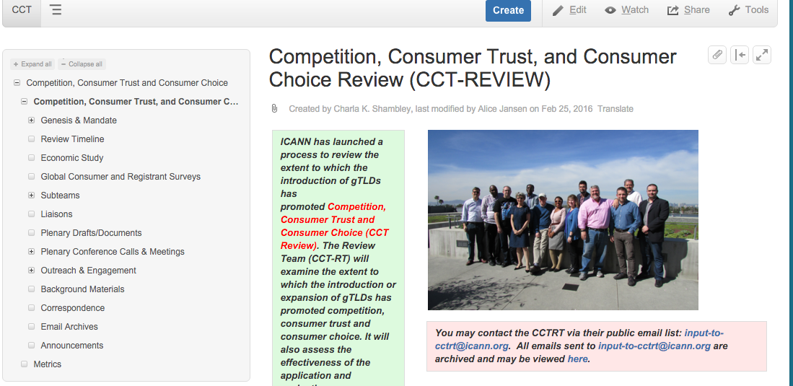
Interested in us?
Public wiki
Mailing-list archives
Open calls/meetings
etc..
See more at https://community.icann.org/pages/viewpage.action?pageId=56135383
Notes:
This is a simpler agenda slide, the outline for your presentation.

Slide 10

We want to hear from you!
Share your unique perspective with us - Your input is KEY to this process
Send us an email at input-to-cctrt@icann.org
Happy to join your session at ICANN 55
Or to schedule a conference call
The floor is yours!
Notes:
Use this slide for diagrams or other graphic elements.

Slide 11
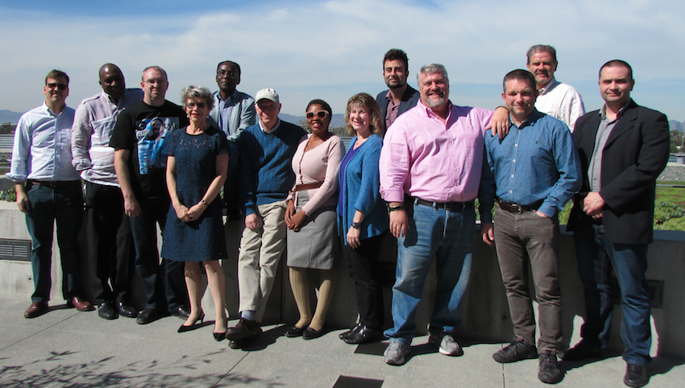
Thank you!
Full Width Photo or Video Here
350px x 650px
Notes:
Insert a 850 x 450 pixels photo.

