Slide 1


EAI Challenges & Actions from Coremail
Marvin Woo

Slide 2

Today Coremail
17 years Concentration on email technology
35,000+ Business Clients, 700+ Million users
1,500+ government institutions, universities are using Coremail
The first EAI provider
The only one with private e-mail solution as well as email clouding service

Slide 3

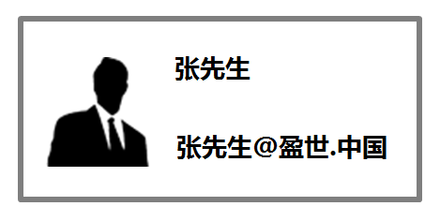
What is EAI ?
IDN Email is email that contains international characters.
International Email Address(IEA) contains non-Roman characters .
e.g. 张先生@盈世.中国;
김희선@항성.한국;
あたりこうすけ@とうしば.日本
International email address is a kind of personal ID with national and ethnic characteristics.
(Name @ company’s name. china)

Slide 4

Coremail’s EAI--Double Email Addresses
Main Address (UTF-8)：Email receiving and sending with RFC 6531
User
Alias Address (ASCII)： Email receiving and sending with RFC 2821
张三@互联网中心.中国
ZhangSan@cnnic.cn
张三@互联网中心.中国
李四@盈世.中国
Receipt
Sending
ZhangSan@cnnic.cn
lisi@coremail.cn

Slide 5
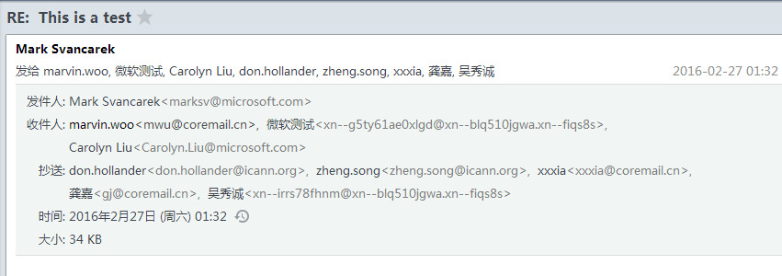
Coremail’s EAI--Punycode
If the email system cann't support EAI, it switches to punycode

Slide 6



Coremail’s EAI--Receive Email
Coremail will classify Emails receipt with different standards.
Receive Email by RFC6531
YES
Send Email
EAI Email?
Receive Email by
RFC2821
NO

Slide 7
Coremail’s EAI--Send Email
Formed by RFC 6532
Send mail by
RFC 6531
YES
Log in with EAI
Send Email
Receiver support EAI?
Formed by RFC2045
Send mail by
RFC2821
NO
Use alias email address

Slide 8



The Challenges met by Coremail
Coremail had EAI in 2012, but met challenges:
No Client supporting EAI
NO EAI Register Platform

Slide 9
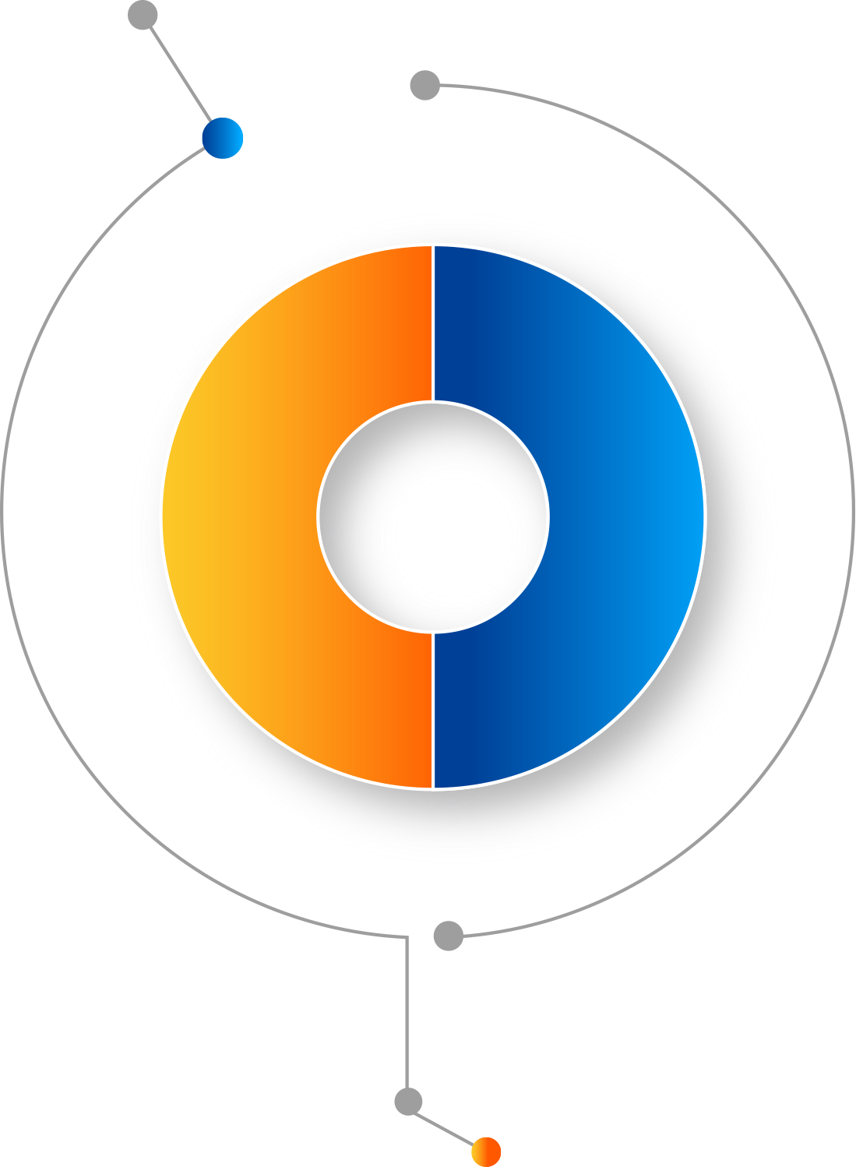


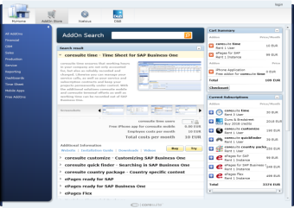


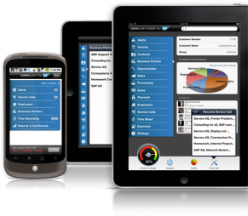


Coremail’s EAI Progress--clients
PC
iOS
App
Release EAI Register Platform
Current
Clients
Operating systems
Android
Release Coremail Flash Mail/APP/Lunkr supporting EAI
EAI
Flash Mail
Windows
Upgrade the email clouding service platform to support EAI
Lunkr
Mobile

Slide 10
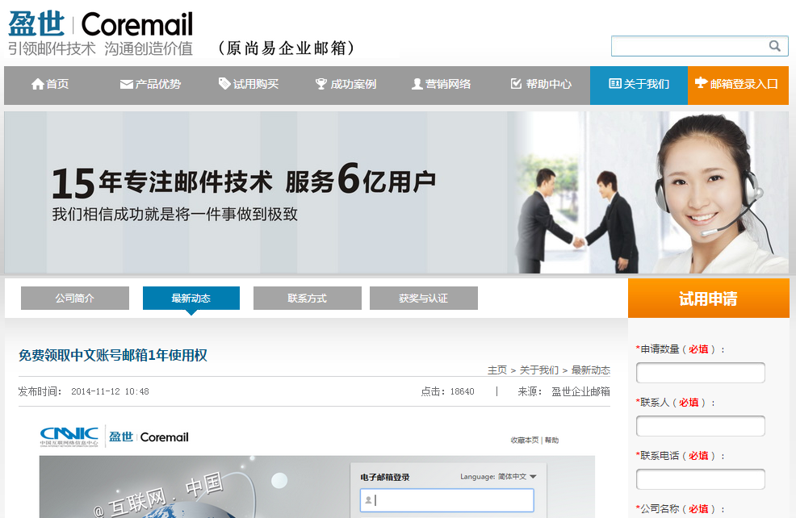
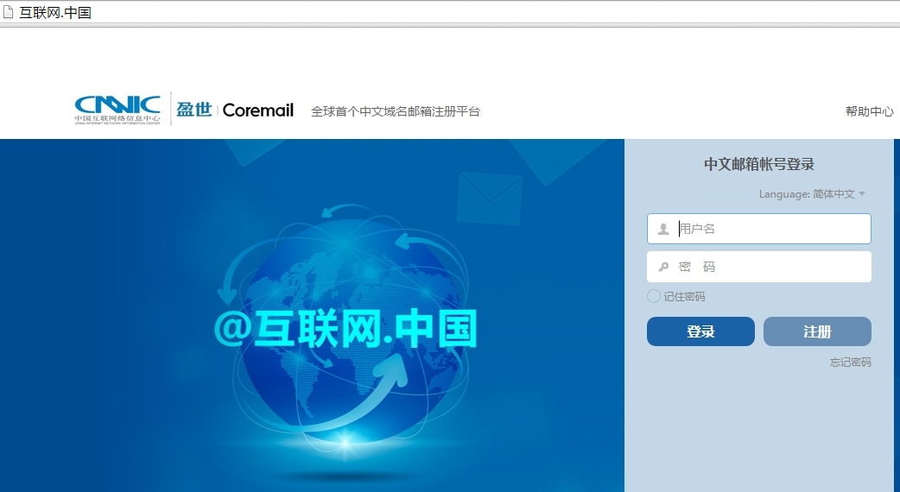
Coremail’s EAI Progress— Register Platform
  the total registered users are more than 100000.

Slide 11
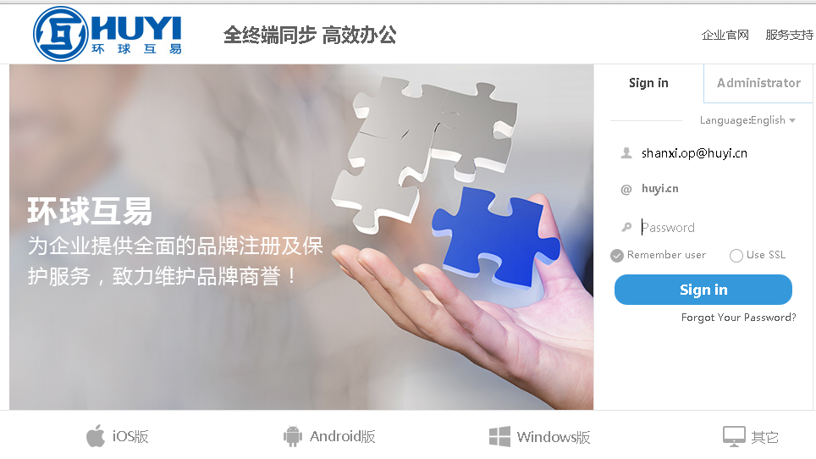
EAI Examples— Chinese
  Huyi EAI Email
  Coremail Agent and gTLD and ccTLD Registrar
  EAI Email System for sales
Coremail Saas Platform
  Millions users on Coremail Saas Platform
  All users have double accounts for EAI application
EAI Email System

Slide 12
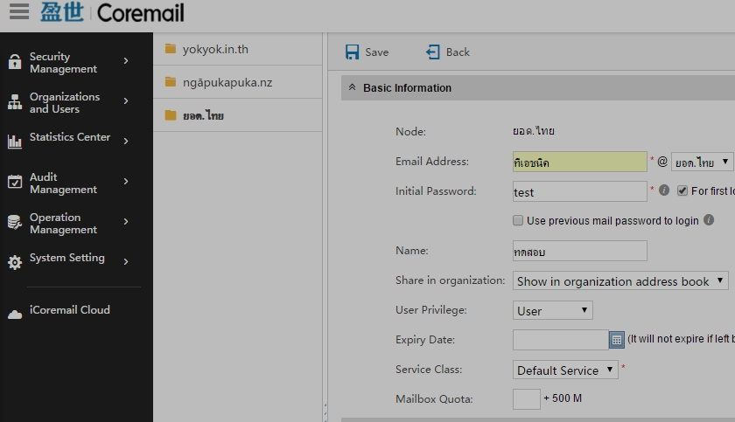
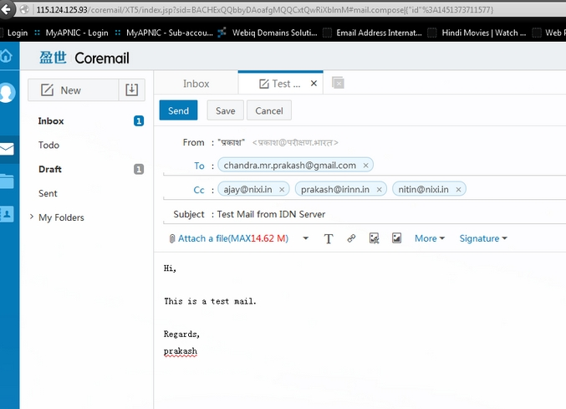
EAI Examples— Thai & Hindi Languages
In Thai Language
In Hindi Language

Slide 13
Challenges Now
EAI cannot improved
Not too much EAI end users
Few systems accepts EAI as registered ID
Softwares Lack of motivation to upgrade
Due to languages, EAI is limited in a local circle
Foreign languages are difficult for international users,
Fewer population, fewer users;
English-speakers lack of motivation
Few apps accept EAI as registered ID
Compatibility issues of different OS and software
platforms
Negative Circle

Slide 14

Call for Actions
Punycode
Compatibility Actions
Keep punycode, ASCII, Unicode
Optimize Punycode
Email operators work together
Users Actions
Deploy and use EAI applications in some
closed circles, such as army, government.
Others…
Thai
Punycode
Hindi
Punycode
Chinese 中文

Slide 15
Thank you!

