Slide 1
IANA Stewardship Transition &
Enhancing ICANN Accountability
Albert Daniels | Webinar LACRALO | December 17, 2015

Slide 2
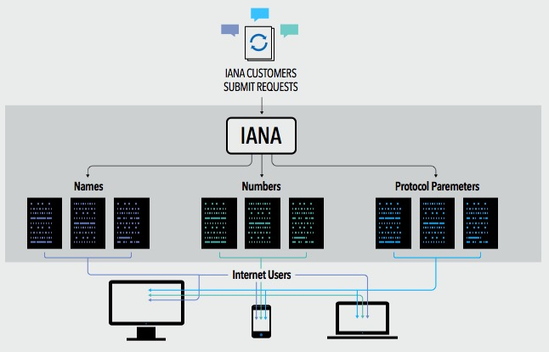
What are the IANA Functions?
The IANA Functions evolved in support of the Internet Engineering Task Force, and initially funded via research projects supported by the U. S. Department of Defense, Advance Research Projects Agency.
ICANN was created to perform the IANA Functions and has done so pursuant to a no-cost contract with the Department of Commerce for over 15 years
These functions include:
The coordination of the assignment of technical Internet protocol parameters
The administration of certain responsibilities associated with Internet DNS Root zone management
The allocation of Internet IP addresses

Slide 3






What is the multistakeholder community?
“Stakeholder” refers broadly to anyone who has an interest in the Internet
Within ICANN, stakeholders include:
The multistakeholder community functions on bottom-up consensus building which, by design, is resistant to capture due to the openness, diversity and equal division of authority among participants
ICANN’s private sector-led multi-stakeholder community supports the success of the Internet’s DNS
Large and small businesses
Technical community
Civil society
Governments
Researchers and academics
End users

Slide 4
The U.S. Government’s Announcement
14 March 2014: U.S. Government announces intent to transition its stewardship of the IANA functions to the global multistakeholder community
  Asked ICANN to convene global stakeholders to develop a proposal
  The multistakeholder community has set policies implemented by ICANN for more than 15 years
The U.S. Government’s announcement:
Marks the final phase of the privatization of the DNS
Further supports and enhances the multistakeholder model of Internet policy making and governance
ICANN was asked to serve as a facilitator, based on its role as the IANA functions administrator and global coordinator for the Internet’s Domain Name System (DNS)
Why
now?

Slide 5
Why Does This Matter to Business?
Almost $8 trillion exchange hands each year through e-commerce, and the continued success of e-commerce is dependent on one, global, secure, stable and interoperable Internet
Business has an important seat at the table in this global conversation and needs to be an active participant in facilitating a successful transition
The next billion Internet users will connect from developing countries and emerging economies. Sole U.S. oversight of the IANA functions is no longer optimal given this new global landscape
  A successful transition would ensure the continuation of a secure, stable and interoperable Internet for all users globally, while failure could result in adverse consequences for global Internet commerce
Notes:
Utilize slides 6-9 depending on the audience.

Slide 6

BCG Article on U.S. Digital Engagement
U.S. companies of all sizes and in all industries have a big interest in maintaining their ability to take full advantage of expanding interconnectedness.
20 years ago, 61% of the Internet’s 35 million users were based in the U.S. Today, the U.S. accounts for less than 10% of the 3 billion connected people worldwide
The U.S. digital economy will contribute $1 trillion to national GDP in 2016.
With an estimated $1.6 trillion in exports in 2014, the U.S. is a major player in the global economy, and the Internet is a powerful driver of global trade.
According to Cisco Systems, there were:
  500 million connected devices in 2003
  12.5 billion in 2010
  Expected to rise to 50 billion in 2020
To make sure U.S. companies and consumers continue to have access to the Internet’s transformational capabilities, both government and private-sector leaders need to stay engaged in the Internet’s long-term evolution.

Slide 7
BCG Article on U.S. Digital Engagement
Areas where U.S. companies can take advantage of a single global Internet:
Small
Business
Manufacturing
Services
72% of U.S. based manufacturing executives (with sales >$1 billion)
said they will invest in additional automation or advanced-manufacturing technologies in next 5 years
Technology leaders far outperform their peers in the marketplace:
12% vs 1% job growth
14% vs 3% annual revenue
increase
The U.S. exported $400 billion in digitally deliverable services in 2014:
Up 12% since 2011
Represents 56% of all U.S. service exports
Represents 17% of total exports
Notes:
This is a simpler agenda slide, the outline for your presentation.

Slide 8
Why Does This Matter to the Technical Community?
IANA services are core and critical to the use of the Internet Protocol.
For several years the technical community has called for an end to the NTIA contract
  This is an opportunity for the community to show how serious it is in further developing this model of Internet Governance
You have a lot of experience in the bottom-up and multistakeholder policy development processes
Your participation and engagement into the process is critical in this evolution of Internet Governance to maintain the security, stability, and resiliency of the Internet DNS and to ensure the IANA functions continue meeting the needs and expectations of the global customers and partners
Notes:
Utilize slides 6-9 depending on the audience.

Slide 9
Why Does This Matter to Governments?
The IANA Stewardship Transition is important for all stakeholders, especially for governments given their responsibility over Internet public policy issues
Successful completion of the IANA Stewardship Transition recognizes that no single government – or group of governments – should have any form of control over the security, stability and interoperability of the Domain Name System (DNS)
  This will help ensure the continued openness, interoperability and stability of the Internet which both countries and their citizens economically, socially and culturally benefit from
The IANA Stewardship Transition proposal will be accompanied by significant proposals to further enhance ICANN’s accountability to the entire Internet Community; including governments (on an equal footing)
Notes:
Utilize slides 6-9 depending on the audience.

Slide 10
Why Does This Matter to Civil Society?
Although the IANA functions are operational functions, they do require global governance and stewardship
The expertise from the non-governmental organization community is essential, especially due to:
  Its expertise in holding governance entities accountable
  Its experience in understanding and explaining public interest
  Its ability to be innovative and propose solutions
Your participation, and that of your networks, is critical in this evolution of Internet Governance to ensure excellence in the proposals and the legitimacy of the processes
This is a chance to strengthen an inclusive, transparent, global and collaborative model of governance that is fit for our present and future
Notes:
Utilize slides 6-9 depending on the audience.

Slide 11




Transition Requirements set by NTIA
NTIA has stated that the transition proposal must have broad community support and address the following four principles:
Support and enhance the multistakeholder model
Maintain the security, stability and resiliency of the Internet DNS
Meet the needs and expectations of the global customers and partners of the IANA services
Maintain the openness of the Internet
NTIA also specified that it will not accept a proposal that replaces the NTIA role with a government-led or intergovernmental organization solution.

Slide 12
Two Parallel Processes
The community developed and is following two parallel processes:
IANA Stewardship Transition
Focused on delivering a proposal to transition the stewardship of the IANA functions to the multistakeholder community
Enhancing ICANN Accountability
Focused on ensuring that ICANN remains accountable in the absence of its historical contractual relationship with the U.S. Government
To drive the processes, the community created multilayered, transparent and diverse working groups to foster discussion and within those groups, has developed working methods and systems for determining consensus

Slide 13
Developing Proposals
NTIA
Announcement
and Criteria
ICG Proposal
ICANN
ICG
CWG
Stewardship
Linkage
CWG Proposal
ICANN
Board
NTIA
Z
CRISP
CRISP Proposal
IANAPLAN
IANAPLAN Proposal
CCWG
Accountability
CCWG Proposal
Notes:
This is a simpler agenda slide, the outline for your presentation.

Slide 14
IANA STEWARDSHIP TRANSITION

Slide 15




The IANA Stewardship Transition: ICG
The IANA Stewardship Transition Coordination Group (ICG) was formed in July 2014 to assemble and deliver a proposal to NTIA through the ICANN Board
  The ICG is made up of 30 individuals representing 13 communities of both direct and indirect stakeholders of the IANA functions
  The ICG’s responsibilities include:
Act as a liaison to all
interested parties, including the three operational communities of the IANA functions
Assess the outputs of
the three operational
communities for compatibility and interoperability
Assemble a complete proposal for the transition
Information
sharing and public communication

Slide 16
ICG RFP Required Proposal Elements
1
Description of community’s use of IANA functions
A description of the function
A description of the customer(s) of the function
What registries are involved in providing the function
A description of any overlaps or interdependencies between that community’s IANA requirements and the functions required by other customer communities
Existing, Pre-Transition arrangements
Policy sources
Oversight and accountability
Proposed Post-Transition oversight and accountability arrangements
Transition implications
2
3
4
5

Slide 17
Request for Transition Proposal Structure
Names
Proposal
Numbers
Proposal
Protocol Parameters
Proposal
Meetings
Mailing list discussion
Public comments
Meetings
Mailing list discussion
Public comments
Meetings
Mailing list discussion
Public comments
ICG (Combined) Proposal
Notes:
This slide can be used for text, graphics or any other elements.

Slide 18
Domain Names Community
The Domain Names community developed a Cross Community Working Group (CWG-Stewardship) to produce a consolidated transition proposal for the elements of the IANA Functions relating to the Domain Name System.
Finalized a Second Draft Proposal:
  Operational: the CWG-Stewardship shifted into expertise-based subgroups to produce the operational parts of the proposal.
    There were 15 ‘Design Teams’ proposed (one on escalation mechanisms, one on reviews, etc.)
  Structural: the group, with assistance from independent legal counsel, considered 7 alternative structural models not fully considered in the first draft proposal
Submitted its response to the ICG RFP on 25 June 2015

Slide 19
Proposal Overview

Slide 20
Linkage & Coordination with CCWG-Accountability
ICANN Budget
Community rights regarding development and consideration
Customer Standing Committee (CSC)
Incorporated into the bylaws
1
4
ICANN Board
Community rights, specifically to appoint/remove members, recall entire Board
Appeals Mechanism
Independent Review Panel should be made applicable to IANA Functions and accessible by TLD managers
2
5
Fundamental bylaws
All foregoing mechanisms are to be provided for in the bylaws as “fundamental bylaws”
3
6
IANA Function Review
Incorporated into the bylaws
The CWG-Stewardship’s proposal is expressly conditioned upon the outcomes of the CCWG-Accountability.
Notes:
Summarize the three main points of your presentation here.

Slide 21
Numbering Resources Community
The five Regional Internet address Registries (RIRs) engaged in community consultations in their respective regions from September to November 2014
The Consolidated RIR IANA Stewardship Proposal Team (CRISP Team) was developed to coordinate the production of a response to the RFP based these consultations
  15 members, 3 from each RIR community
Submitted its response to the ICG RFP on 15 January 2015

Slide 22
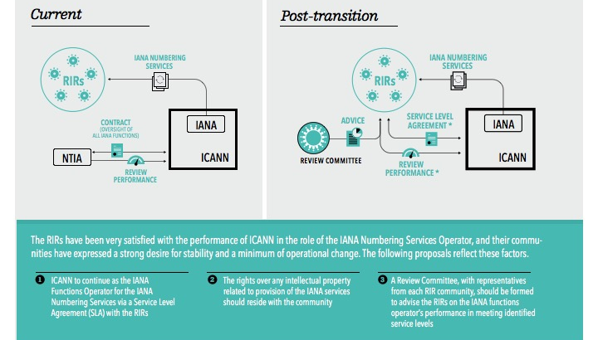
Proposal Overview

Slide 23
Protocol Parameters Community
Established an IANAPLAN Working Group to develop its response to the RFP
  Adopted an Internet Draft as a basis for developing a response
  Underwent IETF last call, and IESG approval
  A total of 10 drafts were produced over 9 months
Submitted its response to the ICG RFP on 6 January 2015

Slide 24
Proposal Overview

Slide 25
Combined Proposal Overview

Slide 26
Public Comment Period
July 31 -September 8
In September 2015, the ICG met in Los Angeles to review and discuss 159 comments received:
  Majority of comments expressed support for proposal
  Clarifications will be requested of each operational community on:
    Cooperation in case of operator change (all)
    Intention to participate in Names-proposed mechanisms (CRISP Team)
    Remit, composition, and other details about proposed mechanisms (CWG-Stewardship)
Submission Breakdown
by region

Slide 27
Next Steps and Timeline
The ICG finalized its work at ICANN54 in Dublin
A status update and current proposal document will be provided shortly after ICANN54
The group awaits confirmation from CWG-Stewardship that its requirements have been met by the CCWG-Accountability
Keep ICG constituted as a body until 30 September 2016
  Maintain ICG mailing list
  Ensure communities know how to get in touch with us
  Schedule calls/meetings only as needed
Currently discussing need for implementation related work, if any

Slide 28
ENHANCING ICANN ACCOUNTABILITY

Slide 29
Enhancing ICANN Accountability
As initial discussions around the transition took place, the community raised the broader topic of the impact of the change on ICANN’s accountability.
The transition would end the U.S. Government’s historical contractual relationship with ICANN
This relationship has been perceived as a backstop with regard to ICANN’s organization-wide accountability
As a
result
ICANN launched a second process, parallel but interrelated with the IANA Stewardship Transition process, to examine from an organizational perspective how ICANN’s broader accountability mechanisms should be strengthened to address the absence of the U.S. Government.

Slide 30
Existing ICANN Accountability Mechanisms
Affirmation of Commitments
Affirmation of Commitments Reviews
Bylaws
Bylaws-Mandated Redress Mechanism
Documentation for Board of Directors
Documented Relationships
External Laws
General ICANN Operational Information
ICANN Board Selection Process
Organizational Reviews
10

Slide 31
CCWG-Accountability Goals and Requirements
The Cross Community Working Group on Enhancing ICANN Accountability
(CCWG-Accountability) was formed to Deliver proposals that would enhance
ICANN’s accountability towards all stakeholders
  The CCWG-Accountability is made up of 28 members representing the 6 organizations who chartered the group, and 173 participants who engage in day-to-day discussions and proposal development
  The CCWG has split its recommendations into two Work Streams:
Work Stream 1
Focused on mechanisms enhancing ICANN accountability that must be in place or committed to within the time frame of the IANA Stewardship Transition
Work Stream 2
Focused on addressing accountability topics for which a timeline for developing solutions and full implementation may extend beyond the IANA Stewardship Transition

Slide 32
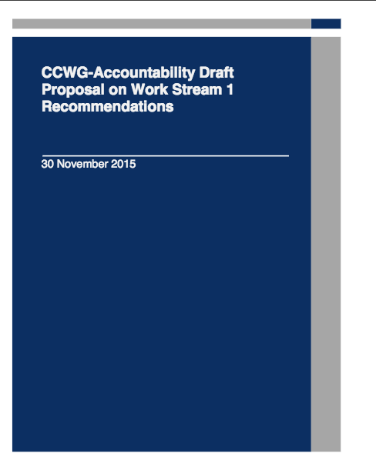
Draft Proposal on Work Stream 1 Recommendations
Structure:
Core proposal (57 pages)
15 detailed annexes of proposed recommendations (including a summary)
10 appendices
Translations to be provided in Arabic, Spanish, French, Russian Chinese and Portuguese
See: https://community.icann.org/x/eLRYAw
Public comment Survey (closes on 21 December): https://www.surveymonkey.com/r/ccwg-acct-draftproposal

Slide 33
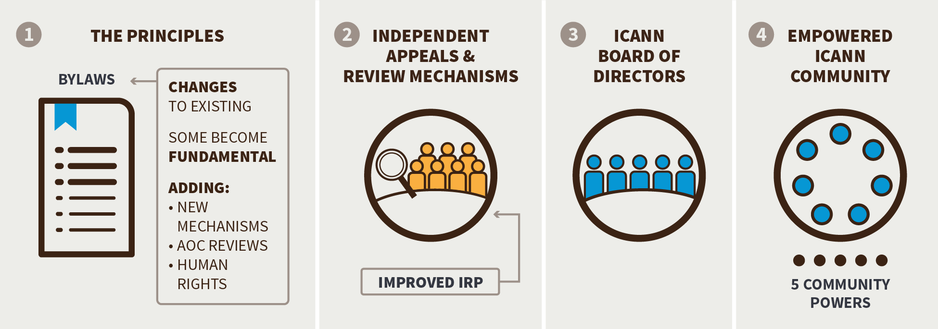
Four Building Blocks
The CCWG-Accountability identified four building blocks that would form the mechanisms required to improve ICANN’s accountability.

Slide 34
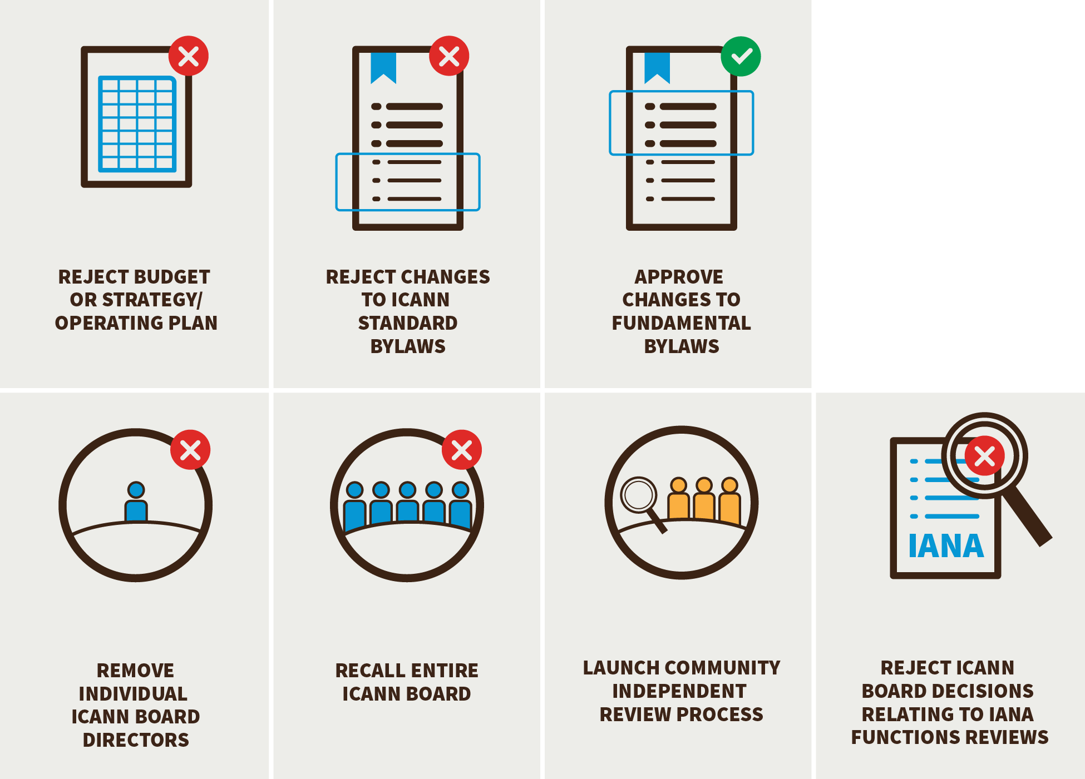
Ensuring Community Engagement in ICANN Decision-making: Seven New Community Powers
The CCWG-Accountability has proposed a set of seven Community Powers designed to empower the community to hold ICANN accountable for the organization’s Principles (the Mission, Commitments, and Core Values).
It is important to note that the powers, as well as the launch of a Separation Cross Community Working Group (as required by the CWG-Stewardship dependencies), can be enforced by using the community Independent Review Process or the Power to recall the entire Board.

Slide 35
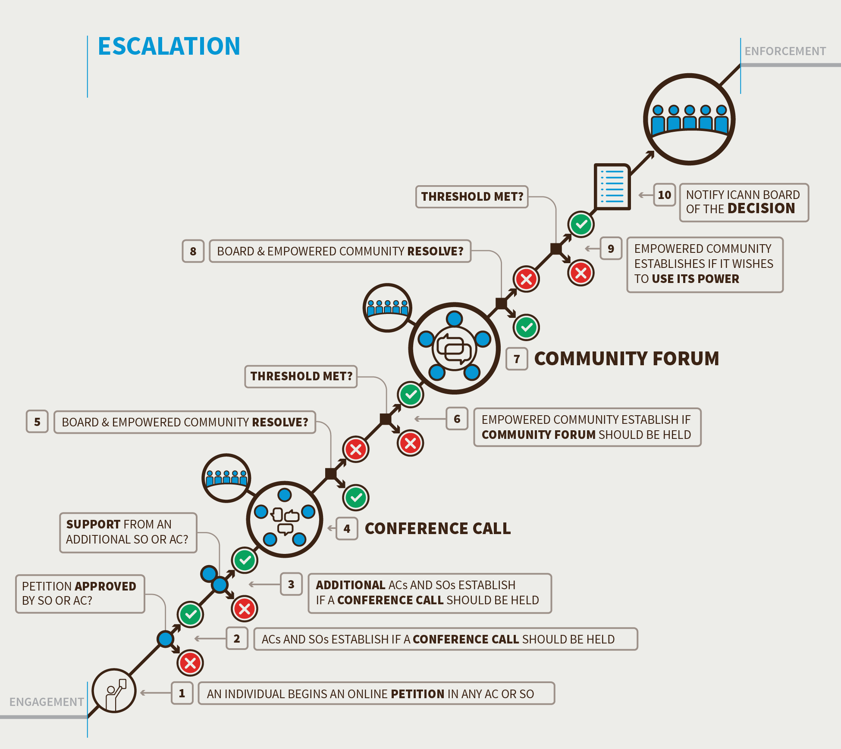
Empowering the Community through Consensus: Engage, Escalate, Enforce
In an effort to prevent disagreements between the community and ICANN Board, the CCWG- Accountability is recommending that ICANN be required to engage with the community on any key decisions it is considering such as Budgets or changing Bylaws.
Should disagreements arise, the CCWG- Accountability is proposing a series of procedures that ensure all sides have the chance to discuss any disagreements and have multiple opportunities to resolve issues before having to resort to the powers of the Empowered Community.

Slide 36

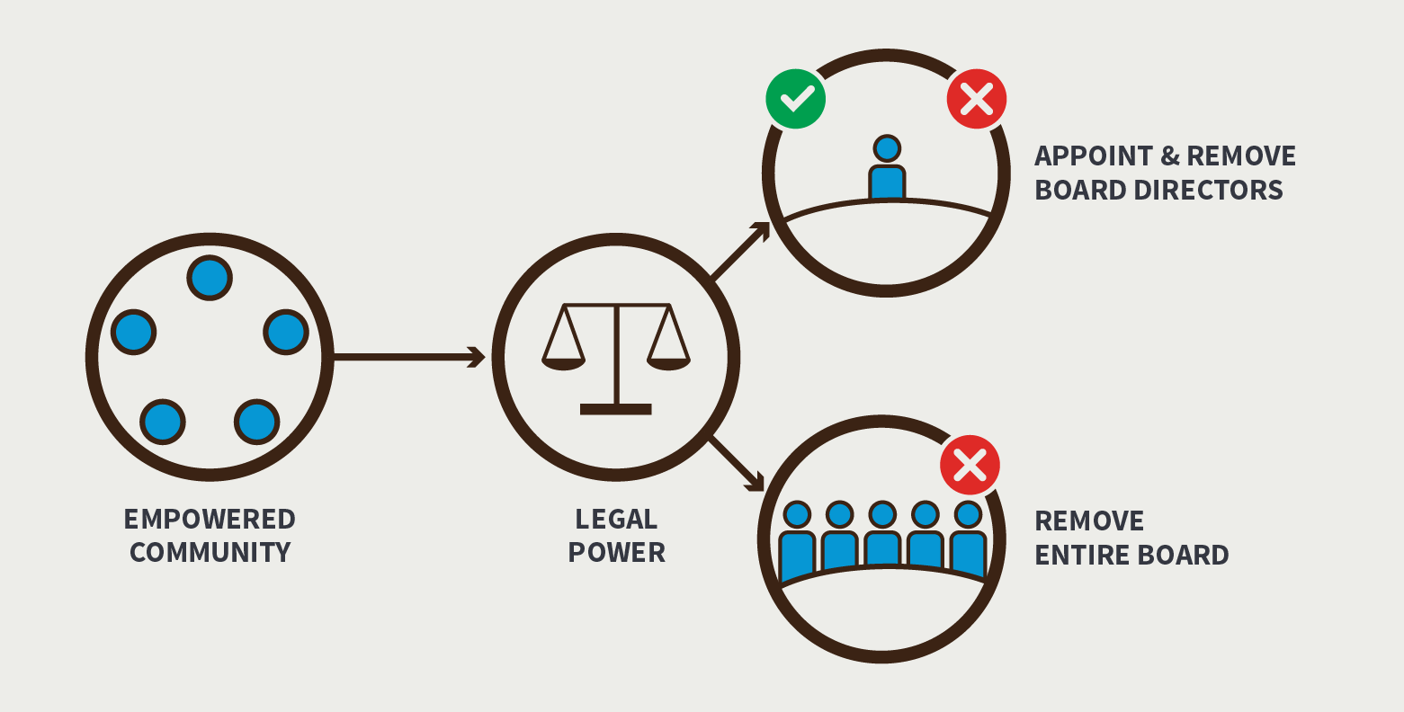
Establishing an Empowered Community for Enforcing Community Powers
Concerns were raised that the “Sole Member” model granted a significant number of powers under California law called “statutory rights.” Commenters expressed concern that these rights, such as the ability to dissolve the corporation, could not be adequately constrained and might have unintended and unanticipated consequences.
To address these concerns, the CCWG-Accountability now recommends implementing a “Sole Designator” model. The Sole Designator has the statutory power to appoint and remove individual ICANN Board Directors or the entire Board which is a requirement of the CCWG -Accountability and the CWG-Stewardship. The CCWG- Accountability recommends that the right to inspect be granted to the Sole Designator. Legal counsel informed the group that adopting a “Sole Designator” model could effectively be implemented while meeting the community’s requirements and having minimal impact on the corporate structure of ICANN.

Slide 37
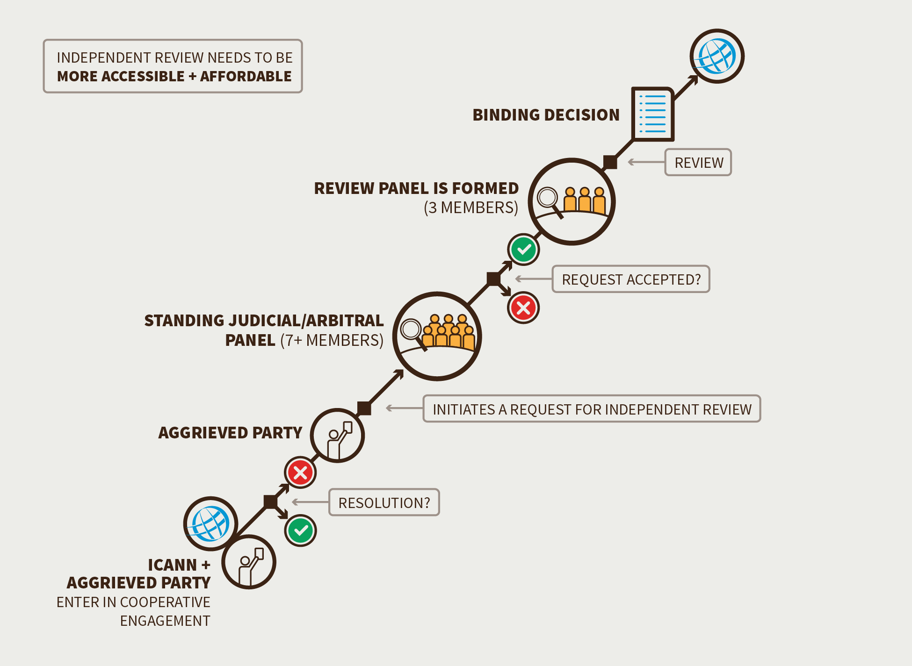
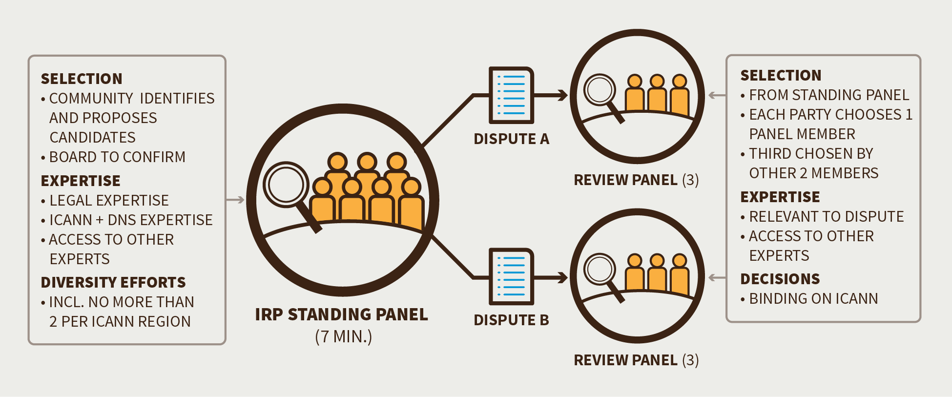
Enhanced Independent Review Process
The overall purpose of the Independent Review Process is to ensure that any ICANN action or inaction does not exceed the scope of its limited technical mission and complies with both its Articles of Incorporation and Bylaws.
Exclusion of ccTLD delegations and revocations and numbering decisions

Slide 38
CWG-Stewardship Dependencies
ICANN Budget: Community rights regarding the development and consideration of the ICANN Budget
ICANN Board: Community rights regarding the ability to appoint/remove Directors of the ICANN Board, and recall the entire Board
ICANN Bylaws: Incorporation of the following into ICANN’s Bylaws: IANA Function Review, Customer Standing Committee and the Separation Process
Fundamental Bylaws: All of the foregoing mechanisms are to be provided for in the ICANN Bylaws as Fundamental Bylaws
Independent Review Panel: Should be made applicable to IANA Functions and accessible by managers of top-level domains

Slide 39
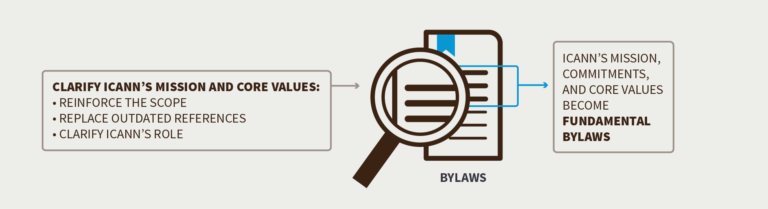
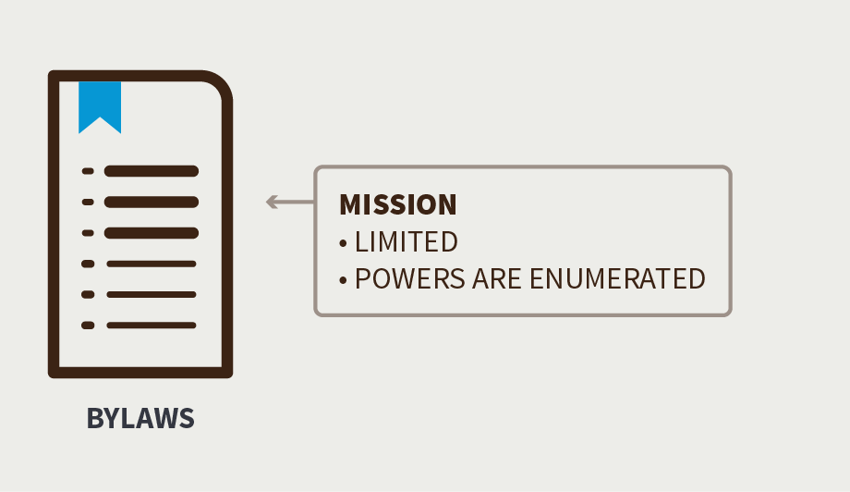
Changing Aspects of ICANN’s Mission, Commitments and Core Values
The CCWG-Accountability recommends:
Clarifying that ICANN shall act strictly in accordance with, and only as reasonably appropriate to achieve its Mission
Updating the ICANN Mission statement to clearly set forth ICANN’s role with respect to names, numbers, root servers, and protocol port and parameters
Clarify that ICANN’s Mission does not include the regulation of services that use the Domain Name System or the regulation of the content these services carry or provide.

Slide 40
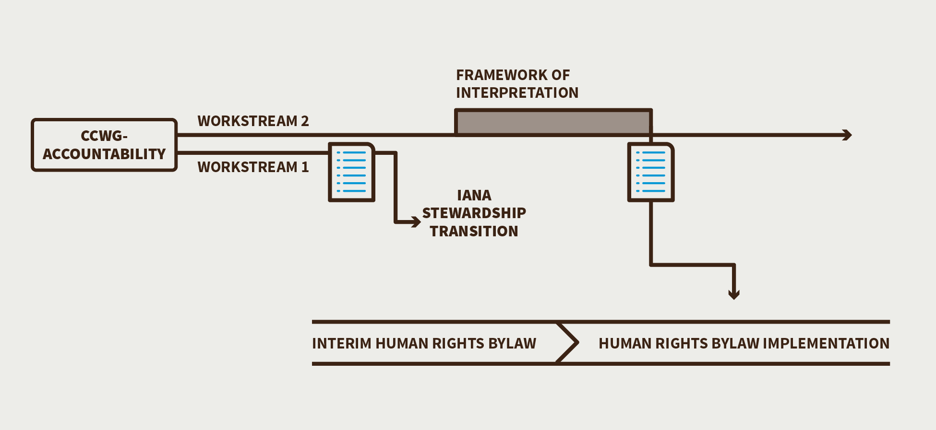
Reaffirming ICANN’s Commitment to Respect Internationally Recognized Human Rights as it Carries out its Mission
Bylaw proposed for adoption will not be fully executed until the Framework of Interpretation is developed
Framework of interpretation to be developed in Work Stream 2
Draft Bylaw text (below)
“Within its mission and in its operations, ICANN will respect internationally recognized human rights. This commitment does not in any way create an obligation for ICANN, or any entity having a relationship with ICANN, to protect or enforce human rights beyond what may be required by applicable law. In particular, this does not create any additional obligation for ICANN to respond to or consider any complaint, request or demand seeking the enforcement of human rights by ICANN.”

Slide 41
Enhancing the Accountability of Supporting Organizations and Advisory Committees
The CCWG-Accountability recommends:
Including review of Supporting Organizations’ and Advisory Committees’ accountability mechanisms as part of Work Stream 1
Reviews be incorporated into existing periodic Structural Reviews
Structural Reviews are intended to review the performance and operation of ICANN SO/ACs

Slide 42
Board Obligations with regards to Governmental Advisory Committee Advice (Stress Test 18)
Proposed amendments to ICANN Bylaws Article XI, Section 2: j.
“The advice of the Governmental Advisory Committee on public policy matters shall be duly taken into account, both in the formulation and adoption of policies. In the event that the ICANN Board determines to take an action that is not consistent with the Governmental Advisory Committee advice, it shall so inform the Committee and state the reasons why it decided not to follow that advice. Any Governmental Advisory Committee advice approved by a full Governmental Advisory Committee consensus, understood to mean the practice of adopting decisions by general agreement in the absence of any formal objection, may only be rejected by a vote of two-thirds of the Board, and the Governmental Advisory Committee and the ICANN Board will then try, in good faith and in a timely and efficient manner, to find a mutually acceptable solution.”

Slide 43
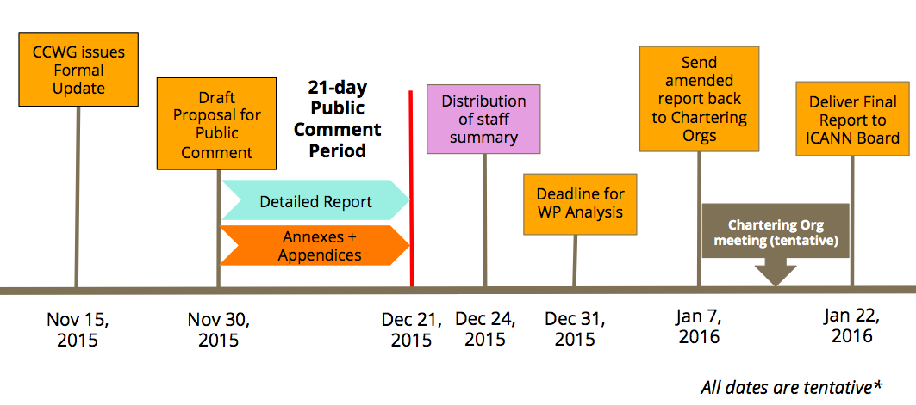
Next Steps and Timeline
Notes:
Timeline and Next Steps
The CCWG-Accountability has had intensive discussions on the group's work plan, anticipated progress and next steps towards finalization. As such, the group has adjusted its timeline in a manner that attempts to balance the various timeline constraints, both inside and outside of the community. While details are still being solidified, the timeline is rigorous, and will likely keep the CCWG-Accountability busy through January. However, the co-Chairs, members and participants of the CCWG-Accountability understand the importance of and will execute an inclusive, open and bottom-up process.
The current timeline proposes posting a high-level overview of recommendations and a summary of changes from the 2nd Draft Proposal for a 35-day public comment on 15 November 2015. Alongside the 35-day public comment, the CCWG-Accountability will submit these resources to the Chartering Organizations for initial feedback. The CCWG-Accountability plans to issue a full detailed report, including annexes and in-depth documentation, mid-way into the public comment period for roughly 20 days of consultation. After synthesis of the comments received, and assuming no major changes, the group currently projects submission of Work Stream 1 Recommendations to the ICANN Board in late January 2016.

Slide 44
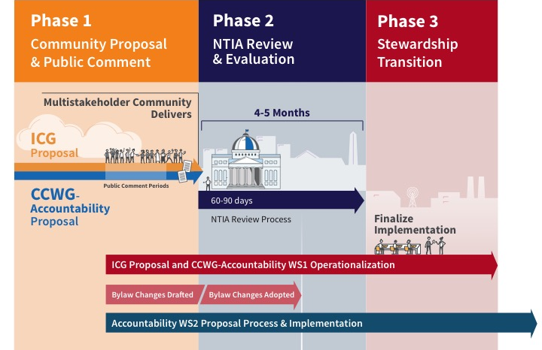
Where are we now?

Slide 45
What Can I Do Now To Get Involved?
Join a working group
  CCWG-Accountability, contact acct-staff@icann.org
Participate in a public comment period
Participating in public comment periods is an integral part of ICANN’s inclusive and bottom-up model of proposal development
Stay up to date on recent developments
  Visit: https://www.icann.org/stewardship-accountability
  Follow @ICANN on Twitter or like ICANN on Facebook
  Subscribe to ICANN news alerts

Slide 46


Questions?
Thank You and Questions
twitter.com/icann
Website: https://www.icann.org/
stewardship-accountability
facebook.com/icannorg
IANA Stewardship Transition
https://www.icann.org/stewardship
Latest news and information on the IANA Stewardship Transition and ICG
Community participation information
Resources and archives from ICG meetings
Enhancing ICANN Accountability
https://community.icann.org/category/accountability
Latest news and information on the Enhancing ICANN Accountability process and CCWG
Announcements and upcoming events

