Slide 1
Web Accessibility - Update
ICANN55 | Web Accessibility Update | 9th March, 2016

Slide 2
The Progress Meter - Where are we now?
2014
2015
2016
Web Accessibility Engagement begins in August
Web Accessibility Testing and Training completes in January
Remediation starts
Web Accessibility Assessment Request (RFP)
ICANN strategy is to measure progress and meet Web Accessibility standards WCAG Level AA
Build sustainable practices using open source testing and tools with a minimum footprint
Notes:
This is a stylized agenda slide for your presentation.
To delete a box, if there are too many boxes, click the edge of the box, ensure the entire box is highlighted, then DELETE.
To update the numbers and text, click inside the circle for the numbers or in the box for the text, revise the text.

Slide 3
Engagement Results
1
Training (Developers, Testers, Designers) 14 staff
2
Tools (Web Dev Toolbar, Tenon open source API, FAE Checker, Snook Color Contrast Checker)
3
Best Practices( Guides, Procurement, Design)
4
Roadmap (At-Large, icann.org, GAC, GNSO…)
  In Progress
WIKI: https://community.icann.org/display/CCCOA/Web+Accessibility+Deliverables

Slide 4
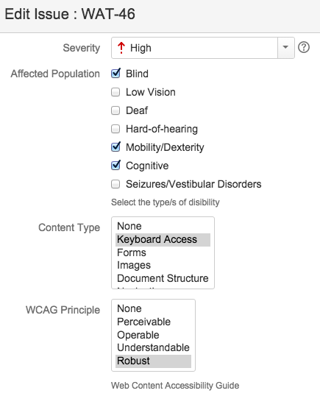
Example of a new testing metrics
All issues identify affected population, content type, and WCAG principle.
Allows us to report on how affected populated can engage with ICANN communities
Provides in put in to Web Accessibility roadmap for prioritizing issue remediation
Regression testing is performed to ensure no new accessibility issues are introduced
Notes:
Use this slide for diagrams or other graphic elements.

Slide 5
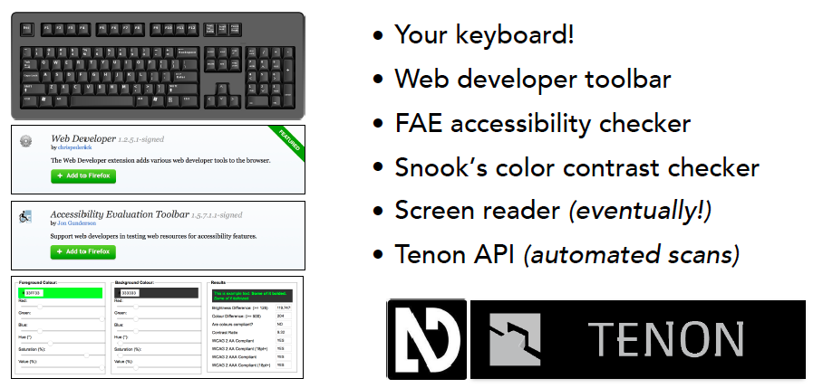
Recommended testing tools
Notes:
Use this slide for diagrams or other graphic elements.

Slide 6
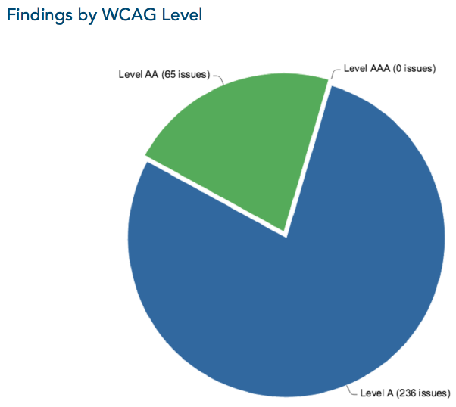
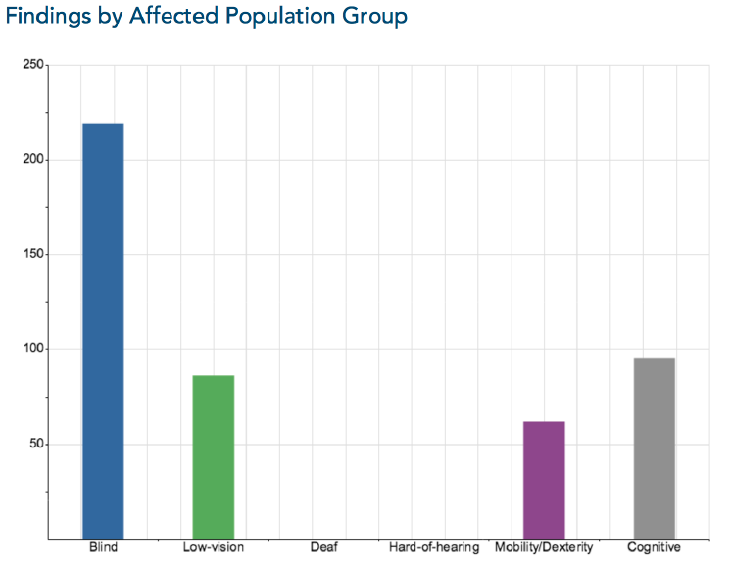
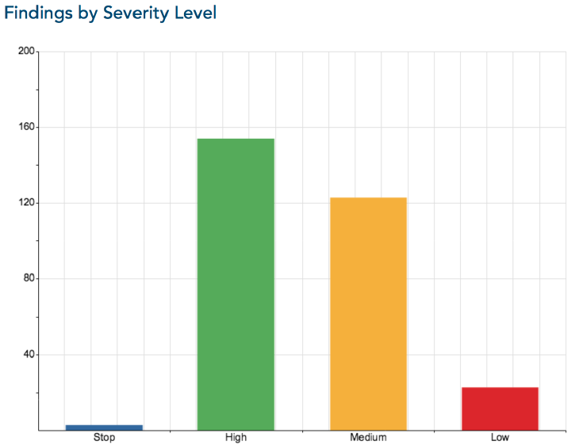
Key Findings and Issues
Scope: 500 pages
  Icann.org
  At-Large
302 total issues
  90 At-Large
34 types of issues
Notes:
Use this slide for diagrams or other graphic elements.

Slide 7
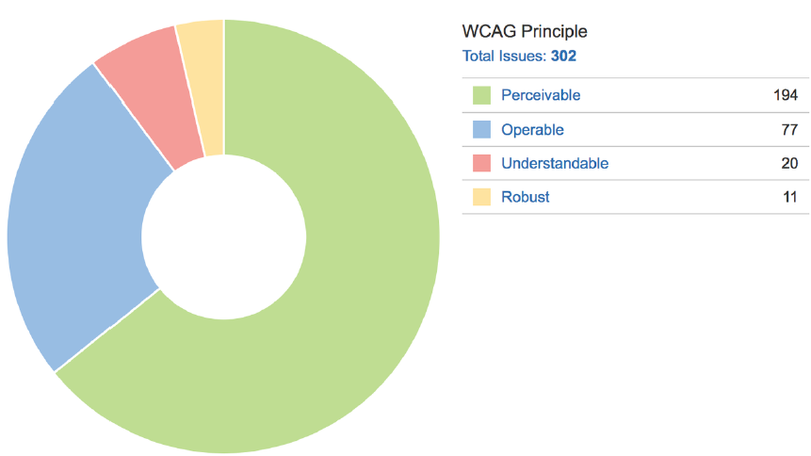
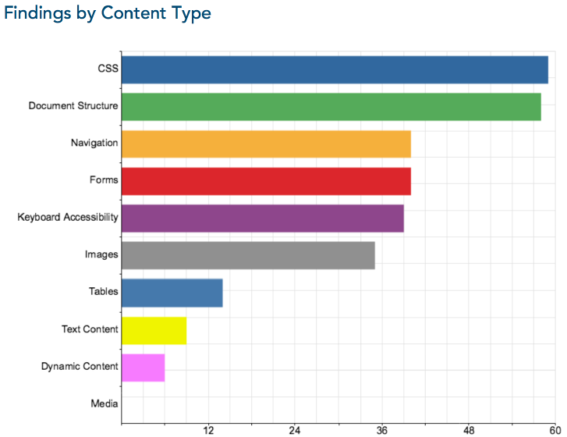
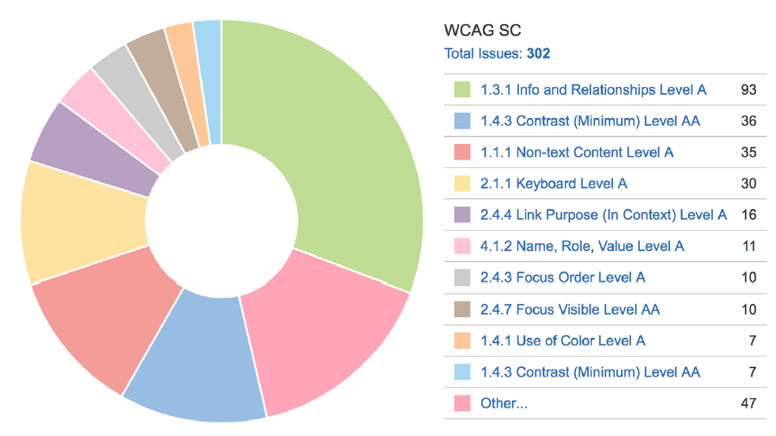
Key Findings and Issues
Notes:
Use this slide for diagrams or other graphic elements.

Slide 8
Next Steps
Web Accessibility Roadmap / Prioritization Matrix for 302 issues
  At-Large new website (high/medium issues Level AA)
  GAC – next website, then GNSO, ccNSO…
  Icann.org
1
2
Integrate Procurement and other Guidelines
3
Apply testing process & tools
4
Measure progress transparently and openly on WIKI

Slide 9
Next Steps
Thank You and Questions
Reach us at
Email: laura.bengford@icann.org
WIKI: https://community.icann.org/display/CCCOA/Web+Accessibility+Deliverables
Visit the WIKI and provide your feedback!
The results of the engagement, progress meters, and web accessibility roadmap will be updated as progress is made on web accessibility.

