Slide 1
IANA Stewardship Transition &
Enhancing ICANN Accountability
Presenter | Event | Date

Slide 2
About this Toolkit – DO NOT USE THIS SLIDE
    This discussion toolkit is intended to:
    Provide accurate information about NTIA’s announcement and its intent to transition its stewardship of the IANA functions
    Provide relevant and up-to-date information on the IANA Stewardship Transition and Enhancing ICANN Accountability processes
    Serve as a resource and reference document for those wishing to engage in a dialogue within and outside of their communities
    Note: This toolkit will be updated as the process evolves and new info becomes available.

Slide 3
What is ICANN?
The Internet Corporation for Assigned Names and Numbers (ICANN) is a global multistakeholder, private sector-led organization that manages Internet resources for the public benefit
ICANN coordinates the top-level of the Internet's system of unique identifiers via global, multistakeholder, bottom-up consensus policy processes, with the outcome of those processes implemented via the IANA Functions.

Slide 4
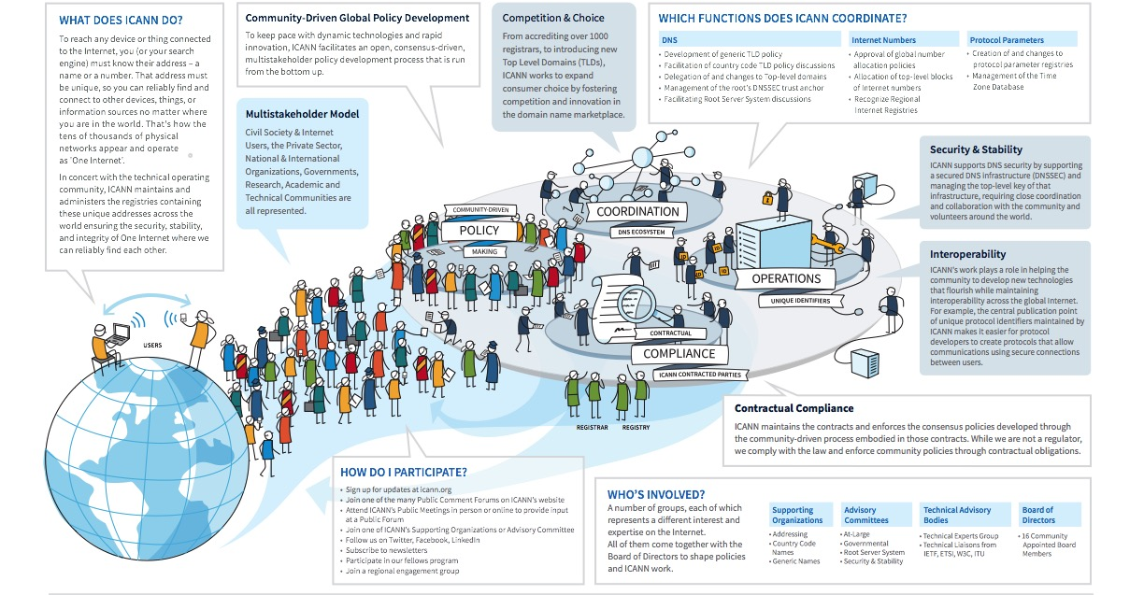
One World, One Internet

Slide 5
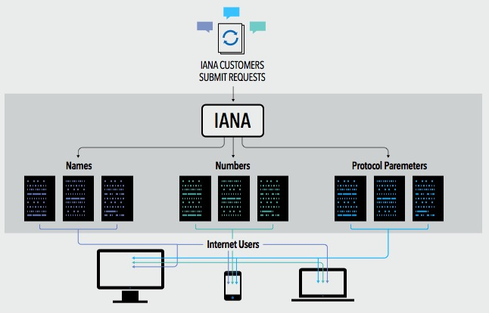
What are the IANA Functions?
The IANA Functions evolved in support of the Internet Engineering Task Force, and initially funded via research projects supported by the U. S. Department of Defense, Advance Research Projects Agency.
ICANN was created to perform the IANA Functions and has done so pursuant to a no-cost contract with the Department of Commerce for over 15 years
These functions include:
The coordination of the assignment of technical Internet protocol parameters
The administration of certain responsibilities associated with Internet DNS Root zone management
The allocation of Internet IP addresses

Slide 6






What is the multistakeholder community?
“Stakeholder” refers broadly to anyone who has an interest in the Internet
Within ICANN, stakeholders include:
The multistakeholder community functions on bottom-up consensus building which, by design, is resistant to capture due to the openness, diversity and equal division of authority among participants
ICANN’s private sector-led multi-stakeholder community supports the success of the Internet’s DNS
Large and small businesses
Technical community
Civil society
Governments
Researchers and academics
End users

Slide 7
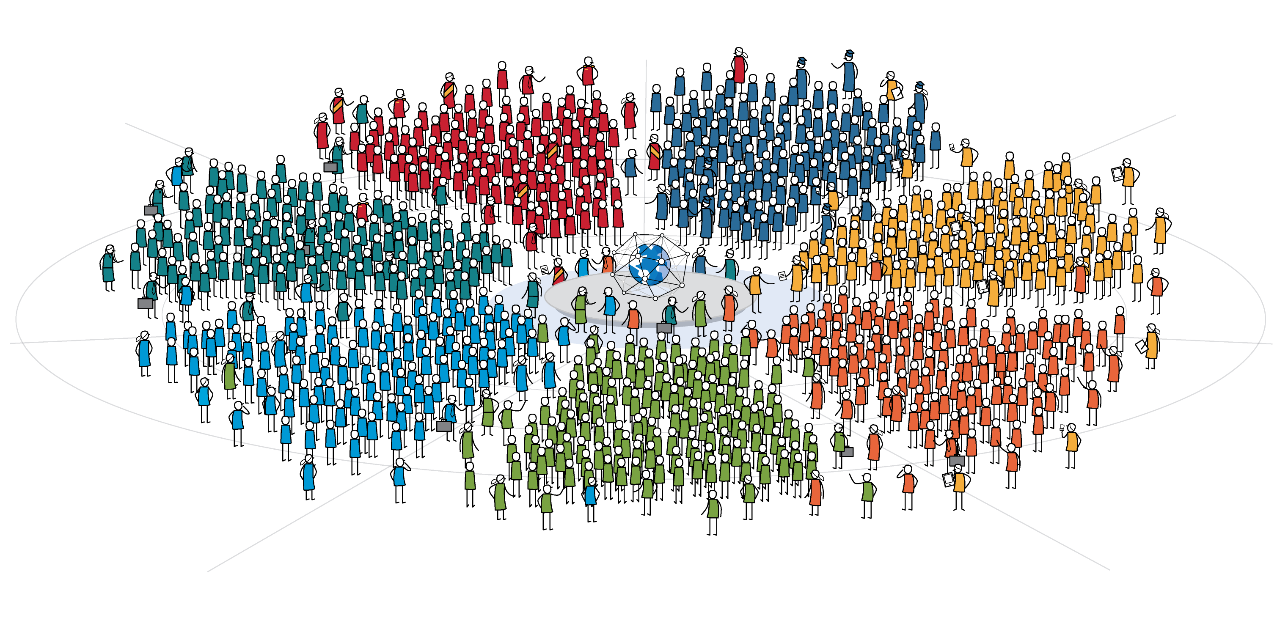

ICANN’s Global Multistakeholder Community
Today’s Community of Communities
In the same way the Internet is a network of networks comprised of computers and devices, the ICANN community is a community of communities comprised of people and organizations
Government & Governmental Organizations
Academic
Business
Internet Users
Technical
Civil Society
Domain Name
Industry

Slide 8
ICANN’s Global Multistakeholder Community
National governments
Distinct economies recognized in international fora
Multinational governmental and treaty organizations
Public authorities (including UN agencies with a direct interest in global Internet Governance)
Private-sector companies
Trade associations
Academic leaders
Institutions of higher learning
Professors
Students
Government & Governmental Organizations
Academic
Business
Internet Users
Technical
Civil Society
Domain Name
Industry
Protocol developers
Equipment and software developers
Network operators
Technical researchers
Registries
Registrars
Domain organizations
Non-governmental Organizations
Non-profits
Non-commercial Users
Think Tanks
Charities

Slide 9
The U.S. Government’s Announcement
14 March 2014: U.S. Government announces intent to transition its stewardship of the IANA functions to the global multistakeholder community
  Asked ICANN to convene global stakeholders to develop a proposal
  The multistakeholder community has set policies implemented by ICANN for more than 15 years
The U.S. Government’s announcement:
Marks the final phase of the privatization of the DNS
Further supports and enhances the multistakeholder model of Internet policy making and governance
ICANN was asked to serve as a facilitator, based on its role as the IANA functions administrator and global coordinator for the Internet’s Domain Name System (DNS)
Why
now?

Slide 10
Why Does This Matter to Business?
Almost $8 trillion exchange hands each year through e-commerce, and the continued success of e-commerce is dependent on one, global, secure, stable and interoperable Internet
Business has an important seat at the table in this global conversation and needs to be an active participant in facilitating a successful transition
The next billion Internet users will connect from developing countries and emerging economies. Sole U.S. oversight of the IANA functions is no longer optimal given this new global landscape
  A successful transition would ensure the continuation of a secure, stable and interoperable Internet for all users globally, while failure could result in adverse consequences for global Internet commerce
Notes:
Utilize slides 6-9 depending on the audience.

Slide 11
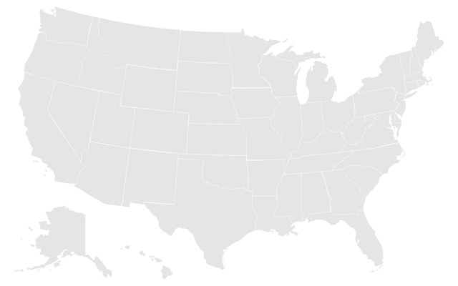
BCG Article on U.S. Digital Engagement
U.S. companies of all sizes and in all industries have a big interest in maintaining their ability to take full advantage of expanding interconnectedness.
20 years ago, 61% of the Internet’s 35 million users were based in the U.S. Today, the U.S. accounts for less than 10% of the 3 billion connected people worldwide
The U.S. digital economy will contribute $1 trillion to national GDP in 2016.
With an estimated $1.6 trillion in exports in 2014, the U.S. is a major player in the global economy, and the Internet is a powerful driver of global trade.
According to Cisco Systems, there were:
  500 million connected devices in 2003
  12.5 billion in 2010
  Expected to rise to 50 billion in 2020
To make sure U.S. companies and consumers continue to have access to the Internet’s transformational capabilities, both government and private-sector leaders need to stay engaged in the Internet’s long-term evolution.

Slide 12
BCG Article on U.S. Digital Engagement
Areas where U.S. companies can take advantage of a single global Internet:
Small
Business
Manufacturing
Services
72% of U.S. based manufacturing executives (with sales >$1 billion)
said they will invest in additional automation or advanced-manufacturing technologies in next 5 years
Technology leaders far outperform their peers in the marketplace:
12% vs 1% job growth
14% vs 3% annual revenue
increase
The U.S. exported $400 billion in digitally deliverable services in 2014:
Up 12% since 2011
Represents 56% of all U.S. service exports
Represents 17% of total exports
Notes:
This is a simpler agenda slide, the outline for your presentation.

Slide 13
Why Does This Matter to the Technical Community?
IANA services are core and critical to the use of the Internet Protocol.
For several years the technical community has called for an end to the NTIA contract
  This is an opportunity for the community to show how serious it is in further developing this model of Internet Governance
You have a lot of experience in the bottom-up and multistakeholder policy development processes
Your participation and engagement into the process is critical in this evolution of Internet Governance to maintain the security, stability, and resiliency of the Internet DNS and to ensure the IANA functions continue meeting the needs and expectations of the global customers and partners
Notes:
Utilize slides 6-9 depending on the audience.

Slide 14
Why Does This Matter to Governments?
The IANA Stewardship Transition is important for all stakeholders, especially for governments given their responsibility over Internet public policy issues
Successful completion of the IANA Stewardship Transition recognizes that no single government – or group of governments – should have any form of control over the security, stability and interoperability of the Domain Name System (DNS)
  This will help ensure the continued openness, interoperability and stability of the Internet which both countries and their citizens economically, socially and culturally benefit from
The IANA Stewardship Transition proposal will be accompanied by significant proposals to further enhance ICANN’s accountability to the entire Internet Community; including governments (on an equal footing)
Notes:
Utilize slides 6-9 depending on the audience.

Slide 15
Why Does This Matter to Civil Society?
Although the IANA functions are operational functions, they do require global governance and stewardship
The expertise from the non-governmental organization community is essential, especially due to:
  Its expertise in holding governance entities accountable
  Its experience in understanding and explaining public interest
  Its ability to be innovative and propose solutions
Your participation, and that of your networks, is critical in this evolution of Internet Governance to ensure excellence in the proposals and the legitimacy of the processes
This is a chance to strengthen an inclusive, transparent, global and collaborative model of governance that is fit for our present and future
Notes:
Utilize slides 6-9 depending on the audience.

Slide 16




Transition Requirements set by NTIA
NTIA has stated that the transition proposal must have broad community support and address the following four principles:
Support and enhance the multistakeholder model
Maintain the security, stability and resiliency of the Internet DNS
Meet the needs and expectations of the global customers and partners of the IANA services
Maintain the openness of the Internet
NTIA also specified that it will not accept a proposal that replaces the NTIA role with a government-led or intergovernmental organization solution.

Slide 17
Two Parallel Processes
The community developed and is following two parallel processes:
IANA Stewardship Transition
Focused on delivering a proposal to transition the stewardship of the IANA functions to the multistakeholder community
Enhancing ICANN Accountability
Focused on ensuring that ICANN remains accountable in the absence of its historical contractual relationship with the U.S. Government
To drive the processes, the community created multilayered, transparent and diverse working groups to foster discussion and within those groups, has developed working methods and systems for determining consensus

Slide 18
Developing Proposals
NTIA
Announcement
and Criteria
ICG Proposal
ICANN
ICG
CWG
Stewardship
Linkage
CWG Proposal
ICANN
Board
NTIA
Z
CRISP
CRISP Proposal
IANAPLAN
IANAPLAN Proposal
CCWG
Accountability
CCWG Proposal
Notes:
This is a simpler agenda slide, the outline for your presentation.

Slide 19
IANA STEWARDSHIP TRANSITION

Slide 20




The IANA Stewardship Transition: ICG
The IANA Stewardship Transition Coordination Group (ICG) was formed in July 2014 to assemble and deliver a proposal to NTIA through the ICANN Board
  The ICG is made up of 30 individuals representing 13 communities of both direct and indirect stakeholders of the IANA functions
  The ICG’s responsibilities include:
Act as a liaison to all
interested parties, including the three operational communities of the IANA functions
Assess the outputs of
the three operational
communities for compatibility and interoperability
Assemble a complete proposal for the transition
Information
sharing and public communication

Slide 21
ICG RFP Required Proposal Elements
1
Description of community’s use of IANA functions
A description of the function
A description of the customer(s) of the function
What registries are involved in providing the function
A description of any overlaps or interdependencies between that community’s IANA requirements and the functions required by other customer communities
Existing, Pre-Transition arrangements
Policy sources
Oversight and accountability
Proposed Post-Transition oversight and accountability arrangements
Transition implications
2
3
4
5

Slide 22
Request for Transition Proposal Structure
Names
Proposal
Numbers
Proposal
Protocol Parameters
Proposal
Meetings
Mailing list discussion
Public comments
Meetings
Mailing list discussion
Public comments
Meetings
Mailing list discussion
Public comments
ICG (Combined) Proposal
Notes:
This slide can be used for text, graphics or any other elements.

Slide 23
Domain Names Community
The Domain Names community developed a Cross Community Working Group (CWG-Stewardship) to produce a consolidated transition proposal for the elements of the IANA Functions relating to the Domain Name System.
Finalized a Second Draft Proposal:
  Operational: the CWG-Stewardship shifted into expertise-based subgroups to produce the operational parts of the proposal.
    There were 15 ‘Design Teams’ proposed (one on escalation mechanisms, one on reviews, etc.)
  Structural: the group, with assistance from independent legal counsel, considered 7 alternative structural models not fully considered in the first draft proposal
Submitted its response to the ICG RFP on 25 June 2015

Slide 24
Proposal Overview

Slide 25
Linkage & Coordination with CCWG-Accountability
ICANN Budget
Community rights regarding development and consideration
Customer Standing Committee (CSC)
Incorporated into the bylaws
1
4
ICANN Board
Community rights, specifically to appoint/remove members, recall entire Board
Appeals Mechanism
Independent Review Panel should be made applicable to IANA Functions and accessible by TLD managers
2
5
Fundamental bylaws
All foregoing mechanisms are to be provided for in the bylaws as “fundamental bylaws”
3
6
IANA Function Review
Incorporated into the bylaws
The CWG-Stewardship’s proposal is expressly conditioned upon the outcomes of the CCWG-Accountability.
Notes:
Summarize the three main points of your presentation here.

Slide 26
Numbering Resources Community
The five Regional Internet address Registries (RIRs) engaged in community consultations in their respective regions from September to November 2014
The Consolidated RIR IANA Stewardship Proposal Team (CRISP Team) was developed to coordinate the production of a response to the RFP based these consultations
  15 members, 3 from each RIR community
Submitted its response to the ICG RFP on 15 January 2015

Slide 27
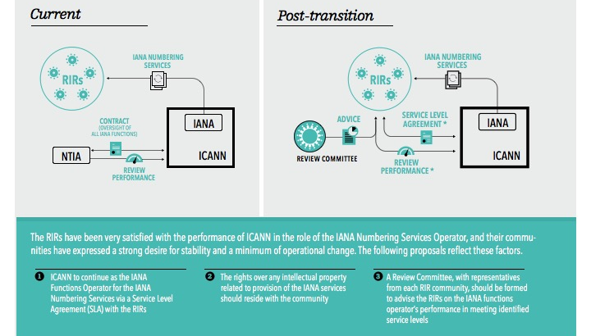
Proposal Overview

Slide 28
Protocol Parameters Community
Established an IANAPLAN Working Group to develop its response to the RFP
  Adopted an Internet Draft as a basis for developing a response
  Underwent IETF last call, and IESG approval
  A total of 10 drafts were produced over 9 months
Submitted its response to the ICG RFP on 6 January 2015

Slide 29
Proposal Overview

Slide 30
Combined Proposal Overview

Slide 31
Public Comment Period
July 31 -September 8
In September 2015, the ICG met in Los Angeles to review and discuss 159 comments received:
  Majority of comments expressed support for proposal
  Clarifications will be requested of each operational community on:
    Cooperation in case of operator change (all)
    Intention to participate in Names-proposed mechanisms (CRISP Team)
    Remit, composition, and other details about proposed mechanisms (CWG-Stewardship)
Submission Breakdown
by region

Slide 32
Next Steps and Timeline
The ICG finalized its work at ICANN54 in Dublin
A status update and current proposal document will be provided shortly after ICANN54
The group awaits confirmation from CWG-Stewardship that its requirements have been met by the CCWG-Accountability
Keep ICG constituted as a body until 30 September 2016
  Maintain ICG mailing list
  Ensure communities know how to get in touch with us
  Schedule calls/meetings only as needed
Currently discussing need for implementation related work, if any

Slide 33
ENHANCING ICANN ACCOUNTABILITY

Slide 34
Enhancing ICANN Accountability
As initial discussions around the transition took place, the community raised the broader topic of the impact of the change on ICANN’s accountability.
The transition would end the U.S. Government’s historical contractual relationship with ICANN
This relationship has been perceived as a backstop with regard to ICANN’s organization-wide accountability
As a
result
ICANN launched a second process, parallel but interrelated with the IANA Stewardship Transition process, to examine from an organizational perspective how ICANN’s broader accountability mechanisms should be strengthened to address the absence of the U.S. Government.

Slide 35
Existing ICANN Accountability Mechanisms
Affirmation of Commitments
Affirmation of Commitments Reviews
Bylaws
Bylaws-Mandated Redress Mechanism
Documentation for Board of Directors
Documented Relationships
External Laws
General ICANN Operational Information
ICANN Board Selection Process
Organizational Reviews
10

Slide 36
CCWG-Accountability Goals and Requirements
The Cross Community Working Group on Enhancing ICANN Accountability
(CCWG-Accountability) was formed to Deliver proposals that would enhance
ICANN’s accountability towards all stakeholders
  The CCWG-Accountability is made up of 28 members representing the 6 organizations who chartered the group, and 151 participants who engage in day-to-day discussions and proposal development
  The CCWG has split its recommendations into two Work Streams:
Work Stream 1
Focused on mechanisms enhancing ICANN accountability that must be in place or committed to within the time frame of the IANA Stewardship Transition
Work Stream 2
Focused on addressing accountability topics for which a timeline for developing solutions and full implementation may extend beyond the IANA Stewardship Transition

Slide 37

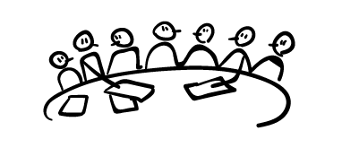


Current Accountability Framework
The CCWG-Accountability identified four building blocks that would form the mechanisms required to improve ICANN’s accountability.
AC
SO
AC
SO
AC
SO
AC
ICANN Board
has the ultimate authority to approve or reject policy recommendations, developed by the SOs. ACs formally advise the ICANN Board on particular issues or policy areas.
The ICANN Community
is organized in three Supporting Organizations (SOs) and four Advisory Committees (ACs).
The Principles
guarantee the mission, commitments and core values of ICANN through its bylaws.
BYLAWS
Independent Appeals Mechanisms
confers the power to review and provide redress, as needed.

Slide 38
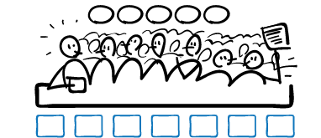
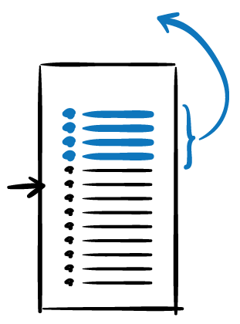

Proposed Enhanced Accountability Mechanisms
The CCWG-Accountability has identified enhancements required to those building blocks that would form the accountability mechanisms required to improve ICANN’s accountability.
1
2
3
4
5
REVIEW / REJECT
BUDGET
STRATEGY/OPS PLAN
BYLAWS
REMOVE / RECALL
AC
SO
AC
SO
AC
SO
AC
ICANN Board
has the ultimate authority to approve or reject policy recommendations, developed by the SOs. ACs formally advise the ICANN Board on particular issues or policy areas (i.e. the Executive).
The Empowered Community
refers to the powers that allow the community SOs & ACs to take action should ICANN breach the principles (i.e. the People).
STRUCTURAL REVIEW
As Community accountability
Fundamental
Bylaws
NEW
NEW IRP
7+ MEMBER STANDING PANEL
BYLAWS
Existing
+
New
mechanisms+
AoC
Reviews
The Principles
guarantee the core mission, commitments and values of ICANN through its bylaws
(i.e. the Constitution).
Independent Appeals Mechanisms
confers the power to review and provide redress, as needed (i.e. the Judiciary).

Slide 39





The Empowered Community’s Powers
The CCWG-Accountability recommends the ICANN community be empowered with five distinct powers.
1. Reconsider/reject Budget or Strategy/Operating Plan
This power would give the community the ability to consider strategic/operating plans and budgets after they are approved by the Board (but before they come into effect) and reject them.
2. Reconsider/reject changes to ICANN “Standard” Bylaws
This power would give the community the ability to reject proposed Bylaws changes after they are approved by the Board but before they come into effect.
3. Approve changes to “Fundamental” Bylaws
This power would form part of the process set out for agreeing any changes of the “fundamental” bylaws. It requires that the community would have to give positive assent to any change, a co-decision process between the Board and the community and that such changes would require a higher vote.
Remove individual ICANN Board Directors
The community organization that appointed a given director could end their term and trigger a replacement process. The general approach, consistent with the law, is that the appointing body is the removing body.
5. Recall entire ICANN Board
This power would allow the community to cause the removal of the entire ICANN Board. (expected to be used only in exceptional circumstances).

Slide 40
Work Streams & Implementation
Possible tracks for implementation of Work Stream 1:
Revising Mission, Commitments and Core Values
Establishing Fundamental Bylaws
Completing the IRP enhancements
Establishing Community empowerment mechanism and incorporation of the community Powers into the Bylaws
Implementing the AoC reviews into the Bylaws
Completing the Reconsideration process enhancements
Elements considered for Work Stream 2:
Refining the operational details of WS1 proposals
  Further assessing enhancements to government participation in ICANN
  Considering the issue of jurisdiction
  Enhancing SO/AC accountability
  Instituting a culture of transparency within the ICANN organization
  Considering improvements to diversity in all its aspects at all levels of the organization
  Defining the modalities of how ICANN integrates human rights impact analyses, within its mission
2015
2016
JAN | FEB | MAR | APR | MAY | JUN | JUL | AUG | SEP | OCT | NOV | DEC | JAN | FEB | MAR | APR | MAY | JUN | JUL | AUG | SEP | OCT | NOV | DEC
Work Stream 1 Development (and identifying topics for Work Stream 2)
Work Stream 1 Implementation
Work Stream 2 Development
Frankfurt
Istanbul
Paris
Work Stream 2 Implementation
ICANN 52
ICANN 53
ICANN 54
ICANN 55
ICANN 56
ICANN 57

Slide 41

Linkage with the CWG-Stewardship
The CCWG-Accountability recognizes that continued and close engagement with the CWG-Stewardship is essential. Key aspects of the CWG-Stewardship proposal are considered to be conditional on the output of the CCWG-Accountability.
CWG-Stewardship Requirements | CCWG-Accountability Proposal | Requirement met?
ICANN Budget Community rights regarding the development and consideration. | Recommended community power: Reconsider/reject budget or strategy/operating plan
ICANN Board Community rights regarding the ability to appoint / remove members, and to recall the entire Board. | Recommended community powers: Appoint & remove individual ICANN directors, Recall entire ICANN board
ICANN Bylaws Incorporation of the following into ICANN’s Bylaws: IANA Function Review, Customer Standing Committee, and the Separation Process. | Recommended to be included as ICANN Bylaws.
Fundamental Bylaws All of the foregoing mechanisms are to be provided for in the ICANN bylaws as Fundamental Bylaws. | Recommended to be included as ICANN Bylaws.
Independent Review Panel Should be made applicable to IANA Functions and accessible by TLD managers. | Will be applicable, except for ccTLD delegations / revocations and numbering decisions.
41

Slide 42
Public Comment Period
August 3 -September 12
In September 2015, the CCWG-Accountability met in Los Angeles to review and discuss public comments received:
  Received 92 comments
  Support for the work and goals of CCWG
  Concern from community leaders (including the ICANN Board) about complexity of the proposal and the effect on timeline
21
Europe
29
North America
13
Asia Pacific &
Oceania
2
Africa
Submission Breakdown
by region
5
Latin America &
Caribbean
Submission Breakdown
by region
13
International
Includes ICANN SO/AC, Constituencies, etc.

Slide 43
Progress at ICANN54 in Dublin
At ICANN54 in Dublin, the CCWG-Accountability held more than 25 hours of formal meetings.
Summary of key decisions and agreed-upon next steps:
Sole Designator as Reference for Enforcement
Decision-Making Model
Independent Review Process
Community Power: Review/Reject Budget and Operating Plan
Community Power: Recall Individual Board Directors
Mission and Core Values
Human Rights
Incorporation of the Affirmation of Commitments into the Bylaws
Work Stream 2
Notes:
A summary of key decisions and agreed-upon next steps are outlined below:
Sole Designator as Reference for Enforcement
The group reached broad agreement to move forward with the Sole Designator as the new reference enforcement model for the next draft proposal. The group will next attempt to finalize "patching" the model to alleviate any outstanding concerns on their next draft proposal.
Decision-Making Model
The group begun defining a consensus based decision-making model, which includes a community consultation period. Discussions on the topic were informed by concerns raised in the Public Comment on the 2nd Draft Report about unintended concentrations of power.
Independent Review Process
The group confirmed support for the proposed IRP enhancements, and is now moving into the implementation phase. To spearhead this phase, a drafting sub-group with expert support will be constructed to develop and draft bylaws and detailed operating procedures.
Community Power: Review/Reject Budget and Operating Plan
The group has identified a balanced process and approach for the One-Year Operating Plan and Budget, which was an outstanding item coming into Dublin.
Community Power: Recall Individual Board Directors
The group confirmed a decision method for removal of a director appointed by the Nominating Committee, and a separate decision method for removal of a director appointed by an Advisory Committee or Supporting Organization.
Mission and Core Values
The group confirmed its support for a clarification of the Mission Statement and articulation of the Commitments and Core Values. An example of a clarification includes ICANN's ability to enforce agreements with contracted parties, subject to reasonable checks and balances.
Human Rights
The group reached consensus to include a general human rights commitment into the Bylaws. However, further work is needed on language and has been tasked to the Human Rights Working Party.
Incorporation of the Affirmation of Commitments into the Bylaws
The group finalized outstanding details of the incorporation of the Affirmation of Commitments Review into the bylaws. There is high confidence that these bylaws are nearly ready for consideration in terms of implementation.
Work Stream 2
The group adopted a focused list of Work Stream 2 items, with an emphasis on transparency requirements. There was also broad agreement to bring some of these transparency requirements into Work Stream 1 in consideration of the discussions around the Sole Designator enforcement model.

Slide 44
Next Steps and Timeline
The CCWG-Accountability aims to have a 35-day public comment from 15 November-21 December 2015. The PC will be issued in two parts:
15 Nov: 20-page Overview of Recommendations + Summary of changes from 2nd Draft Proposal
30 Nov: Entire Proposal + Annexes + In-depth Documentation
Notes:
Timeline and Next Steps
The CCWG-Accountability has had intensive discussions on the group's work plan, anticipated progress and next steps towards finalization. As such, the group has adjusted its timeline in a manner that attempts to balance the various timeline constraints, both inside and outside of the community. While details are still being solidified, the timeline is rigorous, and will likely keep the CCWG-Accountability busy through January. However, the co-Chairs, members and participants of the CCWG-Accountability understand the importance of and will execute an inclusive, open and bottom-up process.
The current timeline proposes posting a high-level overview of recommendations and a summary of changes from the 2nd Draft Proposal for a 35-day public comment on 15 November 2015. Alongside the 35-day public comment, the CCWG-Accountability will submit these resources to the Chartering Organizations for initial feedback. The CCWG-Accountability plans to issue a full detailed report, including annexes and in-depth documentation, mid-way into the public comment period for roughly 20 days of consultation. After synthesis of the comments received, and assuming no major changes, the group currently projects submission of Work Stream 1 Recommendations to the ICANN Board in late January 2016.

Slide 45
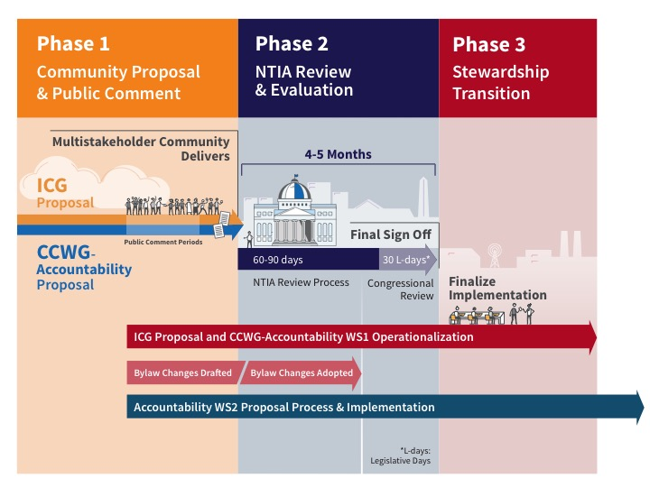
Where are we now?

Slide 46
What Can I Do Now To Get Involved?
Join a working group
  CCWG-Accountability, contact acct-staff@icann.org
Participate in a public comment period
Participating in public comment periods is an integral part of ICANN’s inclusive and bottom-up model of proposal development
Stay up to date on recent developments
  Visit: https://www.icann.org/stewardship-accountability
  Follow @ICANN on Twitter or like ICANN on Facebook
  Subscribe to ICANN news alerts

Slide 47


Questions?
Thank You and Questions
twitter.com/icann
Website: https://www.icann.org/
stewardship-accountability
facebook.com/icannorg
IANA Stewardship Transition
https://www.icann.org/stewardship
Latest news and information on the IANA Stewardship Transition and ICG
Community participation information
Resources and archives from ICG meetings
Enhancing ICANN Accountability
https://community.icann.org/category/accountability
Latest news and information on the Enhancing ICANN Accountability process and CCWG
Announcements and upcoming events

