Slide 1
Cross Community Working Group
(CCWG) Accountability
Update
8 October 2015

Slide 2
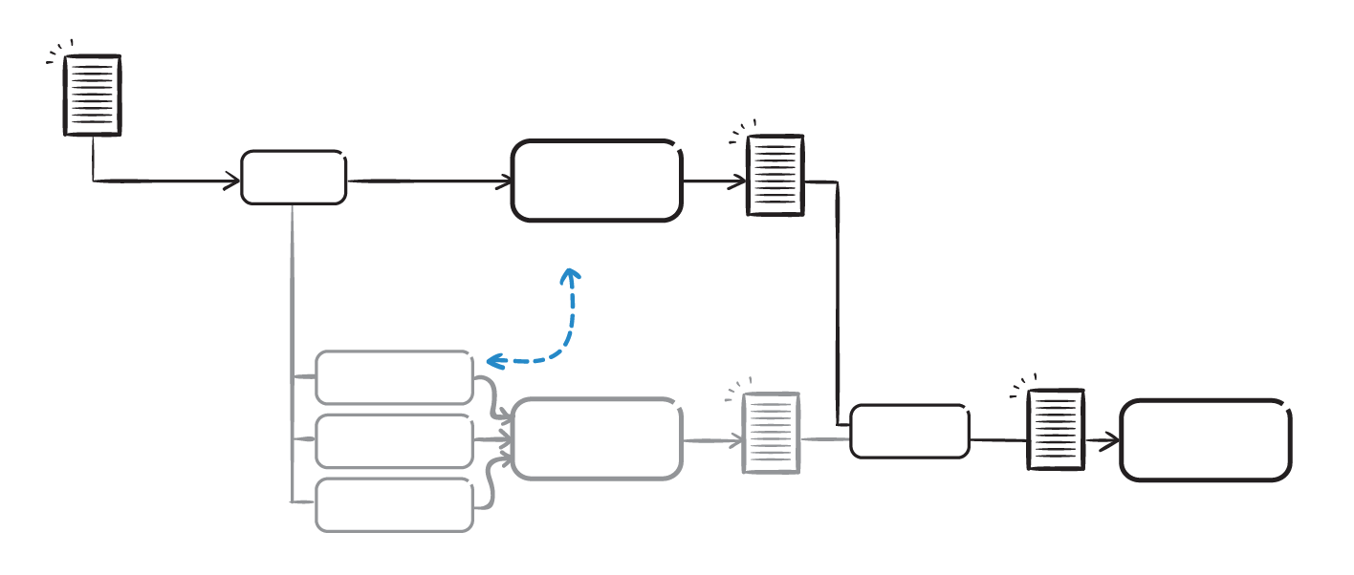
The Two-Track Parallel Process
Since the National Telecommunications and Information Administration (NTIA) announced their intent to transition stewardship of the IANA functions, the ICANN community has been working in a two-track parallel process. The ICG has finalized its Interim Draft IANA Stewardship Transition Proposal, and the CCWG-Accountability has finalized its 2nd Draft Proposal for Work Stream 1.
NTIA
Announcement
& Criteria
ICANN
CCWG
-Accountability
Enhancing ICANN
Accountability
CCWG
Proposal
Linkage
CWG
Stewardship
CRISP
ICG
IANA Stewardship Transition
ICANN BOARD
NTIA
IANAPLAN
ICG
Proposal

Slide 3
Overview
Goal
The CCWG-Accountability is expected to deliver proposals that would enhance ICANN’s accountability towards all its stakeholders.
Scope
Work Stream 1 - Focuses on mechanisms enhancing ICANN’s accountability that must be in place or committed to within the time frame of the IANA Stewardship Transition.
Work Stream 2 - Focuses on addressing accountability topics for which a timeline for developing solutions and full implementation may extend beyond the IANA Stewardship Transition.
The ICANN Community & Board of Directors
The ICANN Community is organized in three Supporting Organizations (SOs) and four Advisory Committees (ACs), each represents key stakeholders. While the ICANN Board has the ultimate authority to approve or reject policy recommendations, Supporting Organizations are responsible for developing and making policy recommendations to the Board. Advisory Committees formally advise the ICANN Board on particular issues or policy areas. Most of the CCWG-Accountability’s efforts are focused on ensuring accountability of the Board of Directors (and ICANN staff) toward these stakeholders, but the question of accountability of the community was also worked on.

Slide 4
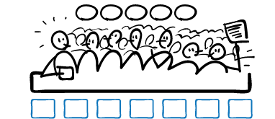
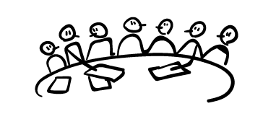
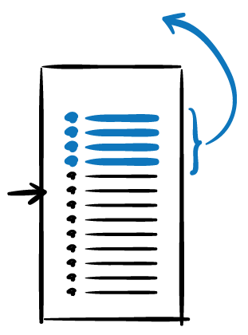

Proposed Enhanced Accountability Mechanisms
The CCWG-Accountability has identified enhancements required to those building blocks that would form the accountability mechanisms required to improve ICANN’s accountability.
1
2
3
4
5
REVIEW / REJECT
BUDGET
STRATEGY/OPS PLAN
BYLAWS
REMOVE / RECALL
AC
SO
AC
SO
AC
SO
AC
ICANN Board
has the ultimate authority to approve or reject policy recommendations, developed by the SOs. ACs formally advise the ICANN Board on particular issues or policy areas (i.e. the Executive).
The Empowered Community
refers to the powers that allow the community SOs & ACs to take action should ICANN breach the principles (i.e. the People).
STRUCTURAL REVIEW
As Community accountability
Fundamental
Bylaws
NEW
NEW IRP
7+ MEMBER STANDING PANEL
BYLAWS
Existing
+
New
mechanisms+
AoC
Reviews
The Principles
guarantee the core mission, commitments and values of ICANN through its Bylaws
(i.e. the Constitution).
Independent Appeals Mechanisms
confers the power to review and provide redress, as needed (i.e. the Judiciary).

Slide 5
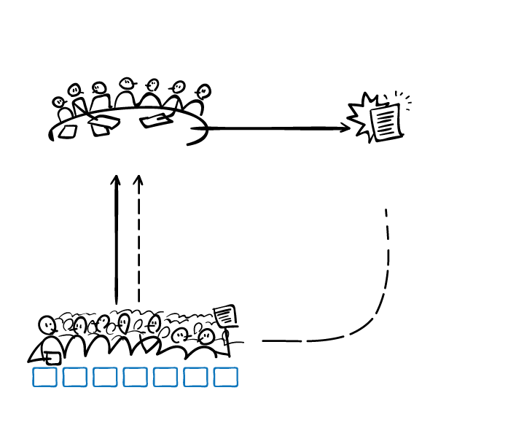
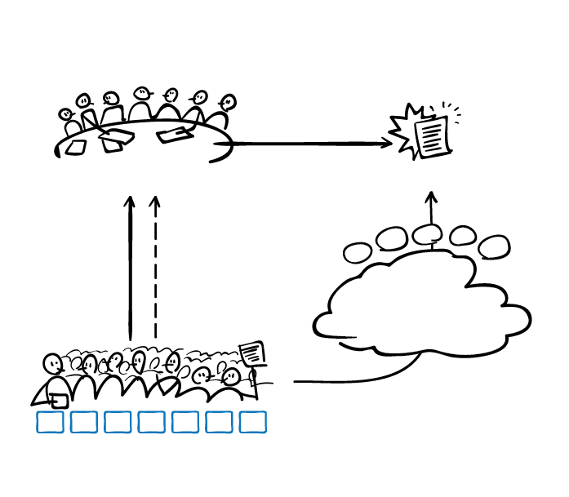
Community Mechanism as Sole Member Model
Many corporate structures and legal mechanisms have been thoroughly explored for organizing the community and enabling it to have enforceable powers, which generally requires “legal personhood” in any jurisdiction. The CCWG-Accountability is recommending the Community Mechanism as Sole Member Model.
The Community Mechanism in which SOs/ACs participate jointly to exercise their community powers would be built into ICANN’s Bylaws and be the Sole Member of ICANN. Decisions of the SOs/ACs per the Community Mechanism would directly determine exercise of the rights of the Community Mechanism as Sole Member (CMSM).
Current
Proposed
If the community disagrees with a Board decision or action, they have no recourse to challenge it.
If the community disagrees with a Board decision or action, they can challenge it exercising their powers through the CMSM.
BOARD
Board Decision or Action
BOARD
Board Decision or Action
Make
Policies
(SOs)
Advise
(ACs)
Make
Policies
(SOs)
Advise
(ACs)
Recourse!
No recourse…
2
3
4
5
1
Representation on the Board
Representation on the Board
Community
Mechanism As
Sole Member
Powers
Community disagrees?
Community disagrees?
AC
SO
AC
SO
AC
SO
AC
AC
SO
AC
SO
AC
SO
AC
THE COMMUNITY
THE EMPOWERED COMMUNITY
5

Slide 6





The Empowered Community’s Powers
The CCWG-Accountability recommends the ICANN community be empowered with five distinct powers.
1. Reconsider/reject Budget or Strategy/Operating Plan
This power would give the community the ability to consider strategic/operating plans and budgets after they are approved by the Board (but before they come into effect) and reject them.
2. Reconsider/reject changes to ICANN “Standard” Bylaws
This power would give the community the ability to reject proposed Bylaws changes after they are approved by the Board but before they come into effect.
3. Approve changes to “Fundamental” Bylaws
This power would form part of the process set out for agreeing any changes of the “Fundamental” Bylaws. It requires that the community would have to give positive assent to any change, a co-decision process between the Board and the community and that such changes would require a higher vote.
4. Remove individual ICANN Board Directors
The community organization that appointed a given director could end their term and trigger a replacement process. The general approach, consistent with the law, is that the appointing body is the removing body.
5. Recall entire ICANN Board
This power would allow the community to cause the removal of the entire ICANN Board. (expected to be used only in exceptional circumstances).
6

Slide 7



CMSM Model: Exercising Powers
How does the community exercise its powers? The exercising of different community powers may include unique steps relevant to a given power, but the general process is as follows.
1
2
3
CAUSE
PETITION
DISCUSSION
DECISION
OUTCOME
ICANN Board or Board Member action causing significant concern to members of the community.
A petition by at least one SO or AC (depending on the power) starts the formal discussion and decision-making about whether to exercise a community power.
The whole community – all SOs and ACs –
discusses the proposed use of the power, online and/or through a proposed ICANN community forum.
SOs and ACs that have voting rights in the Community Mechanism cast their votes to decide whether the power is used or not.
ICANN Board
acts in accordance with the community’s decision.
Generally a maximum period of fifteen days from the announcement of the decision that might trigger the power’s use.
This Discussion Period lasts for fifteen days, starting the day after a valid petition has been received.
This Decision Period lasts for fifteen days, starting the day after the conclusion of the discussion period.
Notable exceptions to this three-step process are for the powers to remove an ICANN director appointed by an SO/AC (where there is an initiating trigger vote in the SO/AC to start consideration of the process) or to co-approve changes to Fundamental Bylaws (where its use is automatically triggered by any proposal for changes to Fundamental Bylaws). To Recall the Entire ICANN Board requires two SOs or ACs (at least one of which is an SO) to sign a petition.

Slide 8
Current key issues
Level of enforceability
Especially for budget and separation powers
This drives the « model » discussion
Decision making for the community
Concerns regarding weights and opt-in / opt-out
Consensus decision making investigated
SO and AC accountability to the global Internet community
New requirement - core reason for Board concerns
Very few concrete suggestions so far
Could there be a 2 steps approach ?
1st phase with powers and low level of enforceability
Governance review with « iron clad » guarantees

Slide 9
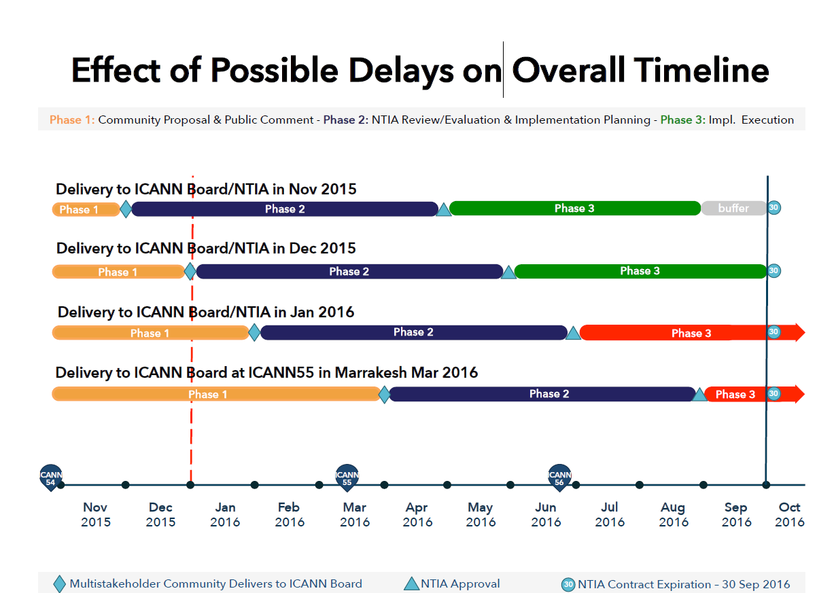
Timeline : Solid orange bordering on red

Slide 10

Keys for a successful Dublin meeting
Expected outcome
Find new common ground for consensus
Assess initial support within SO/Acs
Decide whether extra public comment is needed
Clarify role of the Icann Board in the process
How can you help ?
Have clear view of your core requirements and expectations
Active listening and open mind
Dedicate any available time to the heavy lifting tasks of reviewing public comments or drafting

