Slide 1
Visual Summary
Cross Community Working Group
(CCWG) Accountability
Work Steam 1 – 2nd Draft Proposal for Public Comment
3 August 2015
This document is a summary interpretation of key points found in the proposal described above. The summaries and graphics here present the main recommendations found in the full proposal. This document may be updated based on revisions made to that proposal.

Slide 2
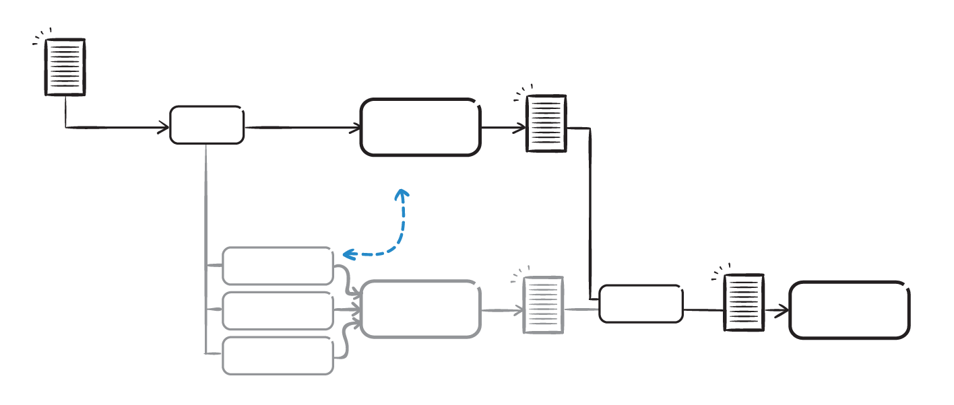
The Two-Track Parallel Process
Since the National Telecommunications and Information Administration (NTIA) announced their intent to transition stewardship of the IANA functions, the ICANN community has been working in a two-track parallel process. The ICG has finalized its Interim Draft IANA Stewardship Transition Proposal, and the CCWG-Accountability has finalized its 2nd Draft Proposal for Work Stream 1.
NTIA
Announcement
& Criteria
ICANN
CCWG
-Accountability
Enhancing ICANN
Accountability
CCWG
Proposal
Linkage
CWG
Stewardship
CRISP
ICG
IANA Stewardship Transition
ICANN BOARD
NTIA
IANAPLAN
ICG
Proposal

Slide 3
Overview
Goal
The CCWG-Accountability is expected to deliver proposals that would enhance ICANN’s accountability towards all its stakeholders.
Scope
Work Stream 1 - Focuses on mechanisms enhancing ICANN’s accountability that must be in place or committed to within the time frame of the IANA Stewardship Transition.
Work Stream 2 - Focuses on addressing accountability topics for which a timeline for developing solutions and full implementation may extend beyond the IANA Stewardship Transition.
The ICANN Community & Board of Directors
The ICANN Community is organized in three Supporting Organizations (SOs) and four Advisory Committees (ACs), each represents key stakeholders. While the ICANN Board has the ultimate authority to approve or reject policy recommendations, Supporting Organizations are responsible for developing and making policy recommendations to the Board. Advisory Committees formally advise the ICANN Board on particular issues or policy areas. Most of the CCWG-Accountability’s efforts are focused on ensuring accountability of the Board of Directors (and ICANN staff) toward these stakeholders, but the question of accountability of the community was also worked on.

Slide 4

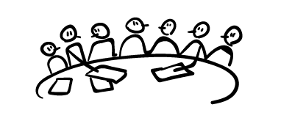


Current Accountability Framework
The CCWG-Accountability identified four building blocks that would form the mechanisms required to improve ICANN’s accountability.
AC
SO
AC
SO
AC
SO
AC
ICANN Board
has the ultimate authority to approve or reject policy recommendations, developed by the SOs. ACs formally advise the ICANN Board on particular issues or policy areas.
The ICANN Community
is organized in three Supporting Organizations (SOs) and four Advisory Committees (ACs).
The Principles
guarantee the mission, commitments and core values of ICANN through its Bylaws.
BYLAWS
Independent Appeals Mechanisms
confers the power to review and provide redress, as needed.

Slide 5
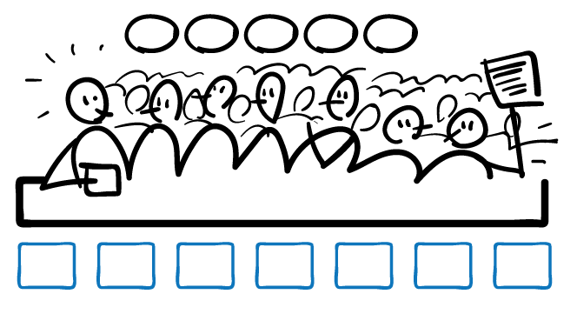
Escalation Paths and the Status Quo
The CCWG-Accountability recommends giving the multistakeholder community more governance powers, as detailed below. These powers are intended to replace the backstop that the historic relationship with the U.S. Government provided.
These powers are intended to provide recourse as part of an escalation path in case of substantial disagreement between the ICANN Board and the ICANN community. They do not change or interfere with the day-to-day operations of ICANN.
Additionally, these powers would not impact the status quo of how the community operates today, or introduce new risks to them.
1
2
3
4
5
AC
SO
AC
SO
AC
SO
AC

Slide 6
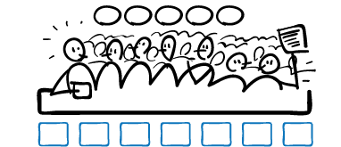
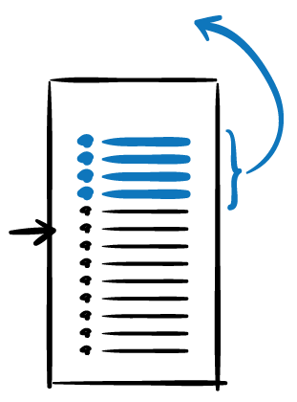

Proposed Enhanced Accountability Mechanisms
The CCWG-Accountability has identified enhancements required to those building blocks that would form the accountability mechanisms required to improve ICANN’s accountability.
1
2
3
4
5
REVIEW / REJECT
BUDGET
STRATEGY/OPS PLAN
BYLAWS
REMOVE / RECALL
AC
SO
AC
SO
AC
SO
AC
ICANN Board
has the ultimate authority to approve or reject policy recommendations, developed by the SOs. ACs formally advise the ICANN Board on particular issues or policy areas (i.e. the Executive).
The Empowered Community
refers to the powers that allow the community SOs & ACs to take action should ICANN breach the principles (i.e. the People).
STRUCTURAL REVIEW
As Community accountability
Fundamental
Bylaws
NEW
NEW IRP
7+ MEMBER STANDING PANEL
BYLAWS
Existing
+
New
mechanisms+
AoC
Reviews
The Principles
guarantee the core mission, commitments and values of ICANN through its Bylaws
(i.e. the Constitution).
Independent Appeals Mechanisms
confers the power to review and provide redress, as needed (i.e. the Judiciary).

Slide 7
The Principles: ICANN’s Mission, Commitments, and Values
ICANN’s Bylaws are at the heart of its accountability. They require ICANN to act only within the scope of its limited mission, and to conduct its activities in accordance with certain fundamental principles. The CCWG-Accountability proposes the following changes be made to the Bylaws.
ICANN’s Mission Statement describes the scope of the organization's activities. The CCWG-Accountability recommends better describing what is in and out of scope for ICANN to do, and to be clear that ICANN can't do anything that isn't specifically allowed in the Bylaws.
ICANN’s Affirmations of Commitments (AoC) requires a periodic review process conducted by the community that results in recommendations for improvement. The CCWG-Accountability proposes to bring aspects of the AoC and the AoC reviews into the ICANN Bylaws.
BYLAWS
ICANN’s Core Values guide the decisions and actions of ICANN. The CCWG-Accountability recommends dividing the existing Core Values provisions into “Commitments” and “Core Values.”

Slide 8
The Principles: Fundamental Bylaws
ICANN’s Bylaws can generally be changed by resolution of the Board with a two-thirds majority. CCWG-Accountability proposes revising ICANN’s Bylaws to establish a set of Fundamental Bylaws, which would hold special protections and can only be changed based on prior approval by the Community with a higher vote threshold.
The CCWG-Accountability recommends that the following items be given the status of Fundamental Bylaws:
The Mission / Commitments / Core Values;
The framework for the Independent Review Process;
The manner in which Fundamental Bylaws can be amended
The Community Mechanism as Sole Member Model
The community powers to Reconsider/reject Budget or Strategy/Operating plans, Reconsider/reject Changes to ICANN Bylaws, Remove Individual ICANN Directors and Recall the Entire ICANN Board
The IANA Function Review and the Separation Process required by the CWG-Stewardship’s proposal;
The Post-Transition IANA governance and Customer Standing Committee structures, also required by the CWG-Stewardship’s proposal.
Current
Proposed
Fundamental
Bylaws
BYLAWS
Existing
+
New
mechanisms
+
AoC
Reviews

Slide 9
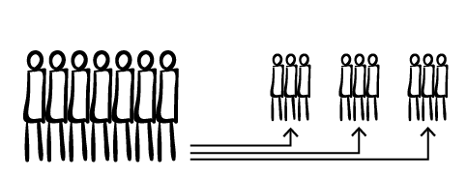
Appeals Mechanisms: Independent Review Process
The CCWG-Accountability recommends significantly enhancing ICANN’s existing Independent Review Process (IRP), whereby any person or entity materially affected by an action (or inaction) in breach of ICANN’s Bylaws by ICANN’s Board may request an independent third-party review of that action.
The core of the recommendation is to institute a Standing Panel to serve as a fully independent dispute resolution function for the ICANN Community. For each dispute, a smaller, 3-member Review Panel will be drawn from the Standing Panel.
The Role & Scope of the IRP
Standing Panel
Review Panels
Determine whether ICANN has acted (or has failed to act) in violation of its Bylaws
Reconcile conflicting decisions in process specific “expert panels”
Hear claims involving rights of the Sole Member
Standing Panel
Review Panels
Composition: 7 members (minimum).
Selection: ICANN to organize a community effort to identify and propose candidate members, Board to confirm.
Expertise: Significant legal expertise; expertise in the workings of ICANN and the DNS; access to other experts upon request.
Diversity: Reasonable efforts to achieve diversity, including no more than 2 panelists from an ICANN region.
Composition: 3 decision makers.
Selection: Selected from Standing Panel. 1 panel member chosen by each party, and those 2 members choose the 3rd member.
Expertise: Relevant to the dispute in question; access to other experts upon request.
Decisions: Are to be binding on ICANN (subject to appeal to full panel) to the extent permitted by law. Possible decisions are:
1) Action/inaction is/is not consistent with Bylaws 2) Substantive decision on Sole Member rights
9

Slide 10
Appeals Mechanisms: Request for Reconsideration
The CCWG-Accountability proposes a number of key reforms to ICANN's Request for Reconsideration (RFR) process, whereby any person or entity materially affected by an action (or inaction) of ICANN may request review or reconsideration of that action by the Board.
Key Reforms Proposed include:
Expanding the scope of permissible requests to include Board or staff actions or inactions that contradict ICANN's Mission, Commitments or Core Values.
Extending the time for filing a Request for Reconsideration from 15 to 30 days.
The grounds for summary dismissal have been narrowed and the ICANN Board of Directors must make determinations on all requests (rather than a committee handling staff issues).
Requiring ICANN Board of Directors to make determinations on all requests after receiving a recommendation from the Board Governance Committee (rather than the BGC deciding).
Tasking ICANN's Ombudsman with initial substantive evaluation of the requests to aid the Board Governance Committee in its recommendation.
Providing requesters an opportunity to rebut the Board Governance Committee's recommendation before a final decision by the entire Board.
Providing enhanced transparency requirements and firm deadlines in issuing determinations.

Slide 11
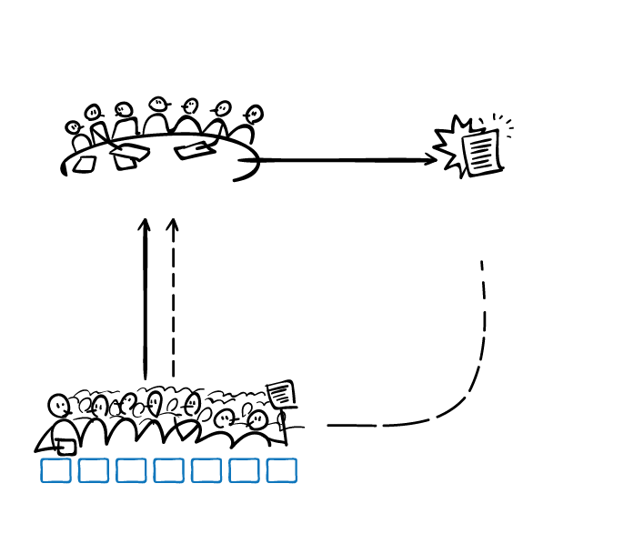
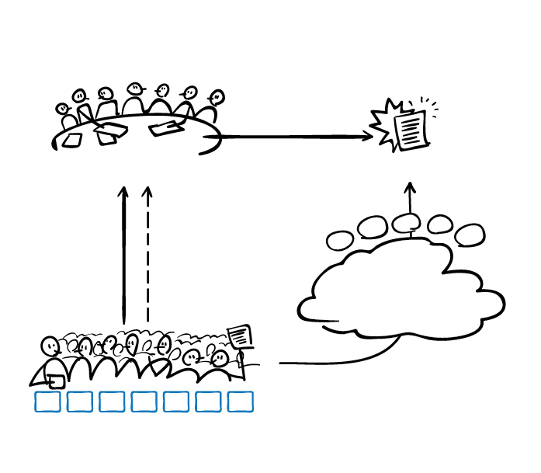
Community Mechanism as Sole Member Model
Many corporate structures and legal mechanisms have been thoroughly explored for organizing the community and enabling it to have enforceable powers, which generally requires “legal personhood” in any jurisdiction. The CCWG-Accountability is recommending the Community Mechanism as Sole Member Model.
The Community Mechanism in which SOs/ACs participate jointly to exercise their community powers would be built into ICANN’s Bylaws and be the Sole Member of ICANN. Decisions of the SOs/ACs per the Community Mechanism would directly determine exercise of the rights of the Community Mechanism as Sole Member (CMSM).
Current
Proposed
If the community disagrees with a Board decision or action, they have no recourse to challenge it.
If the community disagrees with a Board decision or action, they can challenge it exercising their powers through the CMSM.
BOARD
Board Decision or Action
BOARD
Board Decision or Action
Make
Policies
(SOs)
Advise
(ACs)
Make
Policies
(SOs)
Advise
(ACs)
Recourse!
No recourse…
2
3
4
5
1
Representation on the Board
Representation on the Board
Community
Mechanism As
Sole Member
Powers
Community disagrees?
Community disagrees?
AC
SO
AC
SO
AC
SO
AC
AC
SO
AC
SO
AC
SO
AC
THE COMMUNITY
THE EMPOWERED COMMUNITY
11

Slide 12





The Empowered Community’s Powers
The CCWG-Accountability recommends the ICANN community be empowered with five distinct powers.
1. Reconsider/reject Budget or Strategy/Operating Plan
This power would give the community the ability to consider strategic/operating plans and budgets after they are approved by the Board (but before they come into effect) and reject them.
2. Reconsider/reject changes to ICANN “Standard” Bylaws
This power would give the community the ability to reject proposed Bylaws changes after they are approved by the Board but before they come into effect.
3. Approve changes to “Fundamental” Bylaws
This power would form part of the process set out for agreeing any changes of the “Fundamental” Bylaws. It requires that the community would have to give positive assent to any change, a co-decision process between the Board and the community and that such changes would require a higher vote.
4. Remove individual ICANN Board Directors
The community organization that appointed a given director could end their term and trigger a replacement process. The general approach, consistent with the law, is that the appointing body is the removing body.
5. Recall entire ICANN Board
This power would allow the community to cause the removal of the entire ICANN Board. (expected to be used only in exceptional circumstances).
12

Slide 13



CMSM Model: Exercising Powers
How does the community exercise its powers? The exercising of different community powers may include unique steps relevant to a given power, but the general process is as follows.
1
2
3
CAUSE
PETITION
DISCUSSION
DECISION
OUTCOME
ICANN Board or Board Member action causing significant concern to members of the community.
A petition by at least one SO or AC (depending on the power) starts the formal discussion and decision-making about whether to exercise a community power.
The whole community – all SOs and ACs –
discusses the proposed use of the power, online and/or through a proposed ICANN community forum.
SOs and ACs that have voting rights in the Community Mechanism cast their votes to decide whether the power is used or not.
ICANN Board
acts in accordance with the community’s decision.
Generally a maximum period of fifteen days from the announcement of the decision that might trigger the power’s use.
This Discussion Period lasts for fifteen days, starting the day after a valid petition has been received.
This Decision Period lasts for fifteen days, starting the day after the conclusion of the discussion period.
Notable exceptions to this three-step process are for the powers to remove an ICANN director appointed by an SO/AC (where there is an initiating trigger vote in the SO/AC to start consideration of the process) or to co-approve changes to Fundamental Bylaws (where its use is automatically triggered by any proposal for changes to Fundamental Bylaws). To Recall the Entire ICANN Board requires two SOs or ACs (at least one of which is an SO) to sign a petition.

Slide 14
Example: Reconsider/reject changes to ICANN “Standard” Bylaws
How does the community exercise its powers? The exercising of different community powers may include unique steps relevant to a given power, but the general process is as follows.
OUTCOME
CAUSE
1
2
3
The Board absorbs the feedback, makes adjustments, and proposes a new set of amendments to the Bylaws as per its usual processes.
The Board amends Standard Bylaws in ways that the community does not support.
PETITION
DISCUSSION
DECISION
To trigger the process of the use of this community power, a petition of one SO or AC is received.
The whole community – all SOs and ACs –
discusses the proposed use of the power, online and/or through a proposed ICANN community forum.
SOs and ACs cast their votes to decide whether the power is used or not. The chair of each SO/AC is responsible for communicating the votes of the SO/AC to the ICANN Board.
Indicated by signature following the decision of a simple majority (enough votes to exceed 50%) of that SO or AC’s governing body.
A mixture of formal and informal discussion, advice and consideration – within the forum and informally within the SOs and ACs.
To succeed, a veto would require a 2/3 level of support in the Community Mechanism.
This power does not allow the community to re-write a Board-proposed Bylaw change: it is a rejection process where the Board gets a clear signal that the ICANN community is not supportive.

Slide 15
Example: Recalling the Entire ICANN Board
How does the community exercise its powers? The exercising of different community powers may include unique steps relevant to a given power, but the general process is as follows.
CAUSE
1
2
3
OUTCOME
A set of problems have become so entrenched that the community wishes to signal its lack of confidence in the Board.
PETITION
DISCUSSION
DECISION
The interim board replaces the ICANN Board (except for the president)
A petition of at least two of the SOs or ACs, at least one of which must be an SO, is received.
The whole community – all SOs and ACs –
discusses the proposed use of the power, online and/or through a proposed ICANN community forum.
SOs and ACs cast their votes to decide whether the power is used or not. The chair of each SO/AC is responsible for communicating the votes of the SO/AC to the ICANN Board.
Indicated by signature following the decision of a simple majority (enough votes to exceed 50%) of that SO or AC’s governing body.
A mixture of formal and informal discussion, advice and consideration – within the forum and informally within the SOs and ACs.
75% of all the votes available within the CMSM would have to be cast in favor of recall for the recall to be effective.

Slide 16

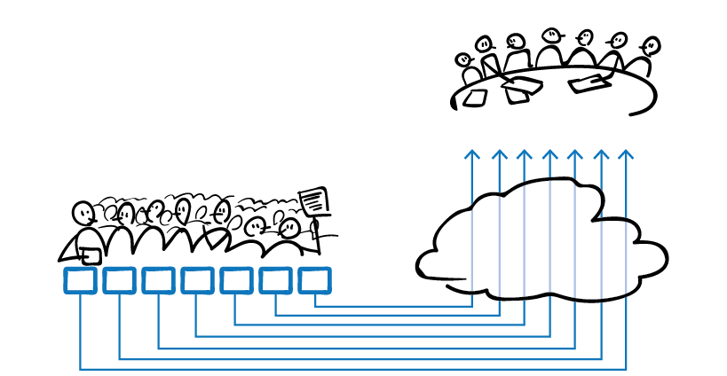
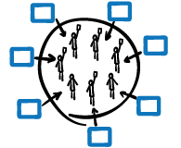
Influence in the Community Mechanism
The CCWG-Accountability considered the decision weights of the various parts of the community. The table on the right sets out the voting distribution proposed by the CCWG-Accountability.
SO or AC | # of Votes
Address Supporting Organization (ASO) | 5
Generic Names Supporting Organization (gNSO) | 5
Country Code Names Supporting Organization (ccNSO) | 5
Governmental Advisory Committee (GAC) | 5
At-Large Advisory Committee (ALAC) | 5
Security and Stability Advisory Committee (SSAC) | 2
Root Server System Advisory Committee (RSSAC) | 2
The SOs/ACs that participate in voting in the Sole Member would do so according to a set of rules described in the ICANN Bylaws that would be created specifically for this purpose. Each SO/AC would be responsible for defining their processes for voting under these rules. The chair of each SO/AC would be responsible for communicating the votes or decisions of the SO/AC to the ICANN Board. This pass-through of cumulative votes and decisions would become the act of the Sole Member.
Participating SOs and ACs would not meet as the Member
BOARD
Community
Mechanism As
Sole Member
AC
SO
AC
SO
AC
SO
AC
No representatives of participating SOs and ACs would cast votes.
Note: GAC, SSAC and RSSAC have not yet decided whether to participate.

Slide 17
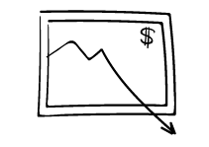



Stress Tests
An essential part of the CCWG-Accountability Charter requires stress testing of the recommended accountability enhancements. The purpose of these stress tests is to determine the stability of ICANN in the event of consequences and/or vulnerabilities, and to assess the adequacy of existing and proposed accountability mechanisms available to the ICANN community.
I
Financial Crisis or Insolvency
II
Failure to Meet Operational Obligations
III
Legal/Legislative Action
IV
Failure of Accountability
V
Failure of Accountability to External Stakeholders
The exercise of applying stress tests identified changes to ICANN Bylaws that might be necessary to allow the CCWG-Accountability to evaluate proposed accountability mechanisms as adequate to meet the challenges identified.

Slide 18
Work Streams & Implementation
The CCWG-Accountability’s work is organized in two Work Streams. Work Stream 1 changes must be implemented or committed to before any transition of IANA Stewardship from NTIA can occur.
Possible tracks for implementation of Work Stream 1:
Revising Mission, Commitments and Core Values
Establishing Fundamental Bylaws
Completing the IRP enhancements
Establishing Community empowerment mechanism and incorporation of the community Powers into the Bylaws
Incorporating the AoC reviews into the Bylaws
Completing the Reconsideration Process enhancements
Elements considered for Work Stream 2:
  Refining the operational details of WS1 proposals
  Further assessing enhancements to government participation in ICANN
  Considering the issue of jurisdiction
  Enhancing SO/AC accountability
  Instituting a culture of transparency within the ICANN organization
  Considering improvements to diversity in all its aspects at all levels of the organization
  Defining the modalities of how ICANN integrates human rights impact analyses, within its mission
2015
2016
JAN | FEB | MAR | APR | MAY | JUN | JUL | AUG | SEP | OCT | NOV | DEC | JAN | FEB | MAR | APR | MAY | JUN | JUL | AUG | SEP | OCT | NOV | DEC
Work Stream 1 Development (and identifying topics for Work Stream 2)
Work Stream 1 Implementation
Work Stream 2 Development
Frankfurt
Istanbul
Paris
Work Stream 2 Implementation
ICANN 52
ICANN 53
ICANN 54
ICANN 55
ICANN 56
ICANN 57
18

Slide 19

Linkage with the CWG-Stewardship
The CCWG-Accountability recognizes that continued and close engagement with the CWG-Stewardship is essential. Key aspects of the CWG-Stewardship proposal are considered to be conditional on the output of the CCWG-Accountability.
CWG-Stewardship Requirement | CCWG-Accountability Proposal | Requirement met?
ICANN Budget Community rights regarding the development and consideration. | Recommended community power: Reconsider/reject budget or strategy/operating plan
ICANN Board Community rights regarding the ability to appoint / remove members, and to recall the entire Board. | Recommended community powers: Appoint & remove individual ICANN directors, Recall entire ICANN board
ICANN Bylaws Incorporation of the following into ICANN’s Bylaws: IANA Function Review, Customer Standing Committee, and the Separation Process. | Recommended to be included as ICANN Bylaws.
Fundamental Bylaws All of the foregoing mechanisms are to be provided for in the ICANN Bylaws as Fundamental Bylaws. | Recommended to be included as ICANN Bylaws.
Independent Review Panel Should be made applicable to IANA Functions and accessible by TLD managers. | Will be applicable, except for ccTLD delegations / revocations and numbering decisions.
19
19

