Slide 1

ICANN and its Structure
Albert Daniels - Carlos Dionisio Aguirre | Webinar
07 July 2015

Slide 2
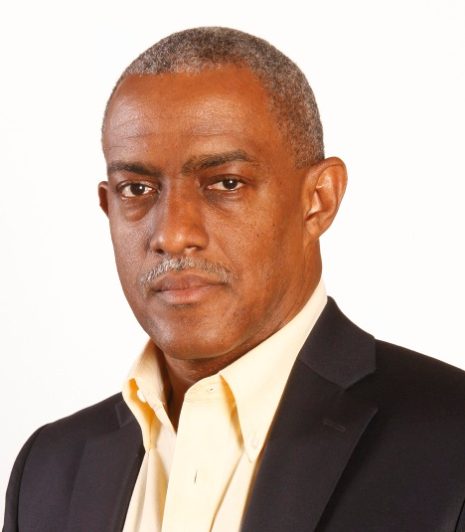
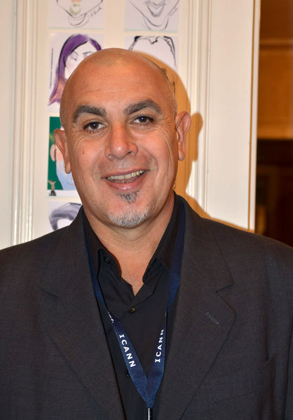
Albert Daniels
Manager for Stakeholder Engagement
The Caribbean -ICANN
Carlos Dionisio Aguirre
Director AGEIA DENSI –
Vice Presidente ADIAR –LACRALO rep.
Former ALAC member (twice)
Former GNSO Councilor

Slide 3
Agenda
History
Milestones
Funding
ICANN Board
Staff areas
Governments and the GAC
RSSAC
SSAC
ASO
ccNSO
gNSO
ALAC
The multi-stakeholder model
How to participate
Q&A
Notes:
This is a simpler agenda slide, the outline for your presentation.

Slide 4
Carlos Dionisio AGUIRRE
Director AGEIA DENSI –
Vice Presidente ADIAR –LACRALO rep.
Former ALAC member (twice)
Former GNSO Councilor
Elect Board Director of Cordoba’s Bar Association
-----------------------------------------------
2nd part.

Slide 5
MULTI-STAKEHOLDER model
-5 sectors: Governments-Business-Tecnical -Academic & Civil Society
---------------------------------------------------
GNSO CPH-NCPH NOMCOM appointee
ALAC 2+1 x5 (+5Presidents & 5Secretariat)
HOW PARTICIPATE?

Slide 6
@neweconomy
Key Words
Knowledge
Participation
Engagement
Outreach
Capacity Building
Please, memorize it !
Notes:
Breakup your presentation, divide it into sections. This is especially useful if most of your presentation is text.

Slide 7
ALS education and engagement
Lack of commitment
of some ALS`s leaders & End Users with different backgrounds
Lack of knowledge especially for end users, just because ALSs leaders lack of commitment
Takes too long to understand ICANN processes,
themes, history, bylaws, technical issues
Lot of time is needed before you are able to contribute and
make comments
@neweconomy
Notes:
Breakup your presentation, divide it into sections. This is especially useful if most of your presentation is text.

Slide 8
What is Before ENGAGEMENT ?
First of all : Participation
Participation with knowledge is required
It is difficult (impossible) get involved if you don`t know
@neweconomy
Notes:
Breakup your presentation, divide it into sections. This is especially useful if most of your presentation is text.

Slide 9
Participation . What mean ?
Participation is a kind of connection - feed back
Participation need at least two participants- where one give and the other receive and viceversa - permanently, and obviously, a learning or discussion point.
Participation mean to have some knowledge about what you are discussing, you have capacity to participate.
If you have not knowledge, you are not be able to participate by lack of capacity.
@neweconomy

Slide 10
KNOWLEDGE
@neweconomy
How this goal will be reached by End Users ?
“Outreach” : another complex issue.
How we built the capacity of End Users?
Social networks – podcasts – papers – brochures.
by radio – with courses, webinars, conferences . Who are the presenters? Who define the scope?
face to face meetings
Personal Desition of LAC ALS`s leaders
WE NEED IDEAS & ...
$$$ ( OF COURSE!) but not so much

Slide 11
Different Rules of Procedure & Operating Principles in 5 Regions different cultures, different distances, different languajes, different customs
4
Europe
1
North America
Asia/Australia/
Pacific Islands
1
Latin America/
Caribbean Islands
2
Africa
@neweconomy

Slide 12
WHO ARE RESPONSIBLES?
We are !!! Each one of Us
Our commitment is after participation and, this commitment mean the obligation to do more outreach, to create capacity building and consecuently more participants, future leaders with enough knowledge..
@neweconomy

Slide 13
SUMMARY & CONCLUSIONS
Our first conclusion is “Work Togheter, because we are responsibles”.
Outreach & Capacity Building are most important words.
What are doing some ICANN bodys in this sense?
Would be good to know about this.
ALS`s involvement - Community
Responsible Leaders !
@neweconomy

Slide 14
@neweconomy
        THANK YOU !!!!

Slide 15








Q&A session
Thank You and Questions
Reach us at:
www.icann.org
twitter.com/icann
gplus.to/icann
facebook.com/icannorg
weibo.com/ICANNorg
linkedin.com/company/icann
flickr.com/photos/icann
youtube.com/user/icannnews
slideshare.net/icannpresentations

