Slide 1

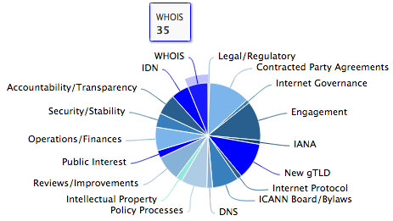
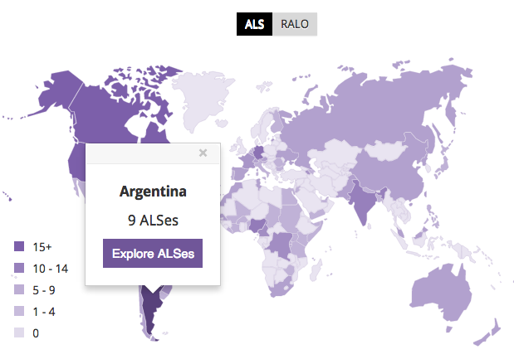
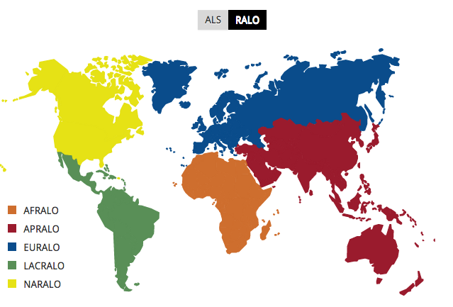
At-Large Website – Teaser of Key Points
1
Policy Process Improvements (ATLAS II Recommentation 26)
  Holistic view from Public Comment to Advice Statement
  Automatic feeds from icann.org
  ‘Follow’ policy advice activities
  Metrics
  Topical views
  Regional views of ALSes
  RALOs
  Demo Session
  Tuesday: 2:30 pm BA time
  Demos: Laura & Ariel
2
3

Slide 2

Web Accessibility – Vendor: Simply Accessible
Introduction
“Simply Accessible is an inclusive experience design agency that focuses on making digital experiences accessible to everyone. This requires us to have a team that excels in design, development and content creation. We put the user first and incorporate people with disabilities into our work on every project.”
Key Principles
Designers
Teachers
Advocates
Pragmatists
Contributors
International Association of Accessibility Professionals (IAAP)
W3C and the Web Accessibility Initiative Education and Outreach WG
Cognitive Accessibility Task Force (COGA)
UX Professionals Association (UXPA).

Slide 3
Web Accessibility - Project Activities
1
Kickoff Meeting – Mid July
2
Training and Testing – August and September
3
Remediation and Continous Measurement - Ongoing
4
Please visit our Digital Services Wiki on the Accessibility project https://community.icann.org/display/digitalservices/Accessibility

