Slide 1
IANA Stewardship Transition Cross Community Working Group (CWG) on Naming Related Functions
CWG RFP 4
Transition Implications

Slide 2
Agenda
Dec 23, 2014
1. Background
2. Work stream #1 – Current Situation
3. Work stream #2 – Describing the transition path
4. Work stream #3 – Testing the proposal
5. Review of timeline & next steps

Slide 3
Background
Important to describe existing arrangements and how changes proposed in RFP 3 are implemented. That is, what needs to change.
The aim of this group is to insure the security and stability of the proposal

Slide 4
Previous call items

Slide 5
Timeline
December 22 : Deadline for submission of public comments
December 22- 30 : Discussion on how to include public comments into CWG proposal
January 2 : Revisit CWG proposal
January 10 - RFP 4 needs to be completed by this date.
January 10-12 Final drafting of the CWG proposal
January 19th, CWG proposal will have to be complete.

Slide 6
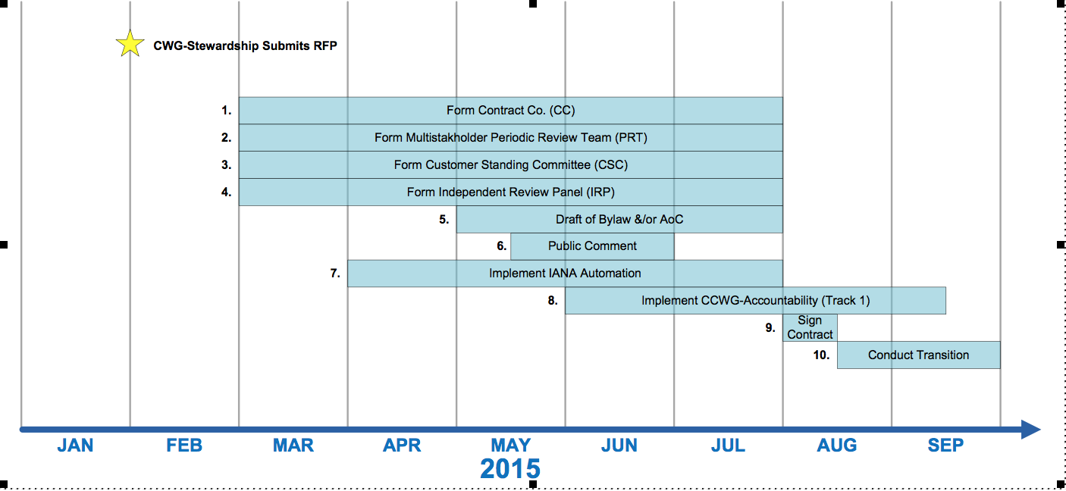
Timeline (II)

Slide 7
Proposed Work Streams

Slide 8
Proposed Work Streams
Describe the current situation
  Need to have a better understanding of the current situation with the existing IANA contract. Review technical proposal
Describe the Transition Path
  Assume that we are going forward with the Contract Co. option
  Describe the transition path that is needed to implement Contract Co.
Testing the new Proposal
  Need to identify the risks, especially during the transition period

Slide 9
Work stream 1
1. Current situation
  1.1 Review of existing ICANN/IANA Technical proposal
  1.2 Discussion of using table of contents from ICANN/IANA Technical proposal as a templete to develop text on how this will change depending on RFP 3 ( Contract Co. <-> all internal, inclusion of IAP etc. ).
  1.3 Identify relevant terms in the ICANN proposal as well
  AGENDA ITEM FROM Co-Chair / Robert :
  Comments on 1.1, 1.2, 1.3 please. Lack of comments, will be interpreted as consensus to proceed using the existing ICANN/IANA Technical proposal as a template.

Slide 10
Work stream 2
2. Transition path
  2.1 Discussion occurred on how to describe the transition path for the different proposals from RFP 3
  2.2 Draft text was presented on how to describe changes
  2.3 Transition path for alternate proposals (ie. ALAC)
  AGENDA ITEM FROM Co-Chair / Robert :
  2.1 & 2.2 Is there any comment on ways to best ways describe the transition changes. A draft text was presented. Is there a consensus on using that as a format? Are there elements missing? Should a summary of changes be presented in some way?
  2.3. Ask for update from ALAC an others who are suggesting/proposing alternate proposals and how (or not) they are including details on transition path from existing contract to new one.

Slide 11
Work stream 3
3. Testing the new proposal
  3.1 Need to document and discuss risks/treats and issues that might arise to maintain security & stability
  AGENDA ITEM FROM Co-Chair / Robert :
  3.1 Ask that discussion start on the list and continue on the call on Dec 23 on compiling a list of risks/threats. Ask for feedback from everyone on the call tomorrow, especially those with security/stability (ie. ssac) expertise and others.. After call, will ask for staff to summarize the threats mentioned and how proposals might be tested..

Slide 12
Work stream 3
3. Testing the new proposal (continued)
  3.2 Need to develop (detailed) list of key periods where testing of proposals is needed. Mention that “transition period” is a critical period where specific and detailed tests will need to be conducted.
AGENDA ITEM FROM Co-Chair / Robert :
3.2 adding on what mentioned in 3.1, ask that conversation take place on the list and on the call on Dec 23 to develop a list of key periods where proposal should be tested (& how)

Slide 13
Next steps
4. Review of timeline
5. Next call
  December 29 (2100 UTC)

Slide 14
THANK YOU

