Slide 1


Slide 2
IDN Program Update to GNSO
Sarmad Hussain | IDN Program Sr. Manager | 7 February 2015

Slide 3
Agenda
Overview of IDN Program
IDN TLD Program
IDN ccTLD Fast Track
IDN Tables
IDN Implementation Guidelines
Communications and Outreach
Next Steps

Slide 4
Overview of IDN Program
      IDN TLD Program
        Label Generation Ruleset (LGR)
        LGR Toolset
        IDN Variant Implementation
      IDN Fast Track Process Implementation
      IDN Tables
      IDN Implementation Guidelines
      Community Outreach
Communications Plan Execution
LGR Development (P2.2)
LGR Specification and Tool (P1)
IDN ccTLD Fast Track
IDN Language Tables
LGR Var. Impl. (P7)
IDN Impl. Guidelines

Slide 5
IDN TLD Program
Notes:
Breakup your presentation, divide it into sections. This is especially useful if most of your presentation is text.

Slide 6
Work Under IDN TLD Program
PHASE 1 (2011)
Case Studies:
PHASE 2 (2011-12)
Integrated Issues Report
PHASE 3 (2012-13)
Projects:
Arabic
Chinese
Cyrillic
Devanagari
Greek
Latin
P1 LGR XML Specification
P2.1 LGR Process for the Root Zone
P6 User Experience Study for TLD Variants
PHASE 4 (Since 2013)
Projects:
P2.2 LGR Development
P1 LGR Specification and Toolset
P7 LGR Implementation
Community agreed to define a Label Generation Ruleset (LGR)
  Reports and documentation of all completed projects available at:
  https://www.icann.org/resources/pages/reports-2013-04-03-en
Notes:
Use this slide for diagrams or other graphic elements.

Slide 7
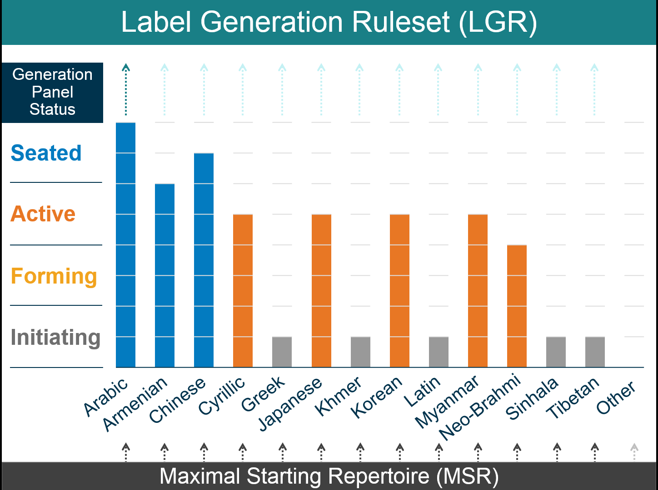
Status of Generation Panels

Slide 8
Maximal Starting Repertoire – Ver. 2 (MSR-2)
MSR-2 released for public comment : https://www.icann.org/public-comments/msr-2014-12-15-en
Upwardly compatible replacement for MSR-1
Total 28 scripts
    Six new scripts added
      Armenian, Ethiopic, Khmer, Myanmar, Thaana, Tibetan
    Existing scripts in MSR-1 unchanged

Slide 9
Guidelines Document for Generation Panels
Overview documents released for public comment: https://www.icann.org/public-comments/lgr-guidelines-2015-01-15-en
Guidelines for Developing Script‐Specific Label Generation Rules for Integration into the Root Zone LGR
Considerations for Designing a Label Generation Ruleset for the Root Zone
Requirements for LGR Proposals
Background technical documents
  Variant Rules
  Whole Label Evaluation (WLE) Rules
  Representing Label Generation Rulesets using XML

Slide 10
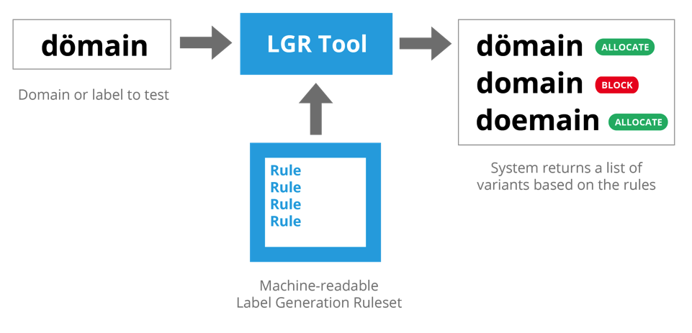
LGR Specification and Toolset
LGR machine-readable specifications at
  https://datatracker.ietf.org/doc/draft-davies-idntables
  Toolset functional priority
    Create LGR
    Use LGR
    Manage LGRs
    Open source
Code Point Rules
Variant Rules
WLE Rules
LGR Tool

Slide 11
IDN ccTLD Fast Track Process
Notes:
Breakup your presentation, divide it into sections. This is especially useful if most of your presentation is text.

Slide 12
Status of IDN Country Code TLDs
ccTLDs: 45/35*
укр
(ua)
рф
(ru)
भारत
بھارت
భారత్
ભારત
ਭਾਰਤ
ভারত
இந்தியா
(in)
бел
(by)
გე
(ge)
հայ
(am)
срб
(rs)
қаз
(kz)
Мон (mn)
سورية
한국
(kr)
мкд
(mk)
(sy)
عراق
پاکستان
(pk)
المغرب
(ma)
فلسطين
(iq)
(ps)
ایران
বাংলা
(bd)
中国中國
(cn)
الجزائر
(dz)
مصر
(eg)
(ir)
السعودية
台灣
台湾
(tw)
تونس
(tn)
(sa)
عمان
سودان
(sd)
ไทย
(th)
(om)
香港
(hk)
امارات
الاردن
(ae)
(jo)
قطر
ලංකා
இலங்கை
(lk)
新加坡
சிங்கப்பூர்
(sg)
اليمن
(qa)
مليسيا
(my)
(ye)
  * Successfully evaluated IDN ccTLDs/Total countries/territories

Slide 13
Overview of IDN ccTLD Fast Track Process
  Completed five years of operation
  Requests in 17 scripts for 26 languages
  38 IDN ccTLDs delegated in the Root Zone representing 28 countries/territories
  Following ccNSO recommendation, a two-panel string similarity review process was implemented in December 2013
    The Extended Process Similarity Review Panel (EPSRP) published results of the first set of evaluations in Oct. 2014:
    https://www.icann.org/resources/pages/epsrp-reports-2014-10-14-en
  Currently under annual review through public comment:
    https://www.icann.org/public-comments/idn-cctld-fast-track-2015-01-15-en

Slide 14
IDN Tables
Notes:
Breakup your presentation, divide it into sections. This is especially useful if most of your presentation is text.

Slide 15
IDN Tables
  Submitted by new gTLDs intending to offer IDNs
    Varied in the character repertoire and contextual rules
  Develop reference Label Generation Rulesets (LGRs) for facilitation and consistency in Pre-Delegation Testing (PDT) and the Registry Service Evaluation Process (RSEP)
  Promote reuse for better end-user experience
  Process:
Develop detailed guidelines
Document authoritative sources and create reference machine-readable LGRs
Conduct expert review of LGRs for content, security and stability
Publish LGRs, authoritative sources and expert reports for each language/script for community feedback
Publish updated reference IDN Tables

Slide 16
IDN Implementation Guidelines
Notes:
Breakup your presentation, divide it into sections. This is especially useful if most of your presentation is text.

Slide 17
Status of IDN Implementation Guidelines
Last updated in 2011
  New IDN terminology due to IDN Variant TLD projects
  Consistent, machine readable format for language tables
  Updated content: IANA IDNA table with Unicode versions, MSR, LGR
  Additional guidelines: informational RFC 6912, User Experience study
GNSO community asked BV-WG to initiate review
Current status - awaiting community response on list of issues
  Letters written to ccNSO and GNSO chairs – 4 Dec. 2014

Slide 18
Communications and Outreach
Notes:
Breakup your presentation, divide it into sections. This is especially useful if most of your presentation is text.

Slide 19
Communication and Outreach Efforts
IDN Program sessions at ICANN meetings
IDN Program updates to SOs/ACs at ICANN meetings
Presentations at meetings
  APTLD, APrIGF, ArabIGF, IGFs, TLDCON, AFRINIC, RIPE NCC
Email communication to SOs/ACs – call to action
Blog for general community: http://blog.apnic.net/2014/09/30/speak-up-for-your-language/
IDN pages at ICANN Community Wiki and ICANN Website
IDN mailing lists
  {vip, lgr, ArabicGP, ArmenianGP, ChineseGP, …}@icann.org

Slide 20
Next Steps
Notes:
Breakup your presentation, divide it into sections. This is especially useful if most of your presentation is text.

Slide 21
Next Steps
Support GPs
  Finalize LGR proposals for seated GPs
  Seat additional GPs
  Activate additional GPs
Work with IP
  Finalize MSR-2
  Finalize guidelines for GPs
  Release LGR-1
Initiate LGR Tool Set development
Compile feedback for IDN Implementation Guidelines
Follow next steps for IDN Variant Implementation
Develop IDN Tables
Continue communication and outreach efforts

Slide 22
Questions & Answers
FOR FURTHER DETAILS:
IDN Program Update (Wednesday 9:00-10:15am; Sophia)
IDN Root Zone LGR (Wednesday 1:00-2:15pm; Moor )
USEFUL LINKS:
To joint a Generation Panel, submit interest at: idntlds@icann.org
Call for Generation Panels: http://www.icann.org/en/news/announcements/announcement-11jul13-en.htm
LGR Procedure: http://www.icann.org/en/resources/idn/variant-tlds/lgr-procedure-20mar13-en.pdf
MSR-1: https://www.icann.org/news/announcement-2-2014-06-20-en
MSR-2 PC: https://www.icann.org/news/announcement-3-2014-12-15-en
LGR Guidelines PC: https://www.icann.org/news/announcement-2-2015-01-15-en
Community Wiki for LGR Project : https://community.icann.org/display/croscomlgrprocedure/Root+Zone+LGR+Project
Notes:
This slide can be used for text, graphics or any other elements.

Slide 23








Engage with ICANN
Thank You and Questions
Reach us at:
Email: engagement@icann.org
Website: icann.org
twitter.com/icann
gplus.to/icann
facebook.com/icannorg
weibo.com/ICANNorg
linkedin.com/company/icann
flickr.com/photos/icann
youtube.com/user/icannnews
slideshare.net/icannpresentations

