Slide 1






Multistakeholder Policy- & Decision-making
“Stakeholder” refers broadly to anyone who has an interest in the Internet
Within ICANN, stakeholders include:
The multistakeholder community functions on bottom-up consensus building which, by design, is resistant to capture due to the openness, diversity and equal division of authority among participants
ICANN’s private sector-led multistakeholder community is directly responsible for the success of the Internet’s DNS
Large and small businesses
Technical community
Civil society
Governments
Researchers and academics
End users

Slide 2
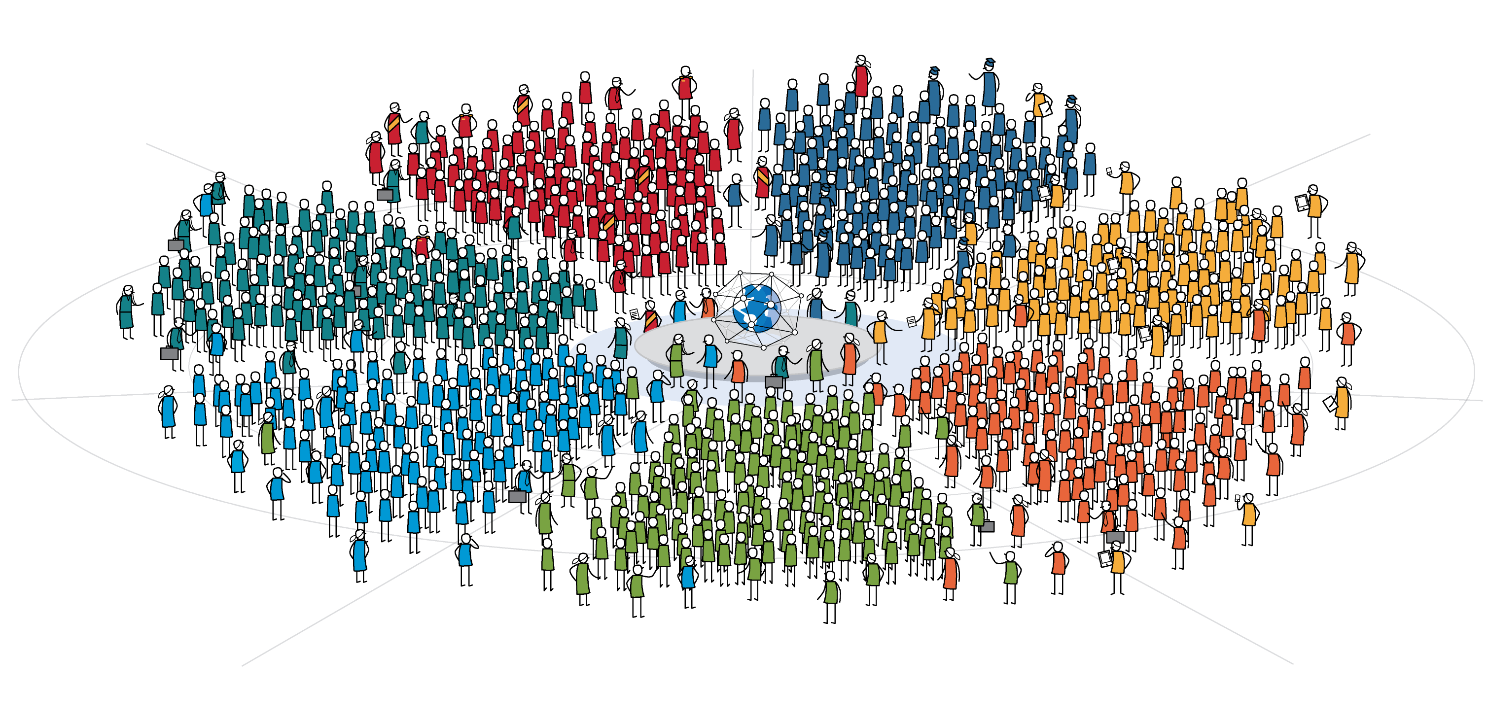

ICANN’s Global Multistakeholder Community
Today’s Community of Communities
In the same way the Internet is a network of networks comprised of computers and devices, the ICANN community is a community of communities comprised of people and organizations.
Government & Governmental Organizations
Academic
Business
Internet Users
Technical
Civil Society
Domain Name
Business

Slide 3
ICANN’s Global Multistakeholder Community
National governments
Distinct economies recognized in international fora
Multinational governmental and treaty organizations
Public authorities (including UN agencies with a direct interest in global Internet Governance)
Private-sector companies
Trade associations
Internet service providers
Academic leaders
Institutions of higher learning
Professors
Students
Government & Governmental Organizations
Academic
Business
Internet Users
Technical
Civil Society
Domain Name
Business
Internet engineers
Software developers
Programmers
Network operators
Registries
Registrars
Domainers
Non-governmental Organizations
Non-profits
Think Tanks
Charities
Research Institutes

Slide 4
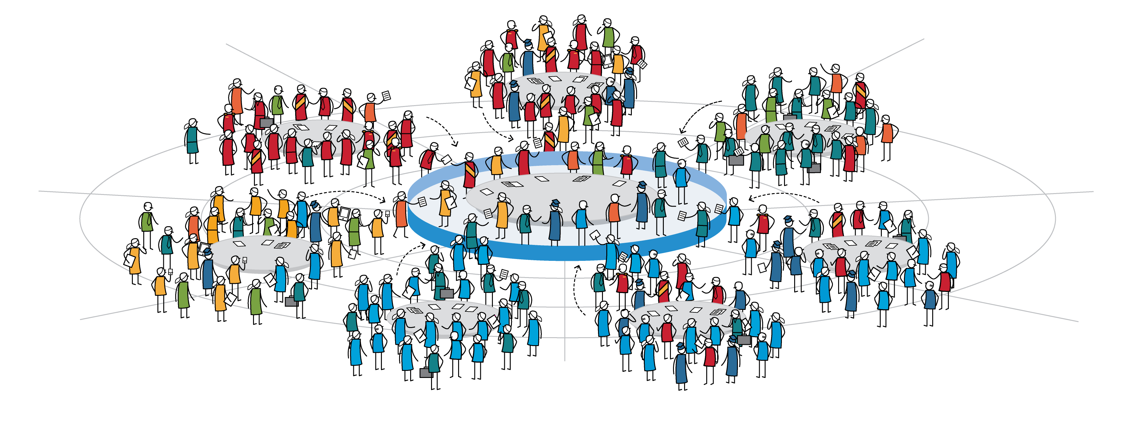







The ICANN Community At Work
The Bottom-Up Multistakeholder Model
The collective efforts of the ICANN community culminate in a common shared goal:
A single, interoperable Internet supported by stable, secure and resilient unique identifier systems.
Country Domain Name Interests
Governmental
Interests
Business & Domain
Name Interests
POLICY / ADVICE
Internet User
Interests
Technical
Interests
IP Address Interests
Business
Government & Governmental Organizations
Civil Society
Domain Name
Business
Internet Users
Academic
Technical

Slide 5
The ICANN Community At Work
The Bottom-Up Multistakeholder Model
The collective efforts of the ICANN community culminate in a common shared goal:
A single, interoperable Internet supported by stable, secure and resilient unique identifier systems.
Country Codes Names Supporting Organization
Government
Advisory Committee
Generic Names Supporting Organization
  Civil Society
  (Non–Commercial Stakeholder Group)
POLICY / ADVICE
At-Large
Advisory Committee
Civil Society
(Internet users)
Root Server System
Advisory Committee
Address Supporting Organization
Security & Stability
Advisory Committee
Business
Government & Governmental Organizations
Civil Society
Domain Name
Business
Internet Users
Academic
Technical

Slide 6

Civil Society At Work In ICANN
The Bottom-Up Multistakeholder Model
The collective efforts of the ICANN community culminate in a common shared goal:
A single, interoperable Internet supported by stable, secure and resilient unique identifier systems.
At Large Advisory Committee (ALAC)
& At Large Structures (ALSs)
Generic Names Supporting Organization
Non Commercial Users Constituency
Non Commercial Stakeholders Group
POLICY / ADVICE
Non Profit Operational Concerns
ALS are the constituent bodies of the At Large Advisory Committee. ALS consist of Internet user organizations and unaffiliated users, they should be organized so that participation by individual Internet users predominates. ALS can be not-for-profit organizations, technical or academic groups, or entities representing business user interests, many ALS self-identify as civil society organizations. ALS support and promote individuals' understanding of, and participation in ICANN.

Slide 7
Civil Society At Work In ICANN
Non Commercial Stakeholder Group (NCSG)
The NCSG provides a voice and representation in the GNSO and other ICANN policy processes to non-profit organizations and individuals who are primarily concerned with the noncommercial, public interest aspects of domain name policy. NCSG has two member constituencies representing different noncommercial interests.
At Large Structures (ALSs)
ALS are the constituent bodies of the At Large Advisory Committee. ALS consist of Internet user organizations and unaffiliated users, they should be organized so that participation by individual Internet users predominates. ALS can be not-for-profit organizations, technical or academic groups, or entities representing business user interests, many ALS self-identify as civil society organizations. ALS support and promote individuals' understanding of, and participation in ICANN.
Noncommercial Users Constituency (NCUC)
NCUC advocates positions on domain name-related policies that protect and support noncommercial communication and activity on the Internet. NCUC members are involved in civil liberties and human rights, Internet freedom, consumer protection, education, research, development, and many other areas of public policy advocacy. The NCUC focuses on issues such as freedom of expression, privacy and human rights, as they relate to the domain name system and the policies that govern it.
Not-for-profit Operational Concerns Constituency (NPOC)
NPOC focuses on the impact of DNS policies on the operational readiness and implementation of non-commercial missions and objectives. It aims to represent the operational concerns of not-for-profit and non-governmental organizations who have registered an Internet domain. Operational concerns include domain name registration, expansion of the DNS, fraud and abuse, using the DNS to provide and collect information and how the DNS can best serve their members and communities.

Slide 8
Civil Society engagement strategy: comments
Content and communications
Supporting the work of ICANN volunteers
Providing information for organizations not fully engaged
What exists: NCSG, NCUC, NPOC sites
Inventory of past contributions, ICANN PDP, meeting reports, member's blog posts, etc
New content: dedicated civil society "landing page"
Social media: dedicated civil society mailing list, twitter (facebook?)
Newsletter: for civil society (generic), section in each regional newsletter, post-ICANN meeting review
NCSG Newcomer Handbook
Guide to ICANN and the DNS
Regular updates on ICANN policy processes, plain English, concise
Webinars: pre-ICANN meeting (what to expect), issue specific

Slide 9
Civil Society engagement strategy: comments
Engagement activities
ICANNN stakeholder engagement teams contributes to / participates in most national and regional IGFs. As appropriate, consider a consistent civil society message for the IGFs?
Outreach pre-event involving local civil society in the ICANN host city (some weeks prior).
In-reach (ICANN academy), develop relevant ICANN-specific training (chairing skills, policy development, how to use ICANN tech

Slide 11

The ICANN Community At Work
ICANN Board of Directors
The ICANN Board is responsible in exercising the authority of ICANN and controlling its business affairs and properties by virtue of a majority vote by its members present during annual, regular, or special meetings where there is a quorum
Nominating
Committee
At-Large Advisory Committee (ALAC)
Country Codes Names Supporting Organization (ccNSO)
Government Advisory Committee (GAC)
Root Server System
Advisory Committee (RSAC)
Address Supporting Organization (ASO)
Non-Voting
Members
CEO
Security & Stability
Advisory Committee (SSAC)
Generic Names Supporting Organization (GNSO)
Internet Engineering Task Force (IETF)
Business
Government & Governmental Organizations
Civil Society
Domain Name
Business
Internet Users
Academic
Technical

