Slide 1
22 09 December 2014
CCWG – Enhancing ICANN Accountability
Project Timeline

Slide 2
Key Milestones
15 Apr 2015 | Publish Draft WS1 Proposal for public comment and begin WS2 deliberations
30 May 2015 | Publish Final WS1 Proposal and submit to Chartering Organizations for approval
20 Jun 2015 | Obtain approval of WS1 Proposal by Chartering Organizations
30 Jun 2015 | Submit WS1 Proposal to ICANN Board
?? Xxx 201X | Publish Draft WS2 Proposal for public comment
?? Xxx 201X | Publish Final WS2 Proposal and submit to Chartering Organizations for approval
?? Xxx 201X | Obtain approval of WS2 Proposal by Chartering Organizations
?? Xxx 201X | Submit WS2 Proposal to ICANN Board

Slide 3

CCWG Accountability Timeline 2014-2015+
 |  |  | T
Charter Adopted
Assess Current & Proposed Accountability Mechanisms
Work Stream 1
Tentative F2F Singapore
  WS1 Public Comment
Tentative F2F Frankfurt
Publish WS1 Final Proposal
  WS1 Proposal OK by COs
  Submit WS1 Final to Board
Work Stream 2
  WS2 Public Comment
Publish WS2 Final Proposal
  WS2 Proposal OK by COs
  Submit WS2 Final to Board
Oct
Nov
Dec
Jan
Feb
Mar
Apr
May
Jun
Jul
Aug
Sep
???
2014
2015

Slide 4
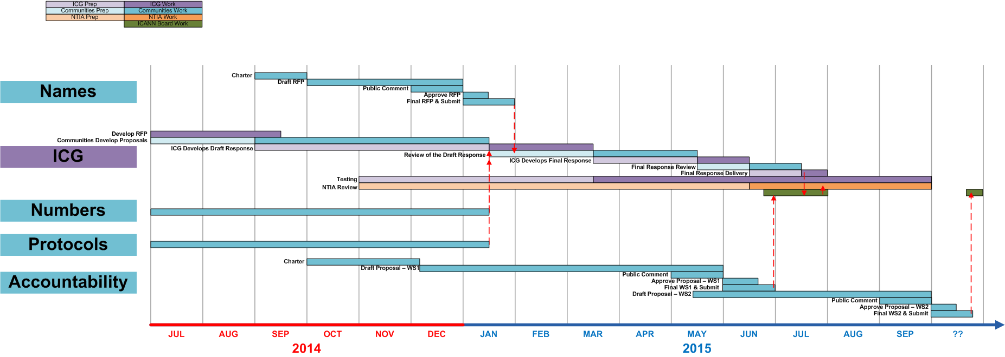
ICG-CWG-CCWG Timeline 2014-2015+

