Slide 1

Transition of the U.S. Commerce Department’s National Telecommunications and Information Administration (NTIA) Stewardship of the IANA Functions to the Global Multistakeholder Community
THIS IS A TOOLKIT
Slides are provided for content and order may be changed based on presentation needs
Updated: 11 August 2014

Slide 2
About this Toolkit
    This discussion toolkit is intended to:
    Provide accurate information about NTIA’s announcement and its intent to transition its stewardship of the IANA functions
    Provide relevant and up-to-date information on the NTIA IANA Functions’ Stewardship Transition process
    Serve as a resource and reference document for those wishing to engage in a dialogue within and outside of their communities
    Note: This toolkit will be updated as the process evolves and new info becomes available.

Slide 3
The U.S. Government’s Announcement
    On 14 March 2014, the U.S. Government (USG) announced its intent to transition its stewardship of the IANA functions to the global multistakeholder community
    As the first step, it asked ICANN to convene global stakeholders to develop a proposal to transition the current role played by the US
    ICANN was asked to serve as a convener based on its role as the IANA functions administrator (since 1998) and the global coordinator for the Internet's Domain Name System (DNS)
    The multistakeholder community has set the policies implemented by ICANN for more than 15 years

Slide 4
Why now?
    The USG always envisioned its role as transitional
    Transitioning the USG out of its current role marks the final phase of the privatization of the DNS as outlined by the USG in 1997
    The decision further supports and enhances the multistakeholder model of Internet policymaking and governance

Slide 5
Transition Proposal’s Guiding Principles
    NTIA has communicated to ICANN that the transition proposal must have broad community support and address the following four principles:
    Support and enhance the multistakeholder model
    Maintain the security, stability, and resiliency of the Internet DNS
    Meet the needs and expectation of the global customers and partners of the IANA services
    Maintain the openness of the Internet
    NTIA also specified that it will not accept a proposal that replaces the NTIA role with a government-led or an intergovernmental organization solution.

Slide 6
What are the IANA Functions?
    The IANA functions involve the coordination of unique Internet identifiers, including:
    Maintenance of the protocol parameter registries on behalf of the IETF
    Allocation of Internet Numbers in cooperation with the Regional Internet Registries
    Management of the .ARPA and .INT domains
    Administrative responsibilities of the DNS root zone
    Coordination of root zone management

Slide 7
Downloadable version here: https://www.icann.org/news/multimedia/469

Slide 8
Upcoming ICG Events:
    7-15 August 2014
    ICG opens comment period on charter
    https://www.icann.org/news/announcement-2014-08-08-en
    19 August 2014
    Second conference call of the ICG
    https://www.icann.org/news/announcement-2-2014-08-07-en
    6 September 2014
    Second face-to-face meeting of the ICG
    https://www.icann.org/news/announcement-2014-07-16-en

Slide 9
As of 29 March 2014:
    ICANN launched a multistakeholder (global in scope) process at the ICANN 49 Meeting in Singapore.
    Based on initial input, from 8 April – 8 May 2014, ICANN issued a call for public comment on the draft principles, mechanisms and process to develop a proposal (translated into 5 official UN languages, plus Portuguese).
    Community response to draft process:
    700 email exchanges
    60 process contributions
    Participation from global stakeholders, including government, private sector, civil society, technical, academic community and end users
    Submissions made in different languages

Slide 10
As of 24 April 2014:
    A special session was held at NETmundial conference in Brazil.
      Over 1,000 attendees from 116 countries
      1168 remote participants from 33 worldwide remote hubs in 23 countries
      Participation from global stakeholders, including government, private sector, civil society, technical, academic community and end users
    ICANN’s GSE team and partner organizations have been and continue to engage in a series of regional dialogues with global stakeholders.

Slide 11
As of 6 June 2014:
    Informed by input on the draft process and subsequent dialogues, the Process to Develop a Proposal and Next Steps was posted online, echoing community feedback.
      Renamed the proposed "Steering Group" to "Coordination Group”
      No role for the Chair of the ICANN Board and Chair of the GAC in selection of members
      Direct representation
      Eliminated the distinction between affected and non-affected parties
      Revised composition to ensure greater balance and representation, including indirect stakeholders non-prescriptive about the roles and responsibilities of the Coordination Group
        Coordination Group will establish its own working methods and modes of operation
      ICANN maintains neutral role as convener and facilitator of process
      Coordination Group encouraged to adhere to diversity standards as they undergo internal selection processes

Slide 12
As of 26 June 2014
    ICANN held a special community run session entitled Transition of NTIA’s Stewardship of IANA Functions at the ICANN 50 Meeting in London.
    Provided the community the opportunity to discuss all elements of the transition process.
    Agenda:
    Role of communities vs. the Coordination Group
    Engaging participants outside of the traditional ICANN, IETF, and RIR participants
    Defined success criteria
    Relationship of the work on Accountability and NTIA Transition
    Open Discussion
    Sessions engaged in dialogue and received comments from a live-streaming chat room and over a dozen interactive hubs around the world.

Slide 13
As of 3 July 2014
    Composition of IANA Stewardship Transition Coordination Group (ICG) announced.
    *17 July 2014 – The ICG accepted the GAC’s request to increase the number of GAC representatives in the ICG from two to five.
Community | Member Name
ALAC | Mohamed El Bashir
ALAC | Jean-Jacques Subrenat
ASO | Hartmut Glaser
ccNSO | Xiaodong Lee
ccNSO | Mary Uduma
ccNSO | Keith Davidson
ccNSO | Martin Boyle
GAC* | Manal Ismail
GAC* | Heather Dryden
GAC* | Kavouss Arasteh
GAC* | Michael Niebel
GAC* | Jandyr Ferreira dos Santos
GNSO | Wolf-Ulrich Knoben
GNSO | Milton Mueller
GNSO | James Bladel
gTLD Registries | Keith Drazek
Community | Member Name
gTLD Registries | Jon Nevett
ICC/Basis | Joseph Alhadeff
IAB | Russ Housley
IAB | Lynn St Amour
IETF | Jari Arkko
IETF | Alissa Cooper
ISOC | Narelle Clark
ISOC | Demi Getschko
NRO | Adiel Akplogan
NRO | Paul Wilson
RSSAC | Daniel Karrenberg
RSSAC | Lars-Johan Liman
SSAC | Patrik Fälström
SSAC | Russ Mundy
ICANN Board Liaison | Kuo-Wei Wu
IANA Staff Expert | Elise Gerich

Slide 14
As of 18 July 2014
    The ICG met for the first time on 17-18 July 2014 in London, United Kingdom.
    In this first face-to-face meeting, the ICG:
    Developed a proposed charter and scope for its future work in support of the community’s development of a proposal
    Conducted an initial discussion of a draft timeline for development of the transition proposal
    Worked on its internal organization, communications needs and participation processes
    20 Members of the ICG attended in-person, one of whom was a GAC interim representative, and 2 liaisons; 5 participated remotely; 2 were unable to attend
    Resources from the ICG meeting, including the meeting agenda, transcripts and audio translations can be found here:
    https://www.icann.org/resources/pages/coordination-group-resources-2014-07-18-en

Slide 15
Principles and Mechanisms
    Principles
    Inclusive
    Transparent
    Global
    Accountable
    Multistakeholder
    Focused in scope
    Pragmatic and evidence-based
    Open to all voices
    Do no harm (maintain security, stability, and resiliency)
    Consensus-based
    Diversity
    Mechanisms
    Web-based platform
    Working methods
    Organize dialogues
    Leverage existing information and processes
    Stress tests
    Clear and visible timeline
    Discussion in other fora
    Widely accessible engagement platforms
    Multilingual support
    Multiple comment fora

Slide 16
Enhancing ICANN Accountability Process
    During discussions around the transition process, the community had also raised the broader topic of the impact of the transition on ICANN accountability
    As a result, a separate but related process on Enhancing ICANN Accountability process was launched
    Scope of the process is to look at ICANN remaining accountable in the absence of its historical contractual relationship with the U.S. Government and the perceived backstop with regard to ICANN's organization-wide accountability provided by that role, such as the renewal process of the IANA Functions Contract
    Unlike the IANA stewardship discussion occurring across multiple fora, this process is fully within the ICANN community
    While separate, the dialogue on Enhancing ICANN Accountability is a key component to the success of the transition process

Slide 17
IANA Functions Stewardship Transition FAQ
    Q. What is this process about?
    A. To develop a proposal to transition NTIA’s stewardship of the IANA functions
    Q. What is this process not about?
    A. This is not about ICANN’s role as the operator of the IANA functions – this role is not the focus of the transition
    Q. Is there a target date for the transition to take place?
    A. Depending on the progress of the dialogue, the global multistakeholder community could be ready to complete the transition before the renewal of ICANN’s contract with the USG in September 2015
    Q. Does this announcement jeopardize the security, stability and resiliency (SSR) of the Internet DNS?
    A. No. In fact, maintaining the SSR of the Internet DNS is one of the principles outlined by the NTIA
    Additional FAQs:
    http://www.icann.org/en/about/agreements/iana/functions-transfer-faqs-14mar14-en.pdf

Slide 18
Getting Involved
    Visit https://www.icann.org/stewardship for:
      The latest resources on the topic
      Participate in the events listed in the timeline
      Follow us on our social channels
    Contribute to the discussion:
      Email enabled forum: http://discuss-stewardship.icann.org/
      IANA Transition mailing list: https://mm.icann.org/mailman/
      listinfo/ianatransition
      ICANN also encourages that discussions continue on the
      many forums and mailing lists that exist across the
      community

Slide 19
Mailing List
Discussion Forum
PROS
CONS
PROS
CONS
Easy to sign up
Simple and easy to respond
Offline access and response is straight forward
Convenient mobile access
Sending private or group messages straightforward
Difficult to follow fragmented conversations
Unfamiliar (dated) technology to wider global audience
Difficult to enter conversations mid-stream and understand full context
Can’t easily filter topics or threads
Hard to moderate and see trends
Improved identity
Features for discussion management
Accessible by a wider global audience
Tag and classify threads
Full email support
Easy to follow, mute and manage followed conversations
Improved search
Trending metrics for views and likes
Need to login to configure email preferences to receive email notifications
Must login to use advanced conversation management features
Web interface takes more bandwidth than email

Slide 20
Thank You! Questions?

Slide 21
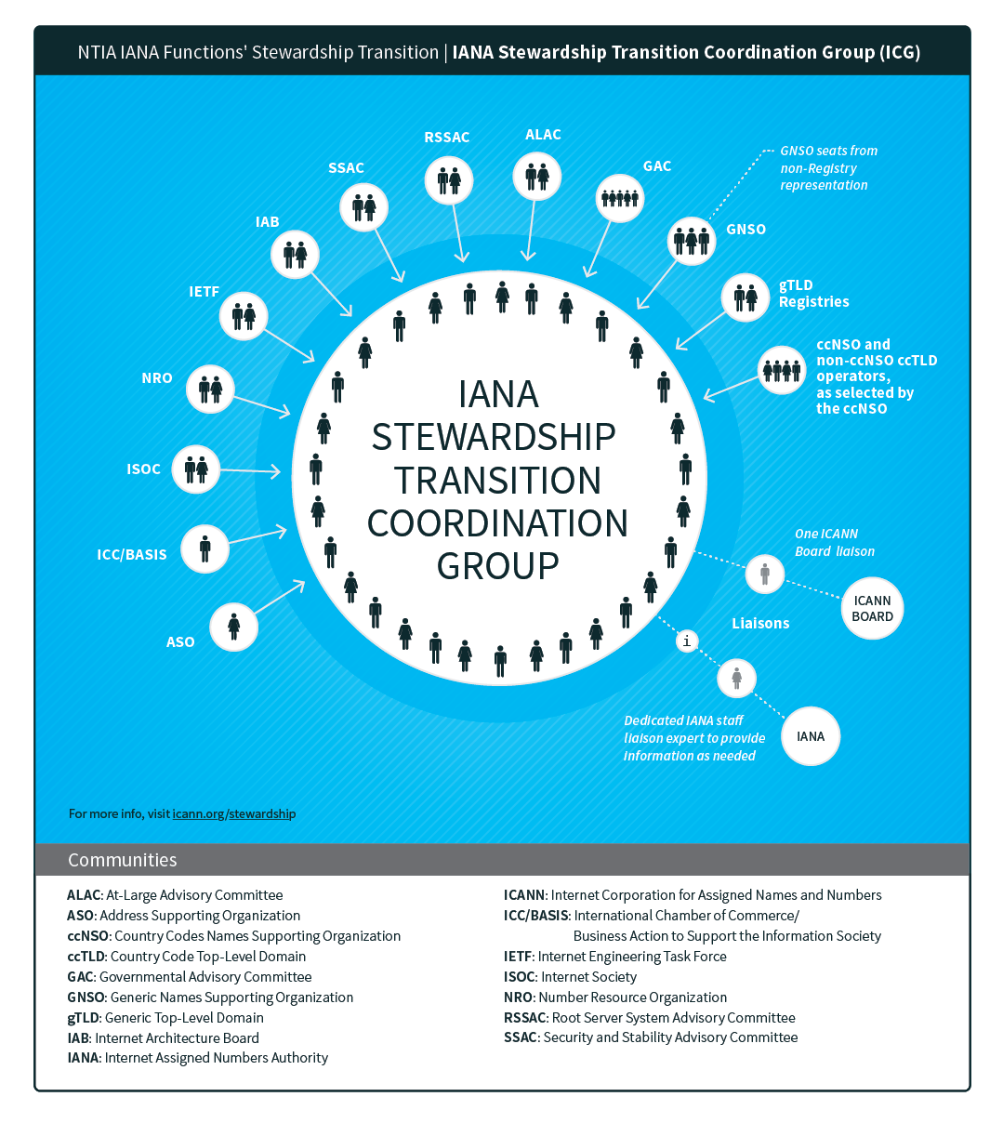
Appendix A

