Slide 1
What’s the LAC Strategic Plan?
How to get involved
Rodrigo de La Parra - VP Latin America and the Caribbean
Rodrigo Saucedo – Project Manager Latin America and the Caribbean
LACRALO Webinar - 13 November 2014

Slide 2
Agenda
What is the LAC Strategic Plan
5 Pilot Projects update
Implementation Plan
How to get involved

Slide 3
What’s the LAC Strategic Plan?

Slide 4

LAC Strategic Plan
  LAC community driven
  Discussions in ICANN45 - Toronto
  Final version in ICANN46 - Beijing

Slide 5
LAC Strategic Plan
  Political Issues
    7 projects
  Capacity Building and Outreach
    27 projects
  Operations
    9 projects
  Economic Issues
    32 projects

Slide 6
LAC Strategic Plan
  Steering Committee
    Fátima Cambronero (At-Large LACRALO)
    Dev Anand Teelucksingh (At-Large LACRALO)
    Carolina Aguerre (LACTLD)
    Eduardo Santoyo (LACTLD)
    Celia Lerman (gNSO)
    Anthony Harris (gNSO)
    Andrés Piazza (LACNIC)
    Oscar Robles (LACNIC)
    Tracy Hackshaw (GAC)
    Olga Cavalli (GAC)
    Victor Martínez (GAC)
    Harmut Glaser (NOMCOM)
    Alejandro Pisanty (ex Board Member – LACRALO)
    Vanda Scartezini (ex Board Member – LACRALO)
    Raimundo Beca (ex Board Member)

Slide 7
5 Pilot Projects

Slide 8
LAC i Roadshow

Slide 9
Merged into one project
___________
2.9.2 To implement an outreach Road Show program to reach out to new stakeholders in the region.
3.1.3 To raise awareness to ISPs in the region of the potential problems they may face in the transition of IPv6 by mean of the Road show outreach project.
3.3.1 To incorporate the subject of new gTLD program awareness and impact in the Capacity building Road show.
3.4.1 To include in the Capacity Building Road Show the promotion of SSR of the DNS.

Slide 10
Objective
___________
The LAC Roadshow is designed to raise awareness across the LAC region on key topics related to the DNS critical infrastructure such as the transition to IPv6, SSR and the impact of the new gTLD program.

Slide 11

Editions
___________

Slide 12
The Caribbean edition
___________
Trinidad and Tobago, 25th April 2014
ICANN
Caribbean Telecommunications Union (CTU)
TTNIC
LACNIC
Caribbean Cybersecruity Center
ALAC
CaribNOG
http://goo.gl/YofxpG

Slide 13
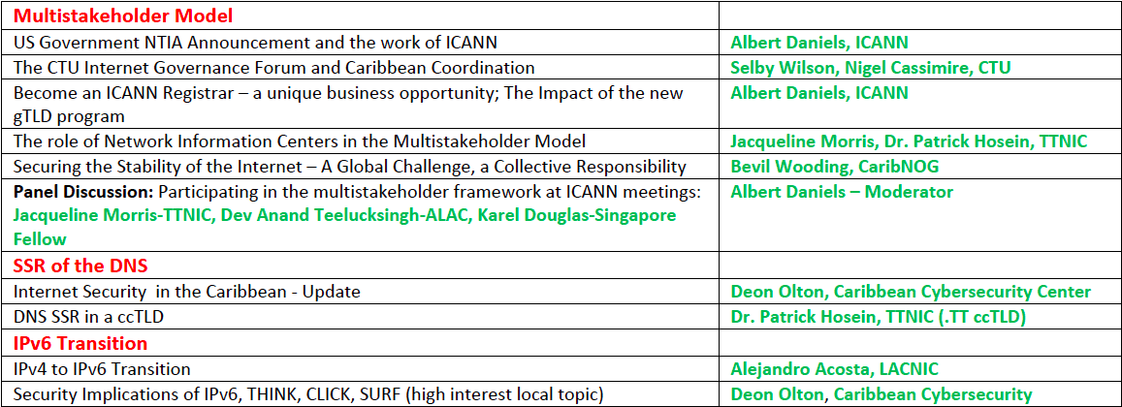
The Caribbean edition
___________
Trinidad and Tobago, 25th April 2014

Slide 14
Central America and Mexico edition
___________
Guadalajara, Mexico 1st October 2014
WCIT2014 (World Congress on Information Technology)
Fadi Chehadé Keynote Speech at WCIT2014 Plenary
Rodrigo de la Parra participated at the Panel "Internet Governance; Rights, Responsibilities, Trust and Integrity”
The BCG Study Breakfast Presentation
An outreach session of the ISPCP Constituency of the gNSO with ISPs from the region

Slide 15
Central America and Mexico edition
___________
Guadalajara, Mexico 1st October 2014
The New gTLDs from the LAC Region
    CEOs of Punto 2012 Aaron and Adolfo Grego shared their experiences on .rest and .bar
    Tony Harris (ecomLAC) and Oscar Robles (NIC México) presented the .LAT.
IPv6 deployment
    Alejandro Martinez Varela, Universidad de Guadalajara
    Javier Contreras, Telmex
    César Díaz, LACNIC

Slide 16
South America edition
___________
Futurecom Sao Paulo, Brazil - 13,14,15 October 2014
Largest event in ICT in Latin America
    15.000 attendees
    340 exhibitors
    325 speakers
    52 countries participating

Slide 17
South America Edition
___________
Futurecom Sao Paulo, Brazil - 13,14,15 October 2014
Remote Hub installed on ICANN booth transmitting sessions from the ICANN L.A meeting.
Security, stability and resiliency of the domain names system
Impact of the new gTLD program.

Slide 18
Communication Project

Slide 19
Comms Plan
___________
To implement a Communications Plan that explains in a simple and clear manner the economic and social benefits of engaging with ICANN.
General objective of the Communication Plan for the region is to optimize the management and information flow from ICANN to LAC actors in order to:
1. Increase awareness of our services, projects and activities;
2. Engage more stakeholders from LAC in our ecosystem;
3. Improve the image of our organization through our internationalization process

Slide 20
Web site
___________
To create a dedicated web page for the LAC region with ICANN community to centralize all information from the region.
Leaders: Dev Anand Teelucksingh LACRLO Fatima Cambronero LACRALO
Miguel Estrada NIC .ar

Slide 21
Online Participation
___________
To promote online participation tools for economic stakeholders in the region through newsletters, mailing list and other relevant and efficient means.
Leaders: Dev Anand Teelucksingh LACRLO
Fatima Cambronero LACRALO

Slide 22
DNS Capacity Building Project

Slide 23
Objective
___________
To articulate and deepen the organization of stability, security and resiliency of the DNS capacity building workshops in coordination with ccTLDs, LACTLD and LACNIC
Leaders: Christian O'Flaherty - ISOC
Gonzalo Romero – ccTLD .co
Carolina Aguerre – LACTLD
Eduardo Santoyo – ccTLD .co
Olga Cavalli - GAC

Slide 24
Activity
___________
LACTLD Tech Workshop 3-6 September
Panama City, Panama http://goo.gl/uMNI0C
DNSSEC for ISPs workshop LACNIC 20
28/10 to 01/11 in Curacao http://goo.gl/ekBnRd
The Project working group had a workshop in Montevideo, Uruguay and they conducted a Gap Analysis about the DNS capacity building in the region. The group came up with a coordinated schedule of DNS capacity building.
http://goo.gl/JUVYsCWorshop
CSIRT, DNSSEC, RPKI, BGP LACNIC 21 6-7 May Cancun, Mexico
http://goo.gl/JUVYsC
LACTLD Tech Workshop 30 September Sao Paulo, Brasil
http://goo.gl/Utov6Y

Slide 25
LAC Space in ICANN meetings

Slide 26
Merged as one project
___________
4.2.1 To create a Lac Space in the main working groups in ICANN meeting in order for regional economic stakeholders to make specific presentation of the business related topics to the region.
4.2.2 To create a permanent Lac Space for and about the business community in LAC as a gathering point for economic stakeholders and also as a reference to meet other stakeholders that are nor from region.
Leaders: Gabriela Szlak
Vanda Scartezini
Celia Lerman

Slide 27
Activity
___________
ICANN 48 Buenos Aires LAC Space
Archival Media:
http://goo.gl/uLnbTS
ICANN 49 Singapore LAC Space
Archival Media:
http://goo.gl/HEC1h9
ICANN 50 London LAC Space
Archival Media:
http://goo.gl/XO5lxE
ICANN 51 Los Angeles LAC Space
Archival Media:
http://goo.gl/8NX4dw

Slide 28
Emergency Response Team
for ccTLDs

Slide 29
Leader and Activity
___________
Oscar Robles - Analysis
Services
Relation with ccTLDs
Continuity
Security
Cooperation
Staff
Other Services
Finance
Legal Environment
Organization
Relation with LACTLD
Relation with ICANN

Slide 30
Implementation Plan

Slide 31
Implementation Plan
___________
Places projects into categories in order to facilitate execution and follow-up.
Promote accreditation of Registrars
Observatories
Creating Interest Group
Funding//Supporting
Inventories
ccTLDs Development
Surveys
Webinars/Remote Parcipation
Programs
Notes:
Internet
Corporation
for
Assigned
Names
and
Numbers
(ICANN)
Caribbean
Telecommunications
Union
(CTU)
Trinidad
&
Tobago
Network
Information
Center
(TTNIC)
Latin
America
and
Caribbean
Network
Information
Center
(LACNIC)
Caribbean
Cybersecruity
Center
ICANN
At
Large
(ALAC)
Caribbean
Network
Operators
Group
(CaribNOG)

Slide 32
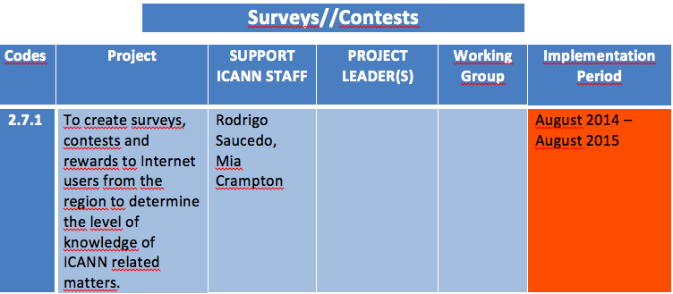
Implementation Plan
___________
Establishes Implementation periods
August 2014 – August 2015
June 2015 – June 2016
Notes:
Internet
Corporation
for
Assigned
Names
and
Numbers
(ICANN)
Caribbean
Telecommunications
Union
(CTU)
Trinidad
&
Tobago
Network
Information
Center
(TTNIC)
Latin
America
and
Caribbean
Network
Information
Center
(LACNIC)
Caribbean
Cybersecruity
Center
ICANN
At
Large
(ALAC)
Caribbean
Network
Operators
Group
(CaribNOG)

Slide 33
Implementation process
___________
Determines implementation process for the projects
Leaders
Working Group
Email list
Document for every project.
  Why is this project necessary?
  General and specific objectives
  time frames (schedule)
  Budget
  How will the project will be evaluate
Notes:
Internet
Corporation
for
Assigned
Names
and
Numbers
(ICANN)
Caribbean
Telecommunications
Union
(CTU)
Trinidad
&
Tobago
Network
Information
Center
(TTNIC)
Latin
America
and
Caribbean
Network
Information
Center
(LACNIC)
Caribbean
Cybersecruity
Center
ICANN
At
Large
(ALAC)
Caribbean
Network
Operators
Group
(CaribNOG)

Slide 34
How to get involved?

Slide 35
Implementation Plan
https://community.icann.org/pages/viewpage.action?pageId=49357942
Get in touch with:
Dev Anand Teelucksingh LACRLO
Fatima Cambronero LACRALO

Slide 36
Thank you!
Questions?
rodrigo.delaparra@icann.org
rodrigo.saucedo@icann.org

