Slide 1
Introduction to
ICANN At-Large and APRALO
Special thanks to:
Japan Chapter

Slide 2
Outline
Introduction to ICANN At-Large
About ALAC
About RALO and APRALO
Getting involved in At-Large and APRALO

Slide 3
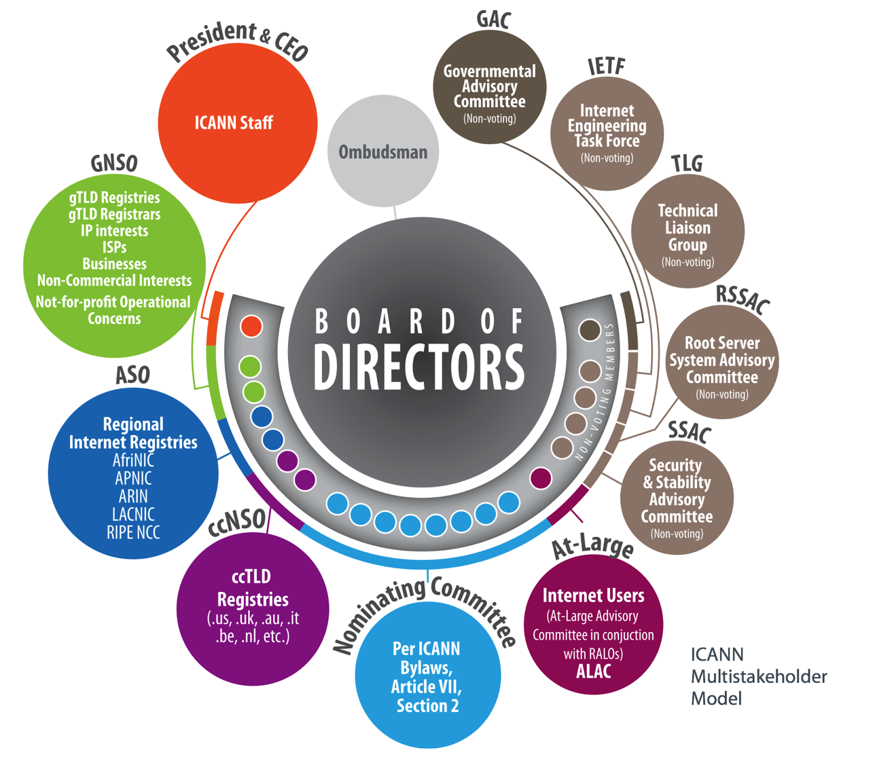
What is At Large?
“At-Large” is the name for the community of individual internet users within ICANN’s multistakeholder model
ICANN Multistakeholder Model
Source: Beginner’s Guide to ICANN: https://www.icann.org/en/system/files/files/participating-08nov13-en.pdf
Notes:
At-Large is the name for the community of individual Internet users who participate in the policy development work of ICANN. At-Large Structures throughout the world represents the views of individual Internet users.

Slide 4
What does At-Large do?
ICANN At-Large provides essential policy advice to ICANN from the internet user perspective
  Provides guidance on how to ensure changes to the Internet’s addressing system can help ensure the Internet becomes a more trusted and safe place
  Provides a way for the worldwide individual Internet user community to engage in all the issues that are a part of ICANN’s work such as:
    Implementation of Internationalized Domain Names;
    Introduction of additional new top-level domains
    Transition of IPv4 to IPv6
    NTIA IANA functions’ stewardship transition
    ICANN Accountability and Transparency, among others
At-Large supports global participation in ICANN by individual lnternet users who want to influence decisions that affect everyone’s use of the Internet every time they use the net.
Source: http://atlarge.icann.org/ and http://www.atlarge.icann.org/en/whatis.htm

Slide 5
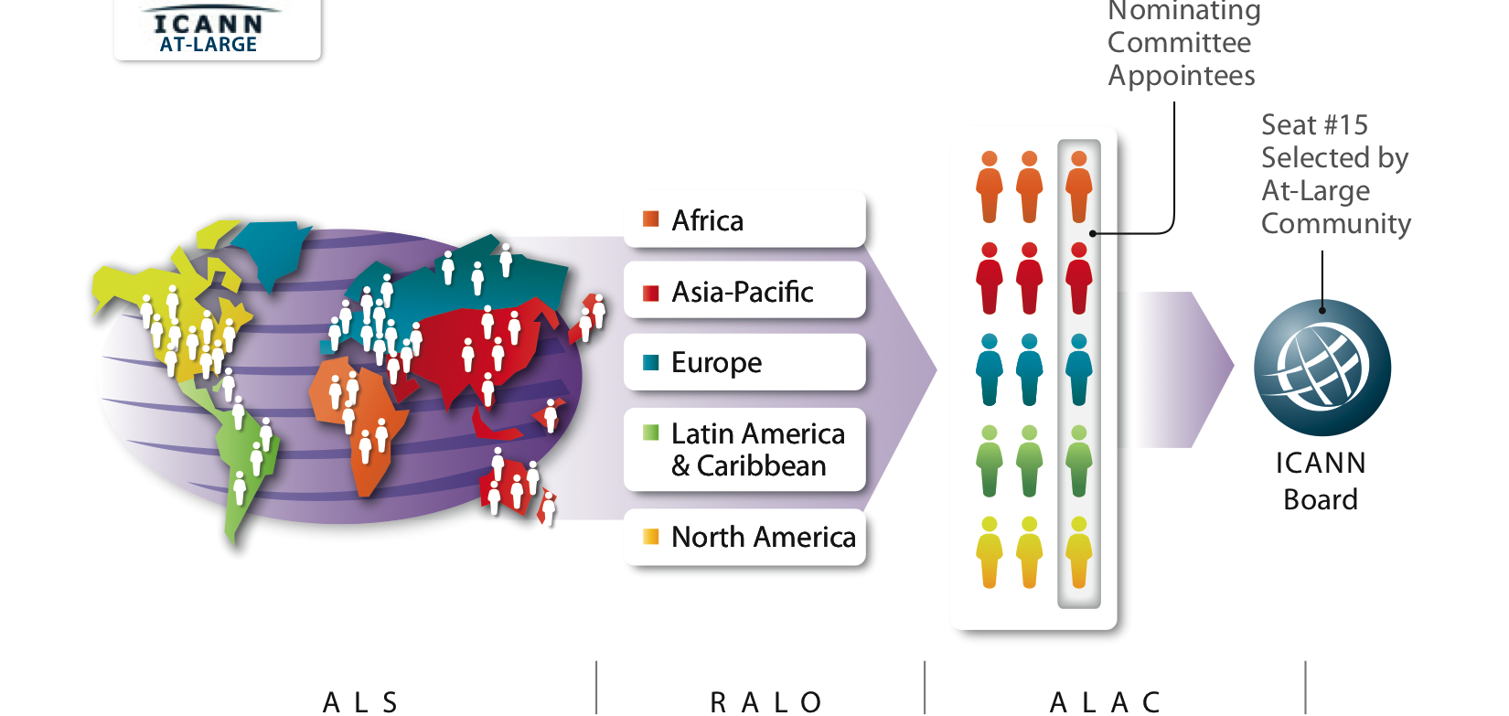
Structure of ICANN At-Large
http://atlarge.icann.org/orgchart

Slide 6
Structure of ICANN At-Large
At-Large Structure (ALS)
  Groups throughout the world that deal with individual Internet users' interests are encouraged to register and participate in ICANN. Groups that meet the minimum requirements will be certified as "At-Large Structures", or ALSes.
Regional At-Large Organizations (RALO)
  ALSes located in each of the five geographic regions of the world have their Regional At-Large Organisations (RALOs), which provides a forum for them to work together on issues that affect their region
At-Large Advisory Committee (ALAC)
  Each RALO selects representatives to the At-Large Advisory Committee, which is a statutory body of ICANN that grants it official standing to advise the larger ICANN community, including the Board of Directors of ICANN, based upon the views of the individual Internet user community worldwide. It also works to bring more Internet user groups into the decision-making processes of ICANN.

Slide 7

About ALAC
    Source: https://archive.icann.org/en/committees/alac/
Members
    ALAC Leadership Team: 4 (Elected from below)
    RALO representatives: 2 selected by each RALO
    Liaison members from other SOs etc: 5
Responsibilities of ALAC
    Advisory role for ICANN
    Support for RALO, ALS
    Appointment of members to the following:
      ICANN Board，GNSO Liaison，ICANN Nomcom etc.
    Proposals on ALS criteria，accreditation process，approving ALSes
    Assisting with outreach strategies on At-Large and relevant ICANN issues
    Publicizing and analyzing ICANN’s proposed policies and decisions
    Offering online platform for discussion among ALS members
    Providing advice to various policy-making organizations within ICANN
Current ALAC Chair
Alan Greenberg

Slide 8
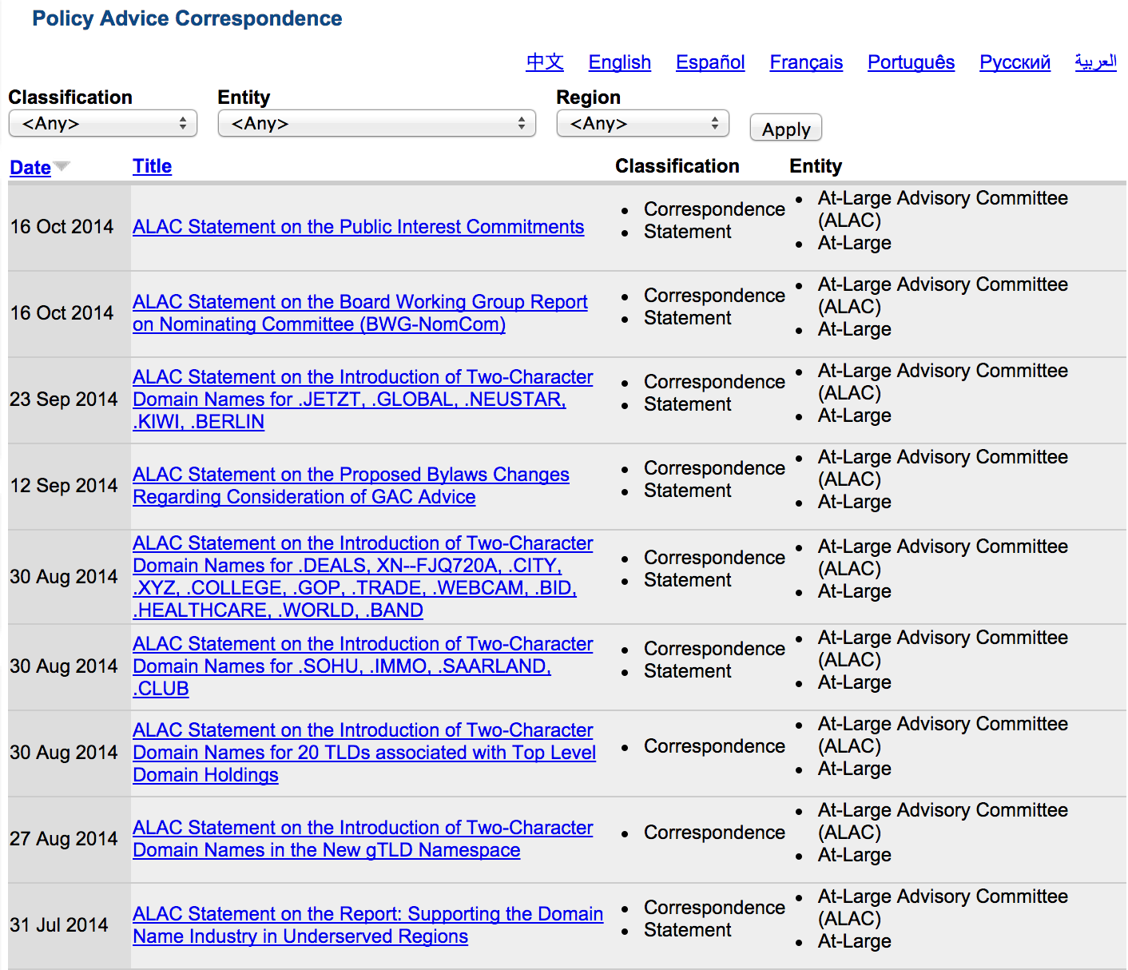
Statements by ALAC
http://atlarge.icann.org/correspondence

Slide 9
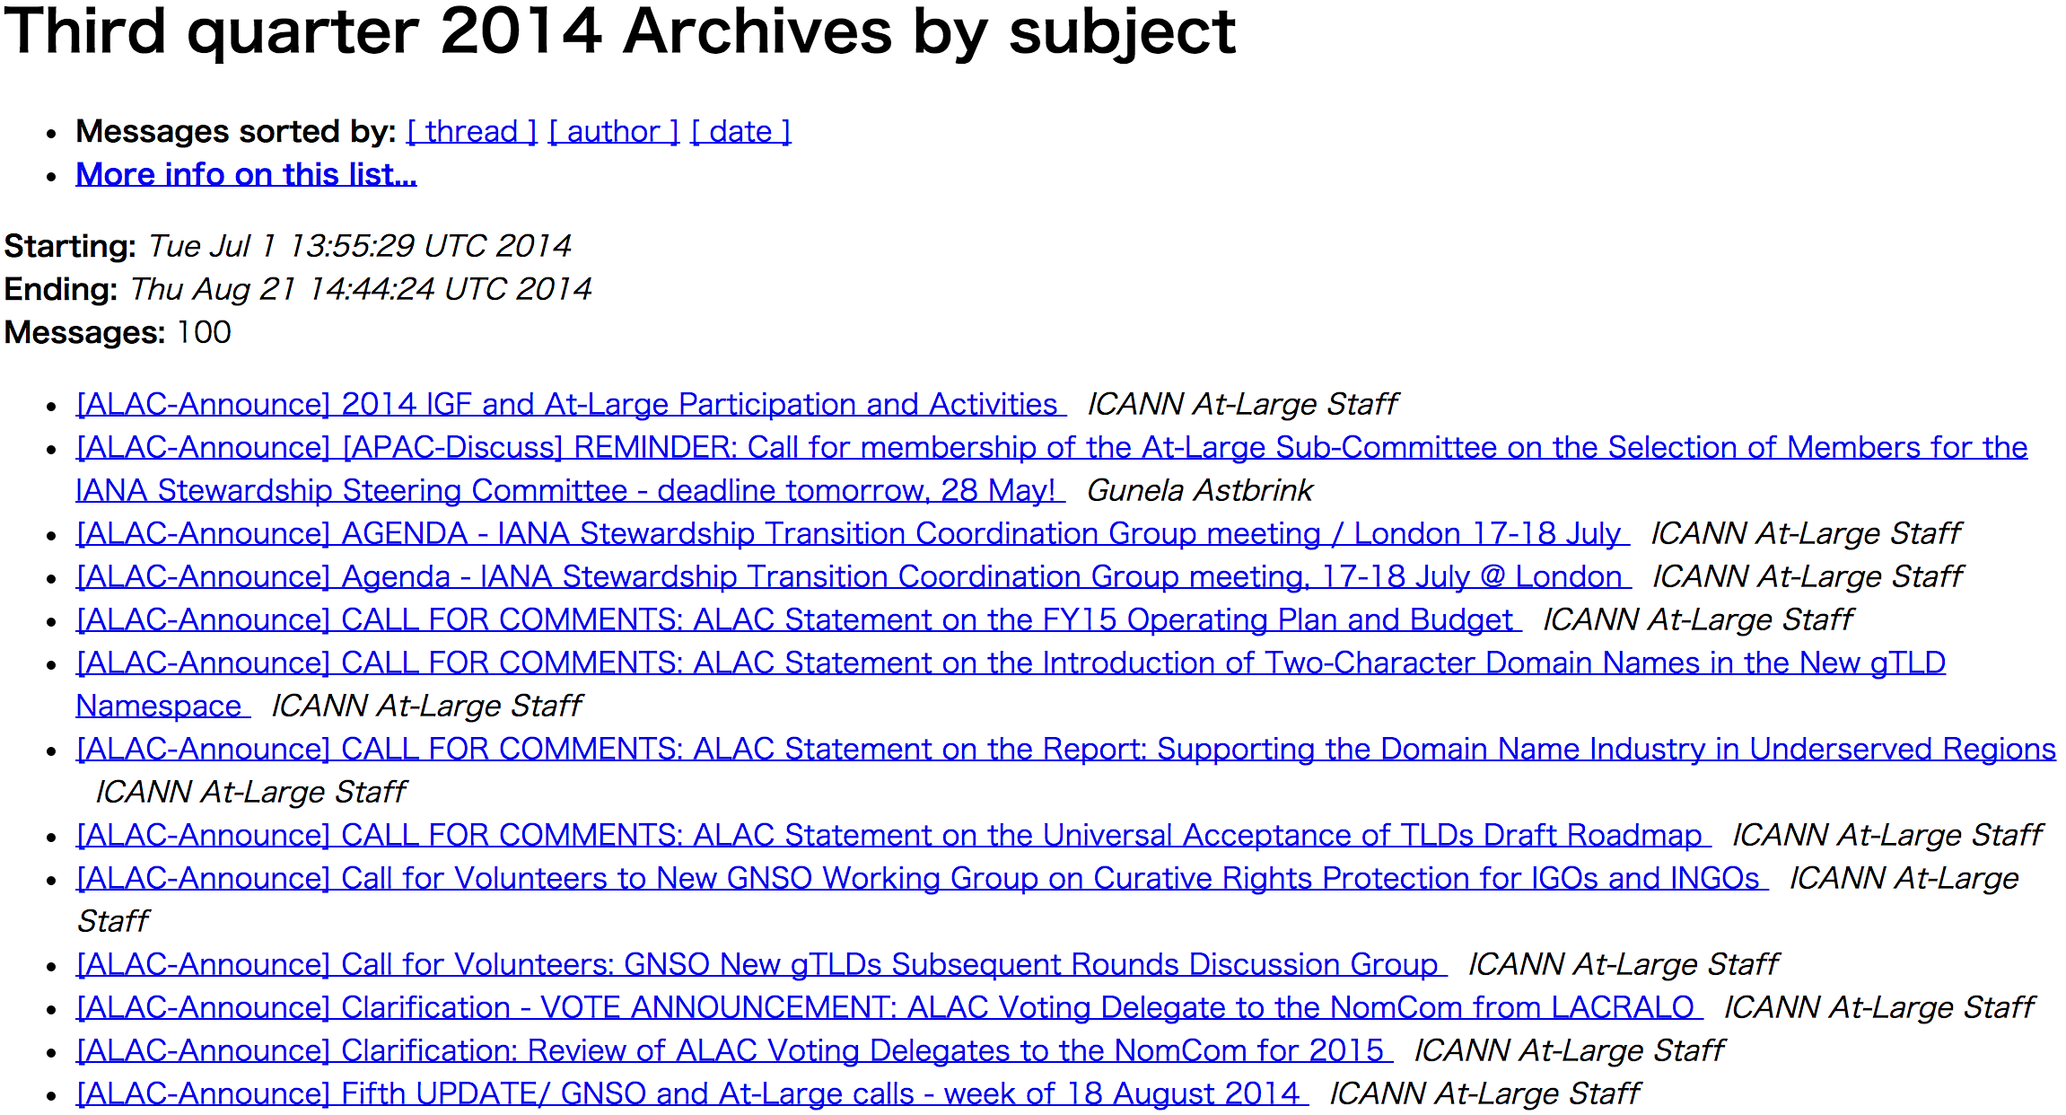
Announcements from ALAC
http://atlarge-lists.icann.org/pipermail/alac-announce/

Slide 10
About RALO
http://atlarge.icann.org/regions
5 Regional-At-Large Organization, based on region:
  African Regional At-Large Organization (AFRALO)
  Asian, Australasian and Pacific Islands Regional At-Large Organization (APRALO)
  European Regional At-Large Organization (EURALO)
  Latin American and Caribbean Islands Regional At-Large Organization (LACRALO)
  North-American Regional At-Large Organization (NARALO)
  Members of RALO
  ALS in the region, as well as other unaffiliated users
  Chair (and Vice Chairs if applicable) as well as the Secretariat
Role of RALOs
  Develop a regional view on current policy issues and to provide input for the At-Large policy process

Slide 11
About APRALO
(Source: APRALO Brochure
https://community.icann.org/display/APRALO/APRALO+Brochure)
APRALO:
encompasses all Internet end-users in Asia, Australasia and the Pacific Islands.
consists of civil society organizations, nonprofits and individuals such as consumer rights group, legal bodies/professional groups, and government nonprofit organizations.
have a direct impact on the direction of ICANN, working to ensure that the expansion of the Internet serves the public interest.
advances policies and services that reduce confusion and abuse while enhancing security, accessibility and stable growth
COLLABORATION
APRALO has MoUs with partners such as APTLD and APNIC to promote and facilitate engagement and training activities within APAC region
DIVERSITY
APRALO covers a vast geographic region and encompasses a diversity of cultures, languages and scripts, presenting exciting challenges
Notes:
APRALO encompasses all Internet end-users in Asia, Australasia and the Pacifiic Islands. Together with other regions, we have a direct impact on the direction of the Internet Corporation for Assigned Names and Numbers (ICANN), working to ensure that the expansion of the Internet serves the public interest.
APRALO consists of civil society organizations, nonprofits and individuals such as consumer rights group, legal bodies/professional groups, and government nonprofit organizations.
we advance policies and services that reduce confusion and abuse while enhancing security, accessibility and stable growth

Slide 12
About At-Large Structures (ALS)
  At-Large Framework
  Minimum Criteria for ALS
    Commit to supporting individual Internet users’ participation in ICANN by sharing relevant ICANN activities and issues, and offering Internet-based mechanisms that enable discussions on relevant ICANN policy and decisions.
    Ensure participation by individual Internet users based within the Geographic Region that the ALS is based, in the ALS' operation.
    Be self-supporting (not rely on ICANN for funding)
    Make publicly accessible, information on ALS’s goals, structures etc.
    Assist the RALO in performing its function
  There are currently more that 180 ALSes active globally that helps represents the interest of individual Internet user
    Number may fluctuate as more are being added and some may be de-certified
    We are also seeing more ISOC local chapters becoming ALSes．
(http://atlarge.icann.org/en/framework.htm#minimumcriteria)
Notes:
On 26 June 2003, ICANN's Board of Directors approved a framework for the formation of local and regional At-Large groups to promote structured involvement and informed participation of the global individual Internet user community in ICANN.
ICANN's At-Large community welcomes interested, qualified groups in all geographic regions to become "At-Large Structures." At-Large Structures, or "ALSes", are groups throughout the world (either existing organizations or those newly formed for this purpose) focusing on participation by individual Internet users at the local or issue level.
Minimum criteria for an At-Large Structure:
- Commit to supporting individual Internet users' informed participation in ICANN by distributing to individual constituents/members information on relevant ICANN activities and issues, offering Internet-based mechanisms that enable discussions of one or more of these activities and issues amon individual constituents/members, and involving individual constituents/members in relevant ICANN policy development, discussions and decisions.
- Be constituted so that participation by individual Internet users who are citizens or residents of countries within the Geographic Region in which the ALS is based will predominate in the ALS' operation. The ALS may permit additional participation by others that is compatible with the interests of the individual Internet users within the region.
- Be self-supporting (not rely on ICANN for funding).
- Post on the Internet (on the ALAC's website or elsewhere) publicly-accessible, current information about the ALS's goals, structure, description of constituent group(s)/membership, working mechanisms, leadership, and contact(s).
- Assist the RALO in performing its function.

Slide 13
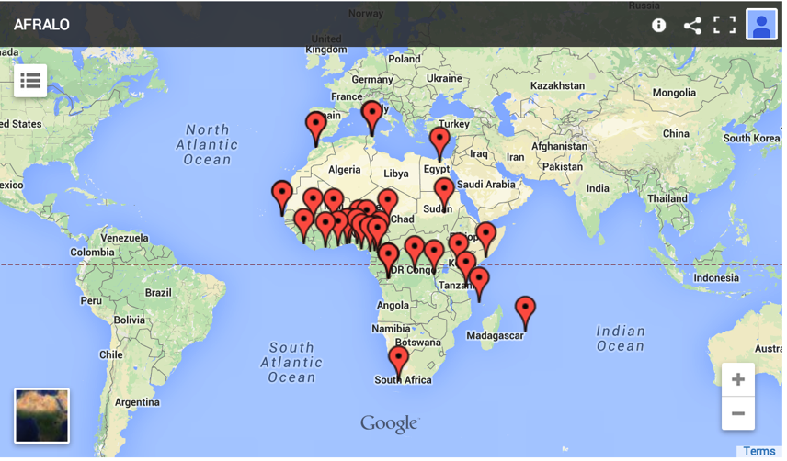
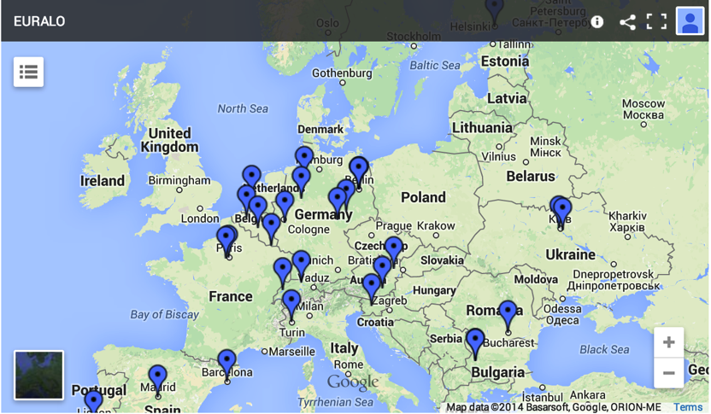
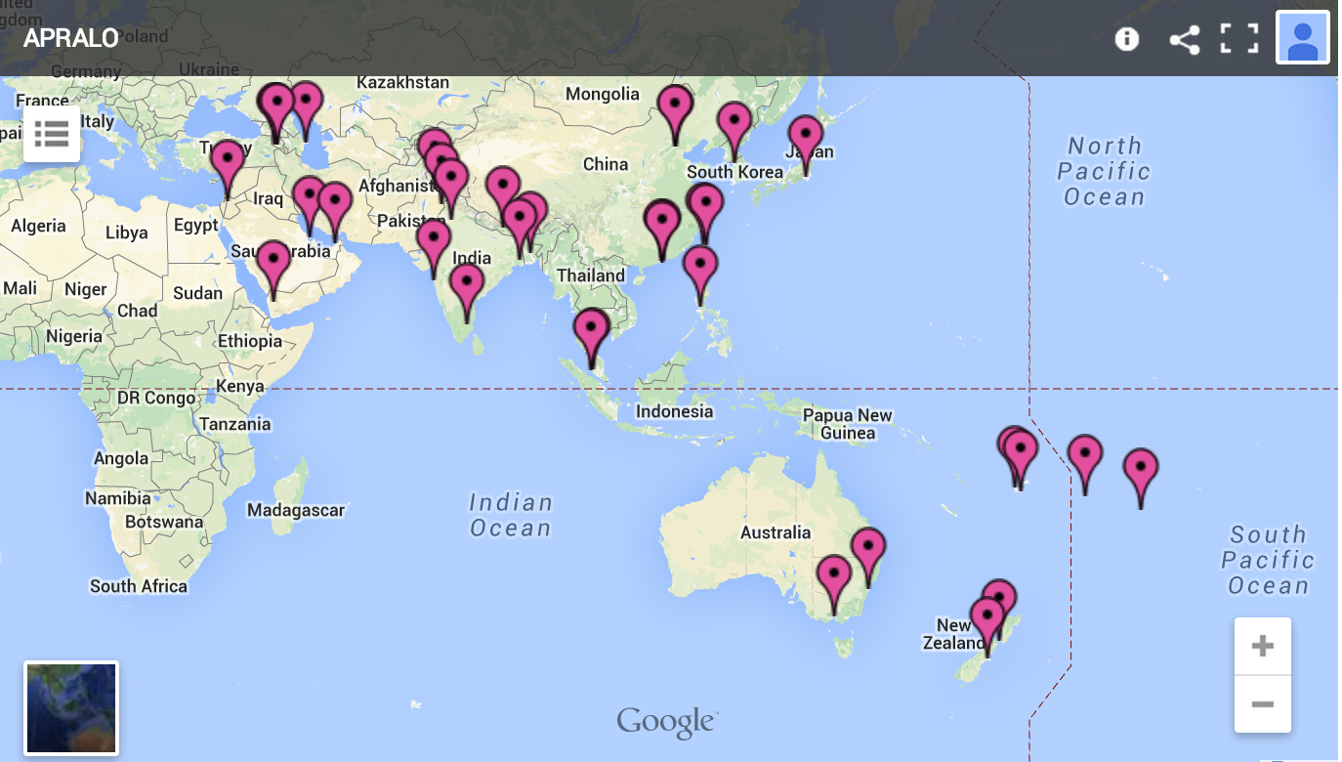
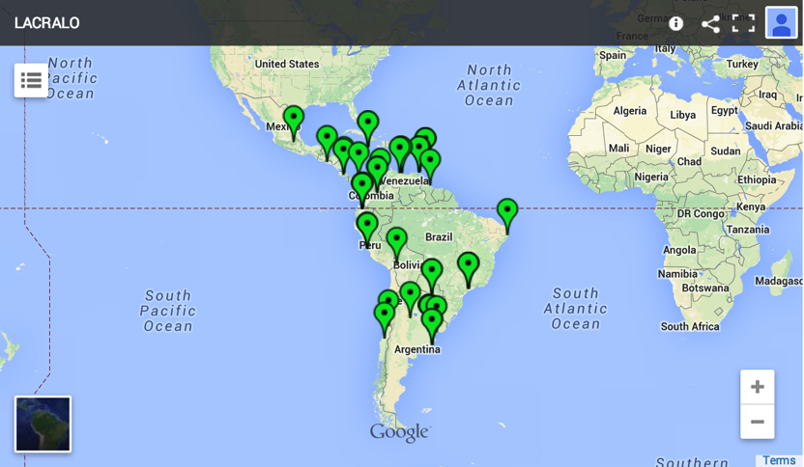
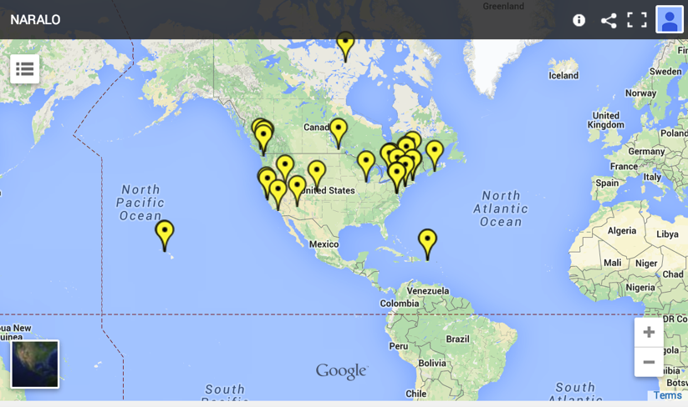
ALSes in APAC and the World
APRALO

Slide 14
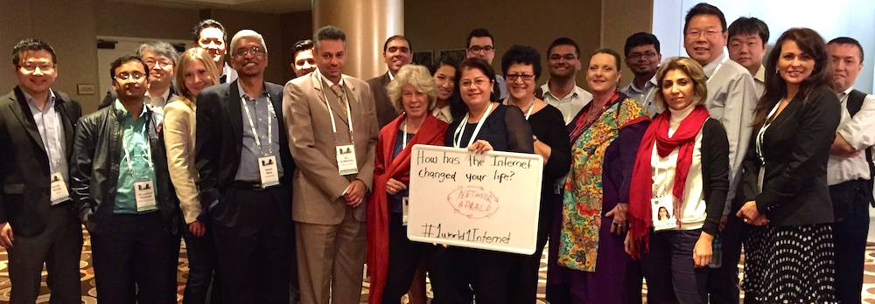
Getting involved in At-Large and APRALO
  Registering with ICANN
    Register and participate in ICANN by submitting a simple online application form (http://www.atlarge.icann.org) to become an “At-Large Structure”!
APRALO @ ICANN51
“The Internet Needs You! If you are an organization located in Asia, Australasia or the Pacific Islands and concerned with Internet-related issues, you can help influence the operation, growth and development of the Internet by becoming part of APRALO. APRALO invites all interested civil society parties to join it in taking part in the decisions that shape the Internet.” - APRALO
Notes:
https://community.icann.org/pages/viewpage.action?pageId=2266081

Slide 15




Connect with Us
  Keep in touch with ICANN At-Large and APRALO:
Facebook: www.facebook.com/icann.atlarge
LinkedIn: www.linkedin.com/groups?home=&gid=2238621
(LinkedIn accessible for registered members of ICANN’s At-Large Community)
ICANN At-Large: www.atlarge.icann.org
APRALO Website: www.apralo.org (APRALO Community Wiki website)
Email: info@apralo.org (APRALO contact info)
Mailing list: apac-discuss@atlarge-lists.icann.org (APRALO mailing list, open subscription)

