Slide 1
NCSG Policy Meeting
18 Sept 2019

Slide 2
Agenda
Introduction
GNSO Council Call Preparation
Council agenda: https://gnso.icann.org/sites/default/files/policy/2019/agenda/agenda-council-19sep19-en.pdf [gnso.icann.org]
III. Policy Update
- Policy topics:
* PDPs & Review Teams Update
- Public comments status: https://www.icann.org/public-comments#open-public [icann.org] & list of volunteers https://community.icann.org/display/gnsononcomstake/Public+Comments+-+2019
IV. Others

Slide 3
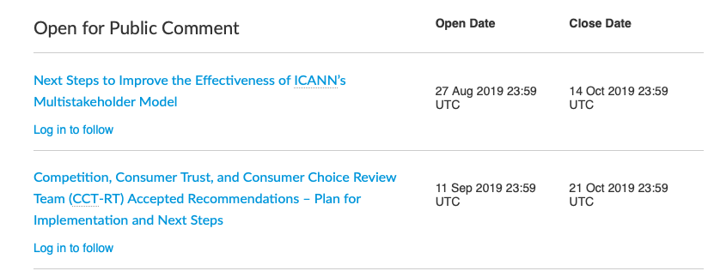
Open Public Comment(s)

