Slide 1
Cross Community Working Group to
Develop an IANA Stewardship Transition Proposal on Naming Related Functions (CWG)
DRAFT TRANSITION PROPOSAL

Slide 2
Agenda
Welcome & introductions
Background
The Draft Transition Proposal
Next steps
Q & A

Slide 3



Welcome & Introductions
Presenters
Lise Fuhr
Co-Chair
Jonathan Robinson
Co-Chair
Greg Shatan
Coordinator RFP 3

Slide 4
Background

Slide 5
Background
NTIA requested:
  ICANN “convene a multistakeholder process to develop a plan to transition the U.S. government stewardship role” with regard to the IANA Functions and related root zone management. (14 March 2014)
Stewardship role includes:
  Administrator of the IANA Functions Contract
  Root Zone Management Process Administrator
  General oversight and accountability derived from these two functions

Slide 6
Transition Proposal’s
Guiding Principles
    NTIA has communicated that the transition proposal must have broad community support and address the following four principles:
    Support and enhance the multistakeholder model
    Maintain the security, stability, and resiliency of the Internet DNS
    Meet the needs and expectation of the global customers and partners of the IANA services
    Maintain the openness of the Internet
    NTIA also specified that it will not accept a proposal that replaces the NTIA role with a government-led or an intergovernmental organization solution.

Slide 7
Community Process
Community consultations, development of proposed multistakeholder process (March – June 2014)
Formation of IANA Stewardship Transition Coordination Group (ICG)
on 3 July 2014
ICG Request for Proposals published on 3 September 2014
Development of CWG Charter by Drafting Team (July – August 2014)
Formation of IANA Stewardship Transition Cross Community Working Group (CWG) on Naming Related Functions (September 2014)

Slide 8
IANA Stewardship Transition CWG on Naming Related Functions
Chartered by At-Large Advisory Committee (ALAC), Country Code Supporting Organization (ccNSO), Generic Names Supporting Organization (GNSO), Governmental Advisory Committee (GAC) and Security & Stability Advisory Committee (SSAC)
The CWG consists of 119 people, organized as 19 members, appointed by and accountable to chartering organizations, and 100+ participants who do so as individuals. The CWG is open to anyone interested.
The CWG has structured its work into sub-groups based on sections of the ICG Request for Proposals (RFP)
A set of “strawman” proposals encompassing a wide range of options and ideas was considered – The draft proposal results from a focus on the specific IANA functions that need to be replaced

Slide 9
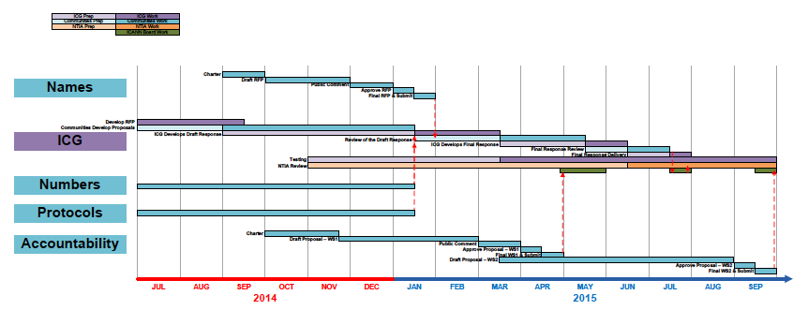
Timeline
Notes:
Timeline driven by ICG deadline for proposals (15 January 2014). Other communities (protocols and numbers) are working in parallel. ICG has following four responsibilities:
(i) Act as liaison to all interested parties in the IANA stewardship transition, including the three “operational communities” (i.e., those with direct operational or service relationships with the IANA functions operator; namely names, numbers, protocol parameters). This task consists of:
a. Soliciting proposals from the operational communities
b. Soliciting the input of the broad group of communities affected by the IANA functions
(ii) Assess the outputs of the three operational communities for compatibility and interoperability
(iii) Assemble a complete proposal for the transition
(iv) Information sharing and public communication

Slide 10

CWG Stewardship Timeline 2014-2015
Charter Adopted
CWG Deliberations Conclude
Publish Draft Proposal
  Public Comment Closes (21)
  Webinars
Publish Final
Proposal
  Proposal OK by Charter Orgs
  Submit Final Proposal to ICG
Sep
Oct
Nov
Dec
Jan
Feb
2014
2015

Slide 11
Draft Transition Proposal

Slide 12
Proposal Structure
Follows the structure of the ICG RFP:
  1. Description of Community’s Use of IANA Functions
  2a. Existing, Pre-Transition Arrangements – Policy Sources
  2b. Existing, Pre-Transition Arrangements – Oversight and Accountability
  3. Proposed Post-Transition Oversight and Accountability Arrangements
  4. Transition Implications
  5. NTIA Requirements
  6. Community Process

Slide 13
In Brief
Final drafts of sections 1, 2A and 2B describe the current situation
Section 3:
  Heart of the transition proposal
  Still a work in progress as not all details have been ironed out as of the publication of this consultation
  Although lacking some details, the information provided in this section should be sufficiently detailed to allow the communities to comment on all key components
  Specific questions have been highlighted as needing further discussion and input
Sections 4, 5 and 6 are currently in development and are directly dependent on the final choices that will be made for section 3

Slide 14
Section 3 – General Principles
The current operational performance of the IANA Naming Functions is generally satisfactory
The CWG does not believe there is a reason to transition the IANA Naming Functions outside of ICANN, but new arrangements post transition should provide the possibility of replacing ICANN as the IANA Functions operator, including by RFP or other tender process
The proposed replacement solution should not seek to recreate another ICANN like structure with associated costs and complexities
The proposal should not seek to replace the role of the ICANN multistakeholder community with the respect to policy development nor to affect existing TLDs or how they are currently applied by the IANA Functions Operator
The existing separation between ICANN as a policy body and ICANN as the IANA Functions Operator needs to be reinforced and strengthened

Slide 15
Link with Accountability CCWG
It is generally agreed that the transition must not take place until:
The requisite accountability mechanisms have been identified by the CWG on Enhancing ICANN Accountability (“Accountability CCWG”);
Accountability mechanisms and other improvements that the community determines are necessary pre-transition have been put in place, and;
Agreements and other guarantees are in place to ensure timely implementation of mechanisms that the Accountability CCWG decides may be implemented post-transition

Slide 16
4 new Entities
Contract Co. - primary function is to be signatory to the contract with the IANA Functions Operator
Multistakeholder Review Team (MRT) – responsibilities include: developing the detailed contract terms; making decisions for Contract Co.; IANA Functions Operator Budget Review; addressing any escalation issues from the CSC; performing certain elements of administration currently set forth in the IANA Functions contract and currently being carried out by the NTIA; managing re-contracting or rebidding process
Customer Standing Committee (CSC) – responsible for operational review
Independent Appeals Panel (IAP) - independent and binding appeals panel

Slide 17
Contract Co.
Legal entity capable of entering into contracts
Lightweight, with little or no staff
Limited purpose and scope

Slide 18
Multistakeholder
Review Team (MRT)
Multistakeholder body with formally selected representatives from all of the relevant communities (exact composition TBD)
Representatives to the MRT would not be paid and could meet in conjunction with ICANN meetings to minimize costs
The operation of the MRT would be based on the concept of maximum public transparency

Slide 19
Customer Standing Committee (CSC)
Takes on NTIA’s responsibilities with respect to managing the IANA Functions Operator’s reports on performance
Receive and review IANA Operator Reports
Escalate any significant issues to the MRT
Primarily made up of a number of representatives of registry operators, and possibly additional individuals with relevant expertise and/or liaisons (or representatives) from other SO/ACs
(unpaid role, exact composition and manner of selection TBD)

Slide 20
Independent Appeals Panel
All decisions and actions (including deliberate inaction) of the IANA Functions Operator that affect the Root Zone or Root Zone WHOIS database be subject to an independent and binding appeals panel
Appeals would be available to customers of IANA, and likely to other parties who feel that they were affected by an IANA action or decision
Does not need to be a permanent body, but could be handled the same way as commercial disputes are often resolved, through the use of a binding arbitration process using an independent arbitration organization, such as the ICC, ICDR or AAA, or a standing list of qualified people under rules promulgated by such an organization

Slide 21
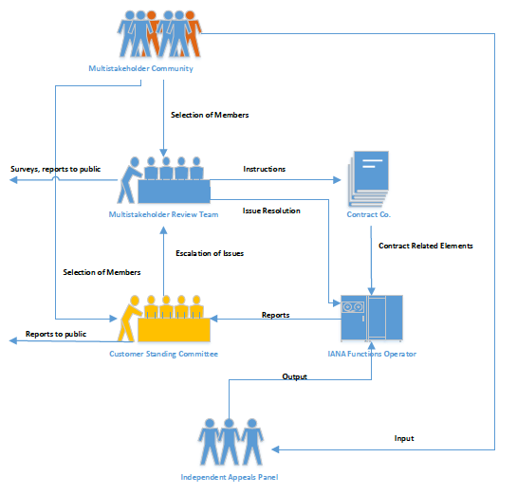
Relationships

Slide 22
Specific input requested
In addition to the input on the overall transition proposal, the CWG is specifically looking for input on:
Possible modifications to the Independent Review of Board Actions (section 3.3 of the document)
Possible modification to the NTIA’s responsibilities acting as the Root Zone Management Process Administrator
(section 3.4.3 of this document)
Input on one specific alternative solution i.e. remaining within ICANN

Slide 23
Next Steps

Slide 24
NEXT STEPS
Public comment forum open until 22 December 2014
Any input welcomed, but especially on section 3
CWG will continue deliberations in parallel, including developing areas of the document relating to items 3, 4, 5 & 6 of the RFP from the ICG.
Co-ordinate with Accountability CCWG
Submission of final transition proposal to chartering organizations for consideration & adoption by 19 January 2015
Submission of final transition proposal to ICG
No later than 31 January 2015

Slide 25
Q & A

Slide 26
Further Information
Public Comment Forum:
https://www.icann.org/public-comments/cwg-naming-transition-2014-12-01-en
Draft Transition Proposal: https://www.icann.org/en/system/files/files/cwg-naming-transition-01dec14-en.pdf
CWG workspace:
https://community.icann.org/x/37fhAg
IANA Stewardship Transition:
https://community.icann.org/x/37fhAg

Slide 27
THANK YOU FOR YOUR PARTICIPATION

