Slide 1
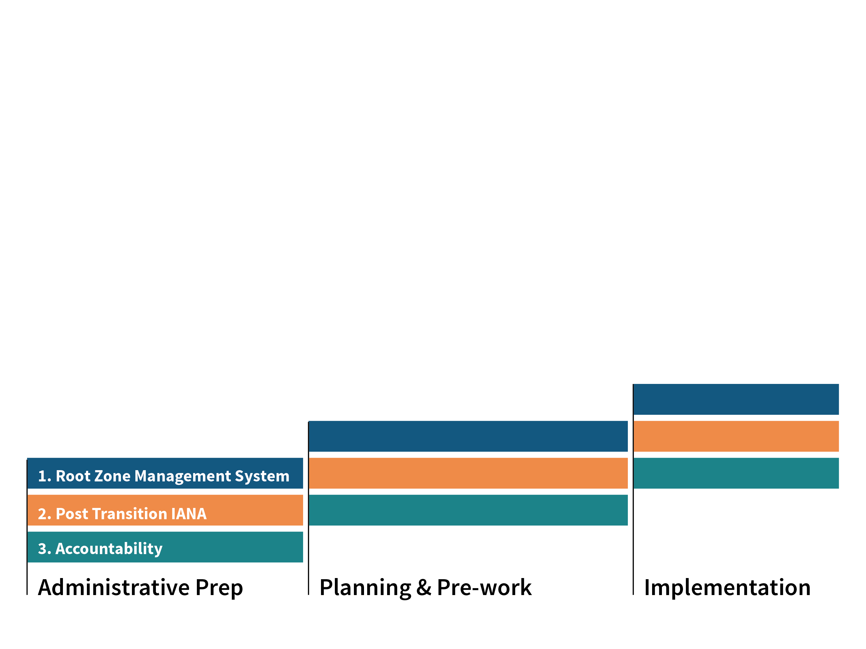
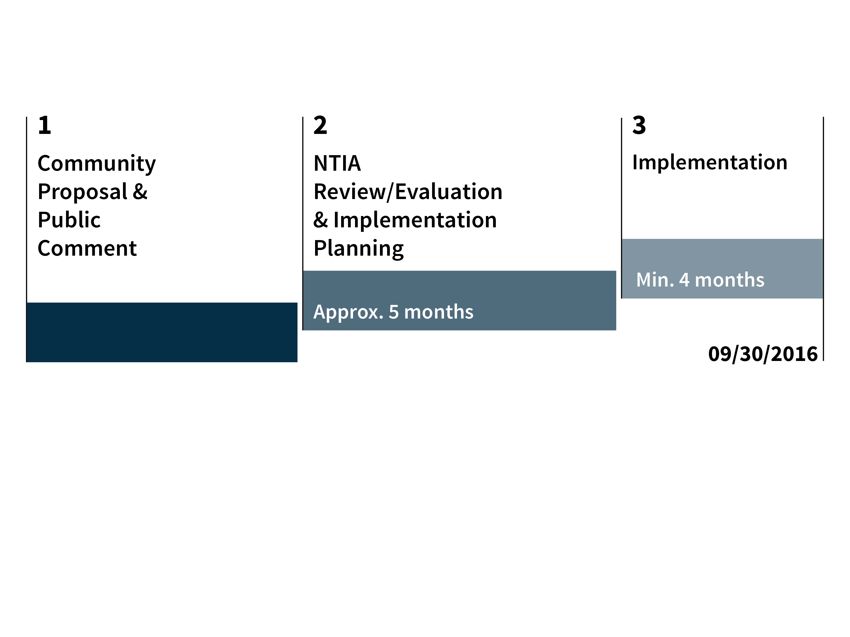
Transition Timeline

Slide 2
FY17 Planning: Critical path with Transition
1 Dec 2015
15 Jan
2016
5 Mar
2016
30 Apr
2016
Jun
2016
FY17 Planning process
Departmental budgeting
Production
Final Draft
Public comment on final draft
Board Approval
Transition process
Delivery to ICANN Board/NTIA in Dec 2015
Phase 1
Phase 2
Phase 3
To Summarize:
We will keep the process on time, and will keep assumptions simple.
ICANN Management will finalize assumptions on Transition/PTI by 15 January 2016.
Notes:
To adjust the length and width of the arrow, click on the arrow, grab a corner, and lengthen or shorten, depending on your preference.
To add a bubble, click on the bubble, ensure it is fully highlighted, COPY and PASTE. Then drag the bubble to your preferred placement.
To delete a bubble, click on the bubble, ensuring it is highlighted and click DELETE. If you make a mistake, go to your top bar on PP and click EDIT, UNDO

