Slide 1
Saturday 11 October 2014
Next Session: Update - Policy & Implementation Working Group
Increased focus on which topics call for policy and which call for implementation work, including which processes should be used, at what time and how diverging opinions should be acted upon. This WG is addressing a number of issues that specifically relate to GNSO Policy & Implementation activities.
Presenter: J. Scott Evans (Co-Chair)
More information: http://gnso.icann.org/en/group-activities/active/policy-implementation

Slide 2
Policy & Implementation WG
Update
2

Slide 3
Why is it important?
Increased focus on which topics call for policy and which call for implementation work, including which processes should be used, at what time and how diverging opinions should be acted upon
GNSO Council formed Working Group in July 2013 to address a number of questions specifically related to policy and implementation in the context of the GNSO

Slide 4
Progress Report
Working Group developed a set of working definitions and posted a set of working principles that underpin the WG deliberations
Input received from ALAC, RySG and ISPCP
WG in the process of developing recommendations which may include new GNSO processes to provide guidance and input, as well as Fast Track PDP
Now focusing on implementation related questions such as how consultation with staff should take place, how should/can the GNSO Council deal with issues as they arise during implementation, what is the role of Implementation Review Teams
Target date for Initial Report for public comment: February 2015

Slide 5
Additional Processes under Consideration
Preview

Slide 6
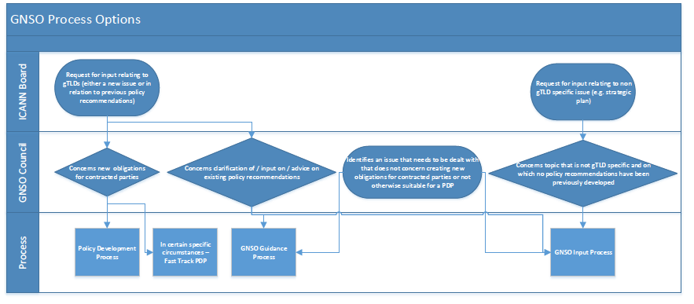
GNSO Processes Options

Slide 7
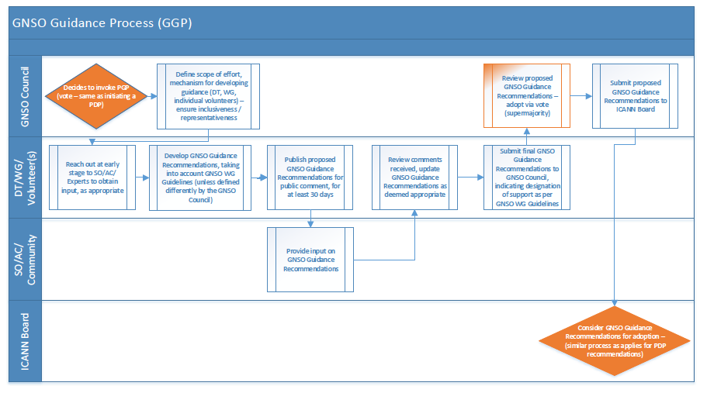
GNSO Guidance Process

Slide 8
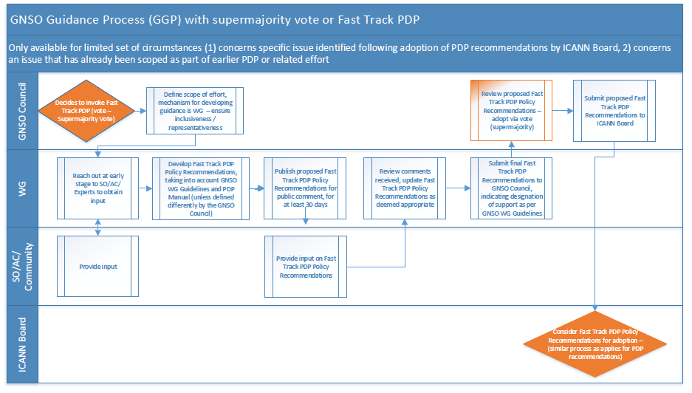
Fast Track PDP

Slide 9
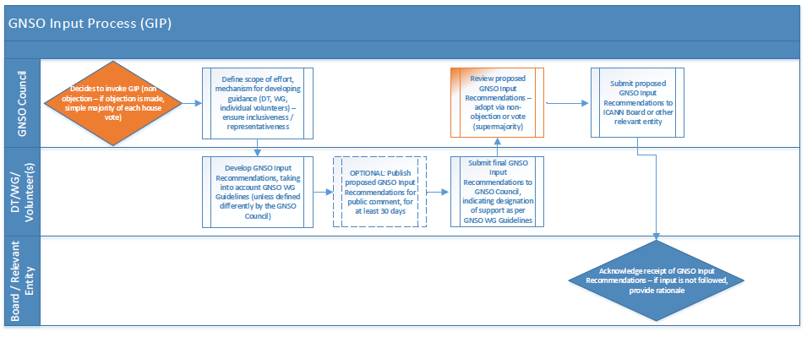
GNSO Input Process

Slide 10


Further Information
WG Workspace - https://community.icann.org/x/y1V-Ag
Project info - http://gnso.icann.org/en/group-activities/active/policy-implementation
WG’s F2F meeting at ICANN51 on Wednesday 15 October from 16.30 – 18.00 local time (see http://la51.icann.org/en/schedule/wed-policy-implementation)

Slide 11
Thank You and Questions

Slide 12
Annex

Slide 13

Background
GNSO agreed to create a DT in Beijing to develop a charter for a Working Group to address issues that have been raised in the context of the recent discussions on policy & implementation that affect the GNSO
DT was formed and started its discussions on 10 June
Proposed charter submitted to GNSO Council for consideration on 5 July and approved on 17 July 2013

Slide 14
Charter
WG tasked to provide recommendations on:
A set of principles that would underpin any GNSO policy and implementation related discussions, taking into account existing GNSO Operating Procedures.
A process for developing gTLD policy, perhaps in the form of “Policy Guidance”, including criteria for when it would be appropriate to use such a process (for developing policy other than “Consensus Policy”) instead of a GNSO Policy Development Process;
A framework for implementation related discussions associated with GNSO Policy Recommendations;
Criteria to be used to determine when an action should be addressed by a policy process and when it should be considered implementation, and;
Further guidance on how GNSO Implementation Review Teams, as defined in the PDP Manual, are expected to function and operate

