Slide 1


Slide 2
15 October 2014
At-large policy round table
Holly Raiche
Panel 1: Privacy and Proxy
1000 – 1045 Hrs

Slide 3
Agenda
Background
  What Is Whois
  Whois Review Team Final Report
  The RAA and P/P services
GNSO WG: Charter Questions
WG early conclusions
Where are we now
Discussion

Slide 4
BACKGROUND: What is Whois
Registrars Must Provide Public Access to:
The names of the primary and secondary nameserver(s) for the Registered Name;
The identity of Registrar
The original creation and expiration date of the registration;
The name and postal address of the Registered Name Holder;
The name, postal address, e-mail address, voice telephone number, and (where available) fax number of the technical contact for the Registered Name; and
The name, postal address, e-mail address, voice telephone number, and (where available) fax number of the administrative contact for the Registered Name.

Slide 5
BACKGROUND: WHOIS Review: Final Report
Accuracy of Whois Data
only 23% of the Whois data met the accuracy standards.
Report’s conclusion: the low level of accuracy is ‘unacceptable’

Slide 6
BACKGROUND: WHOIS Review: Final Report
There are legitimate uses of privacy/proxy services
Individuals – who prefer not to have their personal data published on the Internet;
Organizations – as religious, political or ethnic minority, or sharing controversial moral or sexual information; and
Companies – for upcoming mergers, new product or service names, new movie names, or other product launches
But there are concerns:
the abuse of proxy services by criminals seeking to hide, companies defrauding customers, and parties attacking the security of the Internet including by botnets and malware; and
the current use of privacy and proxy services raises questions about whether ICANN is meeting its AoC commitments relating to ‘timely, unrestricted and public access’ to WHOIS data.

Slide 7
BACKGROUND: WHOIS Review: Final Report
Recommendation: an accreditation system for privacy and proxy services:
goal of this process should be to provide clear, consistent and enforceable requirements for the operation of these services consistent with national laws, and to strike an appropriate balance between stakeholders with competing but legitimate interests

Slide 8
BACKGROUND: RAA - Changes in 2013
The Whois data to be publicly available did not change – BUT
Clause 3.14 Registrars must agree to comply with any ICANN adopted Specification or Policy that established a Proxy Accreditation. … Until such time as the Proxy Accreditation Program is established, Registrar agrees to comply with the Specification on Privacy and Proxy Registrations.

Slide 9
BACKGROUND: RAA – P/P Specification
Compliance with the Specification required
Service terms publicly available, including
P/P identity
Pricing
How to request P/P customer data and when it will be revealed
Process for transfer to another registrar
Handling of complaints/disputes
Maintenance of abuse point of contact and procedures for its use
Escrow of customer data
Obligation to relay allegations of misconduct

Slide 10
GNSO Working Group: Charter questions
Main Issues to be addressed
Maintenance of p/p services
Registration of p/p
Contact point provided by p/p service
Relay of complaints to p/p customer
Reveal of p/p customers’ identities
Termination of [accreditation] of p/p service

Slide 11
GNSO Working Group: Early Conclusions
All P/P services must relay to their customers any notices required under the RAA or an ICANN Consensus Policy.
All P/P service registration agreements must state the customer’s rights and responsibilities and the P/P service’s obligations in managing those rights and responsibilities. Specifically, all P/P services must disclose to their customers the conditions under which the service may be terminated in the event of a transfer of the domain name.
In addition, the WG recommends the following as best practices:
P/P services should facilitate and not hinder the transfer, renewal or restoration of a domain name by their customers, including without limitation a renewal during a Redemption Grace Period under the ERRP and transfers to another P/P service.
P/P services should use commercially reasonable efforts to avoid the need to disclose underlying customer data in the process of renewing, transferring or restoring a domain name.

Slide 12
GNSO Early Conclusions
For accreditation purposes, no distinction between privacy and proxy services
Customer data validated and verified consistent with RAA requirements
P/P services must relay notices required under the RAA or ICANN consensus policy – Options for other material
P/P should use reasonable efforts to avoid need to disclose customer data when renewing/transferring
p/p services available to commercial/non-commercial applicants alike – majority view
ICANN to maintain publicly available list of accredited P/P providers

Slide 13
Where are we now?
Transfer of P/P customer to another registrar
For non p/p customer to non p/p service – no issue
For non p/p customer to p/p service – no issue
For p/p customer to non p/p service – no issue
For p/p customer to another p/p service - issues
Because of the difficulty in verification of customer details, transfer out not now permitted – would that change if both p/p providers accredited
If transfer from one p/p service to another facilitated, what will stop domain hopping

Slide 14
Where are we now?
What does the requirement to ‘relay’ involve?
  Relay – passing on a message from a requestor to the p/p customer
Does that include both electronic and other messages?
Does the p/p provider know if the message has been delivered and, if so, is that fact passed on?
If the message, to the knowledge of the p/p provider, has not been delivered, should other means of delivery be used, and if so, what?
Who pays?

Slide 15
Where Are We Now?
What does ‘reveal’ mean; what does it require?
  Reveal – passing on contact details of customer to requestor
  What contact details?
  Under what circumstances – is there a general principle or on a case by case basis?
  Should the p/p customer be told and/or given an opportunity to respond

Slide 16
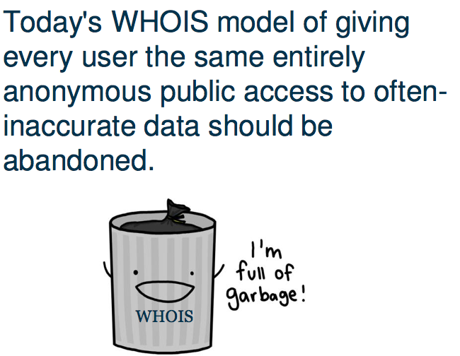
The EWG alternative

Slide 17
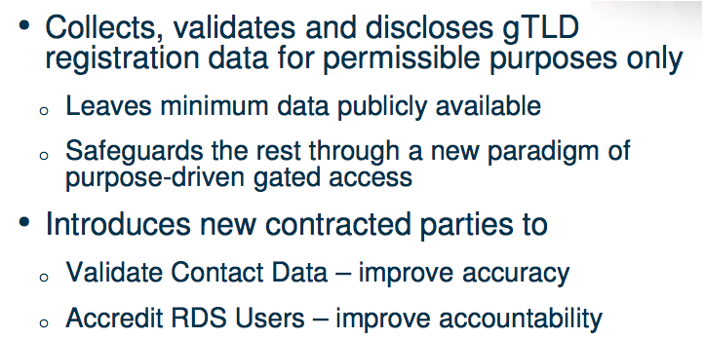
EWG: An Alternative Model?
EWG Recommedations:

Slide 18
Questions & Answers
        QUESTIONS

Slide 19



Engage with ICANN At-Large on Social Media
twitter.com/icann_atlarge
facebook.com/icann.atlarge
youtube.com/user/icannatlarge
Notes:
[KEEP THIS PAGE UP]
Thank you for taking the time to listen. I’d love to hear your feedback or answer any questions.

