Slide 1
ICANN + Boston Consulting Group
Report on e-Friction
Informe sobre e-fricción
Guadalajara, Mexico
Oct 1, 2014

Slide 2
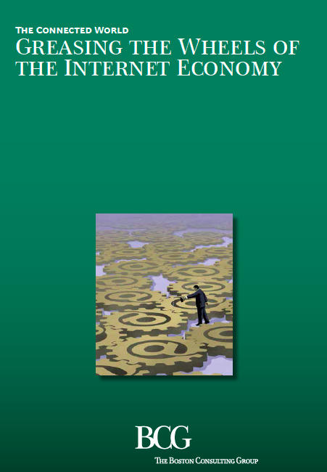
“ENGRASAR LAS RUEDAS DE LA ECONOMÍA DE INTERNET”
Notes:
ICANN Commissioned a report to determine how much the global, interoperable Internet contributes to economic and business success.
The report introduced the concept of “e-friction”. This is broadly defined as barriers to Internet access, whether within a country or across national borders.
The results were released at the World Economic Forum in January.

Slide 3
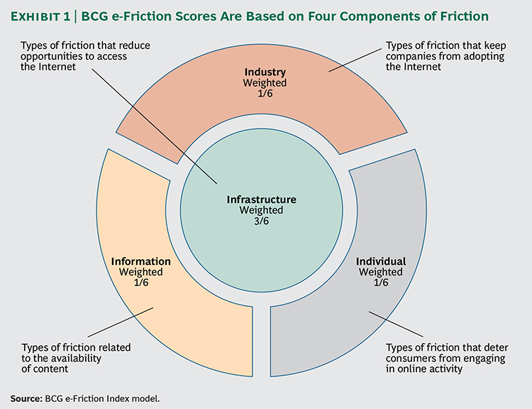
INDUSTRIA
CUATRO
COMPONENTES
DE
E-FRICCIÓN
INFRAESTRUCTURA
INFORMACIÓN
INDIVIDUOS
Notes:
The four categories of friction BCG chose to study are:
Infrastructure – This counts for one half and includes factors like broadband penetration, connection speeds, IPv6 deployment, Internet Exchange Points, etc.
Industry – Things like ease of starting a business, access to ICT skills, access to financing, strong business legal framework, Intellectual property, Enforceable contracts, etc
Individual – This includes trust in online payment systems, online financial services, literacy, percentage of people online, among other factors
Information – This score covers local content, local domain (website) registrations, freedom of the press, freedom of access to official data (e.g. e-government programs)

Slide 4
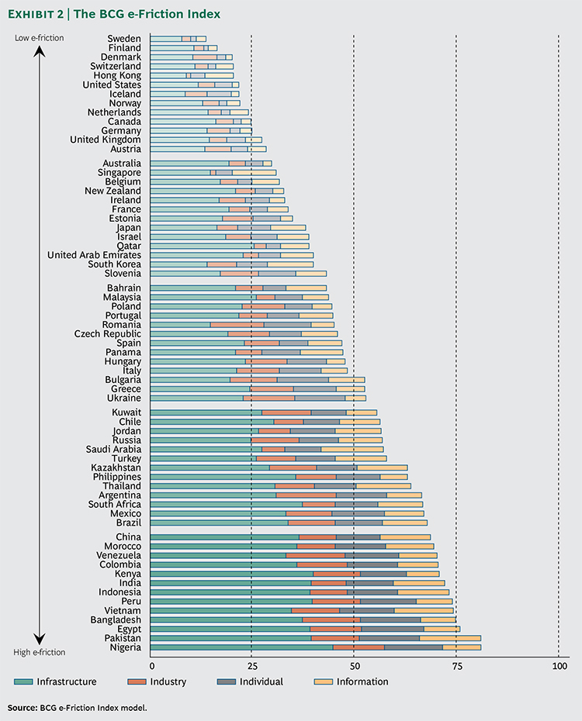
EL ÍNDICE
E-FRICCIÓN
⬅
Notes:
The result of the calculations is a country index that calculates the level of friction in each category and adds them together.
Country scores are based on a combination of the four factors. In this chart, the larger the bar, the greater the friction.
The countries chosen were a factor of which countries had available data.
Open, trading economies and advanced world economies with low infrastructure friction do very well in the survey.

Slide 5
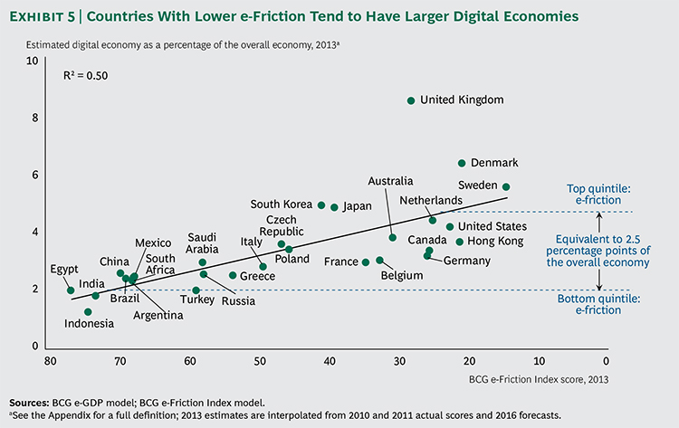
LOS PAISES CON MENOR E-FRICCIÓN SON AQUELLOS CON UNA “ECONOMIA DIGITAL” MÁS IMPORTANTE
Notes:
BCG also pioneered studies on how much of a nation’s GDP comes from the digital economy.
Low e-friction correlates with high e-GDP. The difference between countries in the top quintile and lowest quintile of the index is 2.5% of GDP.

Slide 6
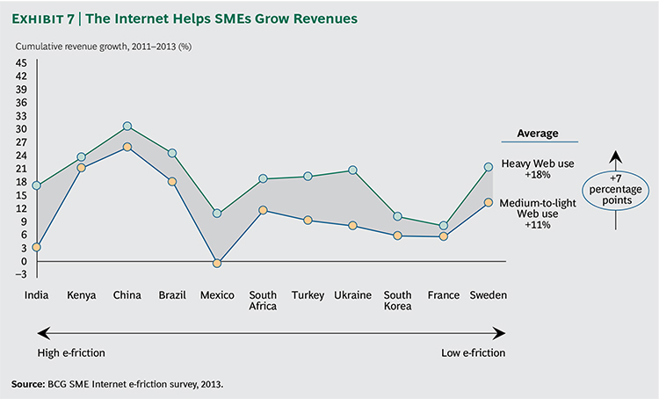
INTERNET AYUDA A QUE LAS EMPRESAS INCREMENTEN SUS INGRESOS
Notes:
The BCG study also surveyed several thousand Small and Medium Enterprises (SMEs) in the countries reviewed.
SMEs in low e-friction countries who embrace e-solutions can increase revenue growth by 7 %.
These SMEs are 50% more likely to be exporters of goods or services and 63% more likely to source inputs internationally.

Slide 7
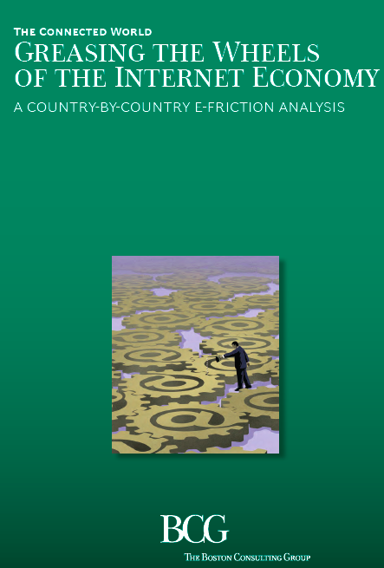
ANÁLISIS DETALLADO
POR PAIS
www.bgcperspectives.com
Notes:
Detailed country-by-country analysis is available in a supplement to the report.

