Slide 1

#ATLAS2

Slide 2

The At-Large Advisory Committee (ALAC)
An Introduction by
Dr. Olivier MJ Crépin-Leblond
ALAC Chair

Slide 3
ICANN Multi-Stakeholder Model
Ombudsman
Board of Directors
Chair
GAC
Governmental
Advisory
Committee
President and CEO
16
9
10
13
14
11
12
1
2
3
4
5
6
7
8
15
L
L
L
L
L
ICANN Staff
MDR – 68
SV – 11
DC – 9
Sydney - 5
Brussels - 5
Other US - 11
Other non-US - 14
Nominating
Committee
Technical
Liaison
Group
Internet
Engineering
Task Force
Per ICANN Bylaws, Article VII, section 2
TLG
IETF
ASO
GNSO
ccNSO
At-Large
Security &
Stability
Advisory
Committee
Root Server
System
Advisory
Committee
Regional Internet Registries
ARIN
RIPE NCC
LACNIC
APNIC
AfriNIC
gTLD Registries gTLD Registrars
IP interests
ISPs
Businesses
Universities
Consumers
ccTLD registries (.us, .uk, .au, .it, .be, .nl, etc.)
Internet Users
(At-Large Advisory Committee,
in conjunction with RALOs)
ALAC
SSAC
RSSAC
Source: http://www.icann.org/en/about/

Slide 4
ICANN Multi-Stakeholder Model
Staff
Ombudsman
President and CEO
Country
Code
Operators
Governments
Internet
Users
GAC
ICANN Staff
MDR
SV
DC
Sydney
Brussels
Other US
Other non-US
Governmental
Advisory
Committee
Another
Multi-
Stakeholder
Model
Technical
Liaison
Group
Internet
Engineering
Task Force
Multi-
Stakeholder Model
TLG
IETF
Other Advisory Committees
ASO
GNSO
ccNSO
At-Large
Security &
Stability
Advisory
Committee
Root Server
System
Advisory
Committee
Regional Internet Registries
ARIN
RIPE NCC
LACNIC
APNIC
AfriNIC
gTLD Registries gTLD Registrars
IP interests
ISPs
Businesses
Universities
Consumers
ccTLD registries (.us, .uk, .au, .it, .be, .nl, etc.)
Internet Users
(At-Large Advisory Committee,
in conjunction with RALOs)
ALAC
SSAC
RSSAC
Source: http://www.icann.org/en/about/

Slide 5
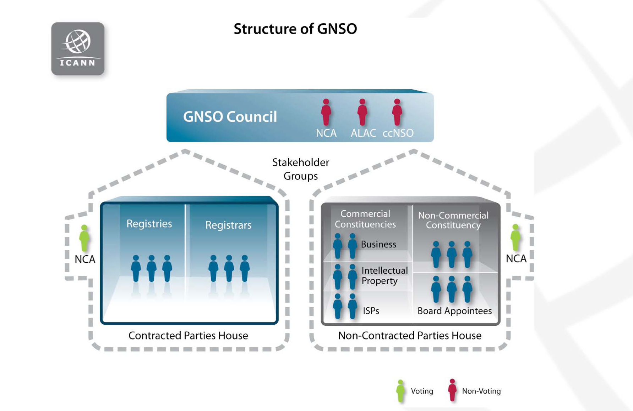
22-23/05/2012
ICANN - ENOG - Odessa 2012
5
Source: http://gnso.icann.org/meetings/presentation-policy-development-20may10-en.pdf

Slide 6
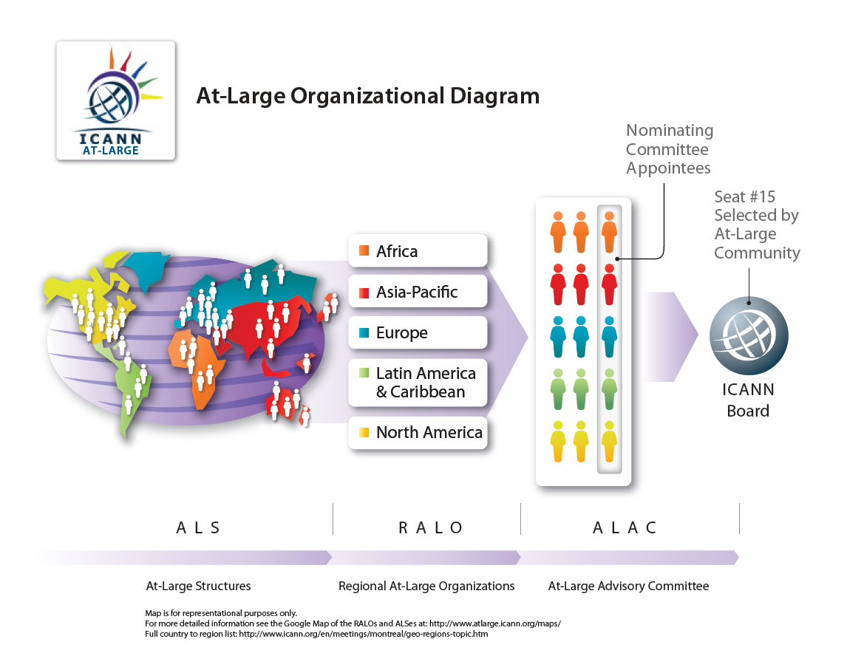
Trebuchet body text
Source: http://www.atlarge.icann.org/orgchart

