Slide 1

Transition of U.S. Commerce Department’s National Telecommunications and Information Administration (NTIA) Stewardship of the IANA Functions to the Global Multistakeholder Community and
Enhancing ICANN Accountability

Slide 2
The U.S. government’s announcement
    On 14 March 2014, the U.S. Government (USG) announced its intent to transition its stewardship of the IANA functions to the global multistakeholder community;
    As the first step, it asked ICANN to convene global stakeholders to develop a proposal to transition the current role played by the USG;
    ICANN was asked to serve as a convener based on its role as the IANA functions administrator (since 1998) and the global coordinator for the Internet's Domain Name System (DNS).
    The multistakeholder community has set the policies implemented by ICANN for more than 15 years.

Slide 3
Why now?
    The USG always envisioned its role as transitional;
    Transitioning the USG out of its current role marks the final phase of the privatization of the DNS as outlined by the USG in 1997;
    The decision further supports and enhances the multistakeholder model of Internet policymaking and governance.

Slide 4
Transition proposal’s guiding principles
    NTIA has communicated to ICANN that the transition proposal must have broad community support and address the following four principles:
    Support and enhance the multistakeholder model;
    Maintain the security, stability, and resiliency of the Internet DNS;
    Meet the needs and expectation of the global customers and partners of the IANA services; and,
    Maintain the openness of the Internet.
    NTIA also specified that it will not accept a proposal that replaces the NTIA role with a government-led or an intergovernmental organization solution.

Slide 5
What are the IANA functions?
    The IANA functions involve the coordination of unique Internet identifiers, including:
    maintenance of the protocol parameter registries on behalf of the IETF;
    allocation of Internet Numbers in cooperation with the Regional Internet Registries;
    management of the .ARPA and .INT domains;
    administrative responsibilities of the DNS root zone;
    coordination of root zone management.
For more information, visit www.icann.org

Slide 6
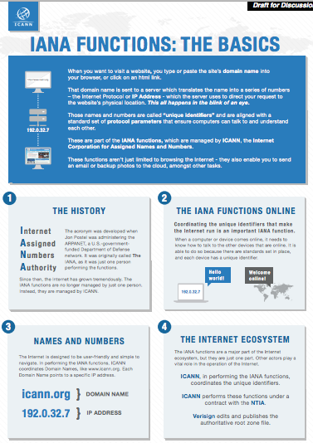
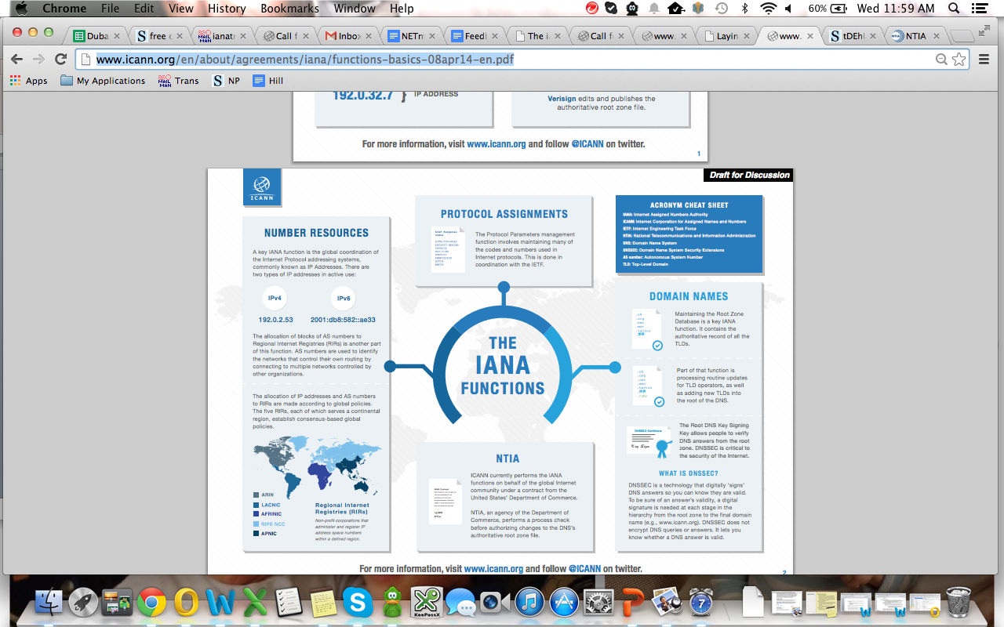
The IANA functions at-a-glance
For more information, visit www.icann.org

Slide 7
Developments since the announcement
    ICANN launched a multistakeholder-designed process at the ICANN 49 Meeting in Singapore in March 2014;
    The goal was to gather the community's views and contributions on how the mechanisms for the transition of NTIA's stewardship of the IANA functions should occur;
    The wider Internet community was also invited to provide their input via a publicly archived mailing list (ianatransition@icann.org), with an initial comment deadline of 27 March.

Slide 8
Developments since the announcement
    On 8 April, ICANN posted the scoping document and, based on initial community feedback and dialogue, issued a call for public input (translated into the six official UN languages) on the draft proposal;
    The draft proposal includes:
      a set of principles and mechanisms;
      the creation of a steering group to shepherd process;
      the process to develop a proposal; and,
      opportunities for participation.
DRAFT: Pending final process as informed by community dialogue and feedback

Slide 9
Scoping document: inside and outside of the scope of the proposal
    In scope:
      defining accountability mechanisms that would serve to replace the USG role to ensure ICANN’s performance of the IANA functions based on the agreements and/or policies provided by the respective bodies (IETF, GNSO, RIRs, ASO, ccTLDs, ccNSO);
    Out of scope:
      policy development related to the IANA functions
      IANA functions operator
        ICANN’s role as the operator of the IANA functions is not the focus of the transition
      issues not within the IANA functions
      The scoping document can be viewed at:
      http://www.icann.org/en/about/agreements/iana/iana-transition-scoping-08apr14-en.pdf

Slide 10
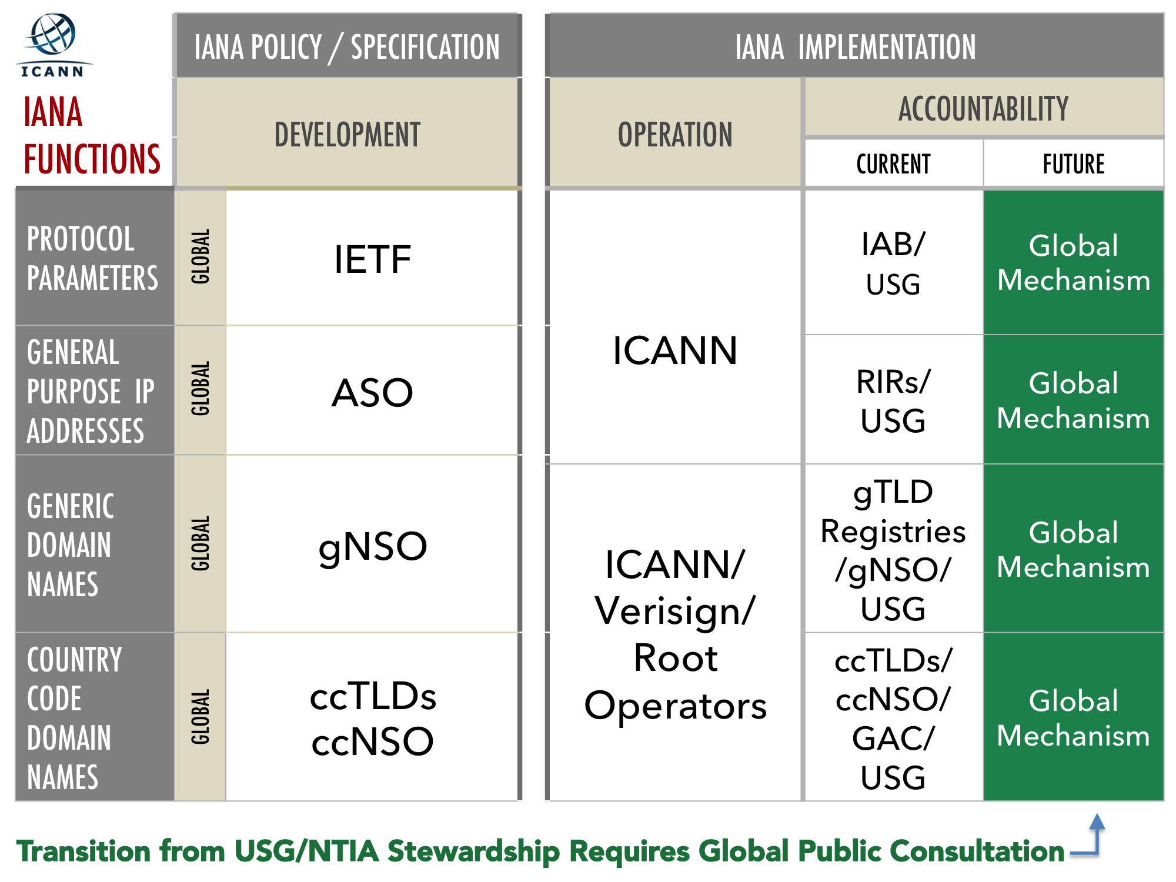
The scope visualized
Mechanism
Mechanism
Mechanism
Mechanism

Slide 11
Principles and Mechanisms
    Principles
    Inclusive
    Transparent
    Global
    Accountable
    Multistakeholder
    Focused [in scope]
    Pragmatic and evidence-based
    Open [to all voices]
    Do no harm
    Consensus-based
    Mechanisms
    Web-based platform
    Utilize working group methods
    Organize dialogues
    Leverage existing information and processes
    Conduct stress tests
    Establish clear and visible timeline
    Recognize discussion in other fora
    Widely accessible engagement platforms
    Multilingual support
    Multiple comment fora
DRAFT: Pending final process as informed by community dialogue and feedback

Slide 12
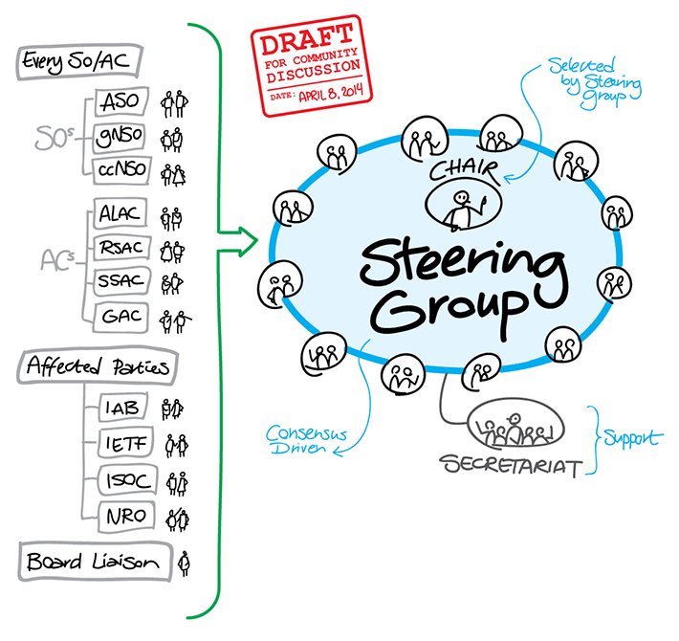
Proposed steering group

Slide 13
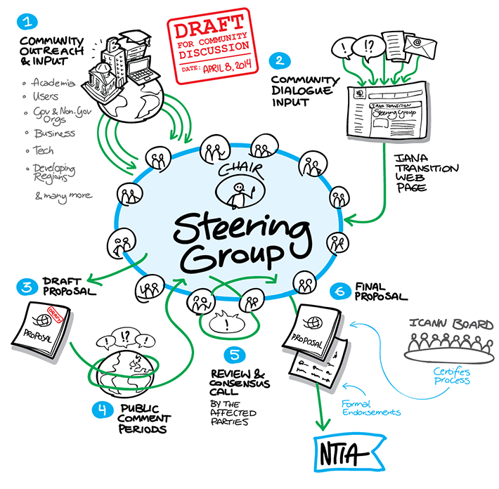
Proposed process

Slide 14
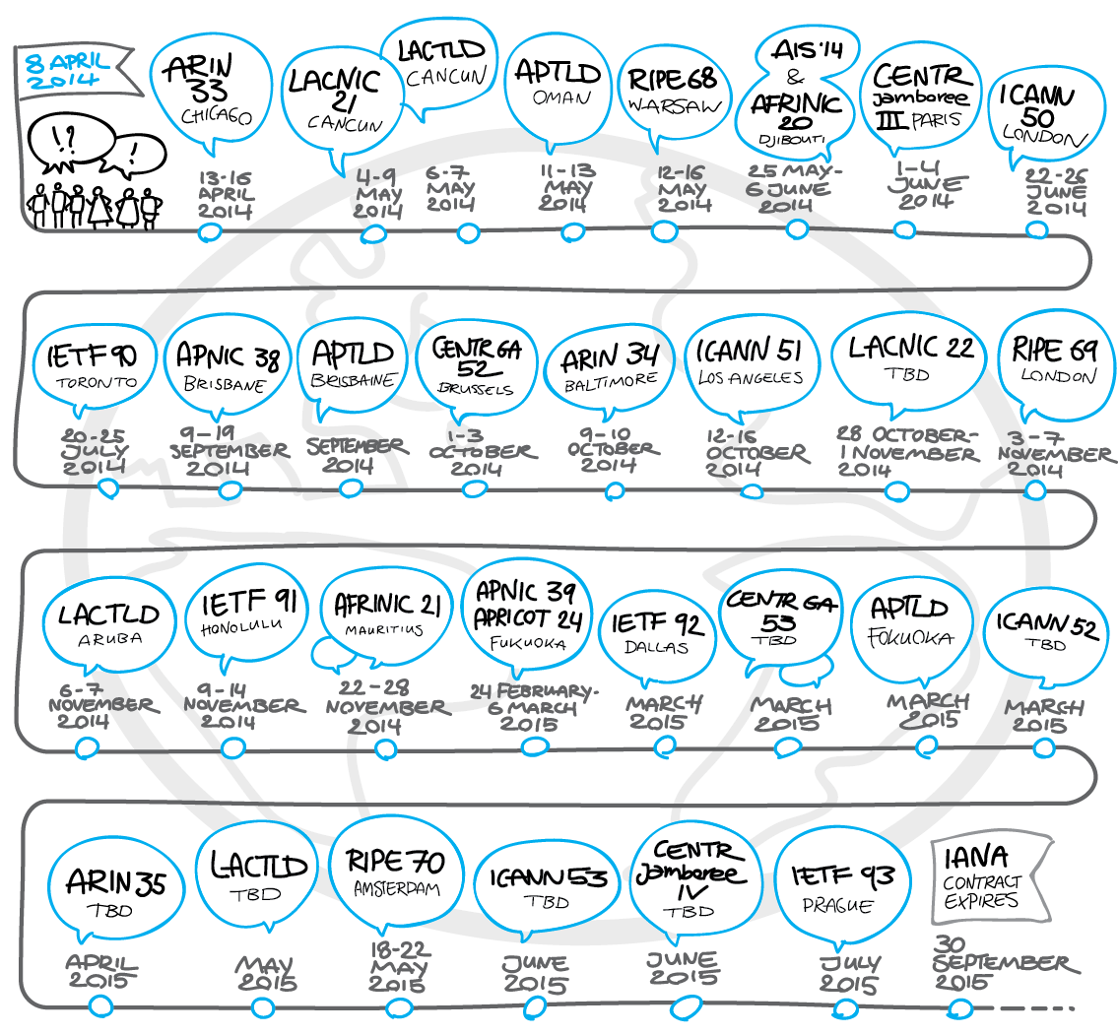
Opportunities for participation (non-exhaustive)
NB. There are multiple dialogues and opportunities for discussions, including at events not listed in the timeline (for example, regional and national IGFs, etc.).
DRAFT: Pending final process as informed by community dialogue and feedback

Slide 15
What happens next?
    The community provided feedback on the proposed process until 8 May;
    The community input received will be compiled, the process then put into place and published;
    A dedicated website supporting the process will be launched by ICANN 50 meeting in London in June.

Slide 16
How can you get involved?
    Visit ICANN.org
      get the latest resources on the topic;
      participate in the events listed in the timeline;
      follow us on our social channels.
    Mailing list
      join to contribute and/or follow the discussion
      ianatransition@icann.org
      access the public archives
      http://mm.icann.org/pipermail/ianatransition/

Slide 17
In Parallel
Enhancing ICANN Accountability process
    In addition to the public dialogue on the process for the transition of the U.S. government’s stewardship role, ICANN has launched a separate parallel public dialogue, the scope of which is to look at the contractual relationship to the U.S. Government and the perceived backstop with regard to ICANN’s organization-wide accountability provided by that role, such as the renewal process of the IANA Functions Contract.
    Purpose of this dialogue:
    Examine from an organizational perspective how ICANN’s broader accountability mechanisms should be strengthened to address the absence of its historical contractual relationship to the U.S. Government.
    This includes looking at strengthening existing accountability mechanism like the Affirmation of Commitments.

Slide 18
Accountability process: inventory of ICANN’s Accountability Efforts
    The Affirmation of Commitments
    AoC Reviews
    First and Second Accountability & Transparency reviews
    Security, Stability and Resiliency of the DNS review teams
    Bylaws-mandated Redress Mechanisms
    Organizational Reviews
    Bylaws and Documented Relationships
    Board of Directors Documentation
    General ICANN Operational Information
    ICANN Board Selection process
    External Laws

Slide 19
Accountability process: public consultation
    The output of this process should:
    Identify the key elements for strengthening ICANN's accountability to address the absence of its historical contractual relationship to the U.S. Government;
    Prioritize those elements for development and/or refinement; and
    Set forth a timeline and mechanisms for the implementation of the improvements identified.
    While separate from the IANA stewardship transition process, this dialogue on enhancing ICANN’s accountability is a key component to the success of the IANA stewardship transition. These processes, running in parallel, will inform each other.
    This consultation process on ICANN's accountability is open to any stakeholder.
    Now open, closes 18 June
    comments-enhancing-accountability-06may14@icann.org

Slide 20
Accountability process: discussions to date and next steps
    Discussions to date:
    What are the means by which the Community is assured that ICANN is meeting its accountability commitments?
    As ICANN grows and improves its overall accountability, what should be the guiding principles to ensure that the notion of accountability is understood and accepted globally?
    How does the Affirmation of Commitments need to evolve to support global acceptance of ICANN's accountability, and who should take part in this AoC?
    Proposed Next Steps:
    Establishing the ICANN Accountability Working Group
    The leaders of ICANN's SOs and ACs will be responsible for appointment of community members to the WG.
    After the public comment and reply period, the WG will commence in time for the ICANN 50 Meeting.

Slide 21
Accountability process: Questions for Community Discussion
    What issues does the community identify as being core to strengthening ICANN's overall accountability in the absence of its historical contractual relationship to the U.S. Government?
    What should be the guiding principles to ensure that the notion of accountability is understood and accepted globally? What are the consequences if the ICANN Board is not being accountable to the community? Is there anything that should be added to the Working Group's mandate?
    Do the AoC and the values expressed therein need to evolve to support global acceptance of ICANN's accountability and so, how
    What are the means by which the Community is assured that ICANN is meeting its accountability commitments?
    Are there other mechanisms that would better ensure that ICANN lives up to its commitments?
    What additional comments would you like to share that could be of use to the ICANN Accountability Working Group?
    comments-enhancing-accountability-06may14@icann.org

Slide 22
Thank you!
Questions?

