Slide 1
ICANN At-Large Mentor Program
Report from ICANN 49, Singapore
- Gunela Astbrink

Slide 2
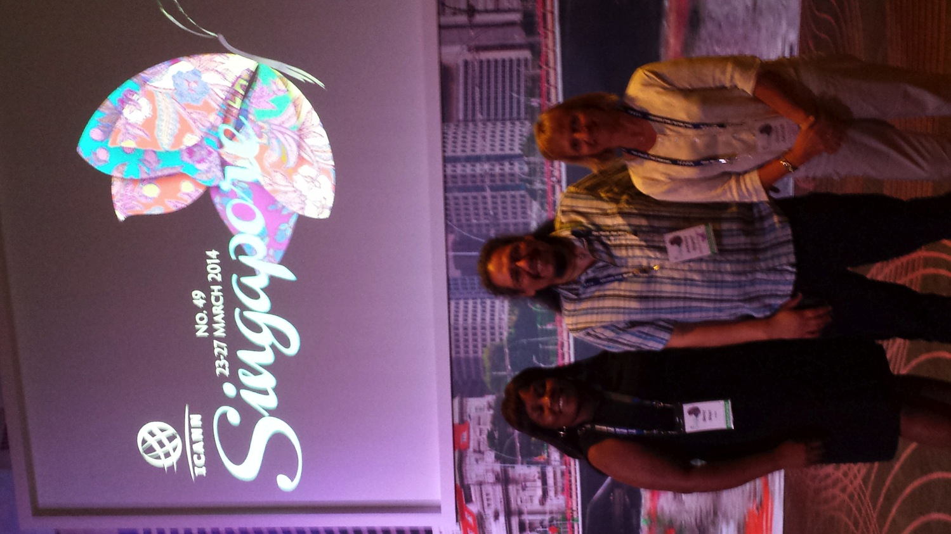
Introduction
A big thank you for selecting Mercy, Anthony and me as the three initial “mentees”
ALAC Chair and staff were very welcoming to mentees at initial web and face-to-face meetings
Maureen Hilyard as my mentor is:
  excellent choice
  based on existing good working relationship

Slide 3
Meetings attended
Welcome ceremony & Public Forum
ALAC
  Accessibility Taskforce
  APRALO
  Board with At-Large
  ATLAS II Planning
  TOR Workshop
ccNSO
Social events
Fellowship & Newcomer
GAC
GNSO
  Board with NCSG
  NPOC
ICANN globalization
APrIGF
ISOC

Slide 4
Active participation
Accessibility Taskforce
  Presented suggested objectives and actions
  https://www.youtube.com/watch?v=w3GfgobNCpk
NPOC
  Discussed Accessibility Taskforce
GNSO Council
  Presented at open mike about web accessibility best practice

Slide 5
Active participation
Public Forum
  Presented at open mike about building a culture of accessibility in ICANN
  http://audio.icann.org/meetings/singapore2014/public-forum-27mar14-en.mp3 at 3:19:56
In all cases, I received positive feedback

Slide 6
Importance of attending ICANN meetings
Building relationships
Forming alliances
Learning about ICANN processes and practice
Profiling issues
Shaping opinion
All these combine to enable me to contribute more actively now and at a leadership level in future

Slide 7
Plans for ICANN 50
Assistance for ATLAS II
  WGs
  Newcomer support
  Involving British disability organisations
Submitted request to speak at ccNSO meeting
Building on Accessibility Taskforce actions
Increasing my learning about ICANN

Slide 8
Impressions of Mentor Program
Fills important gap to support representatives from non-profit organisations in developed countries
Will mature as program becomes established
Recognition needed that mentors have limited time at ICANN meetings but can provide support between meetings

Slide 9
Conclusion and next steps
Inspires me to contribute to ICANN’s work
Support for me to participate in NETmundial will feed into ICANN
Nominated myself to GNSO Council
Included ICANN in teaching Information Policy and Governance at Griffith University
  Stakeholder analysis assignment is on new gTLD program
Connecting with Anthony Niiganii to share ideas about disability
One step at a time!

Slide 10
Thank you!
Thank you for your support!
  Olivier
  Heidi
  Gisella
  Janice
You all go the extra mile!!!

