Slide 1

IPv4 to IPv6 transition
ALS Capacity Building
April 2014
Leo Vegoda

Slide 2
Agenda
History of IP addressing
Relative sizes of IPv4 and IPv6
Feature equivalence
Transition technologies
Current IPv6 deployment status
Q&A

Slide 3

History of IP addressing: Vint Cerf
Vint Cerf select the 32-bit IPv4 address space for the networking experiment he was running
Vint Cerf by Joi Ito cc-by 2.0

Slide 4
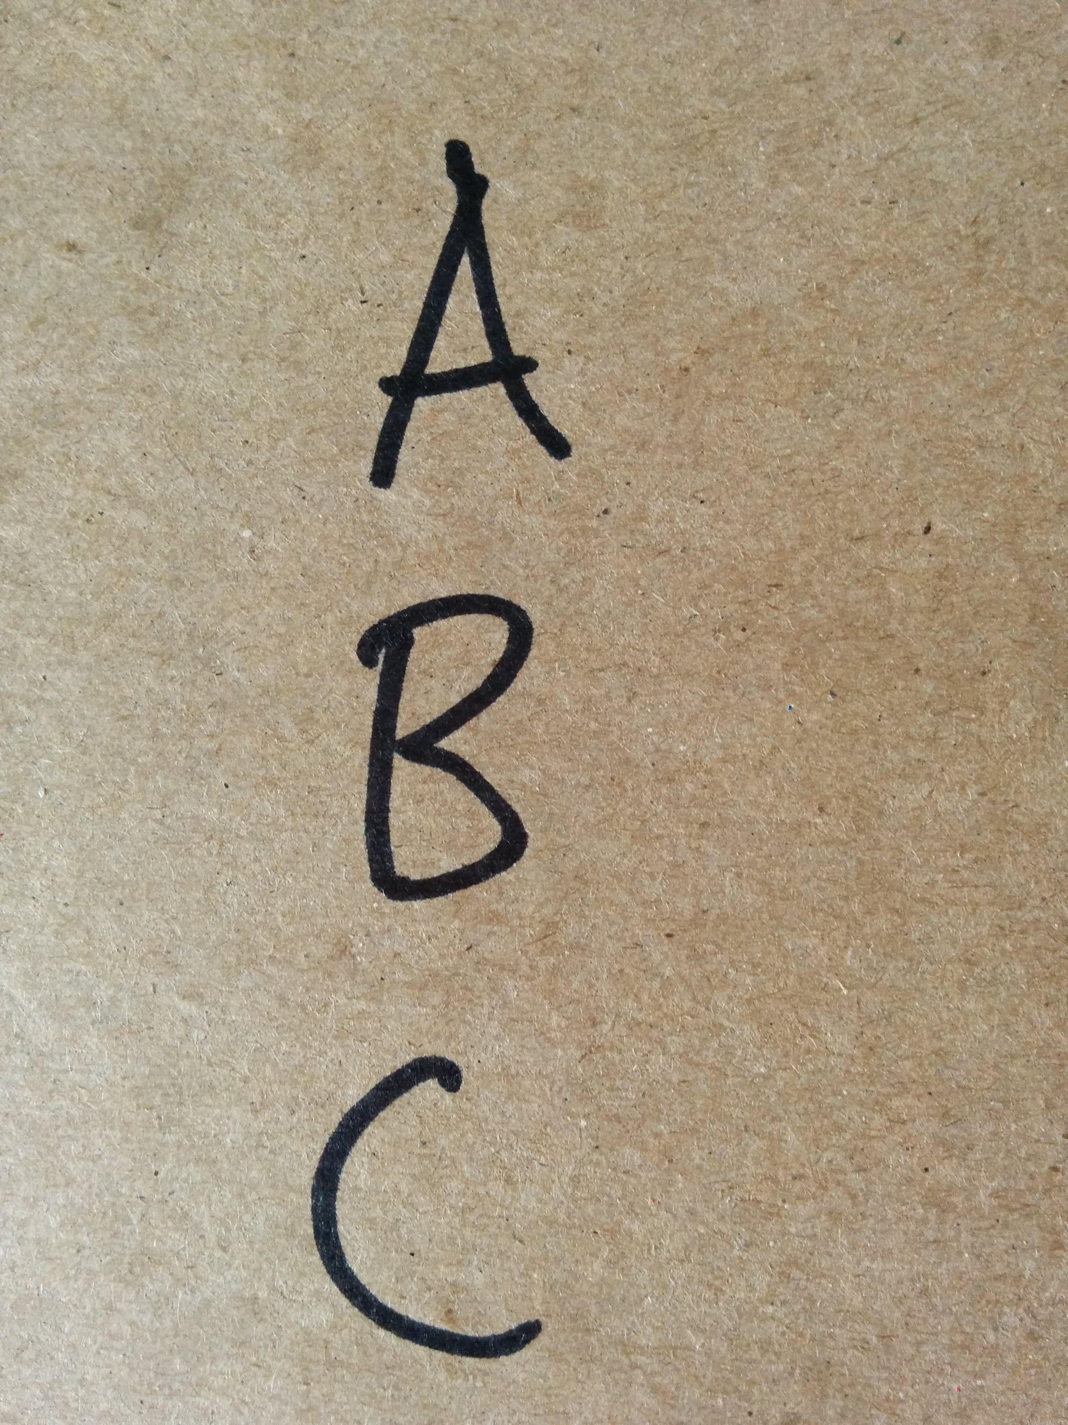
History of IP addressing: 3 phases of increasing efficiency
The initial plan was for up to 256 networks, each of which could have 16m addresses
A year later classful addressing had been introduced
By the mid-1990s CIDR had been developed (alongside NAT) to again increase usage efficiency

Slide 5
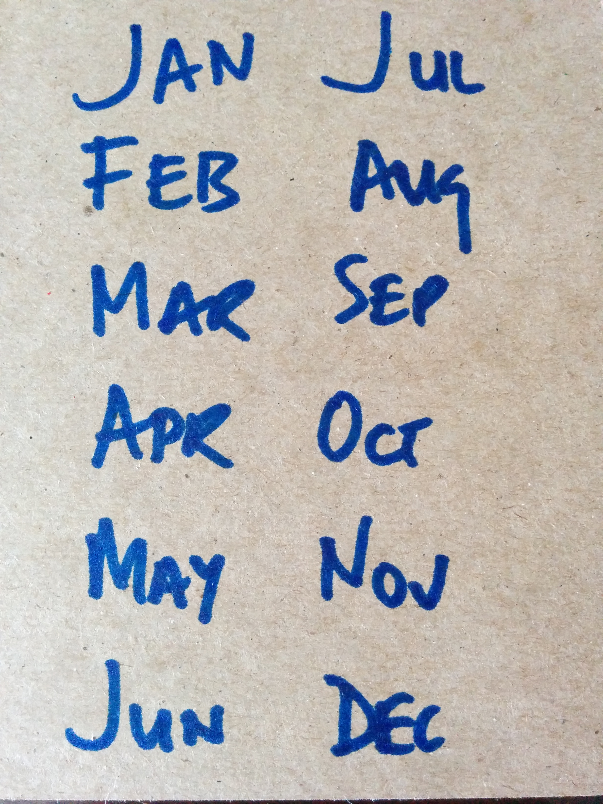
History of IP addressing: significant dates in IPv4’s history
1980 – the start
1981 – Classes introduced
1993 – CIDR introduced
1997 – ARIN formed
2005 – 1st Global Policy
2009 – 2nd Global Policy
2011 – Fully Allocated

Slide 6
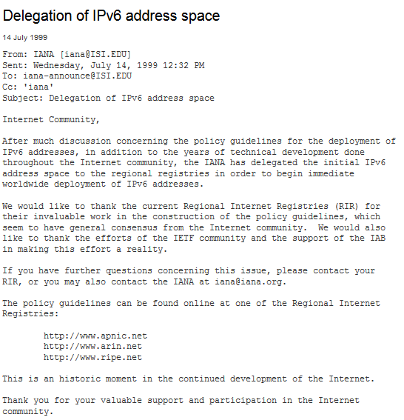
IPv6
IPv6 was standardized in 1996 and became available for production use in 1999
Once it became available, vendors were able to start the work needed to support it

Slide 7
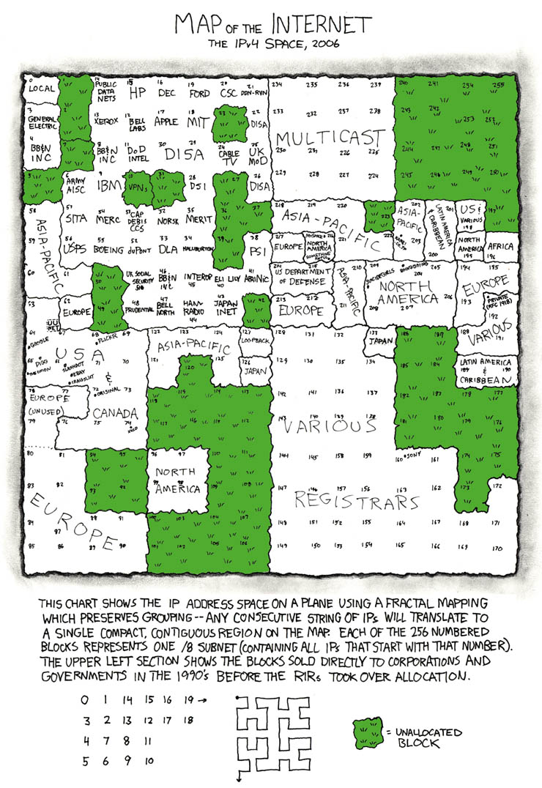
Relative size
In 2006, as we approached full allocation of IPv4 there was very little left despite a significantly smaller Internet than now
Source: xkcd.com
cc-by-nc 2.5

Slide 8
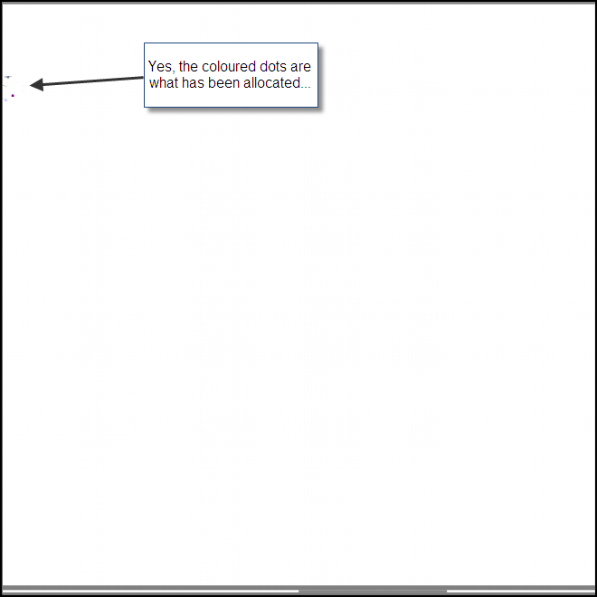
Relative size
We have made massive IPv6 allocations but this 2011 maps shows how tiny they are in the overall IPv6 space
A 128-bit space is much more than four times the size of 32-bit space
Source: http://v6stuff.leclanche.net/

Slide 9

IPv6: count networks not addresses
In IPv4 each address is precious as there are so few
IPv6 we don’t care about individual addresses and count network segments instead
A /64 LAN segment has 18 trillion addresses
A /48 has 65,536 /64s
A /32 has 65,536 /48s
A /12 has a million /32s

Slide 10
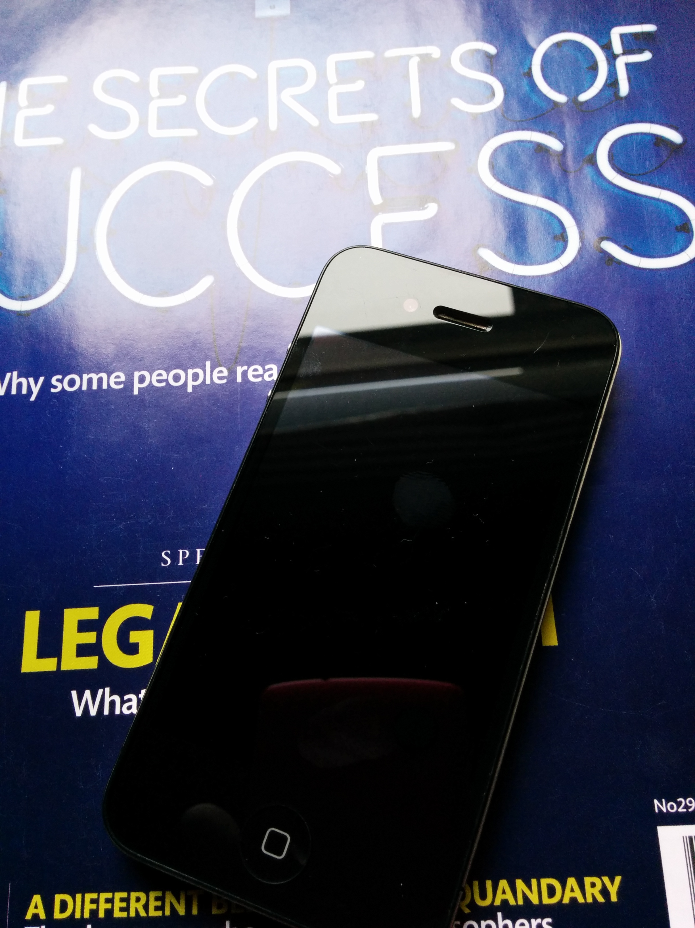
Feature equivalence
All supported desktop and mobile OSs have full IPv6 support
All supported server OSs have full IPv6 support
Most supported infrastructure network equipment has full IPv6 support
Where’s the problem?

Slide 11
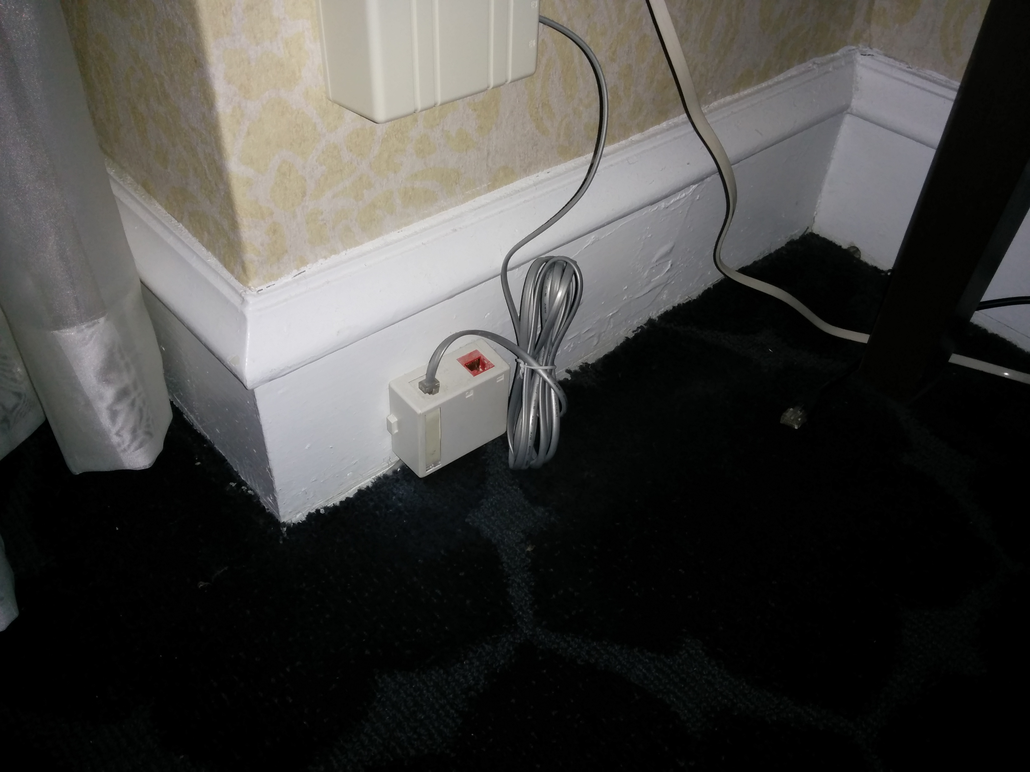
CPE
It’s produced on a shoestring budget
It sits unmanaged and unloved in a dark corner until it breaks
Most of the deployed base has no IPv6 support

Slide 12
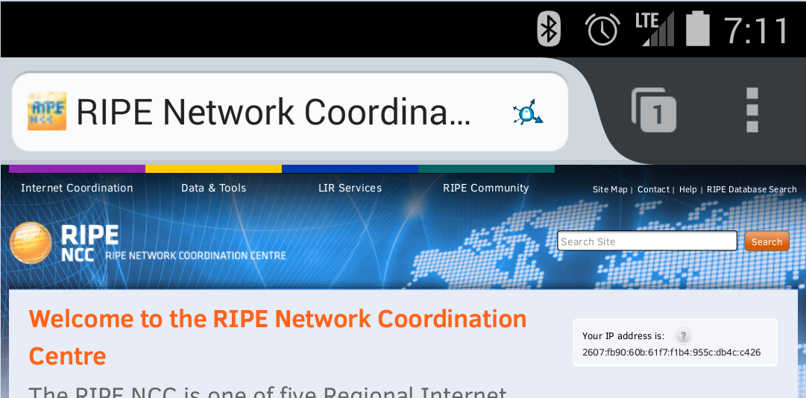
So where are we now?
CPE is only a problem if you rely on fixed line Internet access and that is becoming the exception rather than the norm

Slide 13
Large Scale or Carrier Grade NATs (1)
Traditionally, ISPs have given each subscriber one unique address and subscribers with multiple devices have used NAT to share that address
PC, smartphone, tablet etc…

Slide 14
Large Scale or Carrier Grade NATs (2)
CG NAT shares a single address between multiple subscribers
There are multiple layers of NAT between a subscriber device and the Internet
This is what telcos have done for smartphone for year, but…

Slide 15
Large Scale or Carrier Grade NATs (3)
Smartphones do not use as many connections as desktop or laptop machines
It’s the number of connections per subscriber that counts

Slide 16
Issues
Regulatory requirements for logging address usage
Potentially degrading Internet access experience
Competition between vertically integrated media owners and telcos and start-up OTT providers

Slide 17
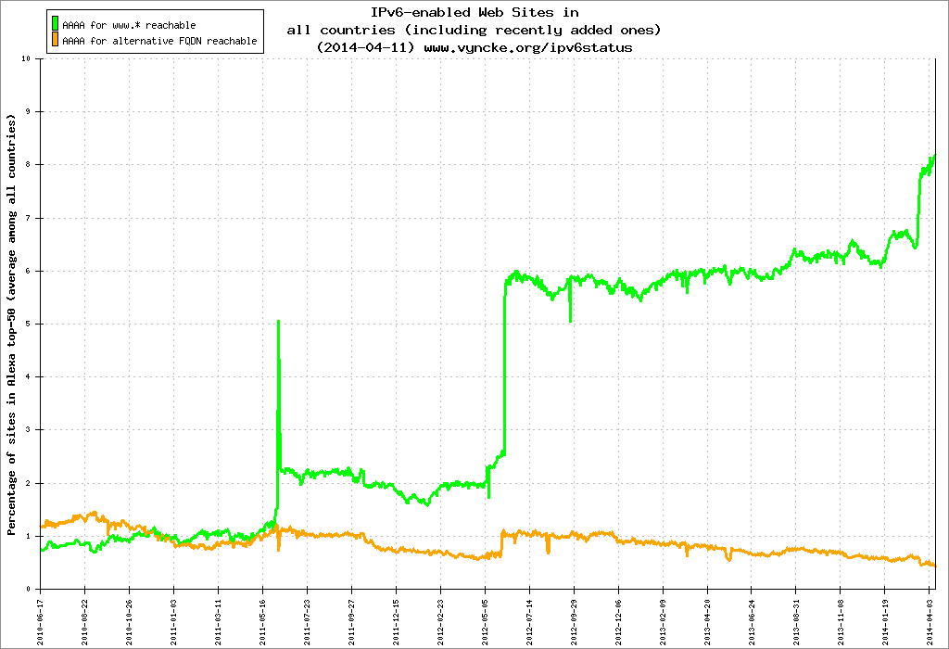
When Cloudflare switched on IPv6
Source: https://www.vyncke.org/ipv6status

Slide 18
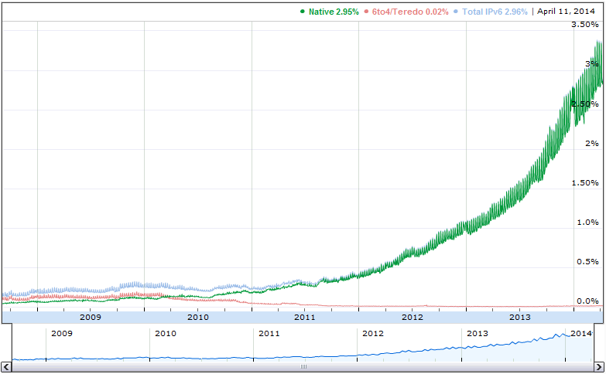
Google’s view
Source: https://www.google.com/ipv6

Slide 19
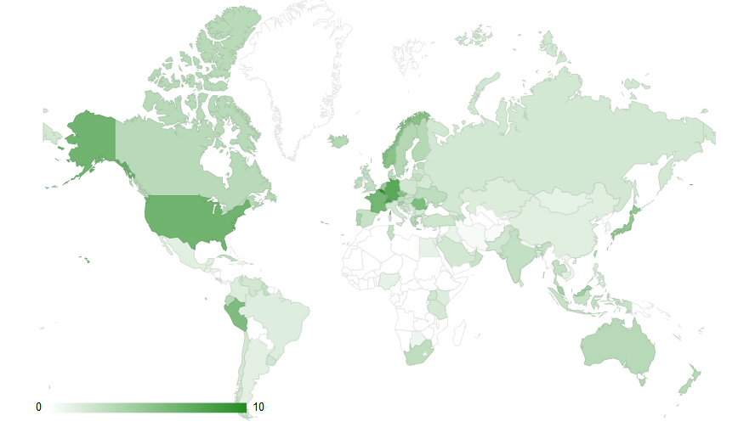
Cisco’s analysis
Source: https://6lab.cisco.com

Slide 20
What was the initial plan again?
The initial plan was for up to 256 networks, each of which could have 16m addresses

Slide 21
Thank You & Questions?

