Slide 1

Transition of U.S. Commerce Department’s National Telecommunications and Information Administration (NTIA) Stewardship of the IANA Functions to the Global Multistakeholder Community
Nigel Hickson
VP; IGO Engagement

Slide 2
The U.S. government’s announcement
    On 14 March 2014, the U.S. Government (USG) announced its intent to transition its stewardship of the IANA functions to the global multistakeholder community;
    As the first step, it asked ICANN to convene global stakeholders to develop a proposal to transition the current role played by the USG;
    ICANN was asked to serve as a convener based on its role as the IANA functions administrator (since 1998) and the global coordinator for the Internet's Domain Name System (DNS).
    The multistakeholder community has set the policies implemented by ICANN for more than 15 years.

Slide 3
Why now?
    The USG always envisioned its role as transitional;
    Transitioning the USG out of its current role marks the final phase of the privatization of the DNS as outlined by the USG in 1997;
    The decision further supports and enhances the multistakeholder model of Internet policymaking and governance.

Slide 4
Transition proposal’s guiding principles
    NTIA has communicated to ICANN that the transition proposal must have broad community support and address the following four principles:
    Support and enhance the multistakeholder model;
    Maintain the security, stability, and resiliency of the Internet DNS;
    Meet the needs and expectation of the global customers and partners of the IANA services; and,
    Maintain the openness of the Internet.
    NTIA also specified that it will not accept a proposal that replaces the NTIA role with a government-led or an intergovernmental organization solution.

Slide 5
What are the IANA functions?
    The IANA functions involve the coordination of unique Internet identifiers, including:
    maintenance of the protocol parameter registries on behalf of the IETF;
    allocation of Internet Numbers in cooperation with the Regional Internet Registries;
    management of the .ARPA and .INT domains;
    administrative responsibilities of the DNS root zone;
    coordination of root zone management.
For more information, visit www.icann.org

Slide 6
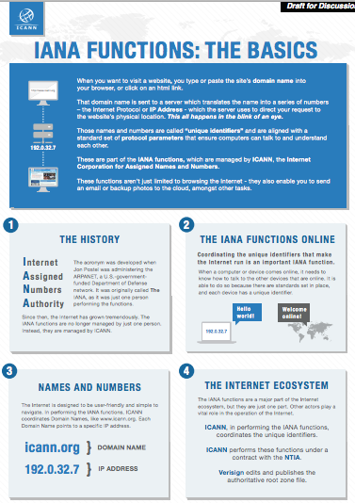
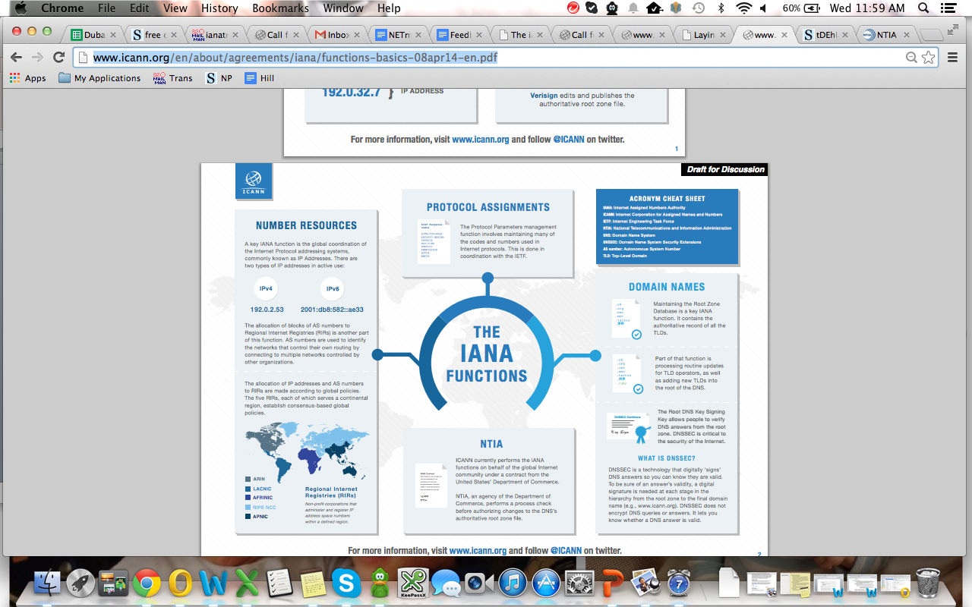
The IANA functions at-a-glance
For more information, visit www.icann.org

Slide 7
Developments since the announcement
    ICANN launched a multistakeholder-designed process at the ICANN 49 Meeting in Singapore in March 2014;
    The goal was to gather the community's views and contributions on how the mechanisms for the transition of NTIA's stewardship of the IANA functions should occur;
    The wider Internet community was also invited to provide their input via a publicly archived mailing list (ianatransition@icann.org), with an initial comment deadline of 27 March.

Slide 8
Developments since the announcement
    On 8 April, ICANN posted the scoping document and, based on initial community feedback and dialogue, issued a call for public input (translated into the six official UN languages) on the draft proposal;
    The draft proposal includes:
      a set of principles and mechanisms;
      the creation of a steering group to shepherd process;
      the process to develop a proposal; and,
      opportunities for participation.
DRAFT: Pending final process as informed by community dialogue and feedback

Slide 9
Scoping document: inside and outside of the scope of the proposal
    In scope:
      defining accountability mechanisms that would serve to replace the USG role to ensure ICANN’s performance of the IANA functions based on the agreements and/or policies provided by the respective bodies (IETF, GNSO, RIRs, ASO, ccTLDs, ccNSO);
    Out of scope:
      policy development related to the IANA functions
      IANA functions operator
        ICANN’s role as the operator of the IANA functions is not the focus of the transition
      issues not within the IANA functions
      The scoping document can be viewed at:
      http://www.icann.org/en/about/agreements/iana/iana-transition-scoping-08apr14-en.pdf

Slide 10
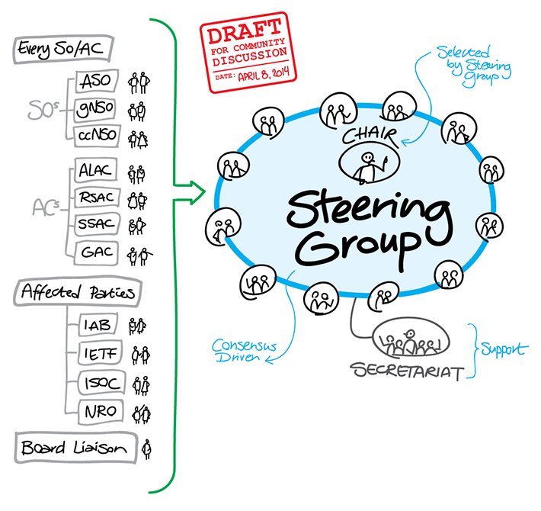
Proposed steering group

Slide 11
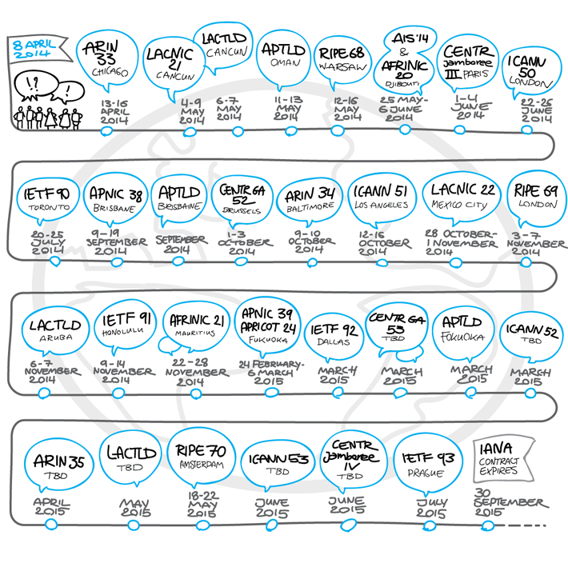
Opportunities for participation (non-exhaustive)
NB. There are multiple dialogues and opportunities for discussions, including at events not listed in the timeline (for example, regional and national IGFs, etc.).
DRAFT: Pending final process as informed by community dialogue and feedback

Slide 12
What happens next?
    The community will provide its feedback on the proposed process by 8 May;
    The community input received will be compiled, the process then put into place and published soon after 8 May;
    A dedicated website that is interactive and contains the necessary tools to facilitate the transition proposal process will be launched by ICANN 50 meeting in London in June.

Slide 13
IANA functions stewardship transition FAQs
    Q. What is this process about?
      A. To develop a proposal to transition NTIA’s stewardship of the IANA functions;
    Q. What is this process not about?
      A. This is not about ICANN’s role as the operator of the IANA functions – this role is not the focus of the transition;
    Q. Is there a target date for the transition to take place?
      A. Depending on the progress of the dialogue, the global multistakeholder community could be ready to complete the transition before the renewal of ICANN’s contract with the USG in September 2015.
    Q. Does this announcement jeopardize the security, stability and resiliency (SSR) of the Internet DNS?
      A. No. In fact, maintaining the SSR of the Internet DNS is one of the principles outlined by the NTIA.
      Addition FAQs can be found at http://www.icann.org/en/about/agreements/iana/functions-transfer-faqs-14mar14-en.pdf

Slide 14
How can you get involved?
    Visit ICANN.org
      get the latest resources on the topic;
      participate in the events listed in the timeline;
      follow us on our social channels.
    Mailing list
      join to contribute and/or follow the discussion
      ianatransition@icann.org
      access the public archives
      http://mm.icann.org/pipermail/ianatransition/

Slide 15
Thank you!
Questions?

