Slide 1

FY15 Operating Plan Framework
Conference call Community/Staff
March 12th 2014

Slide 2
Agenda
Introduction
Update on Process & Calendar
Future State of Operating Plan & Budget Planning
FY15 Operating Plan Framework Highlights

Slide 3
Guidance on Feedback
We are looking for your feedback on this summarized FY15 Operating Plan Framework. Specifically:
Does the plan focus on the right areas directionally?
Are there any significant areas missing?
Are there any significant areas included that we should reconsider?

Slide 4
Introduction
Objectives of this call:
Provide understanding of the status on the FY15 Operating Plan & Budget process: accomplishments to date, timeline update, next step.
Provide a high level understanding of FY15 Operating Plan Framework.
Allow for initial feedback on the FY15 Operating Plan Framework

Slide 5

Management Systems Linkage
Operational Excellence
Strategic Plan
Enterprise Risk Mgmt.
Process Improvement
Business Intelligence
Management Competencies
Exec
Dashboard
Operating
Plan
1 - Objectives
1.2 - Goals
1.2.3 - Portfolios
# - Projects
People Performance Mgmt.
Budget / Cost Mgmt.
Phases Key
Strategy
Implementation
Results
OE
Project Portfolio Mgmt.

Slide 6
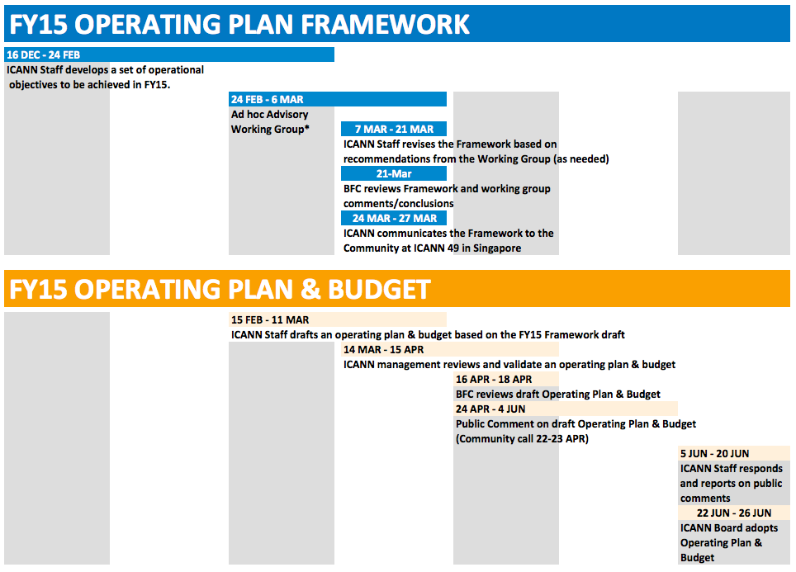
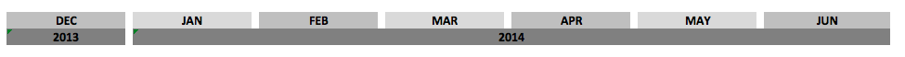
FY15 Operating Plan & Budget Process

Slide 7
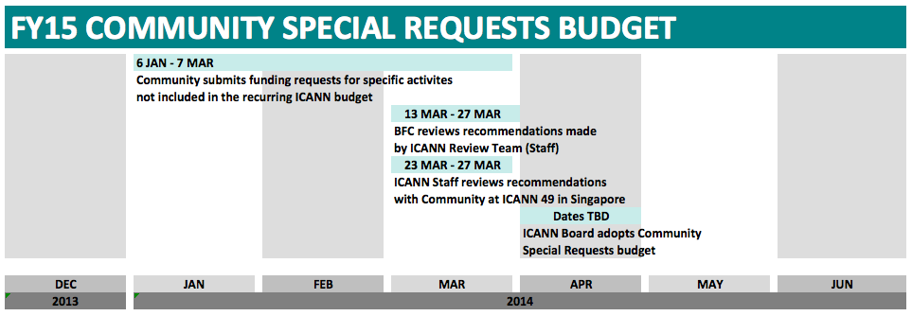
FY15 Operating Plan & Budget Process (Continued)

Slide 8
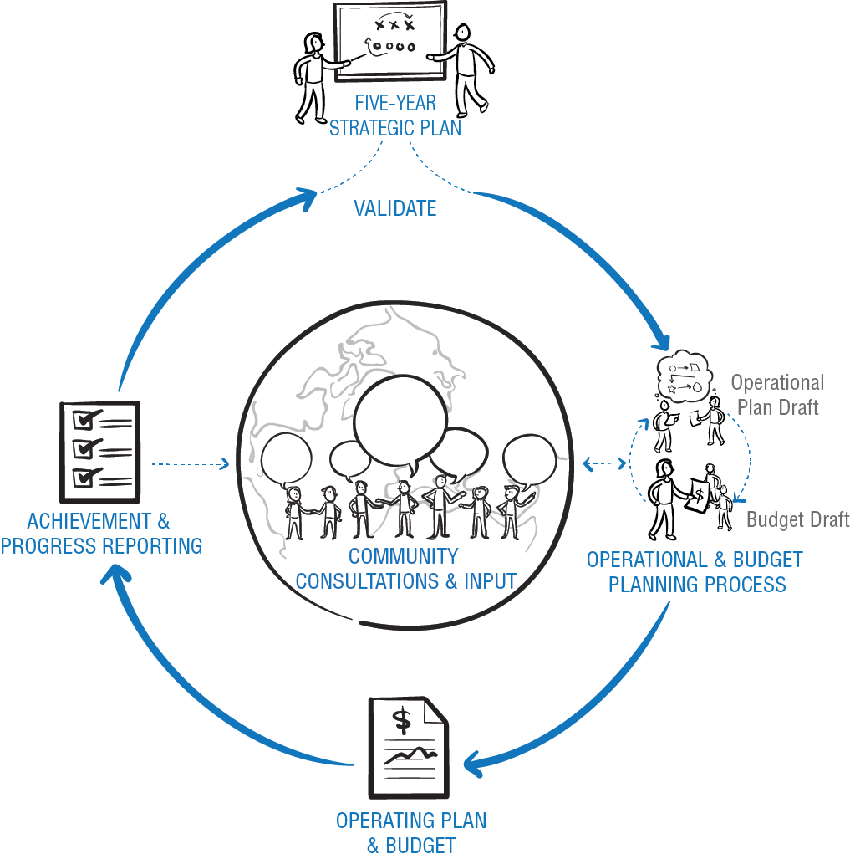
Future Steady State

Slide 9
Strategic Objectives and Goals
• Deliver core internet functions
• Act as stewards of public interest
• Engage in IG ecosystem
• Deepen partnerships with I-Orgs
1
Affirmation of Purpose
• Institutionalize Mgmt. disciplines
• Mature Org. Support Functions
• Optimize R&R services
• Plan for scale, security, continuity
2
Operational Excellence
3
Internationalization
• Engage stakeholders globally
• Communicate clearly & locally
• Integrate global/regional resp.
• Evolve gov. relationships
4
Model Evolution
Multi-
Stakeholder
• Optimize policy dev. process
• Increase/improve participation
• Evolve SO/AC structures
• Promote ethics & transparency

Slide 10
1
2
3
4
OBJ
GOAL
PORTFOLIO
1.1 Deliver core internet functions
Key Success Factor for this Goal:
Demonstrate that ICANN is performing core internet functions in a dependable, transparent and accountable manner
1. WHOIS core function/service & improvements
2. Support identifier technology innovation
3. IANA Operations
Affirmation of Purpose
4. Internationalized Domain Names (IDNs)
5. Security Stability & Resiliency of Identifier System
6. Root System
7. DNS OPS / SSR

Slide 11
1
2
3
4
OBJ
GOAL
PORTFOLIO
1.2 Act as steward of the public interest
Key Success Factors for this Goal:
Clarify and promote an understanding of the Public Interest
Develop and assess "Guidance" for ICANN's stewardship
1. Affirmation of Commitment Reviews
Affirmation of Purpose
2. Define, build a guidance framework &
identify programs to meet public interest

Slide 12
1
2
3
4
OBJ
GOAL
PORTFOLIO
1.3 Engage in the internet governance ecosystem
Key Success Factors for this Goal:
Increase the number of organizations with public mutual recognition of roles and responsibilities with ICANN (in the IG ecosystem)
Identify, track and communicate to efforts under this goal relevant parts of the strategy panels, including the work of the 4th Panel
Contribute to ICANN's efforts on the evolution of the Internet governance ecosystem, and contribute to relevant areas of IG undertaken by other departments
Identify and operationalize key areas relevant to ICANN's evolution in the Internet governance ecosystem, including the AoC
1. ICANN participation in Internet
Governance meetings processes
dialogues and other initiatives
Affirmation of Purpose
2. Support Internet Gov. Ecosystem
advancement

Slide 13
1
2
3
4
OBJ
GOAL
GOAL
PORTFOLIO
1.4 Deepen partnerships with internet organizations
Key Success Factors for this Goal:
Establish clarity on roles and responsibilities of Internet Organizations with in framework
Establish (a) framework(s) for partnership
1. Build stronger partnerships with Internet
organizations and initiatives
Affirmation of Purpose

Slide 14
1
2
3
4
OBJ
GOAL
PORTFOLIO
2.1 Institutionalize Management Disciplines
Key Success Factors for this Goal:
Management understands and utilizes standardized systems and processes
Put in place the mechanisms to enable management to make timely and effective decisions
Conduct timely implementation/tracking of AoC recommendations, as directed by the Board
1. Management Systems Mapping
2. Strategic Initiatives
Operational Excellence
3. AoC Reviews Implementation
4. Business Excellence via EFQM Standards

Slide 15
1
2
3
4
OBJ
GOAL
PORTFOLIO
2.2 Mature organizational support functions
Key Success Factors for this Goal:
Standardize systems and processes to work across the organization in an integrated fashion
Quality services are delivered timely and effectively
1. IT Infrastructure
2. DNS internal infrastructure
3. Contractual Compliance Functions
Operational Excellence
4. Meetings ops
5. Legal internal support and Support
ICANN Board
6. Support Function Operations

Slide 16
1
2
3
4
OBJ
GOAL
PORTFOLIO
2.3 Optimize gTLD Services
Key Success Factor for this Goal:
Define and implement the right services that find acceptance with the targeted stakeholders
1. GDD Services
2. GDD Customer Service
3. GDD Operations
Operational Excellence
4. New gTLD Program
5. Outreach and Relationship Management with Existing and New Registry, Registrar Community

Slide 17
1
2
3
4
OBJ
GOAL
PORTFOLIO
2.4 Plan for Scale, Security, Continuity
Key Success Factor for this Goal:
Develop, communicate and maintain continuity plans to mitigate risk and ensure organizational scalability
1. Enterprise Risk Management (ERM)
Operational Excellence
4. Business Continuity

Slide 18
1
2
3
4
OBJ
GOAL
PORTFOLIO
3.1 Engage Stakeholders Globally
Key Success Factor for this Goal:
Expand and diversify participation of stakeholders from around the world to strengthen ICANN
1. Engage Stakeholders Regionally
2. Digital Engagement
Internationalization
3. Global Stakeholder Engagement Planning
4. Language Services

Slide 19
1
2
3
4
OBJ
GOAL
PORTFOLIO
3.2 Communicate Effectively with Stakeholders
Key Success Factor for this Goal:
Grow and diversify communications activity to demonstrate ICANN's role in distinct geographies and for target audiences
1. Raise awareness of ICANN worldwide
Internationalization
2. Raising Awareness of IANA Functions,
Performance & Reporting

Slide 20
1
2
3
4
OBJ
GOAL
PORTFOLIO
3.3 Integrate Global and Regional Responsibilities
Key Success Factors for this Goal:
Establish rapid and dynamic two-way information flow between regional and global functions
Ensure appropriate resource allocation to regional offices
Optimize alignment and integration of matrix responsibilities
1. Global matrix development
2. Hub and engagement offices
(strategy and planning)
Internationalization
3. Internal Communications

Slide 21
1
2
3
4
OBJ
GOAL
PORTFOLIO
3.4 Evolve Government Relationships
Key Success Factor for this Goal:
Increase and grow number of relevant (targeted/focused) governments, IGOs and regional organizations that recognize and accept the role of ICANN
1. Engagement with Governments IGOs
Internationalization
2. Support GAC Engagement

Slide 22
1
2
3
4
OBJ
GOAL
PORTFOLIO
4.1 Optimize Policy Development Process
Key Success Factors for this Goal:
Enable, strengthen and promote participation of all stakeholders interested in the policy development, policy related and advisory processes
Improve predictability of policy development, and policy related advisory processes
Improve implementability of policies and advice
1. Enable Stakeholder Collaboration,
Communication & Engagement
Multi-Stakeholder Model Evolution
2. Support policy development, policy related
and advisory activities

Slide 23
1
2
3
4
OBJ
GOAL
PORTFOLIO
4.2 Increase & Improve Global Participation
Key Success Factor for this Goal:
Increase numbers, diversity and pathways for engagement by participants interested in ICANN activities and events
1. Advanced Media Tools for Outreach and
Participation (labs, new icann.org, etc.)
2. Deploy Collaboration Platform
(platform for sharing)
Multi-Stakeholder Model Evolution
3. Deploy Community Participation &
Engagement Programs & Services

Slide 24
1
2
3
4
OBJ
GOAL
PORTFOLIO
4.3 Evolve SO/AC Structures
Key Success Factors for this Goal:
Establish a framework for evolving SO/AC structure to increase inclusion, efficiencies and effectiveness
a) Establish mechanism for participation and reputation while improving ease of engagement
b) Engagement to ensure legitimizing multistakeholder model
Improve mechanism for participation, representation and ease of engagement to ensure legitimizing the multistakeholder model
1. Evolving Multistakeholder Model
2. Advancing MSM Innovation
Multi-Stakeholder Model Evolution
3. Organizational Reviews

Slide 25
1
2
3
4
OBJ
GOAL
PORTFOLIO
4.4 Promote Ethics and Transparency
Key Success Factors for this Goal:
Review, improve and promote existing accountability and transparency mechanisms
Ensure observance of a clearly defined ethical framework
1. Conflicts of Interest & Organizational Ethics
2. Conflicts of Interest Management
Multi-Stakeholder Model Evolution
3. Board Accountability and Transparency
4. Bylaws-mandated Accountability and
Transparency Mechanisms

Slide 26
Next Steps
Q&A starting now
Additional questions between today and the Finance session in Singapore:
• by email to Controller@icann.org
• by posting questions on the Wiki page at {link}
Finance session in Singapore:
• Additional Q&A as needed
• Review of feedback summary and actions
Draft FY15 Operating Plan and Budget published for public comments
Notes:
“We will go through the presentation for no more than 1hr, and will dedicate the last 30mins to questions and answers. We suggest that you use the chat area of the Adobe room to record your questions as they come, and we will start the Q&A session with those questions.”
“This call is recorded and the transcript will be available”.

Slide 27


Feedback Opportunities
Q&A now for remainder of call.
Written response to questions in the chat window.
Wikispace for posting feedbackhttps://community.icann.org/display/projfinadhocws/Community+Group+Workspace
The Finance meeting & ongoing discussions in Singapore.

Slide 28
Thank you!

