Slide 1


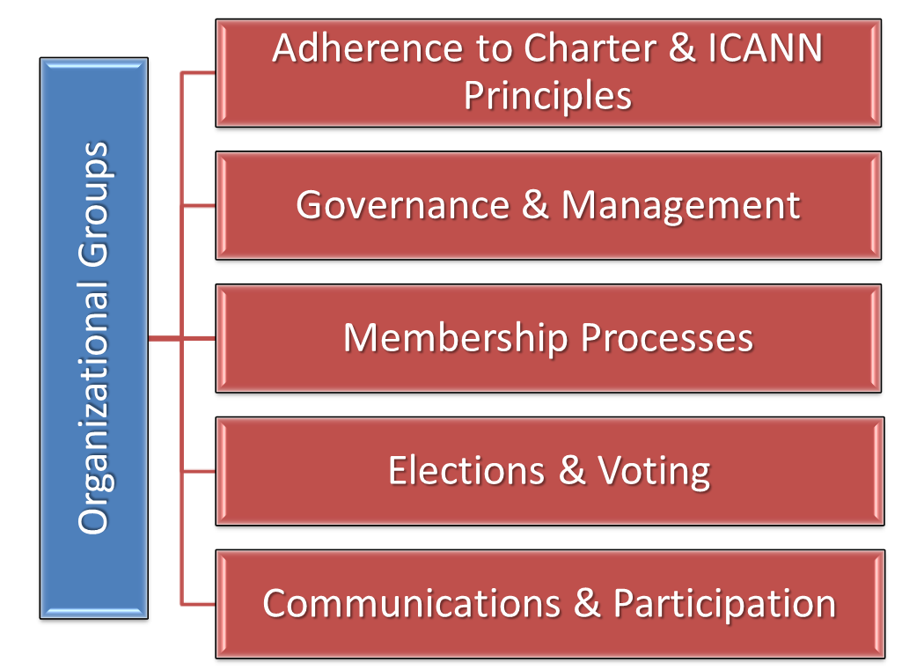
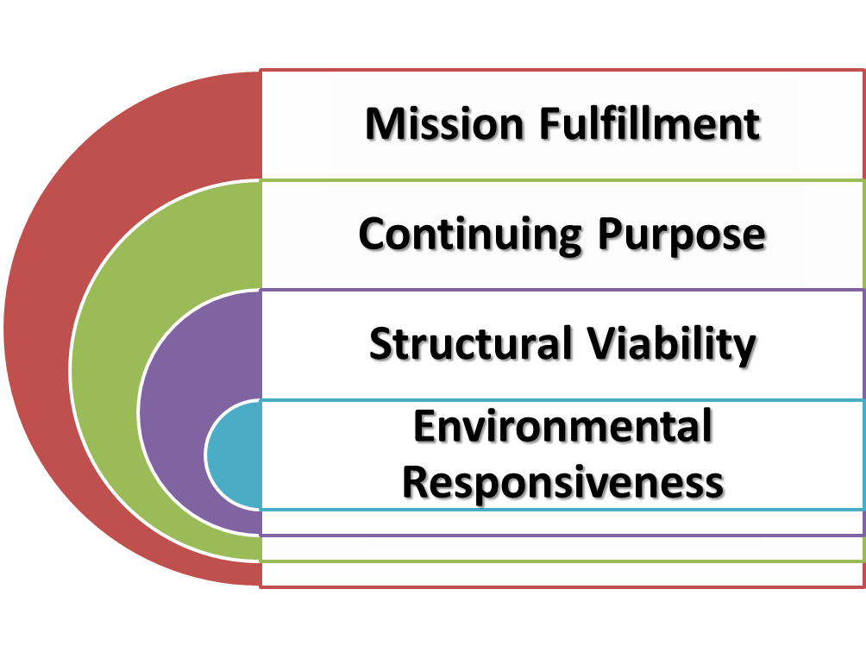
GNSO Review
Structural Improvements Committee
21 March 2014
Singapore

Slide 2
GNSO REVIEW
Objective
  Examine Organizational Effectiveness
Independent Investigator
  Tightly Scoped Contract
  Selected by Competitive Bid
Work Methods
  Examination [Independent Investigator]
  360 Assessment [Staff, GNSO]
  Review ATRT 2 Assessments [Independent Investigator]
  Limited Interviews [Independent Investigator]
Criteria
  Objective and Quantifiable
  Selected from developed lists
  Used for Examination, 360 Assessment, and Interviews

Slide 3
TIMELINE
Phase | Date | Activities
Pre-Review | MAR ‘14 – MAY ‘14 | Finalize Plan Prepare 360 RFP/Select Investigator
Review | MAY ‘14 – JAN ‘15 | Conduct Examination Report and Recommendations Implementation Plan
Implement | FEB ‘15 – FEB ‘16 | Corrective Action Integrate into Plans and Budget Publish Report Monitor Implementation
Operate | MAR ‘16 – MAR ’18 | Gain Operational Experience
Assess | APR ‘18 – DEC ‘18 | Conduct Effectiveness Self-Assessment Prepare Report for Next Review

Slide 4
REVIEW P ROCESS
Review
Review ATRT 2 Assessments
Report
Draft Report 2
Implementation Plan
360 Assessment
Public comments
Board Approval
Board Accept
Interviews
Examination
Draft Report 1
Clarification and Rebuttal
Prepare and Coordinate Implementation Plan
Final Report

Slide 5
ROLES AND RESPONSIBILITIES
SIC
Oversight
Accept Report*
STAFF
Design 360
Prepare RFP
Investigator
Examination
360 Assessment
Review Working Party
Coordinate 360
Coordinate Interviews
Approve Plans*
Select Investigator
Prepare Implementation Plan
Manage Report Process
Interviews
Integrate ATRT2 Recommendations
Prepare Report
Clarification and Rebuttal
Support Investigator
Clarification and Rebuttal
Prepare Implementation Plan
Monitor Process
*Prepare Recommendations for Board Action

Slide 6
Thank You
Questions?

