Slide 1
Advancing Outreach
March 2012

Slide 2
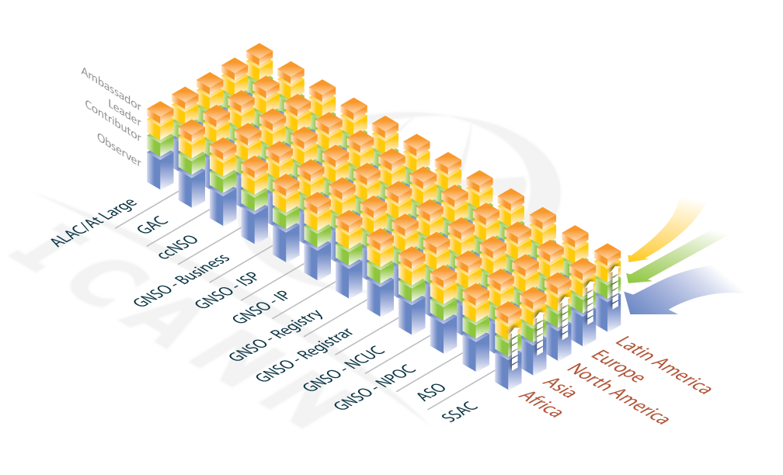
Framework Model
Notes:
IT’s the PEOPLE! ICANN success dependent upon robust bottom-up, multi-stakeholder model; multi-stakeholder model succeeds through broad, representative cross-section of participants. Outreach should: Encourage, support, and enhance participation in the outreach framework at all levels among all stakeholders. Build capacity and encourage growth and increased involvement among participants. Be measurable. Contribute to ICANN’s success. Define “outreach” through its objectives. Activities across ICANN should be: Coordinated, Effective, & Economical. Should provide tool for investment decisions, what activities should be undertaken: ICANN staff work, Community requests

Slide 3
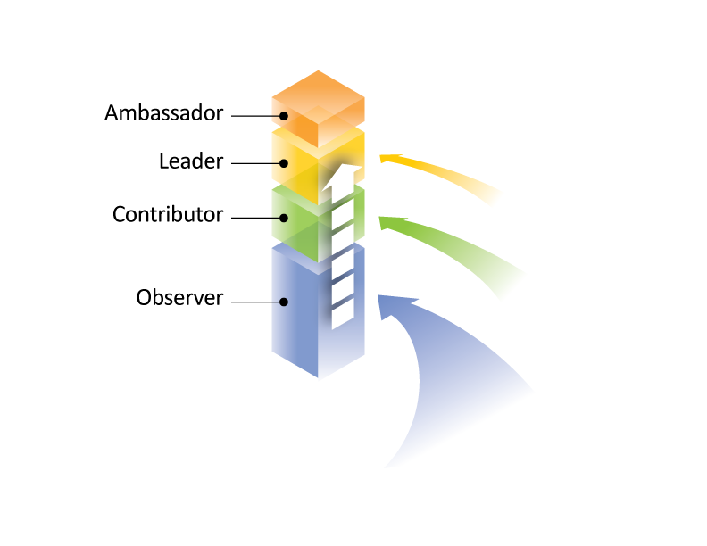
Steps from Dakar
Staff developed “activities inventory” to better coordinate all ICANN activities
  Eliminate redundancy
  Prioritize most effective activities
  Find most effective “home”
Socialized the Framework Model to community through webinars
Began to utilize the Outreach Tool to provide improved roadmap for community budget request process

Slide 4
Community Coordination
Begin encouraging communities to:
  Inventory current outreach activities
  Identify potential outreach activities
Cross check findings with ICANN Inventory
Perform Gap Analysis
Move in, move up, educate….

Slide 5
Integrate with FY13 Activities
Use FY13 budget planning to evaluate each existing or proposed outreach activity, does it:
  Bring participants into ICANN, or
  Make community more involved or
  Strengthen skills and effectiveness
  Evaluation process is meant to provide clear criteria and justification for request approval

Slide 6
QUESTIONS

